Slide 1
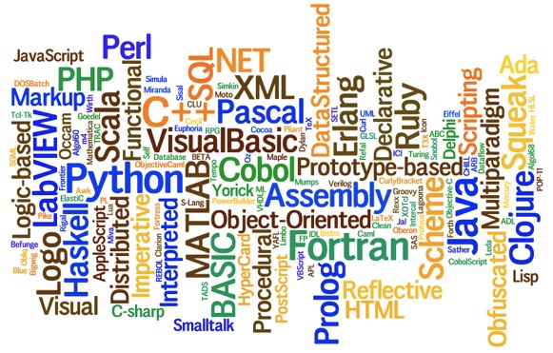
Com S 342: Principles of Programming Languages
Thank Prof Hridesh Rajan for the Lecture Materials

Slide 2
What is an Interpreter?
A program
Written in defining language
Defining language: used to implement
Input: any program in defined language
Output: a value in defined language
Will interpreter always produce output?
No, can fail to terminate.
More precisely, given a program in defined language an interpreter produces a value in the defined language or “diverges”.

Slide 3
Parts of an Interpreter
Read, Eval, Print, REP loop
Read: programs written in defined language
Programs are strings.
Specify legal programs? Grammar.
Read legal programs? Lexical analysis, parsing.
How to store programs internally?
Abstract Syntax Tree (AST).
Eval: given an AST compute value.
Print: value of AST, i.e. value of program.
REP loop: repeat previous three steps

Slide 4
More about Read Phase
Objective: convert program (string) to AST
Lexical analysis
Divide the program into symbols (tokens)
Syntax analysis (or parsing)
Organize tokens into a tree (parse tree)
Structure of parse tree dictated by grammar.
Abstraction
Convert parse tree to Abstract Syntax Tree (AST) by ignoring irrelevant tokens.

Slide 5
Read Phase Example
Objective: convert program (string) to AST
Example program: “(+ 3 4)”
Lexical analysis
Divide the program into symbols (tokens)
`(‘, `+’, DIGIT:3, DIGIT:4, and `)’
Syntax analysis (or parsing)
Organize tokens into a tree (parse tree)
Structure of parse tree dictated by grammar.
Abstraction
Convert parse tree to Abstract Syntax Tree (AST) by ignoring irrelevant tokens.

Slide 6
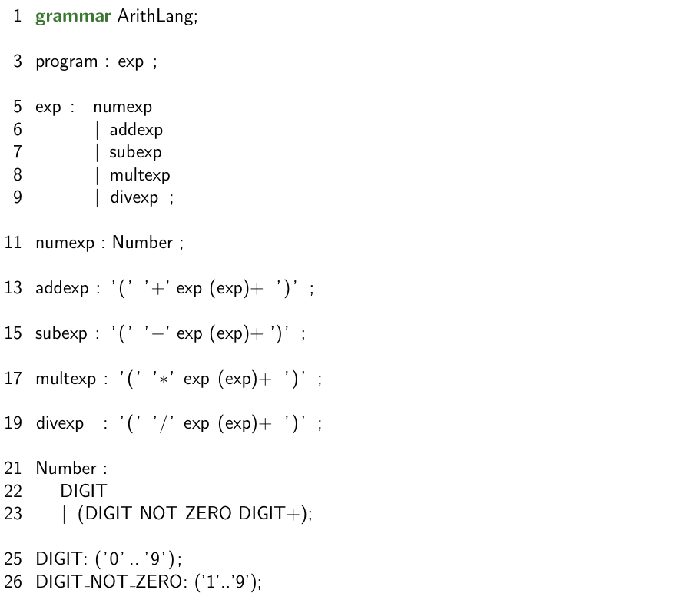
Recall: Arithlang Grammar

Slide 7
Read Phase Example
Example program: “(+ 3 4)”
Tokens: `(‘, `+’, DIGIT:3, DIGIT:4, and `)’
Syntax analysis (or parsing)
Parse tree
program
exp
addexp
numexp
numexp
Tokens
`(‘
`+‘
3
4
`)‘

Slide 8
Read Phase Example
Example program: “(+ 3 4)”
Tokens: `(‘, `+’, DIGIT:3, DIGIT:4, and `)’
Syntax analysis (or parsing)
Parse tree
Node types from grammar
program, exp, addexp, …
Relations from grammar
program
exp
addexp
numexp
numexp
Tokens
`(‘
`+‘
3
4
`)‘

Slide 9
Read Phase Example
Parse tree to AST
Irrelevant tokens are eliminated
Program
program
AddExp
exp
addexp
NumExp
NumExp
3
4
numexp
numexp
Tokens
`(‘
`+‘
3
4
`)‘

Slide 10
Object-oriented Form of AST
ASTNode
Program
Exp
exp : Exp
+ accept(visitor)
+ accept(visitor)
CompoundArithExp
Details please see Figures 2.8 and 2.9
in Rajan’s book
operands : List<Exp>
+ accept(visitor)
AddExp
SubExp
MultExp
DivExp
NumExp
val : double
+ accept(visitor)
+ accept(visitor)
+ accept(visitor)
+ accept(visitor)
+ accept(visitor)

Slide 11
More about Eval Phase
Objective: convert AST to value
Process like recursive tree traversal (c.f. CS 228)
To find value of program “(* 3 (+ 4 2))” find value of sub-expressions “3” and “(+ 4 2)”
PL semantics is essentially a systematically defined recursive traversal strategy
What to do at a AST node?
How to traverse sub AST nodes?
Completeness
Traversal must be defined for each kind of AST nodes, otherwise programs will get stuck.

Slide 12
Traversal Strategies
Objective: realize AST traversal functionality
Example: given an AST node, create a formatted string representation of that node.
1. Augment each AST class with functionality
NumExp.format, AddExp.format, …
2. Augment each AST class with generic traversal
define method to accept any traversal functionality
AST node delegates to external object “Formatter”

Slide 13
Traversal Strategy 1
ASTNode
Program
Exp
exp : Exp
+ format()
+ format()
CompoundArithExp
operands : List<Exp>
AddExp
SubExp
MultExp
DivExp
NumExp
val : double
+ format()
+ format()
+ format()
+ format()
+ format()

Slide 14
Traversal Strategy 1
ASTNode
Program
Exp
public string format() {
return “” + val;
}
exp : Exp
+ format()
+ format()
CompoundArithExp
operands : List<Exp>
AddExp
SubExp
MultExp
DivExp
NumExp
val : double
+ format()
+ format()
+ format()
+ format()
+ format()

Slide 15
Traversal Strategy 1
ASTNode
Program
Exp
public string format() {
String result = “(+”;
?
return result + “)”;
}
exp : Exp
+ format()
+ format()
CompoundArithExp
operands : List<Exp>
AddExp
SubExp
MultExp
DivExp
NumExp
val : double
+ format()
+ format()
+ format()
+ format()
+ format()

Slide 16
Traversal Strategy 1
ASTNode
Program
Exp
public string format() {
String result = “(+”;
for(Exp e : operands)
result += “ ” + e.format();
return result + “)”;
}
exp : Exp
+ format()
+ format()
CompoundArithExp
operands : List<Exp>
AddExp
SubExp
MultExp
DivExp
NumExp
val : double
+ format()
+ format()
+ format()
+ format()
+ format()

Slide 17
Traversal Strategy 1: Eval
ASTNode
Program
Exp
exp : Exp
+ format()
+ valueOf()
+ format()
+ valueOf()
CompoundArithExp
operands : List<Exp>
AddExp
SubExp
MultExp
DivExp
NumExp
val : double
+ format()
+ valueOf()
+ format()
+ valueOf()
+ format()
+ valueOf()
+ format()
+ valueOf()
+ format()
+ valueOf()

Slide 18
Traversal Strategy 1: Eval
ASTNode
Program
Exp
public Value valueOf() {
return new NumVal(val);
}
exp : Exp
+ format()
+ valueOf()
+ format()
CompoundArithExp
operands : List<Exp>
AddExp
SubExp
MultExp
DivExp
NumExp
val : double
+ format()
+ valueOf()
+ format()
+ valueOf()
+ format()
+ valueOf()
+ format()
+ valueOf()
+ format()
+ valueOf()

Slide 19
Traversal Strategy 1: Eval
ASTNode
Program
Exp
public Value valueOf() {
return new NumVal(val);
}
exp : Exp
+ format()
+ valueOf()
+ format()
CompoundArithExp
//Defines legal values of Arithlang
//programs
interface Value {
class NumVal implements Value {
…
}
…
}
operands : List<Exp>
+ format()
AddExp
SubExp
MultExp
DivExp
NumExp
val : double
+ format()
+ valueOf()
+ format()
+ valueOf()
+ format()
+ valueOf()
+ format()
+ valueOf()
+ format()
+ valueOf()

Slide 20
Traversal Strategy 1: Eval
ASTNode
Program
Exp
public Value valueOf() {
double result = 0;
for(Exp e : operands) {
NumVal i = (NumVal) e.valueOf();
result += i.v();
}
return new NumVal(result);
}
exp : Exp
+ format()
+ valueOf()
+ format()
CompoundArithExp
operands : List<Exp>
AddExp
SubExp
MultExp
DivExp
NumExp
val : double
+ format()
+ valueOf()
+ format()
+ valueOf()
+ format()
+ valueOf()
+ format()
+ valueOf()
+ format()
+ valueOf()

Slide 21
Traversal Strategy 1: Eval
ASTNode
Program
Exp
public Value valueOf() {
double result = 0;
for(Exp e : operands) {
NumVal i = (NumVal) e.valueOf(); //1. ?
result += i.v(); //2. ?
}
return new NumVal(result); //3. ?
}
exp : Exp
+ format()
+ valueOf()
+ format()
CompoundArithExp
operands : List<Exp>
AddExp
SubExp
MultExp
DivExp
NumExp
val : double
+ format()
+ valueOf()
+ format()
+ valueOf()
+ format()
+ valueOf()
+ format()
+ valueOf()
+ format()
+ valueOf()

Slide 22
Traversal Strategy 1: Problems
ASTNode
Program
Exp
exp : Exp
+ format()
+ valueOf()
+ format()
+ valueOf()
CompoundArithExp
operands : List<Exp>
AddExp
SubExp
MultExp
DivExp
NumExp
val : double
+ format()
+ valueOf()
+ format()
+ valueOf()
+ format()
+ valueOf()
+ format()
+ valueOf()
+ format()
+ valueOf()

Slide 23
Traversal Strategy 1: Problems
ASTNode
Program
Exp
exp : Exp
+ format()
+ valueOf()
+ format()
+ valueOf()
CompoundArithExp
Scattering and tangling
operands : List<Exp>
AddExp
SubExp
MultExp
DivExp
NumExp
val : double
+ format()
+ valueOf()
+ format()
+ valueOf()
+ format()
+ valueOf()
+ format()
+ valueOf()
+ format()
+ valueOf()

Slide 24
Traversal Strategy 2
ASTNode
Program
Exp
exp : Exp
+ accept(visitor)
+ accept(visitor)
CompoundArithExp
operands : List<Exp>
+ accept(visitor)
AddExp
SubExp
MultExp
DivExp
NumExp
val : double
+ accept(visitor)
+ accept(visitor)
+ accept(visitor)
+ accept(visitor)
+ accept(visitor)

Slide 25
Traversal Strategy 2: Visitor
ASTNode
Program
Exp
exp : Exp
+ accept(visitor)
+ accept(visitor)
CompoundArithExp
operands : List<Exp>
+ accept(visitor)
AddExp
SubExp
MultExp
DivExp
NumExp
val : double
+ accept(visitor)
+ accept(visitor)
+ accept(visitor)
+ accept(visitor)
+ accept(visitor)

Slide 26
Traversal Strategy 2: Visitor
ASTNode
Program
Exp
public Object accept(Visitor visitor) {
return visitor.visit(this);
}
exp : Exp
+ accept(visitor)
+ accept(visitor)
CompoundArithExp
operands : List<Exp>
+ accept(visitor)
AddExp
SubExp
MultExp
DivExp
NumExp
val : double
+ accept(visitor)
+ accept(visitor)
+ accept(visitor)
+ accept(visitor)
+ accept(visitor)

Slide 27
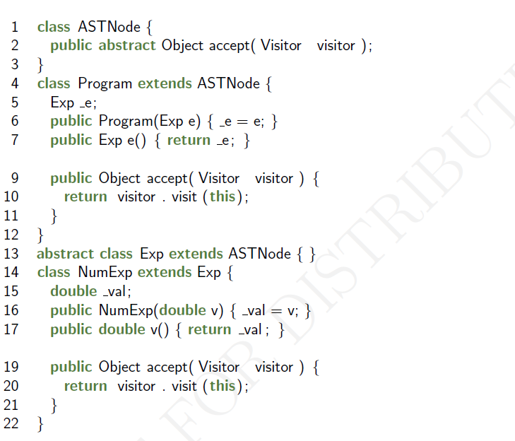

Slide 28
Traversal Strategy 2: Visitor
ASTNode
Program
Exp
public Object accept (Visitor visitor) {
return visitor.visit(this);
}
exp : Exp
+ accept(visitor)
+ accept(visitor)
CompoundArithExp
public interface Visitor <T> {
public T visit(AST.NumExp e);
public T visit(AST.AddExp e);
public T visit(AST.SubExp e);
public T visit(AST.MultExp e);
public T visit(AST.DivExp e);
public T visit(AST.Program p);
}
operands : List<Exp>
+ accept(visitor)
AddExp
SubExp
MultExp
DivExp
NumExp
val : double
+ accept(visitor)
+ accept(visitor)
+ accept(visitor)
+ accept(visitor)
+ accept(visitor)

Slide 29
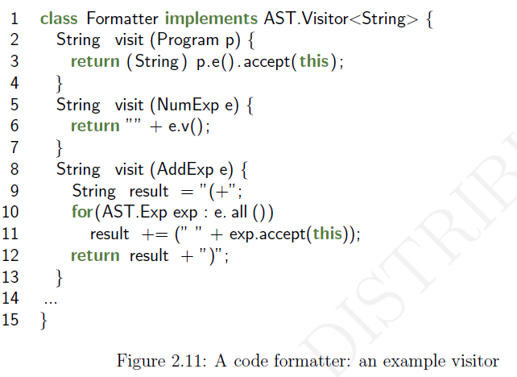

Slide 30
Reading: Rajan’s book Ch2

Slide 31
Review
Grammar of a PL defines legal strings in that PL. Grammar itself is defined by the collection of production rules, terminals, and non-terminals
Parse tree and Abstract Syntax tree

Slide 32
Review: Semantics via Interpreters
Interpreter: a program that given a program in the defined language produces a value or diverges.
Key parts: Read, Eval, Print, REP loop
Read: program to Abstract Syntax Tree (AST)
Eval: AST to value in defined language
Print: value to string
Interpreter of a programming language is itself a program.

Slide 33
Review: Semantics via Interpreters
Interpreter: a program that given a program in the defined language produces a value or diverges.
Key parts: Read, Eval, Print, REP loop
Read: program to Abstract Syntax Tree (AST)
Program – parse -> Parse Tree – abstract -> AST
Eval: AST to value in defined language
Defined systematically for each expression in language
Recursive traversal of AST, convert parts to value
Two strategies for implementing traversal
Decompose and distribute functionality to each AST node
Use visitor pattern, avoid scattering and tangling of concerns
Print: value to string
Interpreter of a programming language is itself a program.

