Slide 1
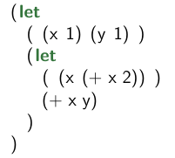
Variable Scoping
Consider the expression below with x and y

Slide 2
Variable Scoping
Consider the expression below with x and y
definition of y

Slide 3
Variable Scoping
Consider the expression below with x and y
definition of y
scope of y

Slide 4
Variable Scoping
Consider the expression below with x and y
definition1 of x

Slide 5
Variable Scoping
Consider the expression below with x and y
definition1 of x
scope of x

Slide 6
Variable Scoping
Consider the expression below with x and y
definition2 of x

Slide 7
Variable Scoping
Consider the expression below with x and y
definition2 of x
Scope of x

Slide 8
Variable Scoping
Consider the expression below with x and y
x = 1, y = 1

Slide 9
Variable Scoping
Consider the expression below with x and y
x = 1, y = 1
x = 3, y = 1

Slide 10
Variable Scoping
Consider the expression below with x and y
x = 1, y = 1
x = 3, y = 1
x = 3, y = 1

Slide 11
Variable Scoping
Consider the expression below with x and y
x = 1, y = 1
x = 3, y = 1
x = 3, y = 1
x = 1, y = 1

Slide 12
A hole in the Scope
Redefine a name creates a “hole”:
So the expression (+ x y) is a hole in the scope of the first definition of x

