Slide 1
CprE-431 Final Project:
DoS and DDoS
By: Sean Gordon, Lorenzo Chavarria, Richa Patel, Jacob Vaughn, Xin Wang
Notes:
Jake

Slide 2
Introduction To DoS Attack
The Denial of Service (DoS) attack is an attempt by hackers to make a network resource unavailable. It usually interrupts the host, temporary or indefinitely, which is connected to the Internet. The target of these attacks can be anyone and everyone, but most attacks target mission critical web servers. Examples of this would include credit card payment gateways, banks, commerce, media companies, government, and trade organizations.
SYN flood – sends a request to connect to a server, but never completes the handshake. Continues until all open ports are saturated with requests and none are available for legitimate users to connect to.
Ping flood – Is a common attack in which an attacker attempts to overwhelm a targeted device with ICMP echo-requests or “pings”. By flooding the target with request packets, the network is forced to respond with an equal number of reply packets. This causes the target to become inaccessible to normal traffic.
Notes:
“Mine” -Jake 2020

Slide 3
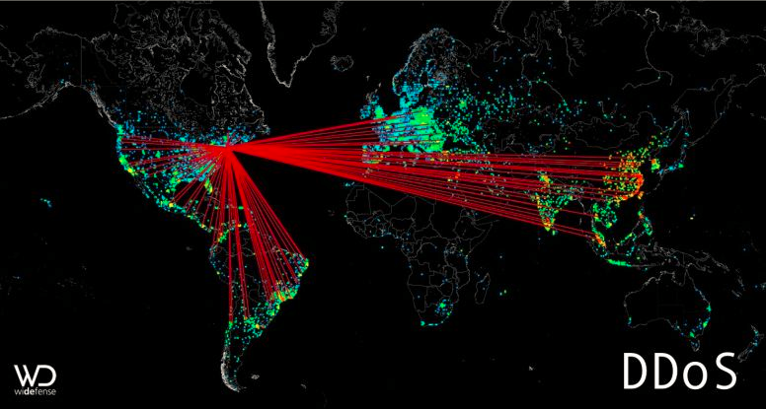
Introduction To DDoS Attack
A distributed denial-of-service (DDoS) attack occurs when multiple machines are operating together to DoS attack one selected target. An attacker is able to use a group of hijacked devices called a botnet to carry out large scale attacks. The location of the attack is difficult to detect due to the random distribution of attacking systems. It is also more difficult to shut down multiple machines than one. The true attacking party is very difficult to identify, as they are disguised behind many (mostly compromised) systems.
Notes:
Jake

Slide 4
Attack Explanation
We began with several smaller DoS attacks against the webserver.
Attacker sent large amounts of ping requests to web server.
Sol. 1: Server admin blocked attacker IP.
Attacker on another client sent large amounts of ping requests.
Sol. 2: Server admin limits the frequency of ping requests allowed.
We then moved to larger scale DDoS attacks
Attacker on 2 clients sending ping requests does nothing due to standing ping limit.
Attacker employs larger botnet, each sending ping requests.
Admin has no choice but to drop all icmp requests.
Notes:
Sean
Hi, my name is Sean Gordon, and I’ll be explaining the attacks used in this project.
We began with several smaller DoS attacks against our sample web server. Our attacker on client A sent large amounts of ping requests to the web server, exhausting the server’s resources in serving the single client. As a solution, the server admin blocked client A’s IP.
To counter, the attacker moved to client B, continuing the attack from there. Rather than simply block client B’s IP, which would just trigger another move, the server admin created a rule to limit the frequency of ICMP packets from a single IP allowed through the network. This limited our attacker’s client B to network traffic equivalent of that of a normal user, stopping the attack.
Next, we moved to larger scale DDoS attacks. As the attacker on a single client cannot impact the web server because of the standing IPTable rules, the attacker employs the use of a large number of clients in a botnet. While each of these clients is limited to a normal amount of traffic, so many of them sending requests at a time halted the use of the server to other clients. In response, the server admin is forced to block all ICMP requests, cutting off the attack.
Script runtime: 1:19
Total runtime: 1:46

Slide 5
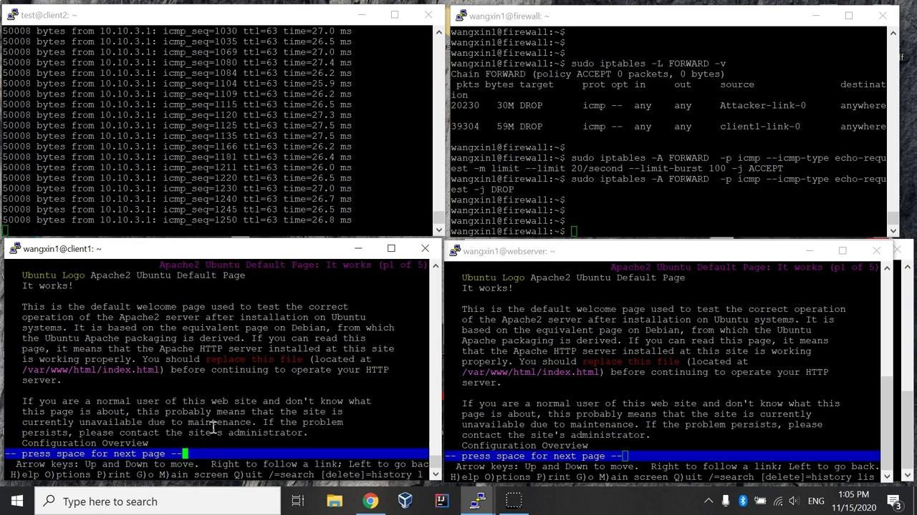
DoS Demos
Notes:
Xin

Slide 6
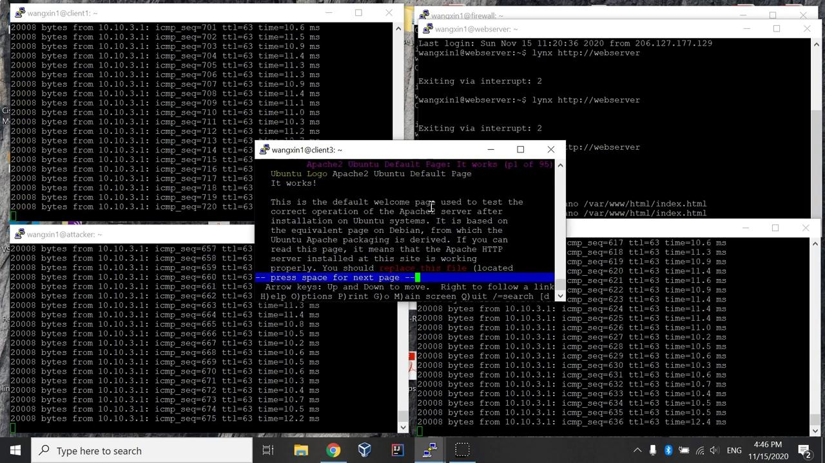
DDos Demo
Notes:
Xin

Slide 7
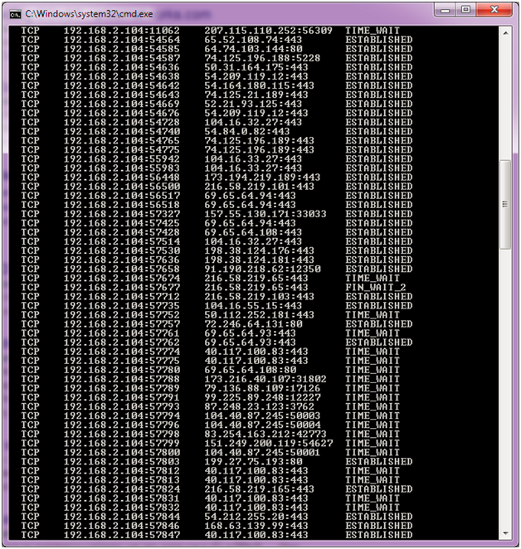
Detect
Realizing that computer is slowing down
There are incoming ICMP packets
All incoming traffic to target network is routed again to one or more distributed data center.
Notes:
Richa

Slide 8
Defend
Iptables can be used to defend against these types of attacks.
Iptables is a command-line tool that allows to control traffic.
Iptable command examples:
sudo iptables -A FORWARD -p icmp -s 10.10.1.1 -j DROP
Sudo iptables -A FORWARD -p icmp --icmp --icmp-type echo-request -j DROP
Other Actions to help defend:
Study traffic and look for changes that are not normal to identify an attack early.
Have overprovision bandwidth
Have a plan to help stop the attack.
Notes:
Lorenzo

Slide 9
Conclusion
Project focused on DoS and DDoS attacks
Explored dangers to web servers.
Explored possible strategies for mitigation.
Project centered around working examples of DoS and DDoS attacks
Began with DoS from single client.
Moved to DDoS after DoS was rendered ineffective.
Solutions involved the use of IPTables to slow or stop the attacks.
Notes:
Sean
This project focused on understanding DoS and DDoS attacks, exploring the dangers they pose to a web server and some strategies to mitigate their effects.
The project centered around working examples of the attacks against a test web server, starting with DoS and moving to DDoS once it was rendered ineffective.
Solutions involving the use of IPTables were employed, and more information was gathered to help identify these types of attacks in the future.
Script runtime: 0:27
Total runtime: 1:46

