Slide 1
Efficient Variants of the
ICP Algorithm
Szymon Rusinkiewicz
Marc Levoy
Stanford University

Slide 2
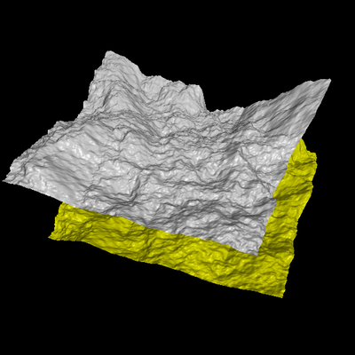
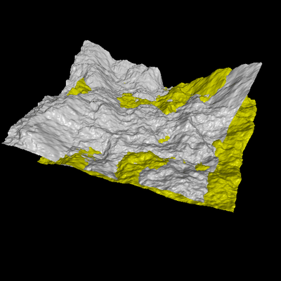
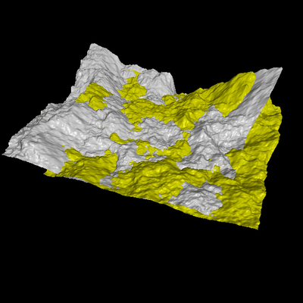
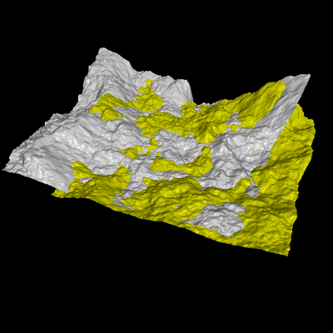
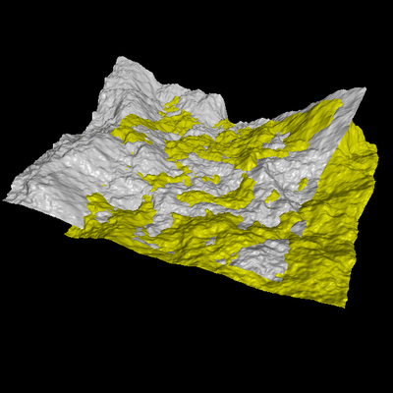
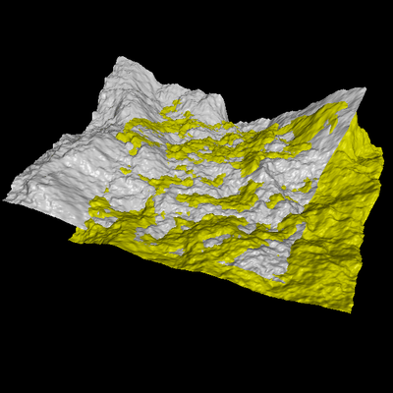
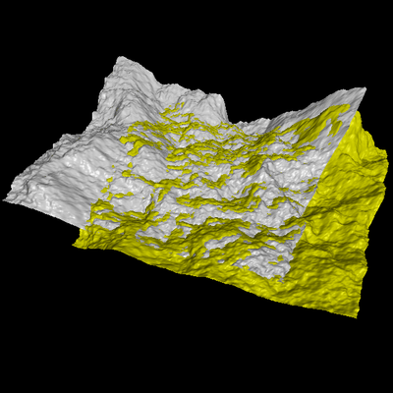

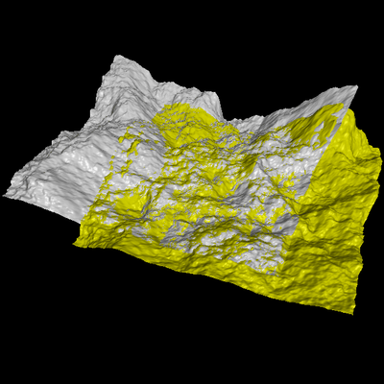
Problem
Align two partially-
overlapping meshes
given initial guess
for relative transform

Slide 3
Aligning 3D Data
If correct correspondences are known,
it is possible to find correct relative rotation/translation

Slide 4
Aligning 3D Data
How to find corresponding points?
Previous systems based on user input,
feature matching, surface signatures, etc.

Slide 5
Aligning 3D Data
Alternative: assume closest points correspond to each other, compute the best transform…

Slide 6
Aligning 3D Data
… and iterate to find alignment
  Iterated Closest Points (ICP) [Besl & McKay 92]
Converges if starting position “close enough“

Slide 7
Outline
Enumeration and classification of
ICP variants
Performance comparisons
High-speed ICP algorithm recombines previously-introduced variants
  Suitable for real-time range scanning

Slide 8
ICP Variants
Variants on the following stages of ICP
have been proposed:
Selecting source points (from one or both meshes)
Matching to points in the other mesh
Weighting the correspondences
Rejecting certain (outlier) point pairs
Assigning an error metric to the current transform
Minimizing the error metric

Slide 9
Performance of Variants
Can analyze various aspects of performance:
  Speed
  Stability
  Tolerance of noise and/or outliers
  Basin of convergence (maximum initial misalignment)
Comparisons in paper focus mostly on speed
Today: summarize conclusions about a few categories of ICP variants

Slide 10
ICP Variants
Selecting source points (from one or both meshes)
Matching to points in the other mesh
Weighting the correspondences
Rejecting certain (outlier) point pairs
Assigning an error metric to the current transform
Minimizing the error metric

Slide 11
Selecting Source Points
Use all points
Uniform subsampling
Random sampling
Normal-space sampling
  Ensure that samples have normals distributed
  as uniformly as possible

Slide 12
Normal-Space Sampling
Uniform Sampling
Normal-Space Sampling

Slide 13
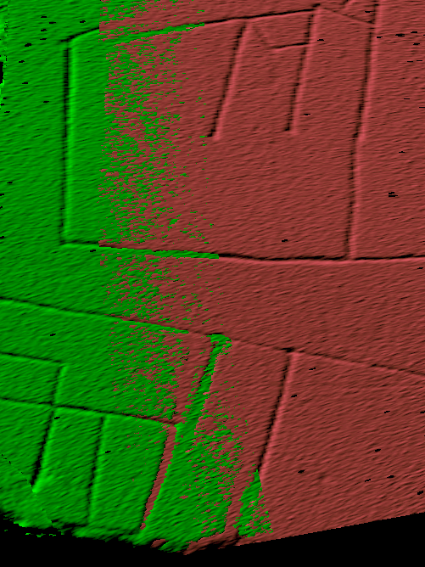
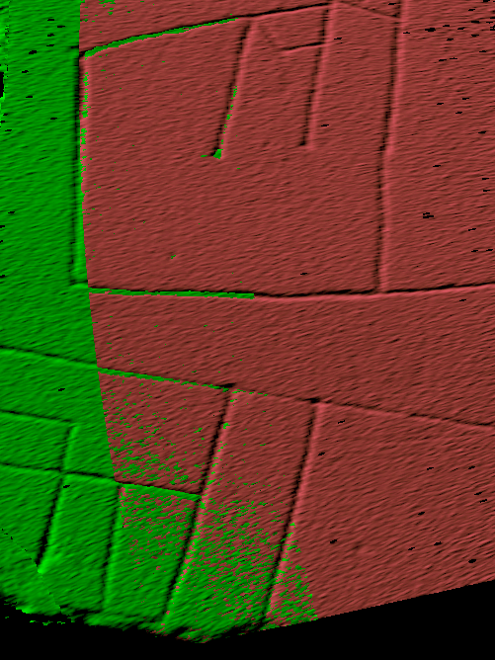
Normal-Space Sampling
Conclusion: normal-space sampling better for mostly-smooth areas with sparse features
Random sampling
Normal-space sampling

Slide 14
Selection vs. Weighting
Could achieve same effect with weighting
Hard to ensure enough samples in features except at high sampling rates
However, have to build special data structure
Preprocessing / run-time cost tradeoff

Slide 15
ICP Variants
Selecting source points (from one or both meshes)
Matching to points in the other mesh
Weighting the correspondences
Rejecting certain (outlier) point pairs
Assigning an error metric to the current transform
Minimizing the error metric

Slide 16
Point-to-Plane Error Metric
Using point-to-plane distance instead of point-to-point lets flat regions slide along each other [Chen & Medioni 91]

Slide 17
ICP Variants
Selecting source points (from one or both meshes)
Matching to points in the other mesh
Weighting the correspondences
Rejecting certain (outlier) point pairs
Assigning an error metric to the current transform
Minimizing the error metric

Slide 18
Matching
Matching strategy has greatest effect on convergence and speed
Closest point
Normal shooting
Closest compatible point
Projection

Slide 19
Closest-Point Matching
Find closest point in other mesh
Closest-point matching generally stable,
but slow and requires preprocessing

Slide 20
Normal Shooting
Project along normal, intersect other mesh
Slightly better than closest point for smooth meshes, worse for noisy or complex meshes

Slide 21
Closest Compatible Point
Can improve effectiveness of both of the previous variants by only matching to compatible points
Compatibility based on normals, colors, etc.
At limit, degenerates to feature matching

Slide 22
Projection to Find Correspondences
Finding closest point is most expensive stage of
the ICP algorithm
Idea: use a simpler algorithm to find correspondences
For range images, can simply project point [Blais 95]

Slide 23
Projection-Based Matching
Slightly worse performance per iteration
Each iteration is one to two orders of magnitude faster than closest-point
Requires point-to-plane error metric

Slide 24
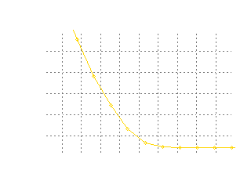
High-Speed ICP Algorithm
ICP algorithm with projection-based correspondences, point-to-plane matching
can align meshes in a few tens of ms.
(cf. over 1 sec. with closest-point)

Slide 25
Application
Given:
  A scanner that returns range images in real time
  Fast ICP
  Real-time merging and rendering
Result: 3D model acquisition
  Tight feedback loop with user
  Can see and fill holes while scanning

Slide 26
Our Implementation
Real-time structured-light range scanner
[Hall-Holt & Rusinkiewicz, ICCV01]
Off-the-shelf camera and DLP projector
Range images at 60 Hz.

Slide 27
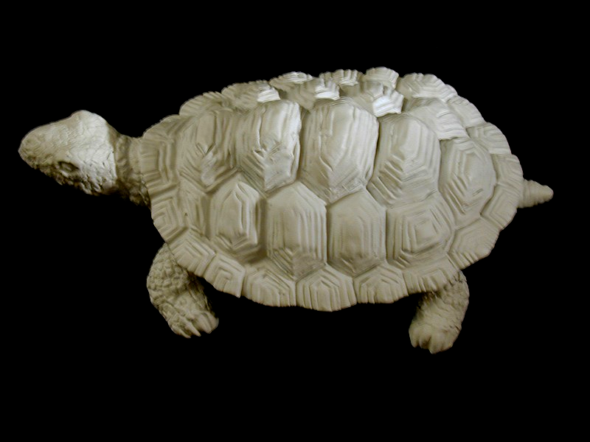
Photograph

Slide 28

Real-Time Result

Slide 29
Conclusions
Classified and compared variants of ICP
Normal-space sampling for smooth meshes with sparse features
Overall speed depends most on choice of matching algorithm
Particular combination of variants can align two range images in a few tens of ms.
  Real-time range scanning
  Model-based tracking

Slide 30
Future Work
More work on examining robustness and stability of variants
Real-time global registration
Other selection / weighting criteria?
  Select in regions of high curvature
  Continuum between ICP with fancy selection
  (or weighting) and feature matching

