Slide 1
Real-time Monocular SLAM: Why Filter?
Remo Meyer & Jan Rüegg

Slide 2
SLAM: Two Approaches
SFM
Few Images
Fast Processor
„Unlimited“ Time
SLAM
Continious Images
Slow / Embedded Processor
Realtime

Slide 3
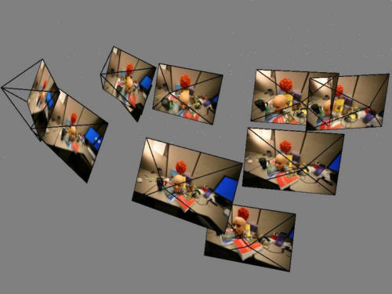
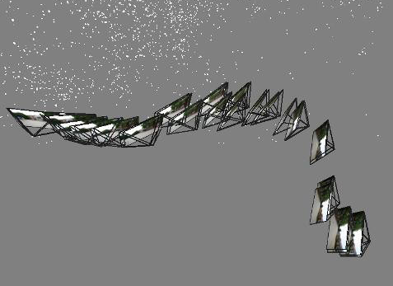
SLAM: Two Approaches
SFM
Keyframes
SLAM
Filter

Slide 4
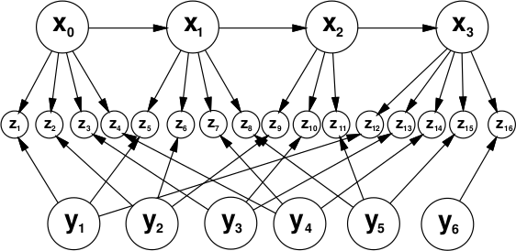
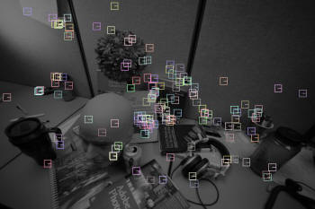
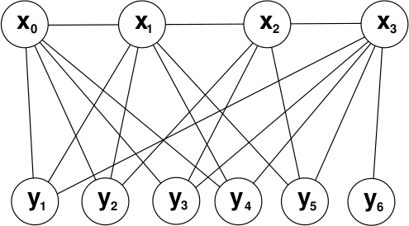
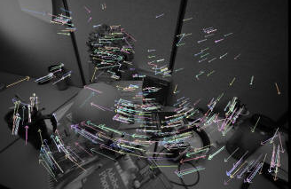
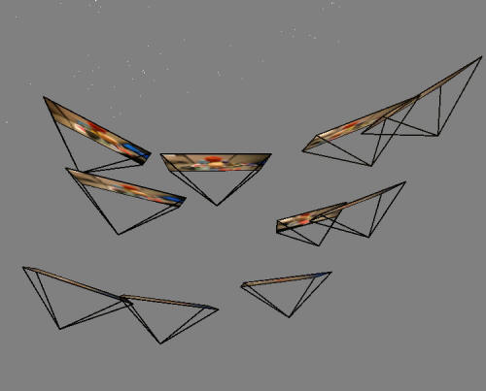
General Idea
Camera Poses
Features
Objects

Slide 5
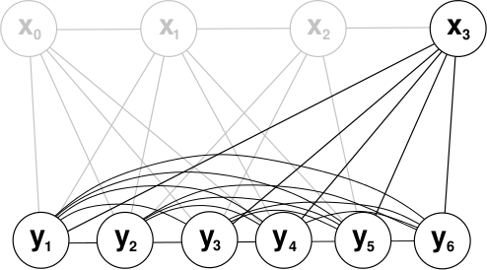
Filter
Camera Poses
Objects

Slide 6
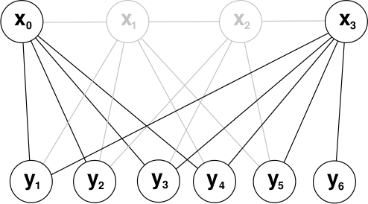
Keyframes
Camera Poses
Objects

Slide 7
Experimental Setup
Simulated Environment
  Camera Rotation
  Sideward Camera movement
  Corridor Camera movement
Real Images
  Sideward Camera movement

Slide 8
Simulation: Sidewards

Slide 9
Simulation: Rotation

Slide 10
Simulation: Corridor

Slide 11
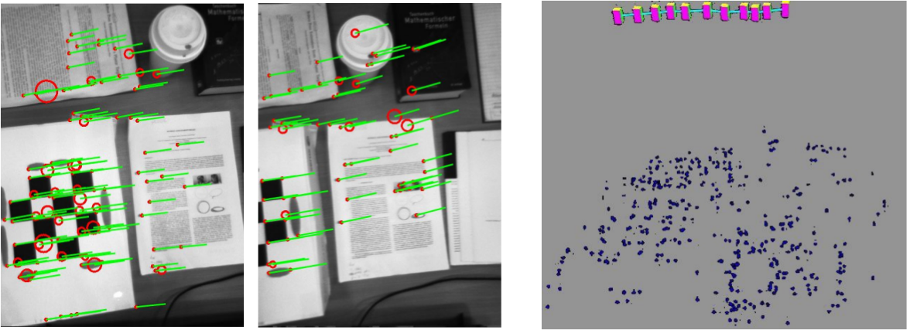
„Real“ Images: Sidewards

Slide 12
Measurements

Slide 13
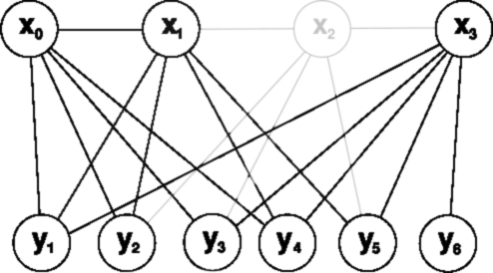
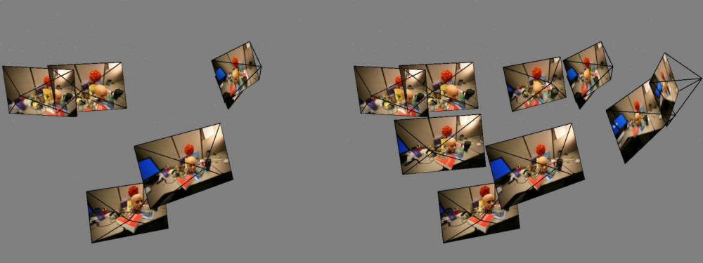
Vary number of Keyframes (m)

Slide 14
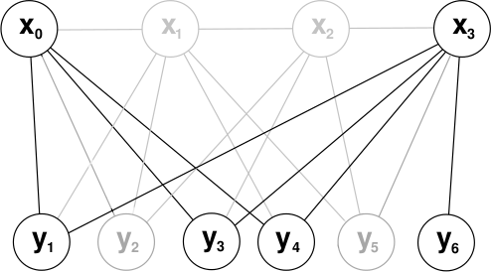
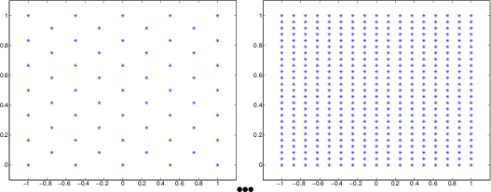
Vary number of Features (n)

Slide 15
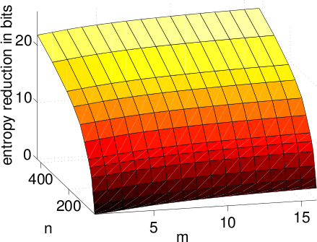
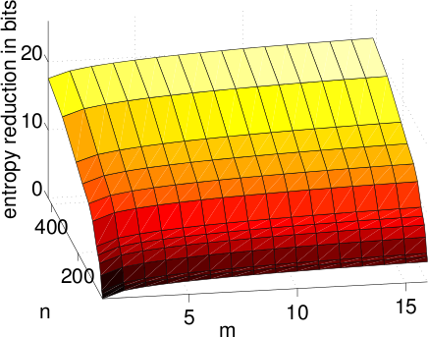
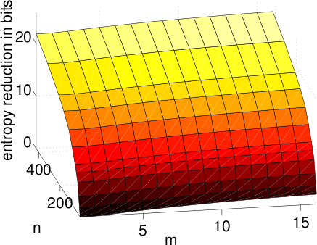
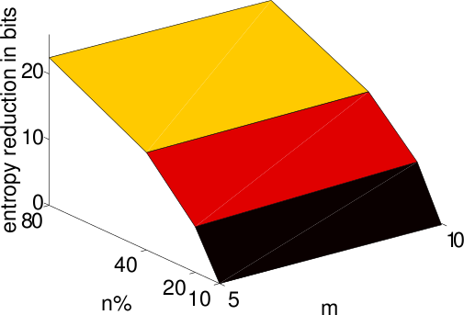
Accuracy

Slide 16
Computational Cost
Filter
Keyframes
m: Number of Keyframes
n: Number of Features

Slide 17
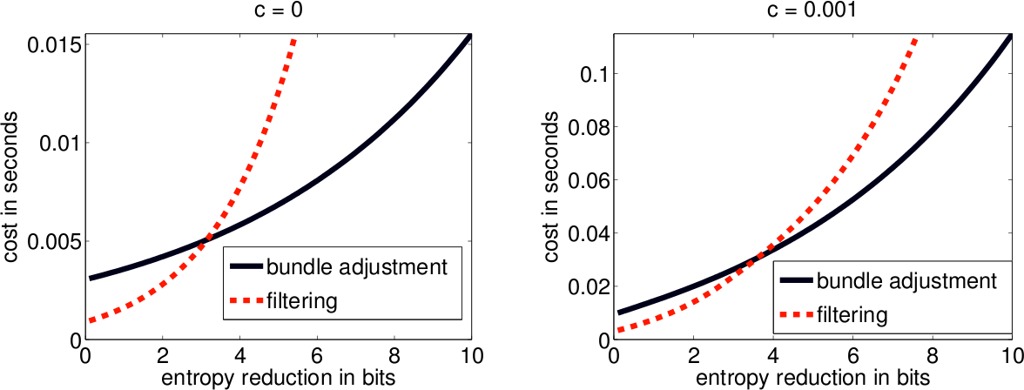
Trade-off
No Tracking Cost
Moderate Tracking Cost

Slide 18
Conclusions
Filter good for very small processing Budget
Better to increase Features than Keyframes

Slide 19
Discussion
Very simple Test Scenes
  Short sequences (~ 16 poses)
  All features always seen
  Simple movement
  Simple objects

Slide 20
Discussion
„A similar measure is defined for the filter case“
Tracking Cost
SLAM initialization

Slide 21
Questions ?
Thanks for listening!

