Slide 1






TEAM DETAILS AND PROBLEM STATEMENT
Problem Statement : Problem 2 – Agricultural Crop Yield Predicition on Indian Crop Data
Team Name : BlueBerryCider
Team Leader Details (Name, Phone Number, Email) : Sahil khandelwal,8524804242,
sahilkhandelwal.zzzz@gmail.com
Institution Name : Amrita Vishwa Vidyapeetham
Course Enrolled : CSE(AI)

Slide 2
Agricultural Crop Yield Prediction on Indian Crop Data
Developing accurate crop yield prediction models is imperative for India's agriculture sector, contributing 16% to the GDP and employing 50% of the workforce, particularly small and marginal farmers. Facing challenges from variable climate and global warming, these farmers lack access to modern technologies. The task involves leveraging or creating robust deep learning models to achieve state-of-the-art results on Indian crop datasets, considering factors like crop genotype, environmental conditions, and management practices. The objective is to empower stakeholders with informed decisions for sustainable and reliable food production, emphasizing all-India predictions.

Slide 3
Goals
The overarching goal is to leverage deep learning models for precise crop yield predictions, focusing on essential crops like potato, onion, and rice in the Indian context. The primary objective is to minimize Root Mean Square Error (RMSE) scores, ensuring the accuracy of forecasts. This endeavor aims to provide reliable insights into agricultural planning, optimize resource allocation, and enhance overall food security by creating robust models that effectively capture the intricate relationships between environmental factors, crop characteristics, and management practices, thereby empowering stakeholders across the agricultural value chain to make informed decisions for sustainable and efficient crop production.

Slide 4
Objective and Methodology
Feature Selection and Engineering:
Identify key factors affecting crop yields (climate, soil, crop varieties, and agricultural practices).
Explore creation or transformation of features for additional insights.
Model Selection and Architecture Design:
Investigate deep learning models (FNNs,CNNs,RNNs, LSTMs, transformers) for yield prediction.
Customize models for specific crop characteristics.
Evaluate trade-offs between model complexity and computational efficiency.
Training and Validation:
Split dataset for each crop into training and validation sets.
Train models with a focus on minimizing RMSE using appropriate loss functions.
Monitor training progress to prevent overfitting.
Hyperparameter Tuning:
Systematically explore hyperparameter space (learning rates, batch sizes, model architecture).
Optimize parameters and conduct sensitivity analyses for performance understanding

Slide 5
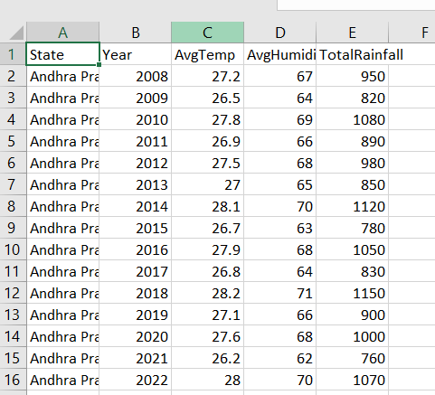
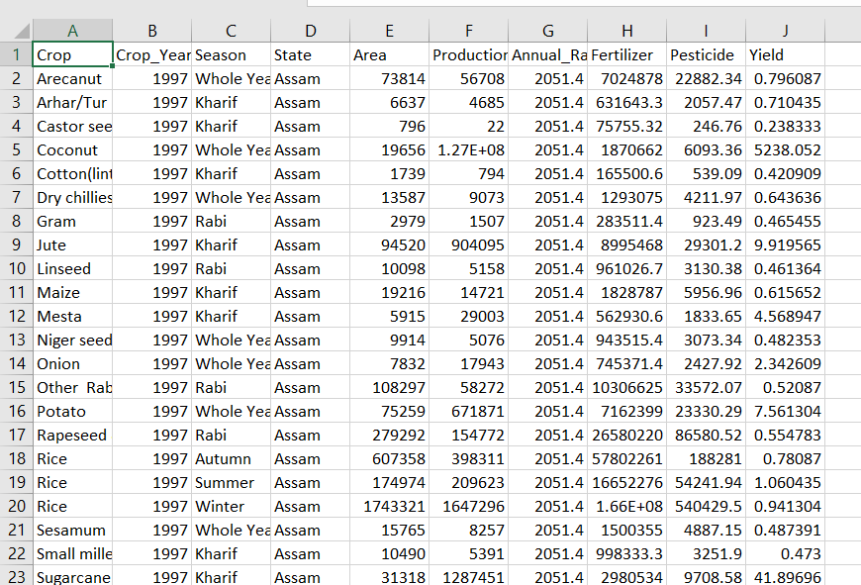
Process Flow 1.Selection and Merging of the datasets (Source – Kaggle and Gemini)
Selection of Dataset

Slide 6
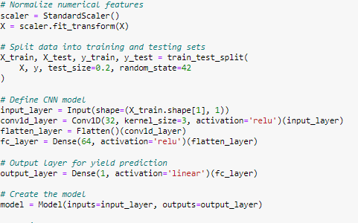
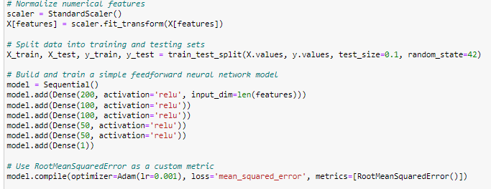
2.Testing of various Models

Slide 7
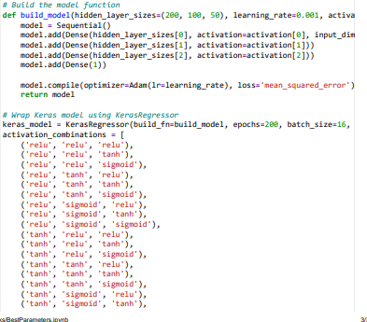
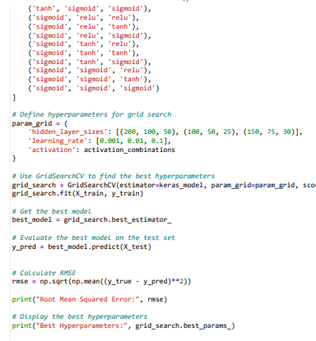
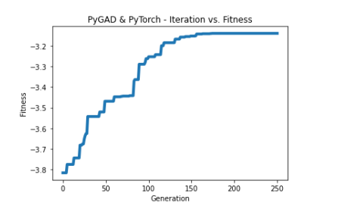
3.Finding Best Parameters(USING GRID SEARCH ,Genetic Algorithm)

Slide 8
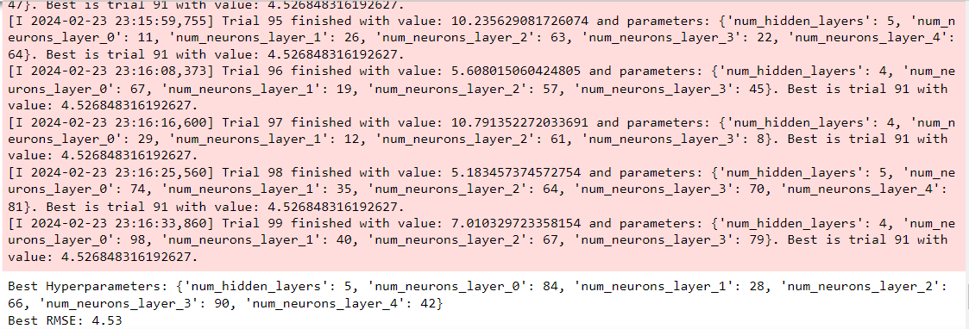
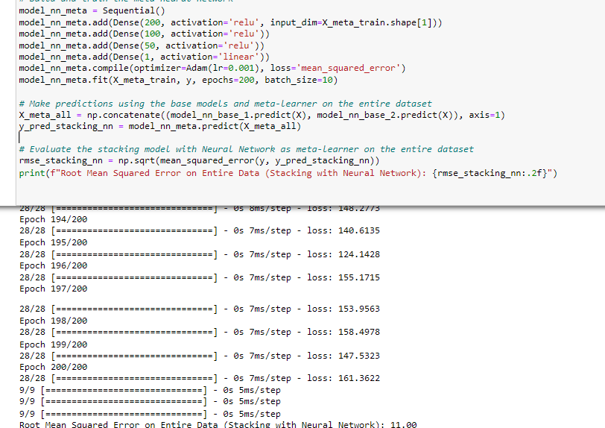
Stacking and Bayesian Optimization

Slide 9
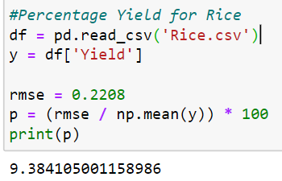
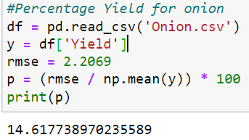
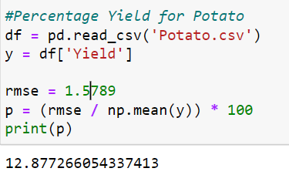
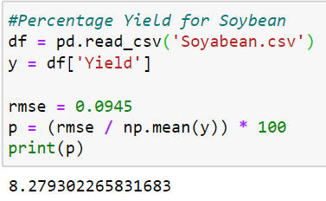
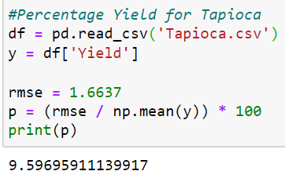
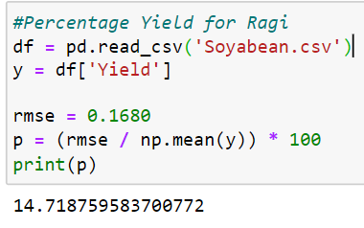
Results

Slide 10
Farmer Level
Our goal is to empower these farmers and break the cycle of poverty and malnutrition.A crop yield model could revolutionise Indian agriculture, and serve as a global model for smallholder farmers. Accurate yield predictions empower smallholder farmers to make informed planting and resource allocation decisions, reducing poverty and malnutrition and improving food security. As climate change intensifies, adaptive farming practices become crucial, making precise yield predictions even more valuable. Solutions developed here can drive sustainable agriculture and ensure a stable food supply for the world's growing population.

