Slide 1



Intel® GenAI Hackathon
Team Name : BlueBerryCider
Problem Statement : Beyond Browsing: Unlcok Hyper Personalized Experiences with GenAI

Slide 2


Problem Statement
The current shopping experience lacks an easy to use hyper personalized shopping experience. Products are usually recommended based on pervious purchases that failed to recognize the overall taste of the user. To address this, there is a need to implement an innovative solution that analyzes individual user profiles, considering purchase history and social media trends

Slide 3
Unique Idea Brief (Solution)
Develop a Conversational Fashion Outfit Generator powered by GenAI. The objective is to build an interactive system that understands user preferences through natural language, offering personalized fashion recommendations. This ensures that the outfit recommendations align with the each users fashion taste.

Slide 4
Features Offered
Personalized Outfits :
The generator analyze a user's purchase history, and social media trends to tailor outfits. This ensure that the outfit recommendations align with the fashion taste.
Enhanced Experience :
The generator helps in enhancing the overall shopping experience. When the users feel that their preferences and latest fashion trends has taken into account they are more likely to make confident decisions.

Slide 5
Process flow
The user asks the model for outfit options
User search, purchase history and details such as age, location, etc fed using langchain enhance outfit choices.
LLM is fine tuned on many varying user prompts using qLoRA weights.

Slide 6
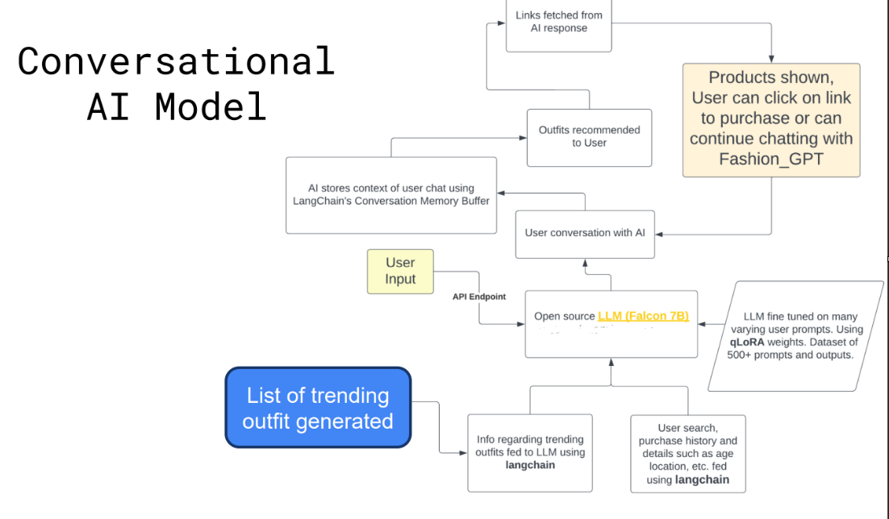
Architecture Diagram (Attached below for reference)

Slide 7
Technologies used (Mark down oneAPI AI Analytics libraries used)
Torch
LangChain
Transformers
Intel one-API

Slide 8
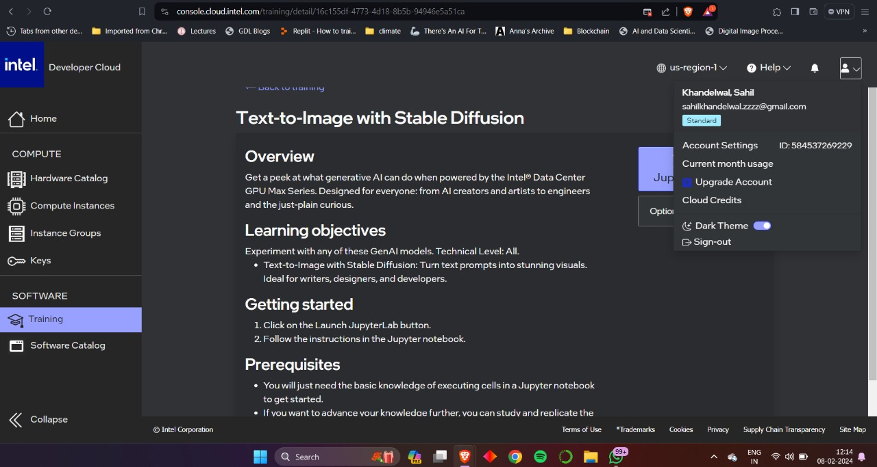
Intel® Developer Cloud Account (Screenshot)

Slide 9
Use case of Intel® Developer Cloud (IDC)
The Intel Developer Cloud proves to be an excellent platform, offering access to powerful CPUs and high-speed internet, thereby facilitating a remarkably swift process. This challenges the misconception that LLM training necessitates GPU usage. The experimentation phase demonstrated that faster inferencing and training are achievable with different models on this platform.

Slide 10
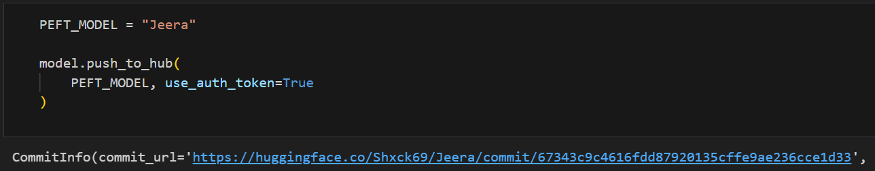
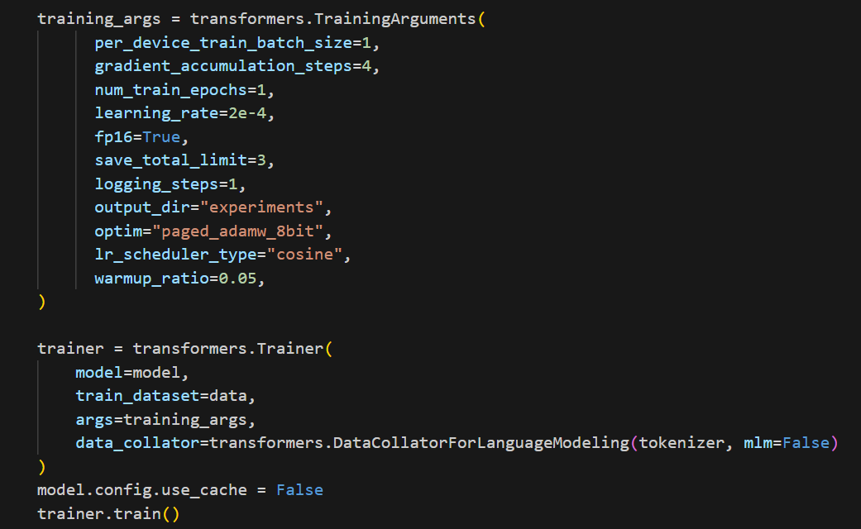
Progress Update
Model Selection
Data collection
Data processing
Fine Tuning

Slide 11
Challenges Faced
Quantization of the Model
Parameter efficient fine Tuning
Integrating with intel one api

Slide 12
Progress To Be Made
Integrating with langchain
Optimization of the model with the help of intel one api and IDC

Slide 13
Thank you so much!

