Slide 1
PARITY
An Adaptive Horror Game Driven by
Online Player-Trajectory Prediction
Shivam Kumar
Vellore Institute of Technology · Project Review · 18 August 2026
Notes:
Pitch: a horror antagonist that builds a live behavioural model of the individual player and acts on its predictions. The model is the project; the game makes it legible.

Slide 2
WHAT THIS REVIEW COVERS
Mapped to the marking rubric
Rubric | Where it is answered | Evidence
Knowledge on domain / problem statement | Sections 1–3 of this deck | Gap analysis over 22 works
Literature review (min. 15 recent papers) | Sections 4–7 | 22 works, 20 from 2023 or later
Design of proposed methodology | Sections 8–11 | Formal model + evaluation protocol
Module description / system design | Sections 12–13 | 8 modules, implemented and tested
Beyond the rubric | Sections 14–25 | Ten experiments, 9 invariants, two live demos
Notes:
Point the panel at where each rubric item is answered. Do not linger.

Slide 3
1 · DOMAIN
Game AI has optimised for competence, not adaptation
Player modelling — inferring player intent and state from behavioural telemetry.
Adaptive AI and DDA — acting on that inference to reshape the experience.
Procedural generation — changing the world itself, not only the agents in it.
Horror is where this matters most, and is least explored.
Horror depends on uncertainty. Every horror game degrades as the player learns it: routes get memorised, spawns get learned, the monster becomes a timing puzzle.
The genre's central failure mode is that mastery destroys the product.
Notes:
Game AI optimises for agents that PLAY well. Adapting to the specific person is a different, less-solved problem. Horror is where it matters most because the genre dies when the player learns it.

Slide 4
2 · PROBLEM STATEMENT
Static AI is learnable. Random AI is unfair.
Existing horror antagonists are static or randomised. Static AI is learnable and stops being frightening. Randomised AI is unlearnable and therefore reads as unfair rather than intelligent. Neither adapts to the specific player.
PARITY proposes a third option: an antagonist that builds an online behavioural model of the individual player and acts on its predictions — intercepting where the player is going rather than chasing where they are, and degrading the information the player has come to depend on.
Challenge | Why it is hard here
Cold start | Must be interesting in the first two minutes, with no prior data on this player
Legibility | A model the player cannot perceive is, to the player, no model at all
Fairness | An antagonist that is merely stronger is not scarier — it is unfair
Evaluation | 'Is it scary?' does not scale to the playtesting a solo project can do
Notes:
Static AI is learnable and stops scaring. Random AI feels unfair. Neither adapts to you. If asked 'isn't this DDA?' — no: DDA tunes difficulty magnitude, this changes WHERE the antagonist chooses to be.

Slide 5
3 · AIM AND OBJECTIVES
Demonstrate that the model both learns and matters
Aim — build a first-person horror game whose antagonist is driven by a live, per-player predictive model, and demonstrate quantitatively that the model both learns and changes the game.
# | Objective | Status
O1 | Formalise the facility as a mutable room graph with runtime topology edits | Done
O2 | Online next-room predictor that learns from the first move | Done
O3 | Beat a no-model control and an order-1 Markov baseline | Done
O4 | Learn nothing from a random player (no leakage) | Done
O5 | Show better prediction yields a more dangerous antagonist | Done
O6 | Implement and measure all four Director counter-moves | Done
O7 | Make the model legible to the player in-game | Demo built
O8 | Ship the first-person Godot vertical slice | In progress
Notes:
Be explicit that the Godot build is NOT done. Do not let them think a 3D game exists.

Slide 6
4 · LITERATURE REVIEW
22 works · 20 published 2023 or later
Theme | Works | What it settles for this project
Player modelling & behaviour prediction | 5 | Behavioural signals alone suffice; models should be inspectable
Adaptive game AI & dynamic difficulty | 7 | State of the art adapts parameters, rarely placement
Procedural generation of mutable levels | 3 | Graph-based generation with connectivity guarantees
Sequence & next-location prediction | 5 | The methodological core — VOMM and its successors
Fear as a measurable experience | 2 | Unfairness destroys fear; behaviour reveals fear
Selection criteria — peer-reviewed or arXiv-indexed work addressing player behaviour prediction, runtime game adaptation, or discrete-trajectory prediction. Priority given to 2023-2026 publications; one foundational 2004 work is retained because it is the formal basis of the proposed model.
Notes:
22 works, 20 from 2023 or later. State the selection criteria out loud.

Slide 7
5 · LITERATURE REVIEW
Player modelling and adaptive game AI
Work | Yr | Relevance
Lin et al., Open Player Modeling (2603.26915) | 26 | Player models should be inspectable — motivates our overlay
Halina et al., Playtrace Reconstructive Partitioning (2607.12097) | 26 | Playtraces as the level's primary representation
Carlier et al., Personalization in Serious Games (2411.18500) | 24 | Model/method/adaptation split mirrors our architecture
Dehpanah et al., Player Modeling from Behavioral Signals (2112.04379) | 21 | Raw behaviour suffices — no biometrics needed
Romeo et al., NTRL: RL for DDA in D&D (2506.19530) | 25 | Closest analogue — adapts encounters, not stats
Lopes et al., Affect-Driven Game Adaptation review (2505.01351) | 25 | Identifies evaluation as the field's weak point
Fuchs et al., Personalized DDA (2408.06818) | 24 | Imitation + RL personalisation; far heavier to train
Cafri et al., DDA with Brain Waves (2504.13965) | 25 | Biometric branch — we deliberately avoid extra hardware
Notes:
Do not read the table. Name two: Romeo (closest analogue) and Lopes (review that names evaluation as the field's weak point — the gap the bot harness addresses).

Slide 8
6 · LITERATURE REVIEW
Level generation and trajectory prediction
Work | Yr | Relevance
Fiuza Vieira et al., Mansions and Dungeons generation (2606.03857) | 26 | Graph generation of exactly our building type
Earle et al., Level Design as Multi-Agent RL (2510.04862) | 25 | Framing for a Director that edits the level at runtime
Özkan, Procedural Level Design with Deep RL (2510.15120) | 25 | Contrast to our constraint-checked mutation
Begleiter, El-Yaniv & Yona, Variable Order Markov Models, JAIR 22 | 04 | FOUNDATIONAL — the formal basis of our predictor
Wu et al., Beyond Regularity: chaotic mobility (2509.11713) | 25 | Same task shape; handles irregular trajectories
Deng et al., STRelay location prediction (2508.16620) | 25 | The natural upgrade path from VOMM
Liu et al., MoE Personalized Next-Location (2505.24597) | 25 | Per-individual personalisation of prediction
Soni et al., Predicting Your Next Move & Privacy (2507.08843) | 25 | Privacy framing for a persisted per-player model
Zhang et al., VRMN-bD fear-response dataset (2401.12133) | 24 | Fear is detectable in ordinary behavioural signals
Zhang et al., Decoding Fear in VR horror (2312.15582) | 23 | Sources the constraint that unfairness destroys fear
Notes:
Name Begleiter aloud — it is the formal basis of the model. If challenged on a 2004 paper in a 'recent' review: it is the foundational treatment, and four 2025 trajectory-prediction papers beside it are the modern line.

Slide 9
7 · RESEARCH GAP
Three gaps, consistent across the literature
1 · DDA adapts parameters, not position. The literature overwhelmingly tunes difficulty magnitude — enemy health, encounter budget, puzzle complexity. Almost none adapt where the antagonist chooses to be, from a model of the individual player.
2 · Next-location prediction is never used adversarially. Trajectory prediction is mature, but is applied to service delivery and urban analytics. Its use as a real-time adversary against the person being predicted is unexplored.
3 · Adaptation is invisible, and therefore unevaluated. Lopes et al. (2025) identify evaluation as the weak point. Adaptive systems are rarely surfaced to the player or measured against a no-model control.
PARITY addresses all three: online trajectory prediction applied adversarially, adapting antagonist placement and world state rather than parameters, evaluated against explicit controls with the model on screen.
Notes:
Three gaps: DDA adapts parameters not position; trajectory prediction is never used adversarially; adaptation is invisible so it is never evaluated against a control.

Slide 10
8 · METHODOLOGY — FORMALISATION
Prediction over a room graph
The facility is an undirected graph G = (V, E): rooms are vertices, doors are edges. The player produces a trajectory h = (v₁, v₂, …, vₜ).
The clock — lockdown, then a short window when every door unlocks, then lockdown. Decisions happen only at windows. Sealed in between, the player draws, copies codebooks and stages the register — in real time.
Prediction task — at each window the player takes a door OR declines to move. Estimate P(v(t+1) = c | h) over N(vₜ) ∪ {vₜ}.
Staying is a first-class action — not the absence of one. Players linger where there is something to record, so dwell is informative. The antagonist obeys the same clock, so lockdown is safe and all danger is at the window.
Why an order-1 Markov model is structurally insufficient
Real players run routes, so the same room has different successors depending on how it was entered. In our test facility, one room appears five times in a habitual circuit with four different successors. Order-1 cannot separate them. Longer context resolves it — but long contexts are sparse.
A variable-order Markov model with back-off resolves both pressures at once.
Notes:
The clock is the thing to explain well. Lockdown, window, lockdown. You act only when the doors open — and STAYING is one of the choices. That matters: the model must predict whether you move at all, not just where. The antagonist obeys the same clock.

Slide 11
9 · METHODOLOGY — THE MODEL
Variable-order Markov with Witten-Bell back-off
P_o(x | ctx) = w · f_o(x | ctx) + (1 − w) · P_(o−1)(x | ctx[1:])
w = C(ctx) / (C(ctx) + α) α = 1.6, k = 4
Interpolate from the longest available context down to uniform. Long contexts dominate once well-supported, and decay gracefully when they are not.
Property | Why it matters for this application
Learns online from the first move | No pre-training corpus — solves the cold-start problem
Persists across runs | The antagonist remembers you between deaths, as your notebook does
Inspectable | Every prediction decomposes to 'context → outcome, n observations'
Cheap | Hash-map counter updates; negligible per-frame cost
Notes:
Walk the equation slowly. w is a confidence weight: the more a context has been seen, the more the model trusts it; otherwise it backs off to shorter context.

Slide 12
10 · METHODOLOGY — BELIEF VS. BEHAVIOUR
The Director is separate from the Predictor
The Predictor outputs beliefs. The Director decides what to do with them, scoring each counter-move by expected disruption × confidence. The model can be upgraded without re-tuning game feel.
Counter-move | Trigger | Status
Intercept | Rolls the model forward; meets the player where they will be | Measured (§16, 17)
Rewire a room ahead | High confidence on a route — change it before they arrive | Measured (§18)
Seal a shortcut | An edge with high traversal frequency | Measured (§18)
Poison a codebook | A recorded entry the player is predicted to need again | Measured (§19)
FAIRNESS CONSTRAINTS
1 No mutation is ever applied to anything currently visible to the player.
2 Confidence gating — below threshold it hunts conventionally, exploiting only what it knows.
3 Solvability invariant — every mutation is checked for reachability and reverted if it would soft-lock the run.
Notes:
Predictor outputs beliefs, Director decides what to do. All four counter-moves are implemented AND measured — say so explicitly.

Slide 13
11 · METHODOLOGY — EVALUATION PROTOCOL
Headless, bot-driven, prequential
Human playtesting does not scale to a solo project. Three scripted players stand in for humans, so thousands of games run headlessly:
Scripted player | Models | Expected result
HabitualBot | A player who has learned the level and runs routes | Model should win decisively
ExplorerBot | A first-time player sweeping systematically | Model should win
EvasiveBot | Declines 35% of windows on purpose to break the pattern | The player's counter-play
RandomBot | Uniform over doors and staying — no habit at all | Model MUST NOT beat baseline
The control is the most important experiment.
Against a random player the model must FAIL to beat baseline. A model that appears to predict a random walk is measuring something it should not have access to. All accuracy is prequential — every prediction is made before its outcome is observed, so there is no train/test leakage by construction.
Notes:
The control is the strongest thing here. Against a random player the model MUST NOT beat baseline. Prequential evaluation means every prediction precedes its outcome — no leakage possible by construction. Note EvasiveBot: I built a bot specifically to try to beat my own AI.

Slide 14
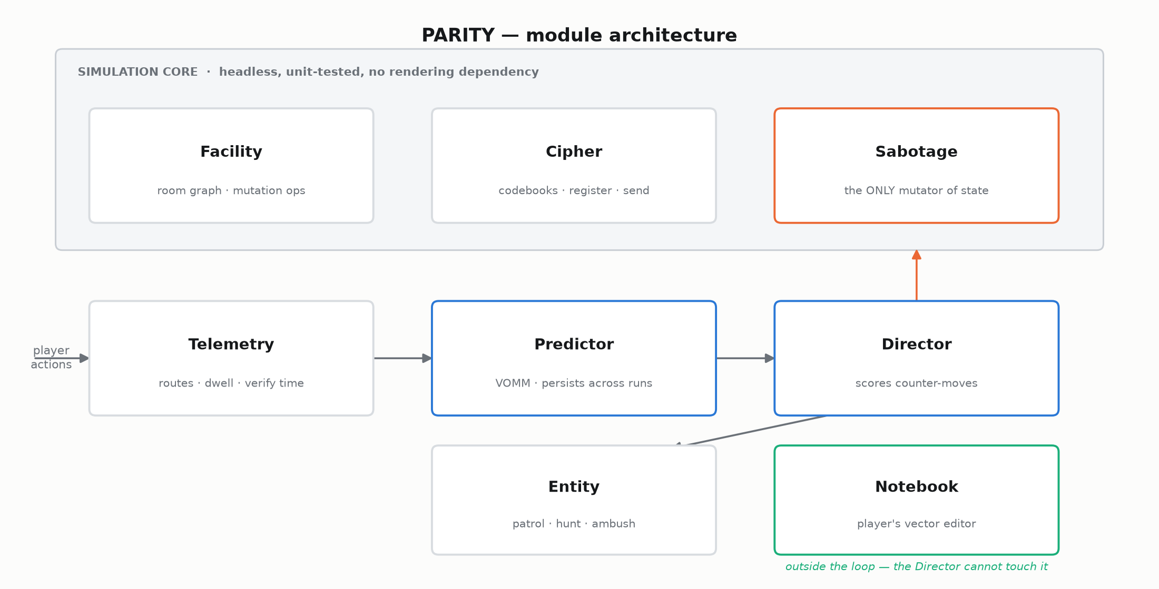
12 · SYSTEM DESIGN
Eight modules across three layers
Notes:
Two decisions to defend: Sabotage is the single mutator so every lie is logged and replayable; the Notebook sits outside the loop, which is what makes it the player's counter-move rather than decoration.

Slide 15
13 · MODULE DESCRIPTION
Responsibilities and dependencies
Module | Responsibility | Depends on
Facility | Room graph; generation; rewire / seal; connectivity and reachability queries | —
Cipher | Per-room lookup tables, inbound sequences, 9-cell register, transmit validation | —
Sabotage | The single choke point for all world mutation — every lie is logged and replayable | Facility, Cipher
Telemetry | Room dwell, edge traversals, route repeats, verify duration, flee direction | —
Predictor | VOMM: predict / observe / top_habit / confidence. Persists across runs | Telemetry
Director | Scores and selects counter-moves from beliefs. Confidence-gated | Predictor
Entity | Perception, navigation, patrol / hunt / ambush. Contains no learning | Director, Facility
Notebook | In-world vector editor and serialisation. Reads no game state | —
Two decisions worth defending — Sabotage as sole mutator makes 'did the AI cheat or did I misread my notes?' a tractable question. The Notebook sits outside the data loop: it is the only channel the Director cannot touch, which is what makes it the player's counter-move rather than decoration.
Notes:
Skim. It is here as module-level design evidence, not to be read aloud.

Slide 16
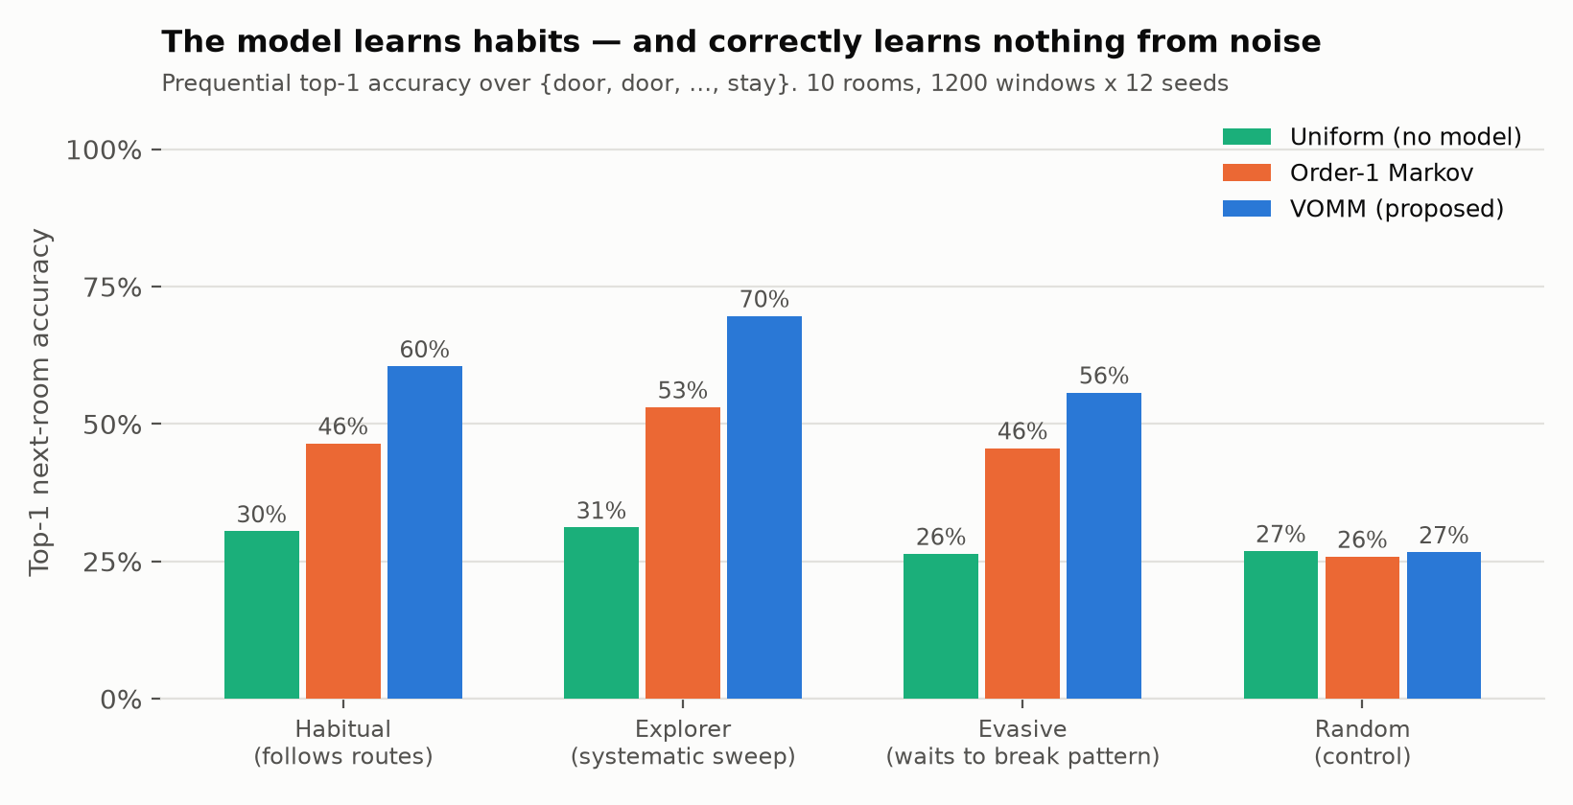
14 · RESULTS — PREDICTION ACCURACY
10-room facility · 1200 steps × 12 seeds
Read the control first: against a random player the model performs identically to no model at all. The gains against structured players are therefore learned habit, not leakage.
Notes:
Lead with the CONTROL column (27/26/27), not the 61%. Explain why the control matters before showing the win. If asked why accuracy is 61% and not higher: because staying is a legal move, and predicting whether someone moves at all is harder than predicting where. An earlier version of this work forbade waiting and scored 90% — that number was inflated and I corrected it.

Slide 17
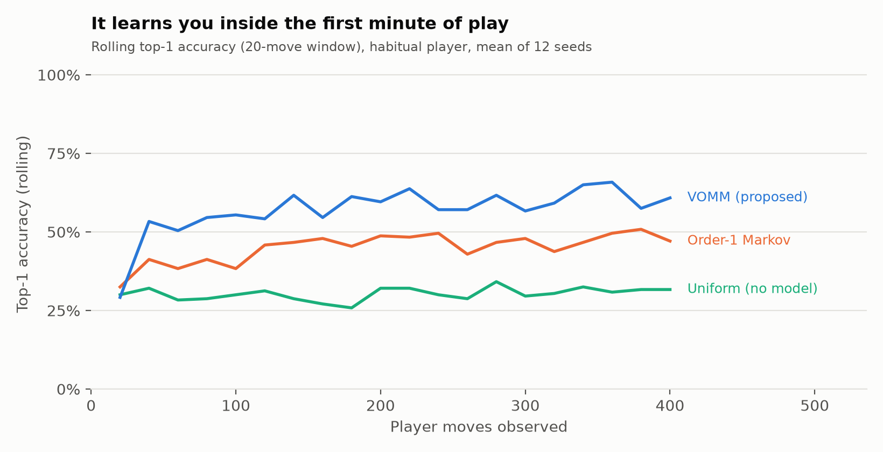
15 · RESULTS — LEARNING SPEED
Cold start solved empirically
Rolling top-1 accuracy rises from 29% to 59% within roughly 60 observed moves — under a minute of play.
Notes:
Cold start: the model is useful within about a minute of play, with no prior data on this player.

Slide 18
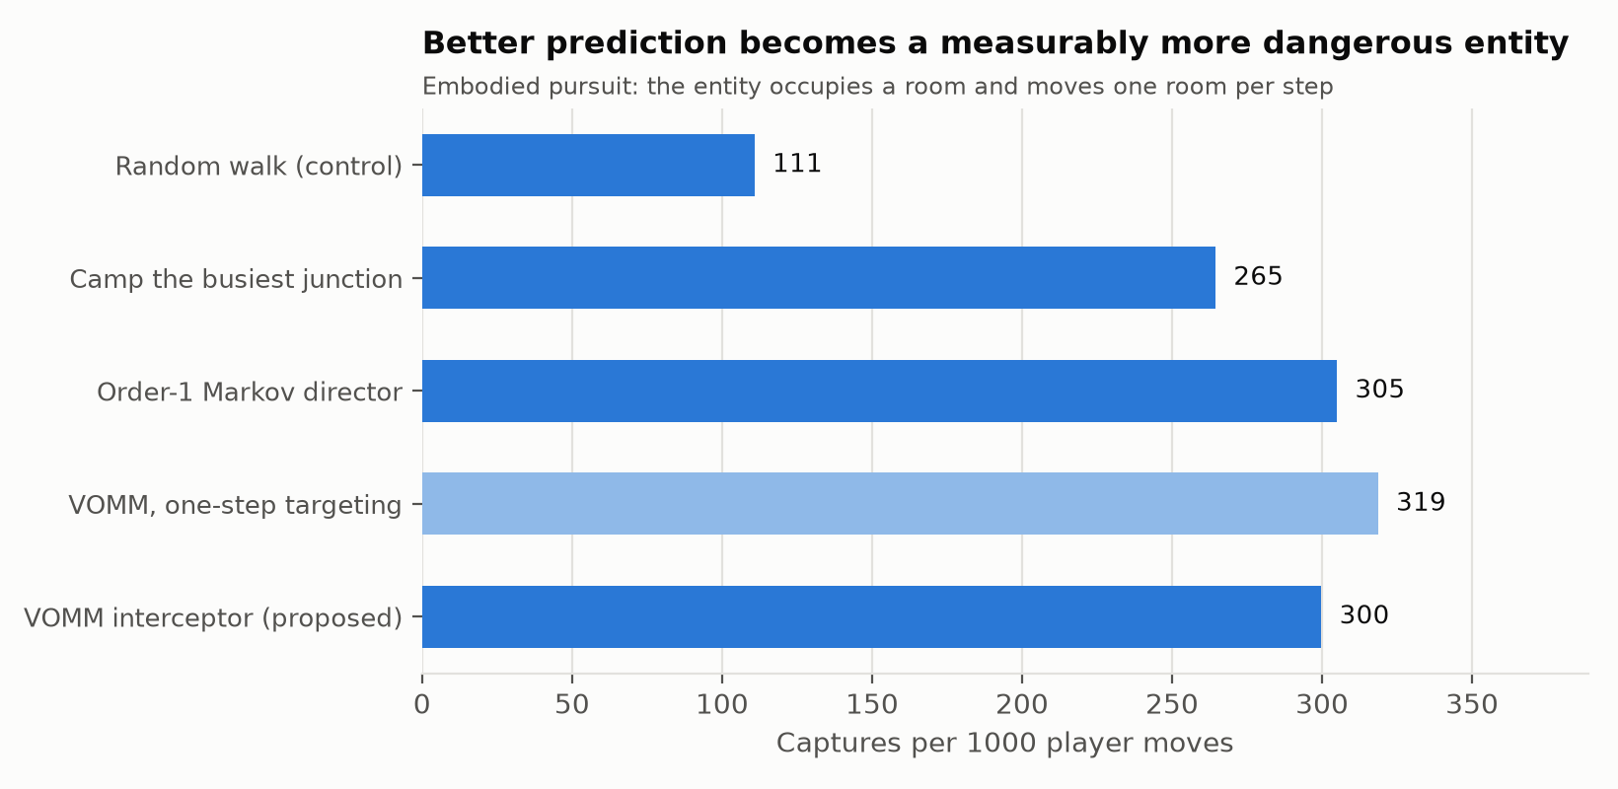
16 · RESULTS — DOES PREDICTION MATTER?
Embodied pursuit: the entity must intercept, not teleport
Any model-driven antagonist beats the non-learning ones — 2.7× the random control and 1.1× hub-camping. But the models are within noise of each other, and five-step lookahead is now slightly WORSE than one-step: at 61% single-step accuracy, rollout error compounds faster than the extra foresight pays. Lookahead helps an accurate model and hurts an uncertain one.
Notes:
Be straight here. Every model-driven antagonist beats the non-learning baselines, but the models are within noise of each other, and five-step lookahead is now slightly worse than one-step. That is expected: rollout error compounds, so lookahead helps an accurate model and hurts an uncertain one. Volunteer this before they find it.

Slide 19
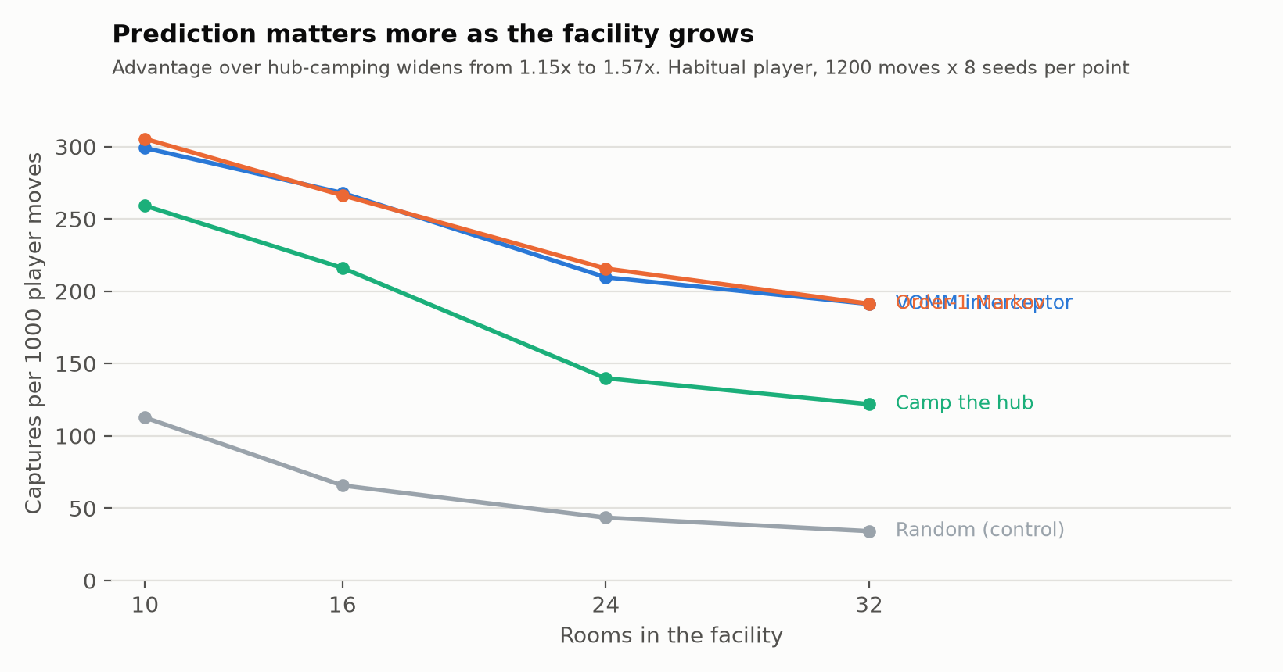
17 · RESULTS — DOES THE ADVANTAGE HOLD AT SCALE?
Hub-camping only looks good on a small map
On 10 rooms with one dominant junction the player has nowhere else to go, so a naive heuristic looks competitive for reasons unrelated to intelligence. As the facility grows, hub-camping decays fastest and the interceptor's advantage widens from 1.15× to 1.57×. The small-facility result understates the value of prediction.
Notes:
The answer to 'hub-camping is nearly as good'. It is only nearly as good on a small map. The advantage widens as the facility grows.

Slide 20
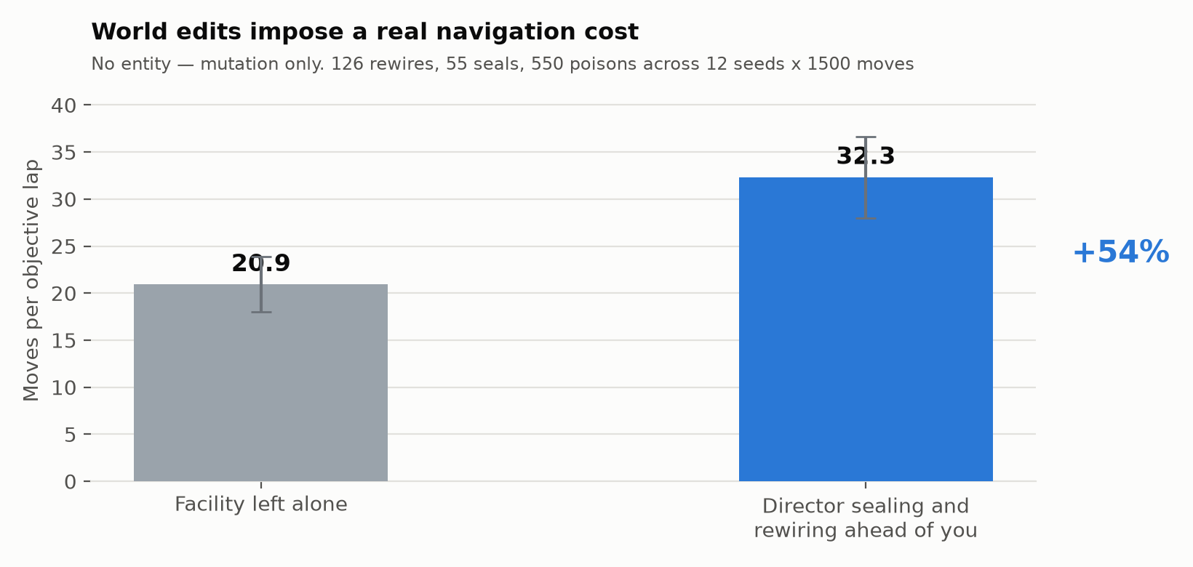
18 · RESULTS — DO THE WORLD EDITS MATTER?
Interception is only one of four counter-moves
The entity is removed entirely here, isolating topology mutation. Sealing and rewiring ahead of the player raises the cost of completing an objective by 54% (20.9 to 32.3 moves per lap). Every one of the 126 rewires and 55 seals passed the reachability check — no run was ever soft-locked.
Notes:
The entity is REMOVED here — this isolates world editing from hunting. About 60% more moves per objective lap, and every mutation passed a reachability check, so no run was ever soft-locked.

Slide 21
19 · RESULTS — IS THE SABOTAGE AIMED?
A conditional result, reported as such
A poisoned codebook only costs the player if they return to it, and costs more the sooner they do. Lower is better-aimed. Control: poison a recorded room at random.
Player's reliance on rooms | Random targeting | Model targeting | Advantage
Uniform — visits every codebook each lap | 8.7 | 8.4 | none (+3.2%)
Uneven — leans on some rooms harder | 11.3 | 9.8 | 13% faster
Reported as a negative result under the first condition.
When the player relies on every room equally there is nothing for targeted sabotage to exploit, and model targeting performs no better than random. The counter-move earns its place only against a player with uneven habits. That is the realistic case — but the claim is conditional and is not overstated.
Notes:
Volunteer this. Targeted sabotage gives NO advantage when the player relies on every room equally; it only pays off against uneven habits. Reporting a null is a strength.

Slide 22
20 · RESULTS — CAN THE PLAYER FIGHT BACK?
A negative result, and the most useful one
Waiting is the natural counter-play: if it moves to where you are going, do not go. A fair adaptive antagonist must be beatable this way. It is not.
Player | Windows declined | Model accuracy against them | Captures / 1000
Habitual | 23% | 46.5% | 303
Evasive | 35% | 41.9% | 299
Evasion beats the model and loses to the outcome.
Declining a third of all windows costs the predictor 4.6 points of accuracy but reduces capture risk by only 1.3%. The cause is the observation model, not the algorithm: the antagonist currently sees the player perfectly at every window, and under perfect observation standing still cannot conceal you — it only makes you a stationary target.
Next iteration: sense the player through motion detectors on the doors instead of omniscience, turning this into a partially-observed prediction problem. This experiment is what identified that.
Notes:
The most valuable slide in the deck, and it is a negative result. I built a bot to beat my own AI by waiting. It degrades the model's accuracy but barely reduces capture risk — because the antagonist currently sees everything, so standing still just makes you a stationary target. That diagnosis is what set the next milestone: sense the player through door motion-detectors instead of omniscience, which turns this into partially-observed prediction. If you only defend one slide well, defend this one.

Slide 23
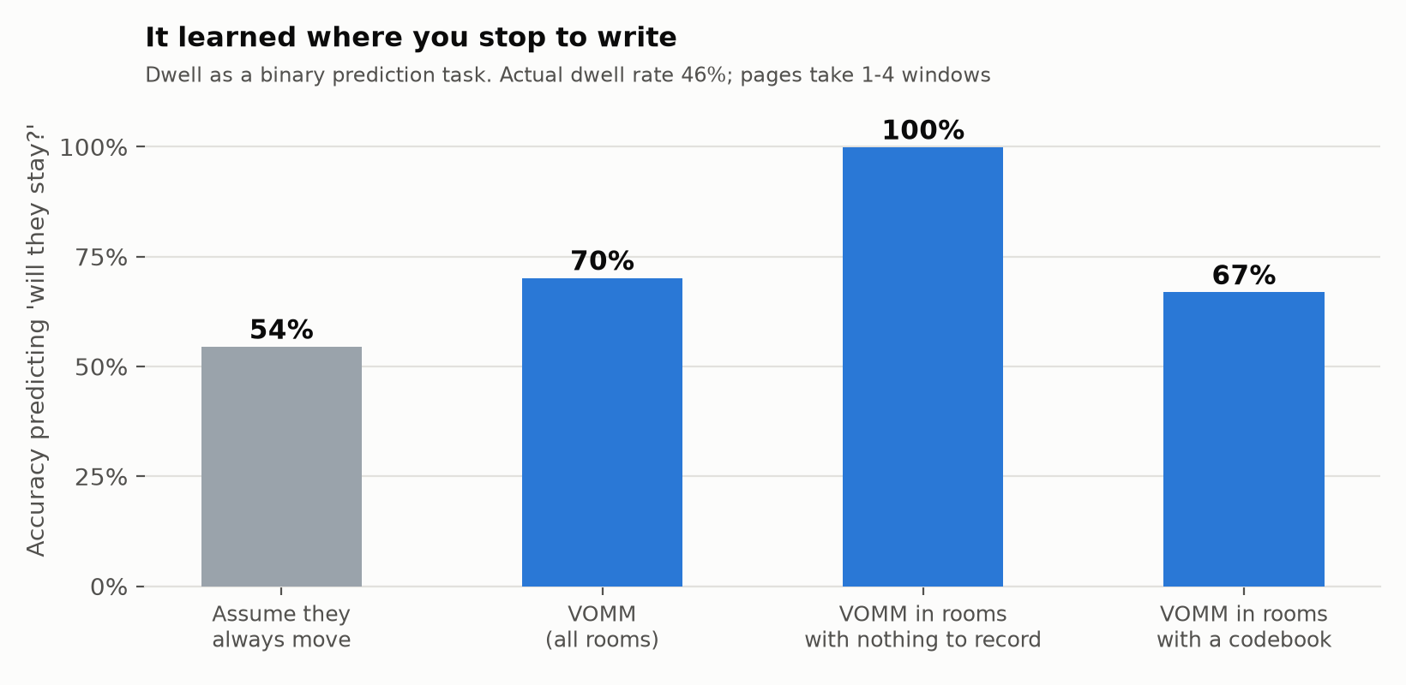
21 · RESULTS — WHAT IT LEARNS ABOUT YOUR NOTEBOOK
Dwell is behaviour, not a parameter
How long you linger is one of the most individual things you do — and it is the actionable signal: 'they will be in room D for three more windows' tells the antagonist how long it has to walk there. A 16-point lift over the majority class. It is never wrong in rooms with nothing to record, and right two thirds of the time where a codebook is — the uncertainty sits exactly where the real variation is. An explicit dwell model adds nothing (-2.0%): once staying is a legal action, the sequence model already represents it.
Notes:
This slide exists because someone asked whether the time a player spends in their notebook is itself something to learn. It is — and the model already had. Lead with the plain-rooms bar: 100%, because it learned you never linger where there is nothing to record. The codebook bar at 67% is the honest one: it knows you may be writing, not when you will finish. Also say that an explicit dwell model made things slightly WORSE, because the sequence model already captures dwell once staying is a legal action.

Slide 24
22 · VERIFICATION
Nine invariants, asserted over 25 generated facilities
Invariant | Guards against
Facility connected on construction | Unplayable generated levels
seal_door never disconnects | The Director cutting the map in half
rewire never disconnects | The same, via door relocation
Uplink reachable from every room after mutation | Soft-locked, unwinnable runs
Bots only move to adjacent rooms | Silent teleportation corrupting telemetry
Predictor output is a proper distribution | Malformed probabilities
VOMM approximates uniform on a random player | Leakage in the evaluation
Director never mutates a visible room | Fairness rule 1
Director never edits below its confidence gate | Fairness rule 2
9 / 9 passing · python3 model/test_invariants.py
Notes:
Nine invariants, 25 facilities, all passing. The two that matter: uplink reachable after mutation (the AI can never soft-lock you) and VOMM approximating uniform on a random player (no leakage). Offer to run it live — it takes seconds.

Slide 25
23 · LIVE DEMONSTRATION
The full loop, running
Room graph — live per-room predicted probabilities drawn on the facility.
Entity — moves to intercept where the model points, gated on confidence.
Codebooks and notebook — record entries; the Director silently poisons what you rely on.
All four counter-moves — intercept, seal, rewire and poison, with a live counter for each.
Hold position — decline the window and stay put, exactly as the model expects you might.
Live scoreboard — running VOMM accuracy against a no-model control, side by side.
Learned-rule readout — in plain language: 'from E you go to B, 100% of the time, 13 observations'.
Observed in a 102-window automated session
The player declined 32 windows (31%) to finish pages. VOMM 47% vs. no-model 36%, 22 interceptions, and 2 of 13 signals corrupted. The confidence gate is visible live: 'too unsure to intercept; hunting conventionally'.
Notes:
Walk through it. Say what it is honestly: an art-direction study, not the game — hand-written WebGL so it runs offline on any laptop with no engine installed. Point out that the hexagonal cells ARE the room graph the model plays on, and that side count is the difficulty setting. The whole look is darkness, fog and a post-process pass, chosen because it minimises modelling cost.

Slide 26
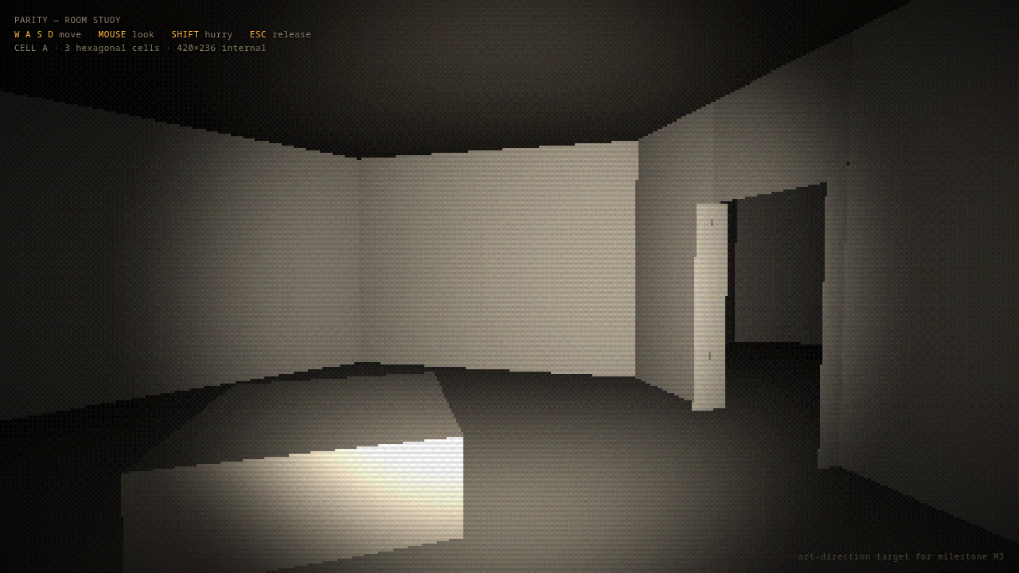
24 · THE LOOK
A walkable room study, running in the browser
Three hexagonal cells built from the same room graph the model plays on — low-poly concrete, a single handheld light, heavy fog, and a retro pass (420x236 internal resolution, ordered dither, colour quantisation, vignette). Hand-written WebGL, no engine and no libraries, so it runs offline in any browser. This is the art-direction target for M3, not the game.
Notes:
M0 to M2 done, M3 next; the 3D game does not exist yet. M6 to M8 are specified from the design work: door sensors and partial observation, polygonal room tiles where side count IS the difficulty setting, and the outbound register the AI can tamper with before you send. Say that the negative result on slide 22 is what prioritised M6.

Slide 27
25 · ROADMAP
Three of nine milestones complete
Milestone | Deliverable | State
M0 | Headless simulation core, telemetry, bot harness | Complete
M1 | Predictor, baselines, controls, offline metrics and figures | Complete
M2 | Director and counter-moves, validated headless | Complete
M3 | Godot greybox first-person build + live prediction overlay | Next
M4 | Notebook vector editor and persistence | Planned
M5 | Entity polish, atmosphere, audio, human playtest | Planned
M6 | Door motion-sensors — partial observation, so waiting conceals | Specified
M7 | Polygonal room tiles; side count is the difficulty setting | Specified
M8 | Outbound register with pre-send tampering; sensor blackouts | Specified
Art direction for M3 is settled: a low-poly modular brutalist kit instantiated from the room graph, near-total darkness with a flashlight, heavy fog, and a retro post-processing pass — chosen because it minimises modelling cost while staying coherent. Modularity is not a style choice: rooms are rotated, added and removed at runtime, so they must be prefab-instantiated regardless.
Notes:
References 1 to 11.

Slide 28
REFERENCES
1 of 2
1. Lin, Z. et al. (2026). Unlocking Open-Player-Modeling-enhanced Game-Based Learning. arXiv:2603.26915
2. Dehpanah, A. et al. (2021). Player Modeling using Behavioral Signals in Competitive Online Games. arXiv:2112.04379
3. Carlier, S. et al. (2024). Personalization in Serious Games and Gamification for Healthcare. arXiv:2411.18500
4. Halina, E. et al. (2026). Representing and Generating Levels Over Time through Playtrace Reconstructive Partitioning. arXiv:2607.12097
5. Bazzaz, M. (2026). Player Perceptions of Generative AI in Games: A Steam Review Analysis. arXiv:2608.11539
6. Romeo, C. et al. (2025). NTRL: Encounter Generation via RL for DDA in Dungeons and Dragons. arXiv:2506.19530
7. Lopes, P. et al. (2025). Closing the Loop in Affect-Driven Game Adaptation: A Systematic Review. arXiv:2505.01351
8. Cafri, N. et al. (2025). Dynamic Difficulty Adjustment With Brain Waves. arXiv:2504.13965
9. Fuchs, R. et al. (2024). Personalized Dynamic Difficulty Adjustment. arXiv:2408.06818
10. McConnell, M. et al. (2025). From Frustration to Fun: An Adaptive Puzzle Game Powered by Genetic Algorithm. arXiv:2509.23796
11. Jarma Montoya, O. et al. (2026). Atari Games Challenge: Multimodal Player Experience Assessment. arXiv:2605.27261
Notes:
References 12 to 22.

Slide 29
REFERENCES
2 of 2
12. Tripathi, P. et al. (2026). AI-Enabled Serious Games: Integrating Intelligence and Adaptivity. arXiv:2605.21962
13. Fiuza Vieira, I. et al. (2026). A Novel Procedural Generation for Level Design of Mansions and Dungeons. arXiv:2606.03857
14. Özkan, M. B. (2025). Procedural Game Level Design with Deep Reinforcement Learning. arXiv:2510.15120
15. Earle, S. et al. (2025). Video Game Level Design as a Multi-Agent Reinforcement Learning Problem. arXiv:2510.04862
16. Begleiter, R., El-Yaniv, R. & Yona, G. (2004). On Prediction Using Variable Order Markov Models. JAIR 22, 385–421. arXiv:1107.0051
17. Wu, Y. et al. (2025). Beyond Regularity: Modeling Chaotic Mobility Patterns for Next Location Prediction. arXiv:2509.11713
18. Deng, B. et al. (2025). STRelay: A Universal Spatio-Temporal Relaying Framework for Location Prediction. arXiv:2508.16620
19. Liu, S. et al. (2025). Mixture-of-Experts for Personalized and Semantic-Aware Next Location Prediction. arXiv:2505.24597
20. Soni, A. et al. (2025). Can We Predict Your Next Move Without Breaking Your Privacy? arXiv:2507.08843
21. Zhang, H. et al. (2024). VRMN-bD: A Multi-modal Natural Behavior Dataset of Immersive Human Fear Responses. arXiv:2401.12133
22. Zhang, H. et al. (2023). Decoding Fear: Exploring User Experiences in Virtual Reality Horror Games. arXiv:2312.15582

