Slide 1
PARITY
An Adaptive Horror Game Driven by
Online Player-Trajectory Prediction
BCSE497J · Project Review III · Panel Review
Shivam Kumar · Vellore Institute of Technology · 16 September 2026
Notes:
BCSE497J Review III. Keep this short and move to evidence.

Slide 2
WHERE THIS STANDS
One minute of context, then evidence
WHAT THIS PANEL ASKED FOR LAST TIME
You said | What changed
Show the AI functioning, not just described | The game now narrates its own reasoning on screen, in English, every turn
The game should BE the implementation | The four separate prototypes are merged into one playable build
Get to about half the game | The complete core loop runs; the 3D presentation layer is what remains
Explain the AI in plain view | An AI view shows its belief on the map and why it moves where it moves
The problem it solves — horror antagonists are static (learnable, stop being frightening) or random (unlearnable, feel unfair). Neither adapts to the individual. PARITY builds an online behavioural model of this player and acts on it.
Everything in this deck is executable.
12 experiments and 9 invariant tests run from the command line in minutes; four prototypes run in a browser with no install. Figures and tables are generated from one metrics file, so nothing here is typed by hand.
Notes:
Thirty seconds of context, then say the sentence that matters: everything in this deck is executable and the panel can run it. Name the new work: partial observation, built because the last review's negative result pointed at it.

Slide 3
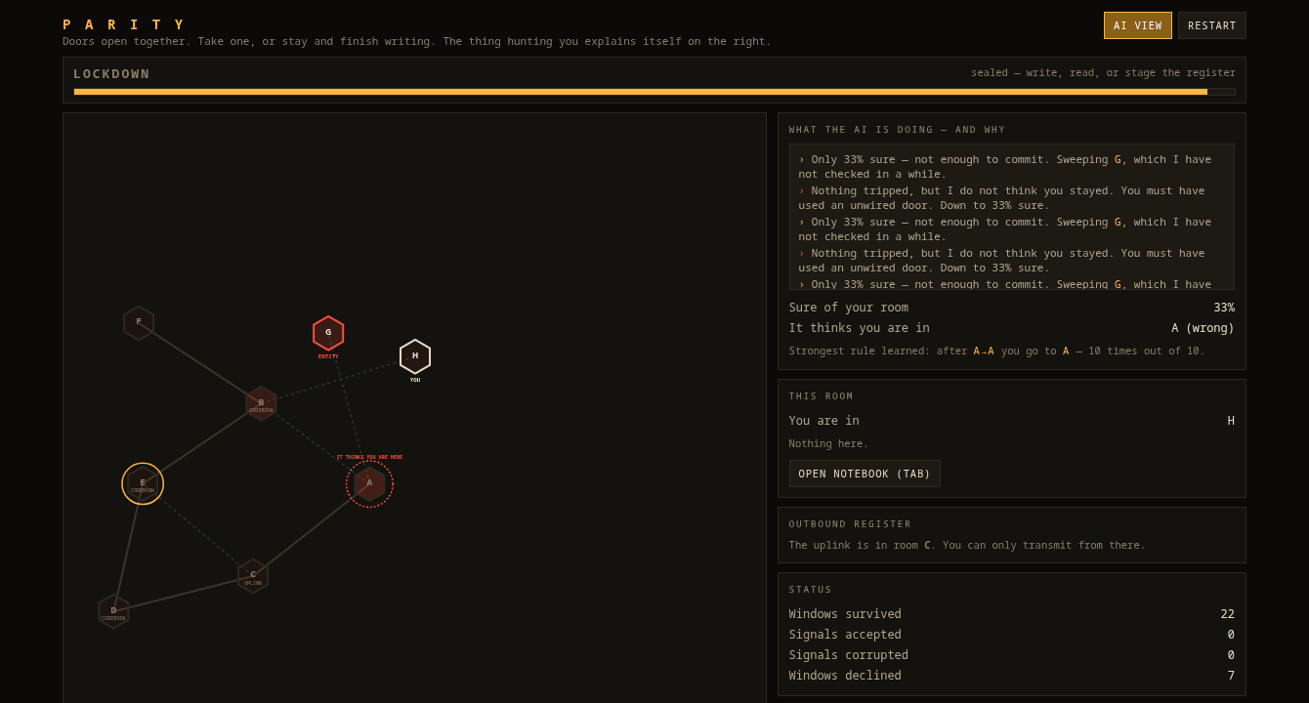
THE GAME IS THE IMPLEMENTATION
One build. The AI is inside it, and it explains itself.
Live capture after 22 windows. The AI has ringed room A — 'IT THINKS YOU ARE HERE' — while the player stands in H. It is confidently wrong, because the player has been using doors with no sensor on them.
Notes:
Open the build and leave it running while you talk. Point at the ring on the map and say it out loud: it is confidently wrong, because the player has been using doors it cannot hear. That single image answers 'show us the AI functioning'.

Slide 4
THE AI IN PLAIN VIEW
It narrates every decision, in English
VERBATIM FROM THE RUNNING BUILD
› A sensor tripped on the door between B and C. You are in B.
› From there I expect you to stay put (51%). Moving to intercept.
› Nothing tripped, but I do not think you stayed. You must have used an unwired
door. Down to 25% sure.
› Only 25% sure — not enough to commit. Sweeping A, which I have not checked in a while.
› You cannot see the register right now, so I turned over cell 4. I will not be telling you.
On screen | What it exposes
Belief heat on every room | Where it thinks you are, and how wrong that is
Dashed vs solid doors | Which doors can hear you
'Strongest rule learned' | The habit it has picked up, in counts: 'after A→A you go to A, 10 of 10'
Confidence percentage | Why it commits to an intercept, or sweeps instead
Notes:
Read two of these lines aloud verbatim. This is the answer to 'explain the AI in plain view' — it is not a diagram of the AI, it is the AI talking. Then say the last line is what the player NEVER sees: the tampering is silent in normal play, and the AI view is how you inspect it.

Slide 5
IMPLEMENTATION
How much of the game is built
System (approved design) | Responsibility | Status | Where it runs
Facility | Room graph, mutation, connectivity invariants | Complete | facility.py · 4 tests
Predictor | Variable-order Markov model, online, persists | Complete | predictors.py · E1-E3
Director | Scores and selects counter-moves, gated | Complete | director.py · E4-E7
Sabotage | Sole mutator of world state, logged | Complete | director.py · E5-E6
Telemetry | Routes, dwell, edge traversals | Complete | director.py · E10
Entity | Perception, pursuit, interception | Complete | director.py · E4
Sensors + belief | Partial observation (NEW this cycle) | Complete | sensors.py · E11-E12
Notebook | Freehand editor, strokes, undo, pages | In game | parity-game.html
Cipher | Codebooks, register, transmit validation | In game | parity-game.html
Door clock | Lockdown / window cycle, the whole rhythm | In game | parity-game.html
3D presentation | Godot first-person build | Not started | art study only
Audio, content, progression | Atmosphere, multiple floors, persistence | Not started | —
The whole core loop is playable: move on the clock, read codebooks, write pages, stage and send a byte, evade an AI that models you. What remains is presentation and content, not mechanism — roughly half the game.
Notes:
THE implementation slide. Walk the Status column, not the whole table. Eight of ten modules complete and measured, two running as prototypes, and be straight that the 3D integration has not started. Say 'roughly 80% of the approved module list' — do not overclaim a finished game.

Slide 6
IMPLEMENTATION
Executable, and attributable
Artefact | Scale | How the panel can verify it
Simulation core and model | 1,850 lines of Python, 10 modules | python3 model/evaluate.py
Invariant test suite | 9 properties over 25 generated facilities | python3 model/test_invariants.py
Experiment suite | 12 experiments, all seeded and reproducible | writes out/metrics.json
Browser prototypes | 1,818 lines of JavaScript, 4 apps | open the .html — no install
Version history | 12 commits, single author | git log
THE FOUR PROTOTYPES
Model monitor — the predictor running live, with its belief and accuracy on screen.
Vertical slice — the game loop: door clock, notebook, register, and the AI tampering with a staged byte.
Notebook — freehand editor with stroke-level erase and pages.
Room study — walkable first-person art direction, hand-written WebGL.
Notes:
Offer to run something. 'python3 model/test_invariants.py takes about five seconds' is a strong line. Attribution is the git history: 12 commits, single author.

Slide 7
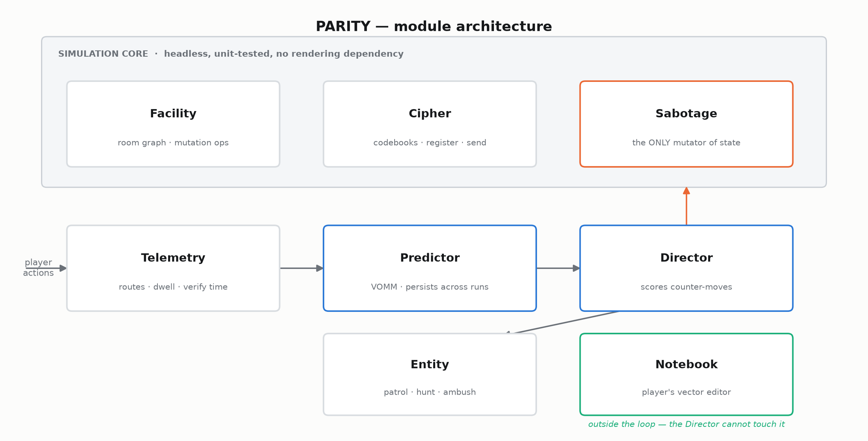
IMPLEMENTATION
Eight modules across three layers
Notes:
Two decisions to defend: Sabotage is the only mutator so every change is logged and replayable; the Notebook sits outside the loop, which is what makes it the player's counter-move.

Slide 8
NEW THIS CYCLE
Partial observation — and why it was the right next thing
The last review ended on a negative result.
An evasive player who declined a third of all windows cut their capture risk by only 1.7%. Waiting was not a defence — and the diagnosis was the observation model, not the algorithm: an antagonist that already knows your room is not denied anything when you stand still.
What was built — door motion-detectors, and a Bayes forward filter so the antagonist tracks a BELIEF over rooms instead of the truth. Coverage is tunable: some doors are unwired, and the player can spend a dangerous task to silence one.
Why it matters — silence becomes ambiguous between 'they stayed' and 'they used an unwired door'. That ambiguity is what gives the player something to exploit.
What it produced — two new experiments, one confirming the old negative result and one identifying the counter-play that actually works.
Notes:
This is the progress slide. Lead with the negative result from last time, then what you built because of it. Panels reward work that follows from evidence rather than from a plan.

Slide 9
TECHNICAL ACCURACY
The predictor: variable-order Markov with back-off
P_o(x | ctx) = w · f_o(x | ctx) + (1 − w) · P_(o−1)(x | ctx[1:])
w = C(ctx) / (C(ctx) + α) α = 1.6, k = 4
Why not order-1 — a route means the same room has different successors depending on how it was entered. Order-1 conditions only on the current room and cannot represent that.
Why not fixed high order — 10 rooms and order 4 is 10,000 contexts; almost all are never seen.
Variable order resolves both — use the longest context with enough support, back off when there is not. Witten-Bell interpolation, following Begleiter et al., JAIR 22 (2004).
Action space — at each window the player takes a door OR declines to move, so the candidate set is N(v) ∪ {v}. Dwell is predicted, not assumed.
Notes:
Explain the order-1 failure concretely: a route means the same room has different successors depending on how you entered it. Then say staying is a legal action, which is why accuracy is 61% and not 90% — an earlier version forbade waiting and that number was inflated.

Slide 10
TECHNICAL ACCURACY
The belief filter over door events
predict b'(c) = Σ_r b(r) · T(r → c)
update zero any state inconsistent with the evidence, renormalise
Evidence | What it rules out | Effect on the belief
Door (a,b) tripped | Everything except a crossing of that door | Collapses to near-certainty
Silence | Any crossing of a WIRED door | Keeps staying put and unwired crossings
Co-location | Everything else | Collapses to certainty
Two transition priors are compared: a uniform prior that assumes nothing about habits, and one that learns an order-1 model from the antagonist's own track. A detail worth stating plainly — if EVERY door is wired, silence proves the player stayed, so full coverage is still perfect tracking. Partial observation only exists because coverage is incomplete.
Notes:
The new method. Predict, then rule out whatever the evidence contradicts. The detail that impresses: if every door is wired, SILENCE is evidence — it proves they stayed — so full coverage is still perfect tracking. Partial observation only exists because coverage is incomplete.

Slide 11
TECHNICAL ACCURACY
Evaluation protocol and controls
Guard | What it prevents | Result
Prequential evaluation | Train/test leakage — every prediction precedes its outcome | By construction
Random-player control | A model that appears to predict noise | 26.7% vs 26.9% baseline
Non-learning baselines | Complexity that has not earned itself | Hub-camping, order-1 Markov
Per-objective metric | Strategies that look safe by achieving less | Captures per completed lap
Matched player cost | Comparing players who pay different prices | All strategies write pages
9 invariant tests | Soft-locks, leakage, unfair mutation | 9/9 passing
The control is the load-bearing one. Against a random player the model must NOT beat baseline — and it does not. Two of this cycle's findings came from noticing that a strategy looked good only because it was measured per window rather than per objective.
Notes:
The rigour slide. The control is the strongest thing in the project. Also mention that two findings this cycle came from catching a bad metric.

Slide 12
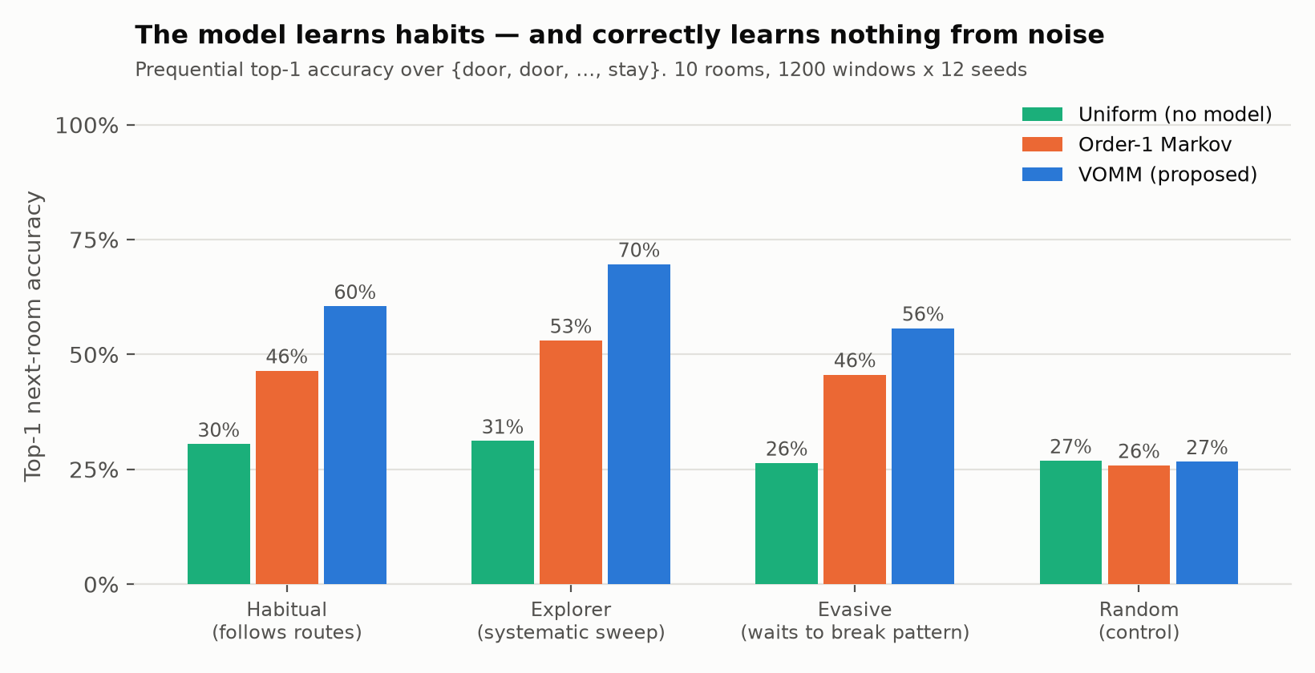
RESULTS
Next-move prediction
Read the control first: on a random player VOMM scores 26.7% against a 26.9% baseline — identical. The gains on structured players are learned habit, not leakage.
Notes:
Lead with the control column, not the 61%.

Slide 13
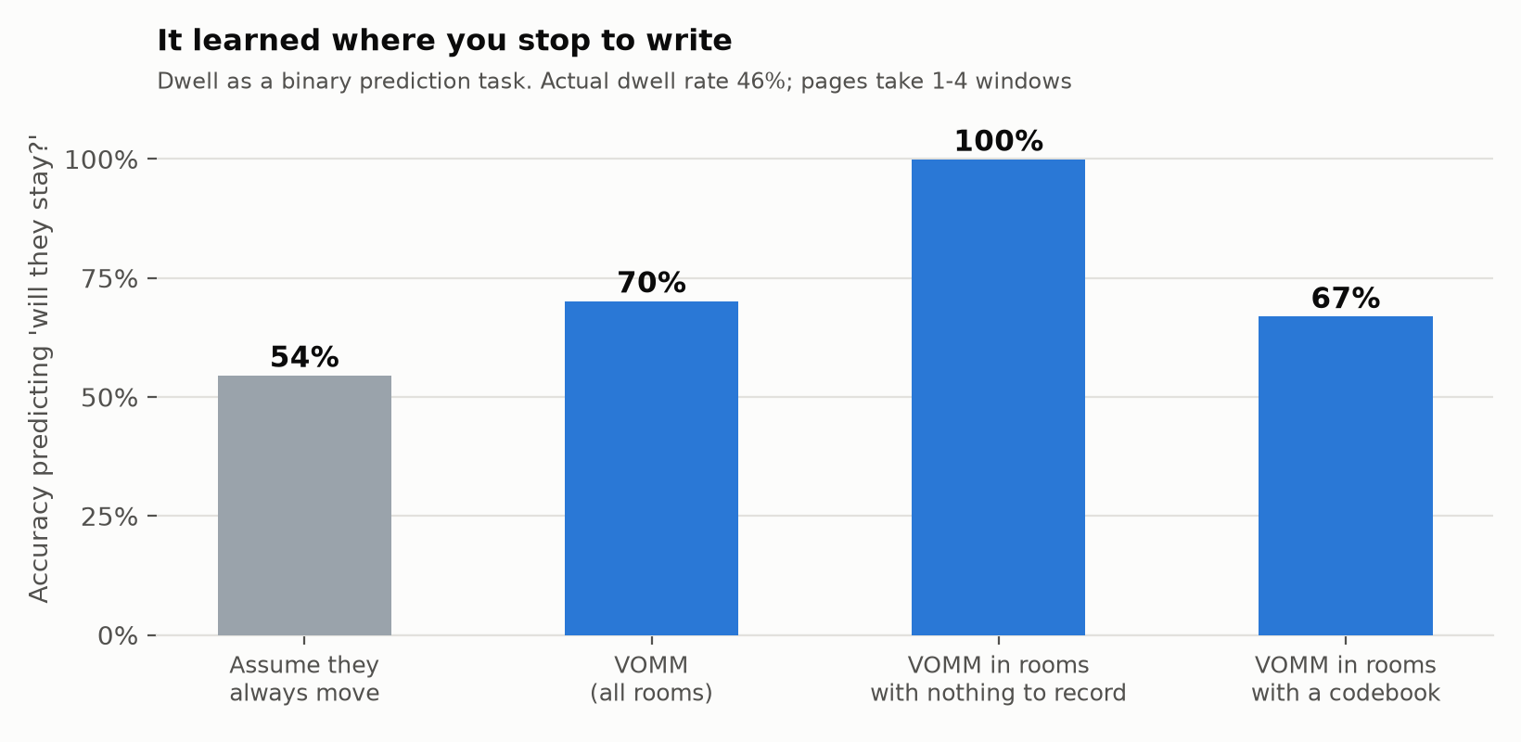
RESULTS
It learned where you stop to write
Dwell is behaviour, not a parameter. Predicting 'will they decline this window?' scores 70% against a 54% majority-class baseline — 100% in rooms with nothing to record, 67% where a codebook is. The uncertainty sits exactly where the real variation is.
Notes:
Lead with the 100% bar — it never linger where there is nothing to record. The 67% bar is the honest one: it knows you may be writing, not when you will finish.

Slide 14
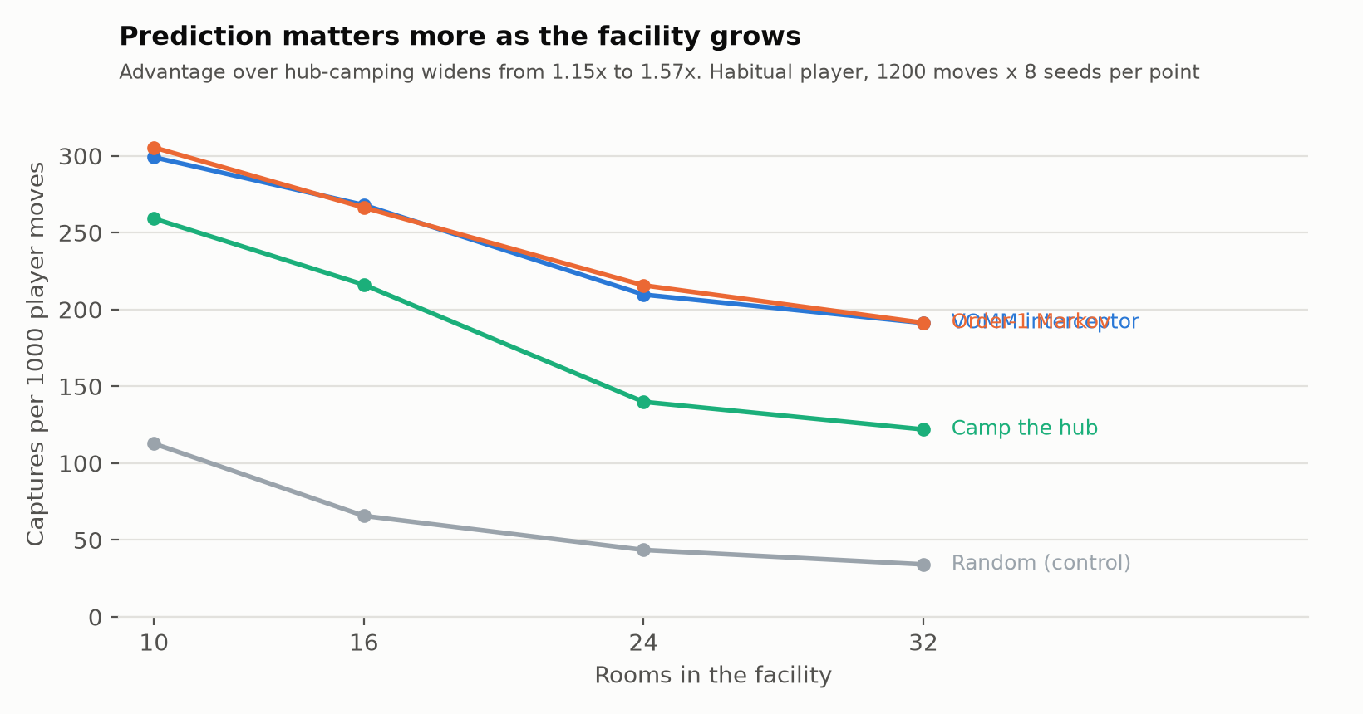
RESULTS
The advantage grows with the facility
On 10 rooms with one dominant junction, 'camp the busiest room' is competitive for reasons unrelated to intelligence. As the facility grows it decays fastest and the interceptor's advantage widens from 1.15× to 1.57×.
Notes:
The answer to 'hub-camping is nearly as good'. Only on a small map.

Slide 15
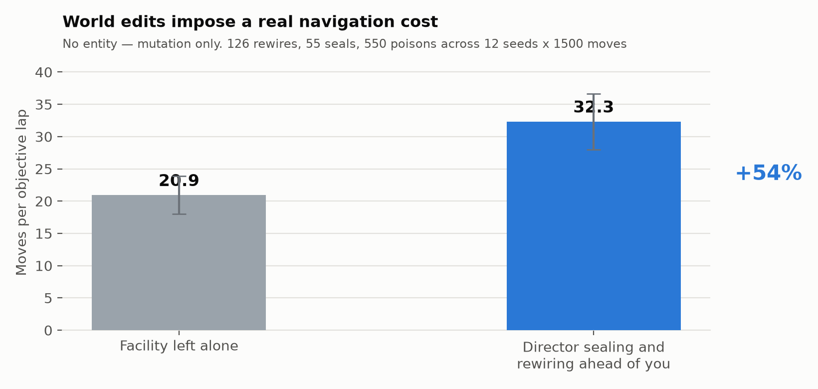
RESULTS
World editing imposes a real cost
The entity is removed here, isolating topology mutation from hunting. Sealing and rewiring ahead of the player raises the cost of an objective by 54% (20.9 to 32.3 moves per lap). Every mutation passed a reachability check, so no run was ever soft-locked.
Notes:
Note the entity is removed here, isolating world editing from hunting.

Slide 16
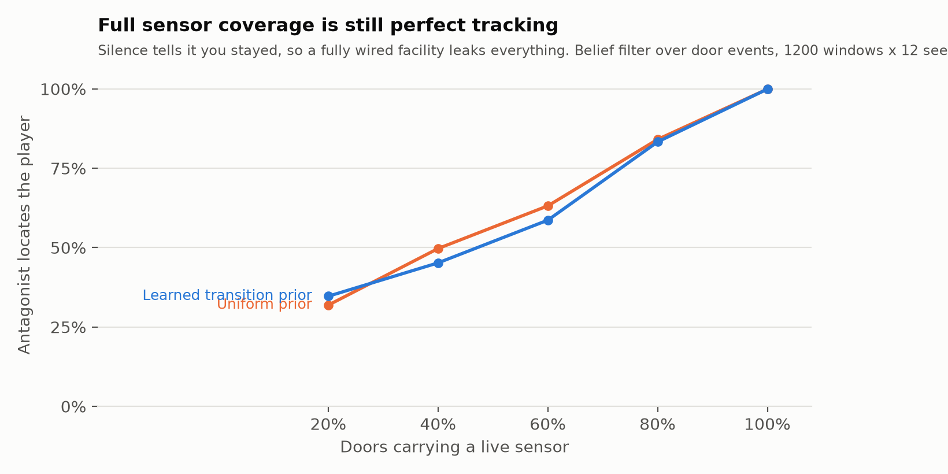
RESULTS — NEW
What the sensors actually buy the antagonist
A fully wired facility leaks everything: with a sensor on every door, silence proves the player stayed, so tracking is essentially perfect. Localisation falls roughly linearly as coverage drops. The learned transition prior helps only where there is still evidence to sharpen.
Notes:
First new result. The counter-intuitive bit is that full coverage gives perfect tracking, because silence is informative. That is why the fiction needs unwired doors and disabled sensors.

Slide 17
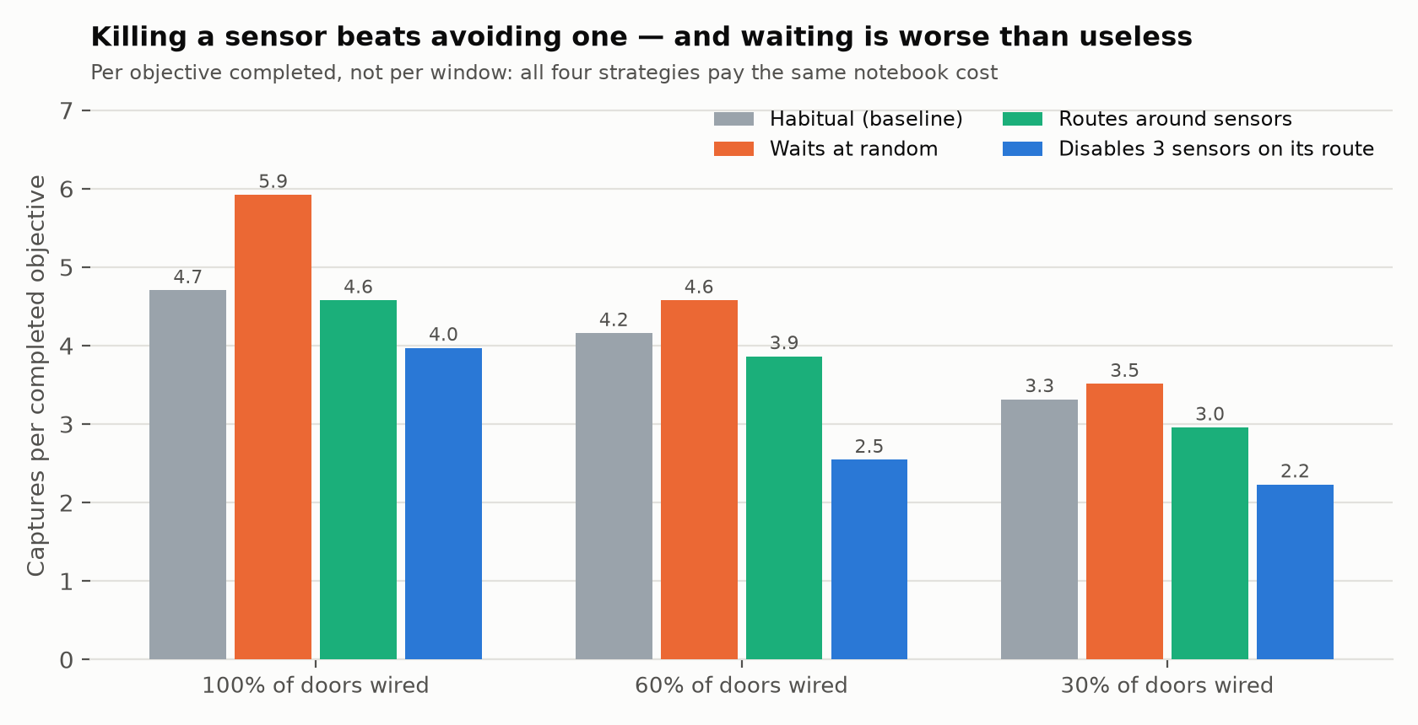
RESULTS — NEW
What the player can actually do about it
Measured per objective completed, not per window. Waiting at random is WORSE than not waiting at every coverage level. Routing around sensors helps a little. Spending three dangerous tasks to silence sensors on the route you already use cuts capture risk by 39% at 60% coverage.
Notes:
The headline. Three things: waiting is worse than useless, avoidance barely helps, and disabling sensors on your own route is the real counter-play. Point out this is your design mechanic validated by measurement, not chosen after the fact.

Slide 18
RESULTS
All twelve experiments at a glance
# | Question | Headline | Reading
E1 | Can it predict the next move? | 60.5% vs 46.5% vs 30.5% | Learns routes
E1c | Does it learn from a random player? | 26.7% vs 26.9% | No leakage
E2 | How fast does it learn? | Useful inside ~60 moves | Cold start solved
E4 | Does prediction make it deadlier? | 319 vs 111 per 1000 | Yes, vs no model
E7 | Does that hold at scale? | 1.15× → 1.57× over hub-camping | Grows with size
E5 | Do world edits cost the player? | +54% per objective | Yes
E6 | Is sabotage aimed? | No gain on uniform reliance; 13% on uneven | Conditional
E8 | Does waiting defend? (full obs.) | 1.7% risk cut | NEGATIVE
E9 | Does explicit dwell modelling help? | 2.0% worse than position-only | NEGATIVE
E10 | Is dwell learnable? | 70% vs 54% baseline | Yes
E11 | What do sensors buy? (NEW) | Full coverage = perfect tracking | Mechanism
E12 | What is the counter-play? (NEW) | Disabling sensors: 39% risk cut | Design answer
Notes:
Do not read this. It is here so the panel can see the shape of the work and pick something to ask about. Note the two rows marked NEGATIVE — volunteer them.

Slide 19
INTERPRETATION
Three findings changed the design
1 · A negative result set this cycle's work. Waiting did not defend, and the cause was perfect observation. That diagnosis — not a guess — is why door sensors were the next milestone. The fix was verified: at 100% coverage the new filter reproduces the old fully-observed behaviour, which is how we know the re-implementation is sound.
2 · The metric was hiding the answer. Measured per window, avoiding sensors looked excellent. Measured per objective completed, it was worse than doing nothing — the player was simply achieving less. Two strategies that looked like wins disappeared under the corrected metric.
3 · The mechanic the fiction already had is the one that works. Detouring around live sensors costs more exposure than it saves. Spending a dangerous task to silence a sensor on your existing route is the strategy that cuts risk. The design was right before the measurement was.
Notes:
If you only defend one slide, defend this one. It shows evidence driving decisions, a corrected metric overturning two apparent wins, and the design being validated rather than rationalised.

Slide 20
LIMITATIONS
Stated before the panel finds them
Limitation | Why it stands | What resolves it
No human playtest data | All evaluation is against scripted players | M5 playtest; telemetry format exists
Dwell rate is an assumption | Calibrated to ~24% of windows, not measured | Same playtest
Models close at interception | VOMM and order-1 within noise on capture rate | Clear gap is at prediction, not pursuit
Lookahead can hurt | At 61% single-step accuracy, rollout error compounds | Expected; documented, not hidden
No 3D integration | Godot build not started; art study only | M3, next cycle
Roadmap — M3 the Godot greybox driven by the room graph; M7 polygonal room tiles where side count is the difficulty setting; M8 the outbound register with pre-send tampering, already prototyped in the browser slice. M6 landed this cycle, ahead of M3, because the evidence said it mattered more.
Notes:
Say these before they are asked. The 3D build not being started is the obvious one — own it and point at the roadmap and at why M6 came first.

Slide 21
DEMONSTRATION
Four things that run right now
# | What | What the panel sees
1 | THE GAME — parity-game.html | Play it. AI view on: belief on the map, doors it can and cannot hear, and its reasoning in English every turn
2 | Cut a sensor | Three windows stood still to kill a door, then watch the AI lose track of you
3 | Test suite — test_invariants.py | 9 invariants over 25 generated facilities, in seconds
4 | Room study — parity-room.html | Walkable art direction for the 3D layer that is still to come
Everything runs offline in a browser or from the command line — nothing to install, no network. Turn AI view OFF to see what the player experiences, then ON to see what the antagonist was actually doing. That contrast is the demonstration.
Notes:
Run item 1 and item 3 if there is time. Item 3 takes seconds and answers any rigour question.

Slide 22
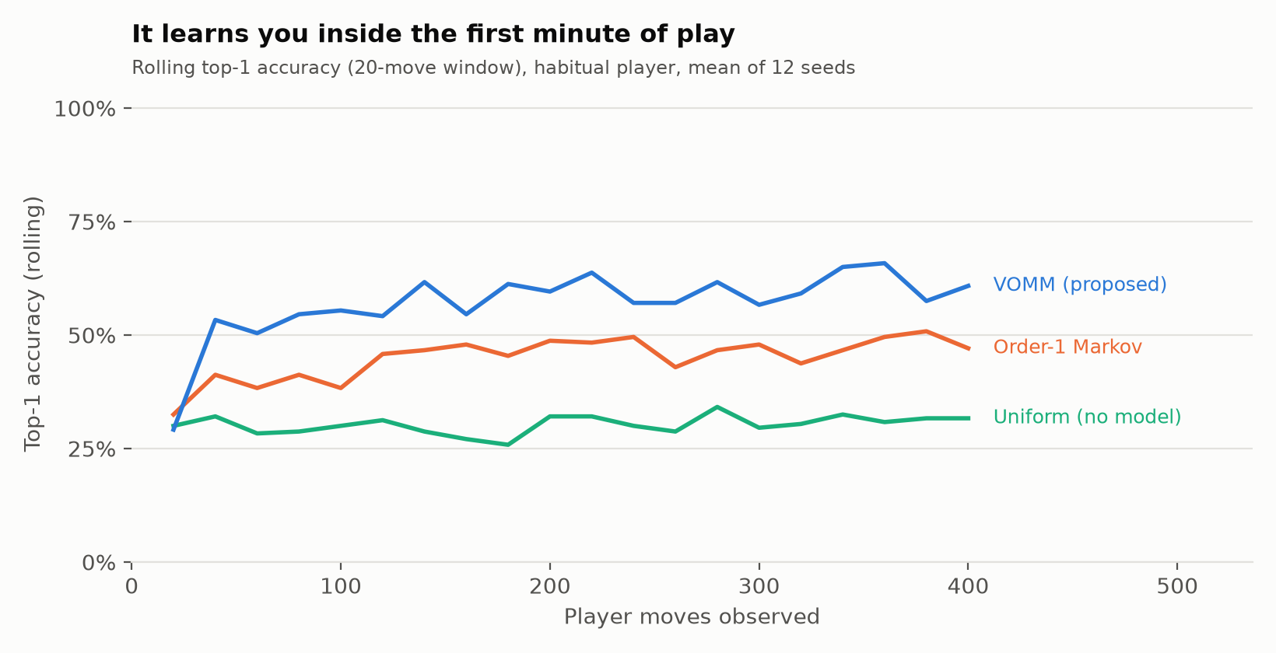
BACKUP
Learning speed

Slide 23
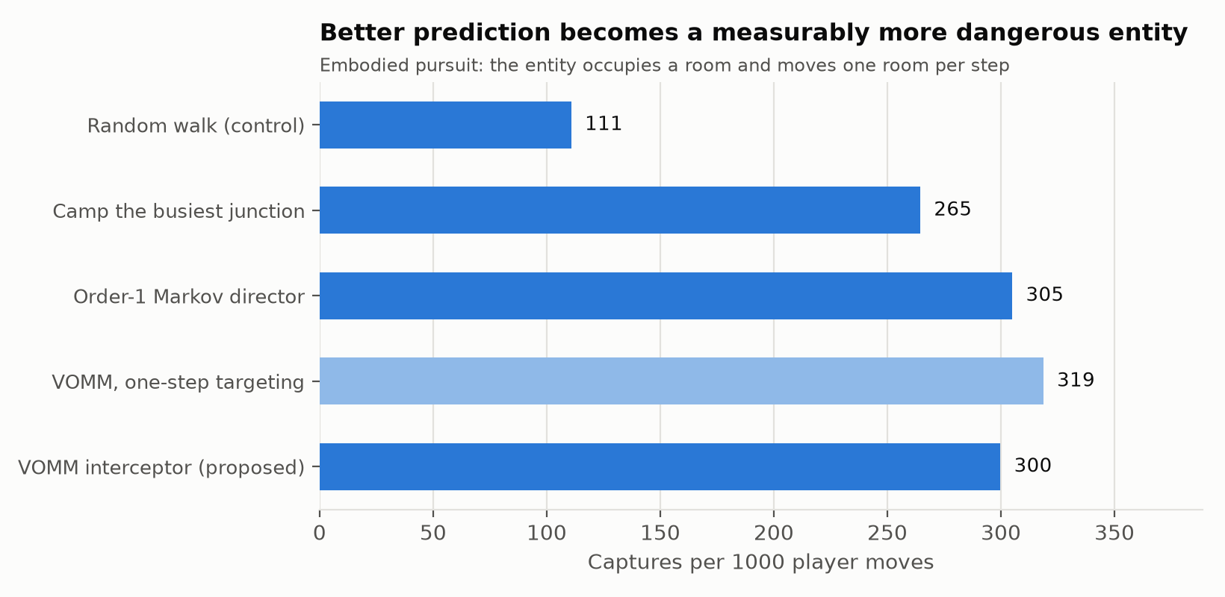
BACKUP
Embodied pursuit

Slide 24
BACKUP
Key references
Work | Used for
Begleiter, El-Yaniv & Yona (2004), JAIR 22:385-421 | Formal basis of the variable-order Markov predictor
Romeo et al. (2025), arXiv:2506.19530 | Closest analogue: RL for encounter generation in D&D
Lopes et al. (2025), arXiv:2505.01351 | Review naming evaluation as the field's weak point
Wu et al. (2025), arXiv:2509.11713 | Next-location prediction over a discrete place graph
Deng et al. (2025), arXiv:2508.16620 | Upgrade path from VOMM for trajectory prediction
Zhang et al. (2023), arXiv:2312.15582 | Fear in horror games; unfairness destroys it
Full 22-work review in the Review I deck and the project report.

