Slide 1
PARITY
An adaptive horror game driven by online player-trajectory prediction
0 1 0 0 1 1 0 1
Shivam Kumar Arya · Parth Jaiswal
B.Tech Computer Science and Engineering (AI & Robotics) · BCSE497J
Vellore Institute of Technology
Notes:
The antagonist builds a behavioural model of the individual player and acts on it. The game is not a wrapper around the AI; it is the application that makes the AI legible.

Slide 2
The problem
01
Game AI has optimised for competence. Adaptation to the individual player is the less-solved half.

Slide 3
Three fields, one gap between them
Each is mature on its own. What is missing is a system that infers, acts and reshapes the world as one loop — and is measured as one.
Player modelling
Adaptive AI and DDA
Procedural generation
Infers intent from telemetry.
Rarely drives the antagonist in real time.
Acts on inference, but usually by
tuning numbers, not by taking decisions.
Changes the world, but offline —
before the player arrives, not in response.
The research gap
No published system closes the loop and reports it against controls. PARITY builds the loop, and measures every claim against a baseline that has no model and a player that cannot be modelled.
Notes:
The gap is not that any one of these is unsolved. It is that nobody runs them as one closed loop and then reports it honestly against a control.

Slide 4
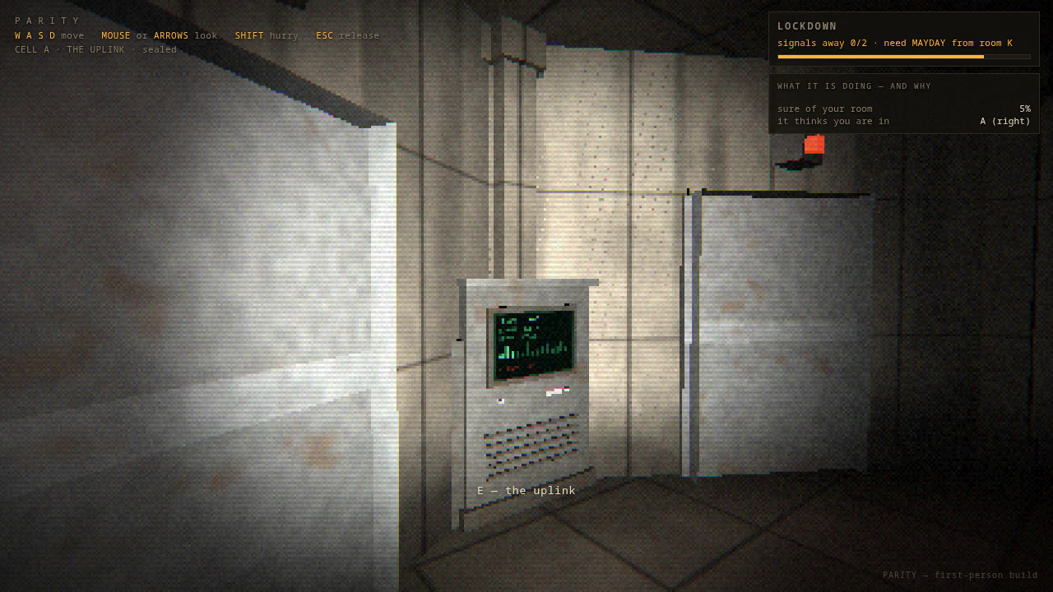
What the player is actually doing
Carry eight bits from a codebook to the uplink and transmit. Twice. That is the whole game.
1
Read a codebook
A lit panel in a room gives a keyword and its eight bits.
2
Write it down
The notebook is freehand and the only record nothing can edit.
3
Carry it to the uplink
Every door in the facility unlocks together for three seconds, then seals.
4
Stage and send
While the byte sits staged and you are away, it may turn one bit over.
Notes:
Keep this short. The point of the loop is that it gives the antagonist a reason to predict you: you must move between known rooms on a known clock.

Slide 5
How it works
02
Three parts: something that predicts, something that localises, and something that decides what to do about it.

Slide 6
Belief, prediction and action are separate
Keeping them apart is what makes each one measurable on its own — and what let us find that one of them was never being called.
Belief filter
Predictor
Director
Where are they now?
Where will they go?
What should I do?
A Bayes forward filter over the room graph, updated from door-sensor events. Silence is evidence too.
A variable-order Markov model with Witten-Bell back-off, learning online from the trajectory it infers.
Intercept, seal a door, rewire the facility, or quietly corrupt a page the player has already copied.
Fairness is a constraint, not a difficulty setting. The antagonist never reads the player's position directly, never edits a room the player is standing in, and never acts below a confidence gate. Nine invariants assert this over 25 generated facilities.
Notes:
The separation is not tidiness. Because the director is its own object, we could test it in isolation — and that is how we found the counter-moves were never being called in any measured experiment.

Slide 7
The predictor: a variable-order Markov model
Long context when the evidence supports it, short context when it does not — decided per prediction, not per model.
Witten-Bell back-off weights a context by how often it has actually been seen, so a rare context defers to its shorter parent instead of guessing from one observation.
Pₒ(x | ctx) =
w · fₒ(x | ctx) + (1 − w) · Pₒ₋₁(x | ctx[1:])
w = C(ctx) / (C(ctx) + α)
α = 1.6 max order k = 4
Staying put is a first-class action. The candidate set is the neighbouring rooms plus the current room — an earlier version omitted it and inflated accuracy by 28 points.
Three attempts to beat it failed
It learns online, from the room sequence the belief filter infers, not from ground truth it is never given.
Grid search over α and k — no gain.
Intent tagging on the context — +0.1 points.
An explicit goal-conditioned variant — 56.7% against the plain model's 59.9%.
The variable-order context already encodes what those modules tried to add.
Notes:
If asked why not an RNN: the honest answer is that we tried three ways to add structure and all three lost to data sparsity. That is a result, and it is in the report.

Slide 8
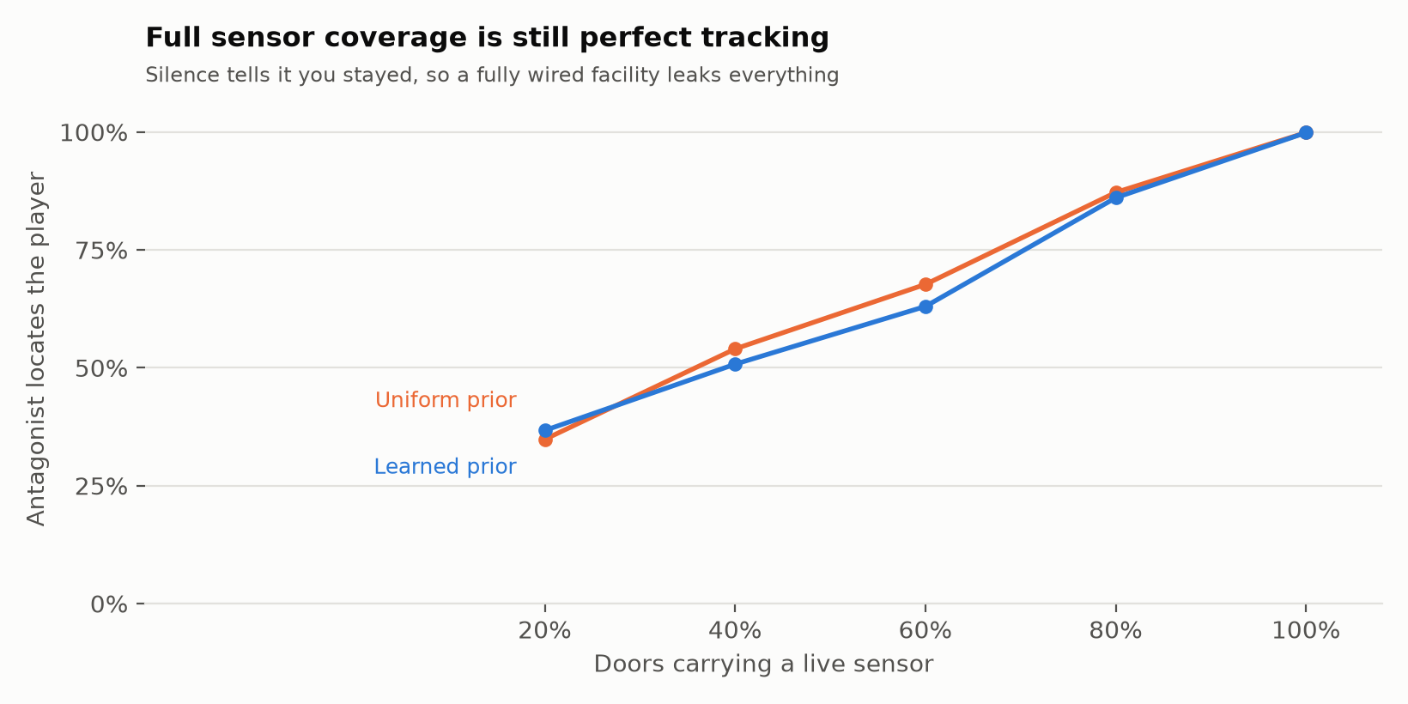
It cannot see you. It hears doors
The antagonist observes motion detectors on doorways, not the player. Everything it believes is inferred from which doors tripped — and which did not.
Silence is evidence
If a wired door did not trip, the player did not cross it. The filter rules out those transitions.
Cutting a sensor is counter-play
A dangerous task buys you a dead door — one the antagonist can no longer hear you use.
But it has a sweet spot
At 60% coverage, killing three sensors cuts risk 21%. At full coverage the same move backfires by 91%.
Notes:
The backfire at full coverage is the most interesting line on this slide. Cutting a sensor removes a door from the antagonist's hearing, but it also removes it from the set of explanations for silence, which sharpens the filter elsewhere.

Slide 9
Results
03
Every number below is prequential — predicted before it was observed — and reported against a control that cannot be modelled.

Slide 10
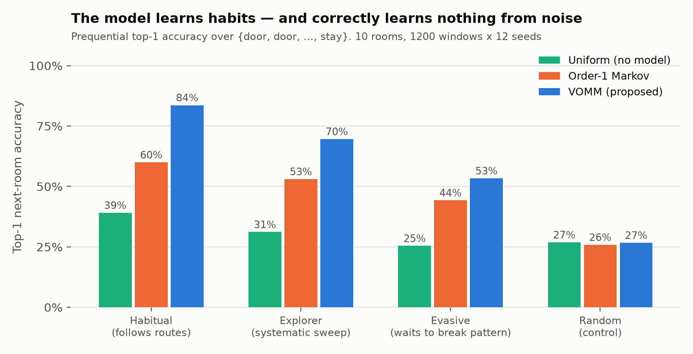
It predicts where you go next
Top-1 next-room accuracy, mean of 12 held-out facilities. The candidate set is the neighbouring rooms plus staying put.
83.6%
against a habitual player,
against 60.0% for order-1 Markov
26.7%
against a random player —
no model scores 26.9%
The control is the row that matters. Against a player with no habits the model performs identically to having no model at all. The gains are learned behaviour, not leakage from the simulator.
Notes:
If a panel member attacks one number, it will be this one — they will say the bots are scripted so of course it predicts them. The random control is the answer: same simulator, same pipeline, no signal to find, and the model finds none.

Slide 11
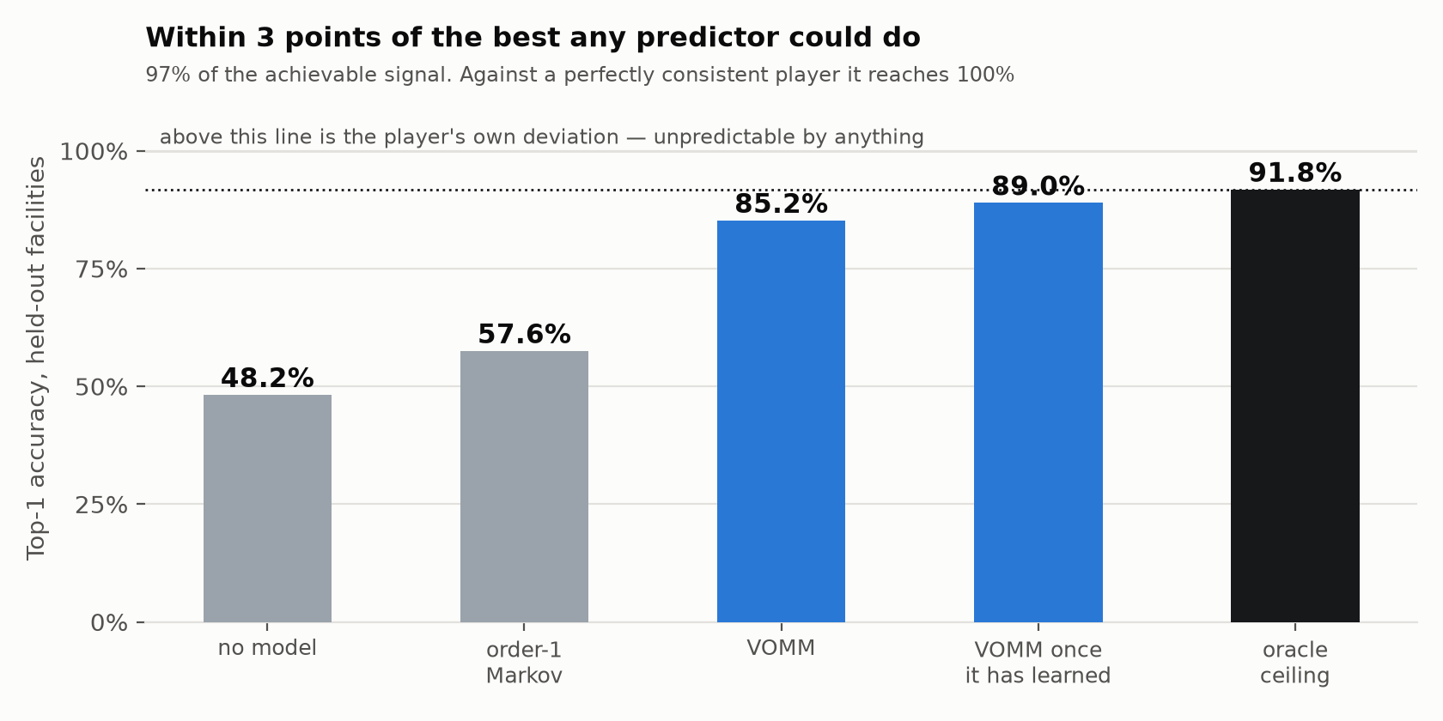
How well trained is it, really?
Accuracy alone does not say whether a model is good — it says how predictable the player is. So we measured the ceiling.
An oracle that cheats
Give a predictor the player's internal state — the room it is walking to, whether it is mid-page — and it reaches 91.8%. That is the ceiling.
The model, from behaviour alone
89.0% once settled. That is 97% of the achievable signal, with no access to anything the player knows.
Against a perfect routine
100%. When the player is genuinely consistent, it is not approximately right — it is right.
Notes:
This reframes the 83.6%. The remaining gap is mostly the player's own randomness, not a modelling failure. Three attempts to close it confirmed that.

Slide 12
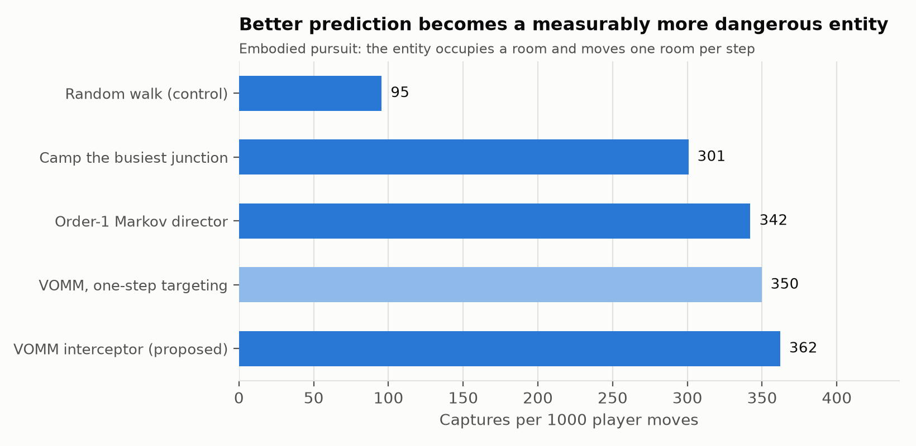
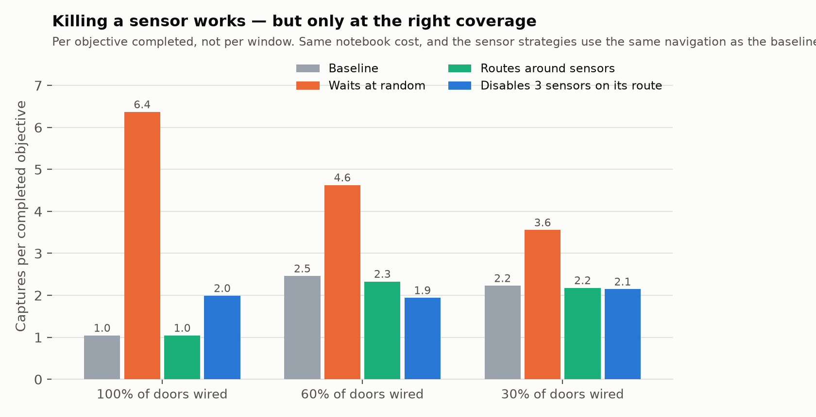
Prediction makes a materially better antagonist
Captures per 1000 moves against an entity that ambushes where the model points, versus no model and versus camping the busiest junction.
Captures by antagonist strategy
Captures per objective by what the player tries
Notes:
Right-hand chart: waiting is catastrophic — +439% at full coverage. Hiding from a model that has learned you wait is the worst thing you can do. That is the design working.

Slide 13
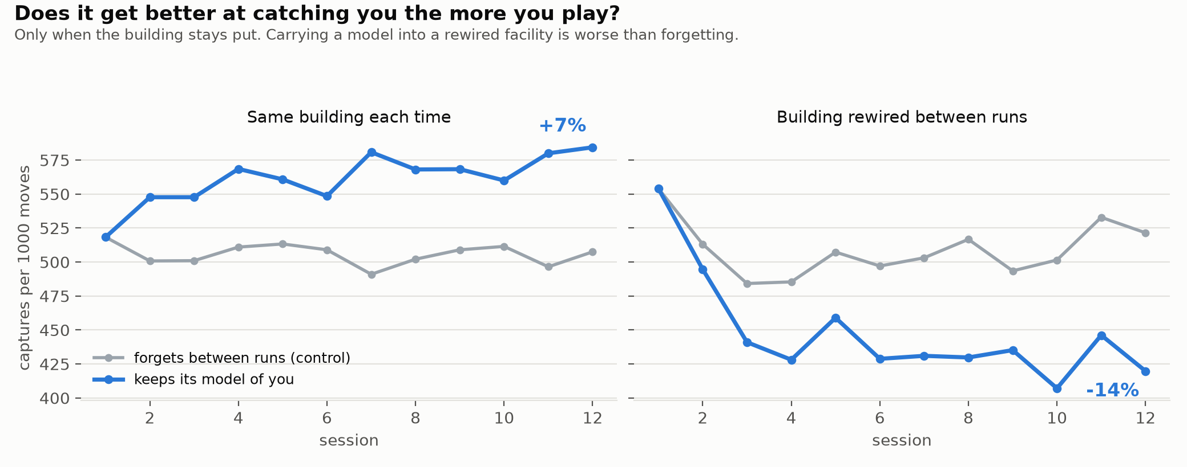
Does it get better the more you play?
The game claims your pages survive and so does its model of you. Twelve consecutive sessions, everything reset but the predictor — each against a control that forgets.
+6.9%
-14.5%
Both controls are flat. The trend is retained learning, not the player settling into a route.
more captures by session 12
when the building stays put
when the building is rewired —
carrying the model is worse than forgetting
Notes:
This is the newest result and the one to dwell on. It also found a design bug: the shipped build regenerates the facility on re-entry, which is exactly the condition where memory hurts — so the line the game delivers on the death screen is currently false. Report section 7.8.

Slide 14
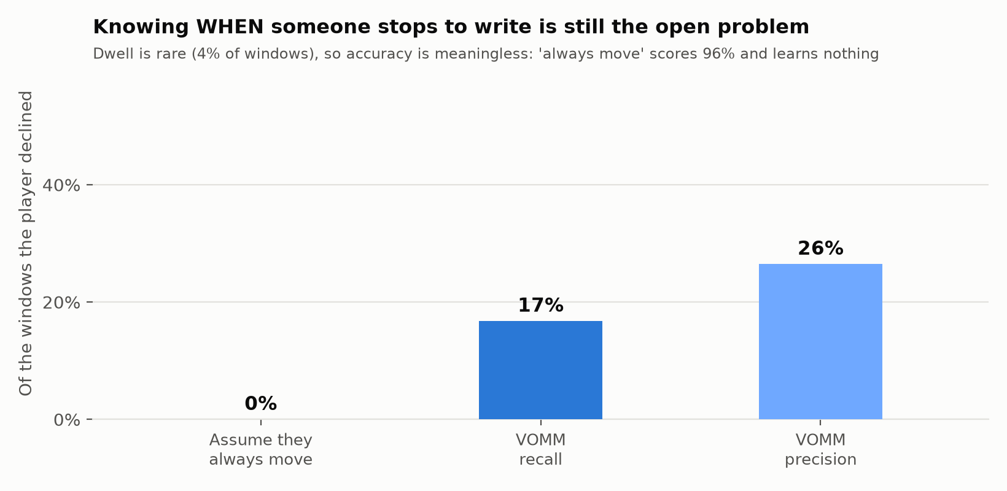
The open problem: knowing when you stop to write
Once the player writes realistically — each codebook copied once, not re-copied — pausing becomes rare, and accuracy stops meaning anything.
4.4%
16.8%
of windows are a pause —
so “always move” scores 96%
recall on the rare event,
against 0% for that baseline
Why this is the honest weak spot. Recall is the right measure for a rare event and 16.8% is not good. Four attempts to improve it, including an explicit first-visit feature, each made it worse: every one split the context and lost more to sparsity than it gained in signal.
Notes:
Lead with this if asked what does not work. Naming your weakest result before the panel does is worth more than defending it.

Slide 15
The build
04
The game is not a wrapper around the model. It is the thing that makes the model visible while you are losing to it.

Slide 16
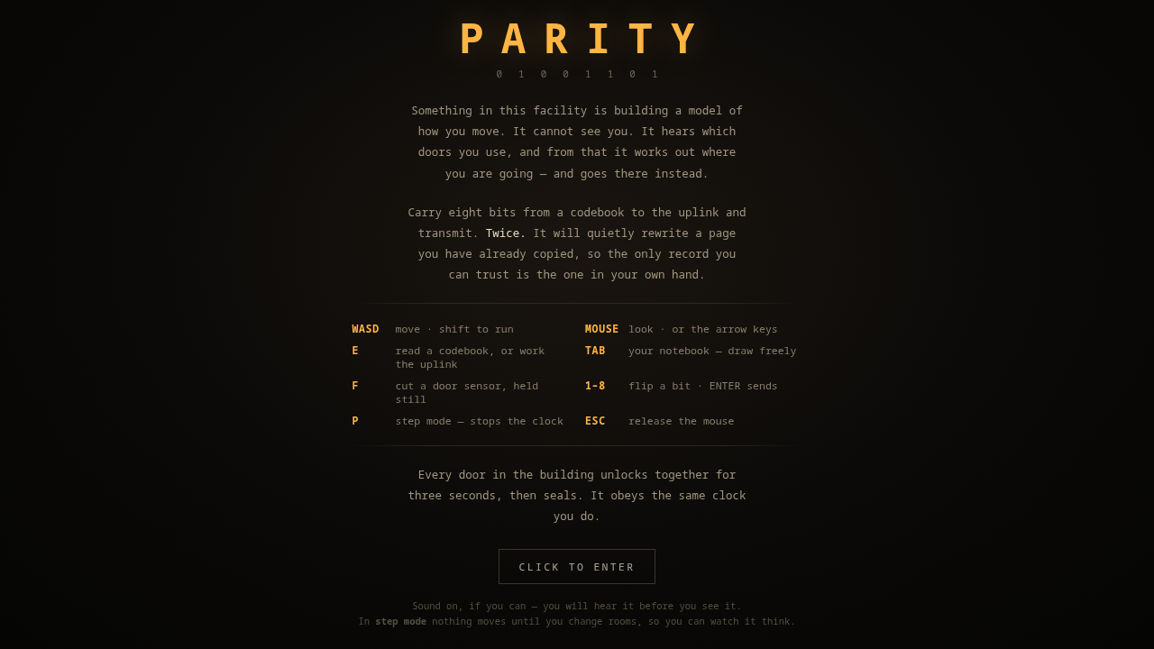
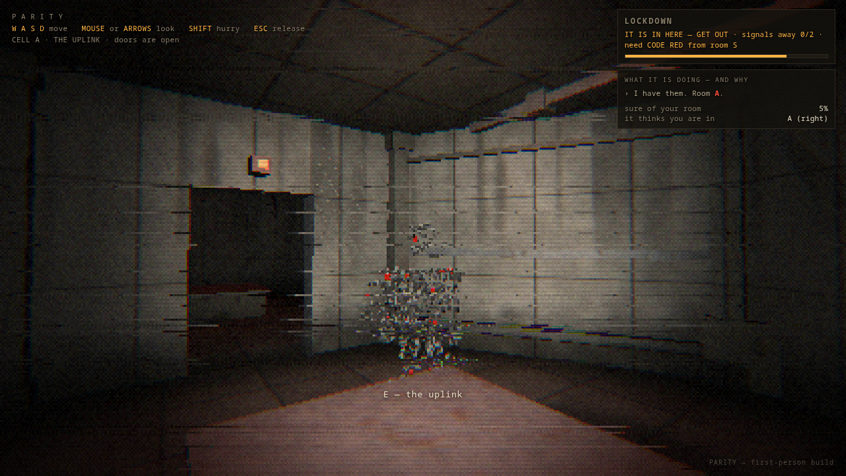
Playable, in a browser, with the AI on screen
Hand-written WebGL2. 19 rooms, a door clock, synthesised audio, and a panel that narrates what the antagonist believes and why.
The facility, before you enter
A codebook room — the panel you must copy
It is in the room with you
Step mode (P) stops the clock and gives the antagonist exactly one turn per room you enter, so a belief update, a prediction and an interception can each be read out loud instead of raced.
Notes:
Demo in step mode. Walk one room, pause, read the belief panel aloud, then take the next step. Do not try to play it properly in front of the panel.

Slide 17
What shipped, and how it was verified
The model was not touched by the build work — which is itself a claim that had to be checked, not asserted.
1
A new facility every run
2
An antagonist made of its model
Seeded generation, so the layout cannot be memorised between sessions.
The figure is built from the prediction it is acting on, shown as an echo.
3
Doors, light and sound
4
An automated player
Panels that seal on the clock, lights that react, and audio synthesised at runtime — no asset files.
Drives the real build through the real input path, and records a playthrough to video.
9 / 9 invariants hold over 25 generated facilities · automated player completes the objective on all 12 seeds tested · every figure regenerates from one command
Notes:
The verification line matters more than the feature list. Anything in this deck can be reproduced with python3 model/evaluate.py.

Slide 18
What this work does not establish
Stated plainly, because the limits are a result too.
Nobody has played it
The players are scripted
Every behavioural parameter — the deviation rate, the writing model — is an assumption. Claims about fear, difficulty and enjoyment are untested.
A Markov model predicting a scripted agent is a weaker claim than one predicting a person. Human traces are the single highest-value next step.
Memory does not transfer
Dwell is unsolved
Retained learning helps in a fixed building and hurts in a regenerated one. The predictor is keyed on room indices, and an index stops meaning the same thing.
16.8% recall on the moment the player stops to write, after four failed attempts to improve it.
Notes:
Say all four out loud. A panel that hears you name your own limits stops hunting for them.

Slide 19
Where it stands
A horror antagonist that models the individual player, and a measurement that says how well.
It predicts the next room 83.6% of the time against a habitual player, and 26.7% against one with no habits — which is exactly what having no model scores. The gain is learned behaviour, not leakage. Against an oracle that can see the player's internal state, it reaches 97% of the achievable signal from behaviour alone.
It gets better at catching a returning player, and we now know the one condition where it does not.
Next: human playtest traces in place of scripted players, and a predictor re-keyed on features that survive a rewired building.
github.com/Sh1v4mKum4r/parity
Notes:
Close on the second-to-last line. The project set out to make a predictive AI the player can feel, and the measurement that it works is the deliverable.

