Slide 1
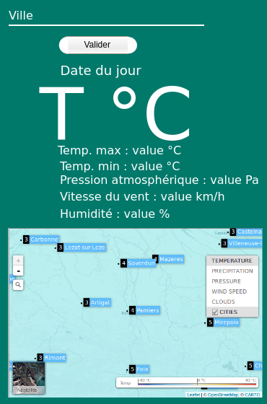
Wireframe Version Mobile

