Slide 1
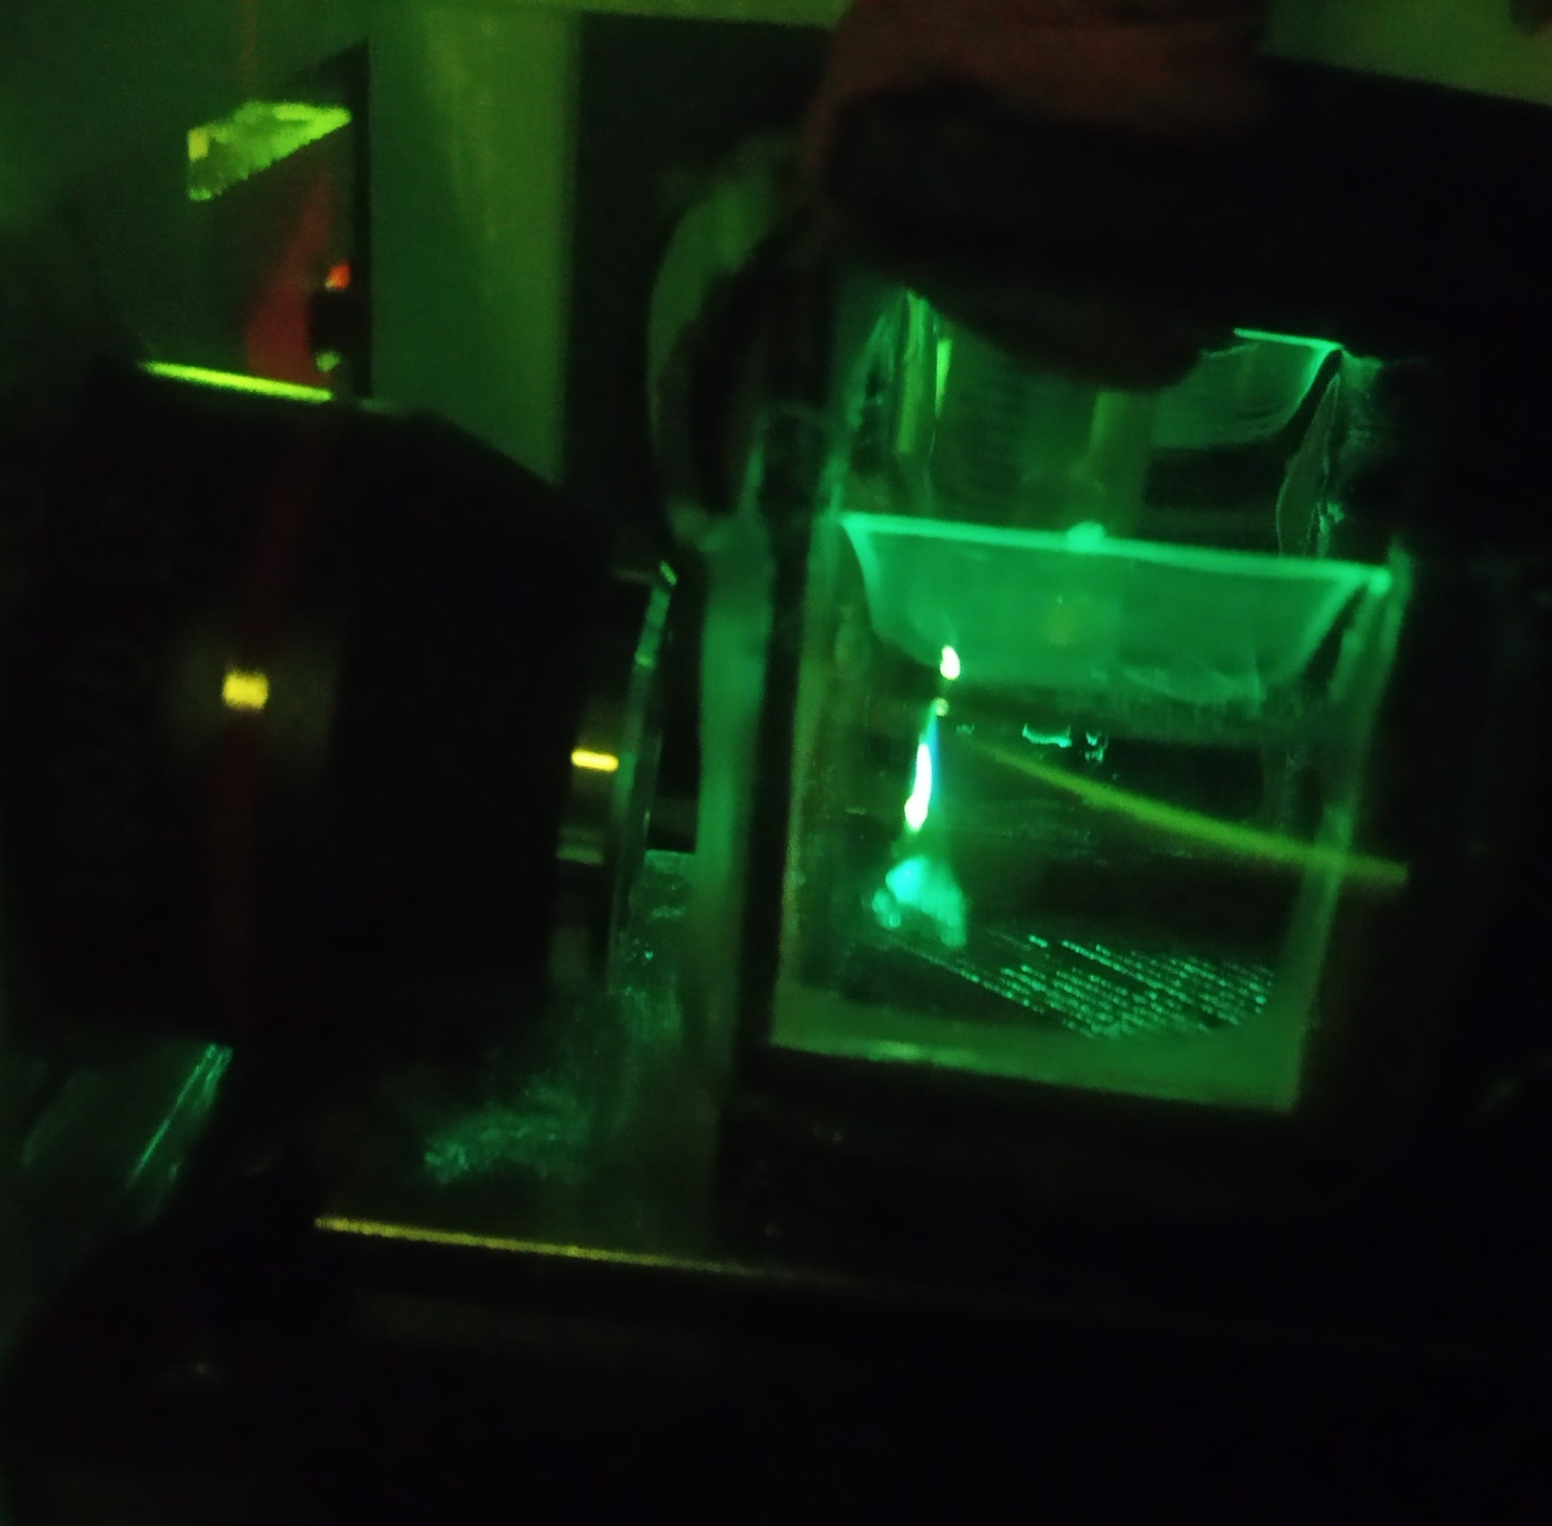

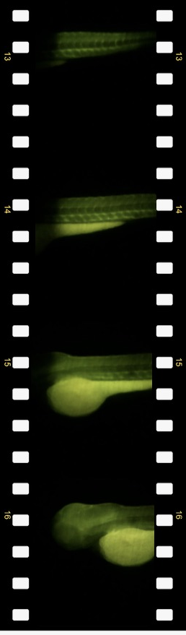


Lichtblattmikroskop
Kamera
Laser
Fluoreszierend Zebrafisch
iPhone Linse
Filter
„Fernrohr“
Sammellinse
fokussieren
Objektiv
(Detektion)
4×
Zylinderlinse
Probe
4×
Spiegel
Probe scannen
Objektiv
(Beluechtung)
YOU
SEE,
TOO
useetoo.org

Slide 2
Light sheet Microscope
Assembly
Laser
Beam Expander
Cylindrical Lens
Mirror
Illumination Objective
Sample Stage
Z-Stage
Camera + Filter
Camera
Laser
Filter
iPhone Lens
„Telescope“
Alignment
Convex Lens
focus
Laser centered
Beam colimated
Light sheet focused in the center of the S-stage, in the height of the detection objective
Sample plane focused on camera
Light sheet aligned to the sample plane
Objective
(Detection)
10×
Cylindrical Lens
Sample
4×
Kinematic
Mirror
Z-stack
acquisition
Objective
(Illumination)
YOU
SEE,
TOO
useetoo.org

Slide 3



Smartphone Mikroskop
„Endlichoptik“-Mikroskop
Die Smartphone Kamera hat eine Linse mit kurzer Brennweite um ein Bild auf dem Kamera-Sensor zu erzeugen. Die Abbildungseigenschaften verhalten sich somit ähnlich wie das menschliche Auge.
LED
oder
Smartphone
fokussieren
Kamera
Objekt
Objektiv
10×
20×
Make sure that the exit pupil of the eyepiece fills the field of view of the smartphone camera.
Okular
(leer)
Vergrößerung
Spiegel
Spiegel
$V= V_{Objektiv}× V_{Okular}$
YOU
SEE,
TOO
useetoo.org

Slide 4

Smartphone Microscope
„Finite-corrected“ microscope
The smartphone camera has a short focal length lens to create an image on the camera sensor. The imaging properties are therefore similar to those of the human eye.
LED array
or
Smartphone
focus
Camera
Sample
Objective
Z-stage
10×
20×
Make sure that the exit pupil of the eyepiece fills the field of view of the smartphone camera.
Eyepiece
(empty)
Mirror
Mirror
Magnification
$m= m_{Objective}× m_{Eyepiece}$
YOU
SEE,
TOO
useetoo.org

