Slide 1
Project 601- Drones
Shlomo Assaf and Tomer Bahar

Slide 2
Overview
The drone simulation is implemented using Python programming language and utilizes the PyGame library for the graphical user interface (GUI).
This simulation can create diverse environments. Using open-source GIS data into the simulation. Or generation of random environments, providing flexibility in testing and experimentation.
The simulation incorporates a server component that can efficiently manage and monitor multiple drones simultaneously.
In this simulation we can control a drone's movement by giving it a velocity vector, the simulation support both getting commands from the user or a RL controller that provide this vector and try to learn the best way to get to the destination.

Slide 3
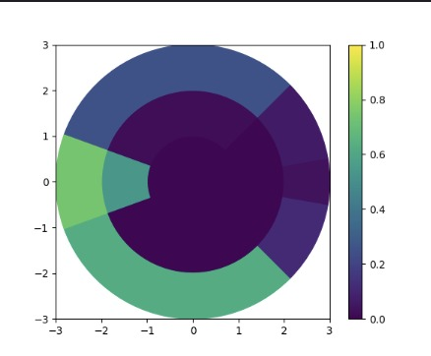
The Drone
The Radar
Is a 2D(3D) radar that divides its view into regions and scopes, this way it has less states to calculate and the learning can be more effective
Radar
GPS
Battery
Motion Control
Drone

Slide 4
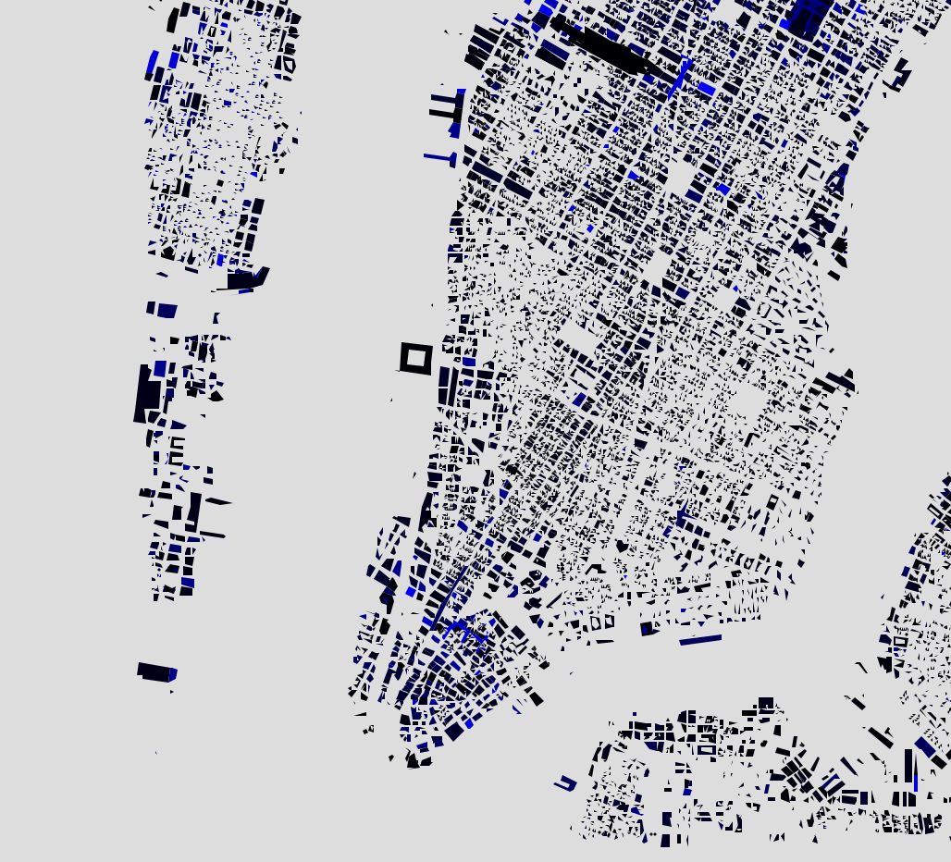
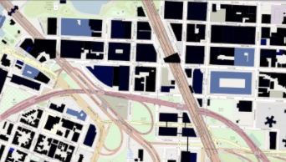
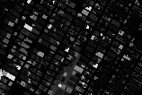
The Map
In order to make the simulation more realistic we put an effort to create a tool that generate 1 pixel per meter map.
First we extract geojson building data from open steet map.
Using folium library we manage to draw the building on street map (similar to google maps)
Then using scraping we were able to make the finial map. (stitching small images downloaded separately).

Slide 5
The Graphs – Neo4j
A major challenge encountered during the calculation of drone routes was the complexity of the 3D map, which proved too intricate to compute within a reasonable timeframe.
To address this issue, we implemented a graph-based approach to explore all possible drone movement options. While the calculation process may take some time (depending on the user's computer), the resulting graph is stored on a server for future reuse, particularly when operating within the same map.
For this purpose, we employed a service named neo4j for the graph server.
Neo4j is a graph database management system that excels in storing and querying graph data structures, offering efficient traversal and manipulation capabilities essential for our drone route optimization tasks.

Slide 6
UML
Environment
Drone
GPS
Pre-game map generator
RL
Motion Controller
Power management
Radar
PyGame Handler
Environment info server
Graph server
Drone server

Slide 7
Reinforcement learning
Overview - State:
18 radar features (6 regions * 3 scopes) +
relative_angle, velocity_magnitude, target_magnitude, target_angle, battery_level
Each feature is normalized.

Slide 8
Reinforcement learning
Overview - Reward:
Terminate episode if : out of bounds\ hit obstacle (-1000000)
or if meet target (+1000000)
O.W reward = (90-abs(relative_angle)*100)*velocity_magnitude
(we did handle it, so it’ll reach target with minimal velocity)

Slide 9
Reinforcement learning
Main Challenge - State Space. (~23^100)
In order to train the agents (currently one at a time). We tried to utilize two methods –
Solution 1: Deep Q-Learning, we manage to create all the infrastructure, but the model did not converge.
Solution 2: Q-Learning, with special data structure that will reduce the number of states the agent will calc for every run. (evolution kd-tree)

