Slide 1
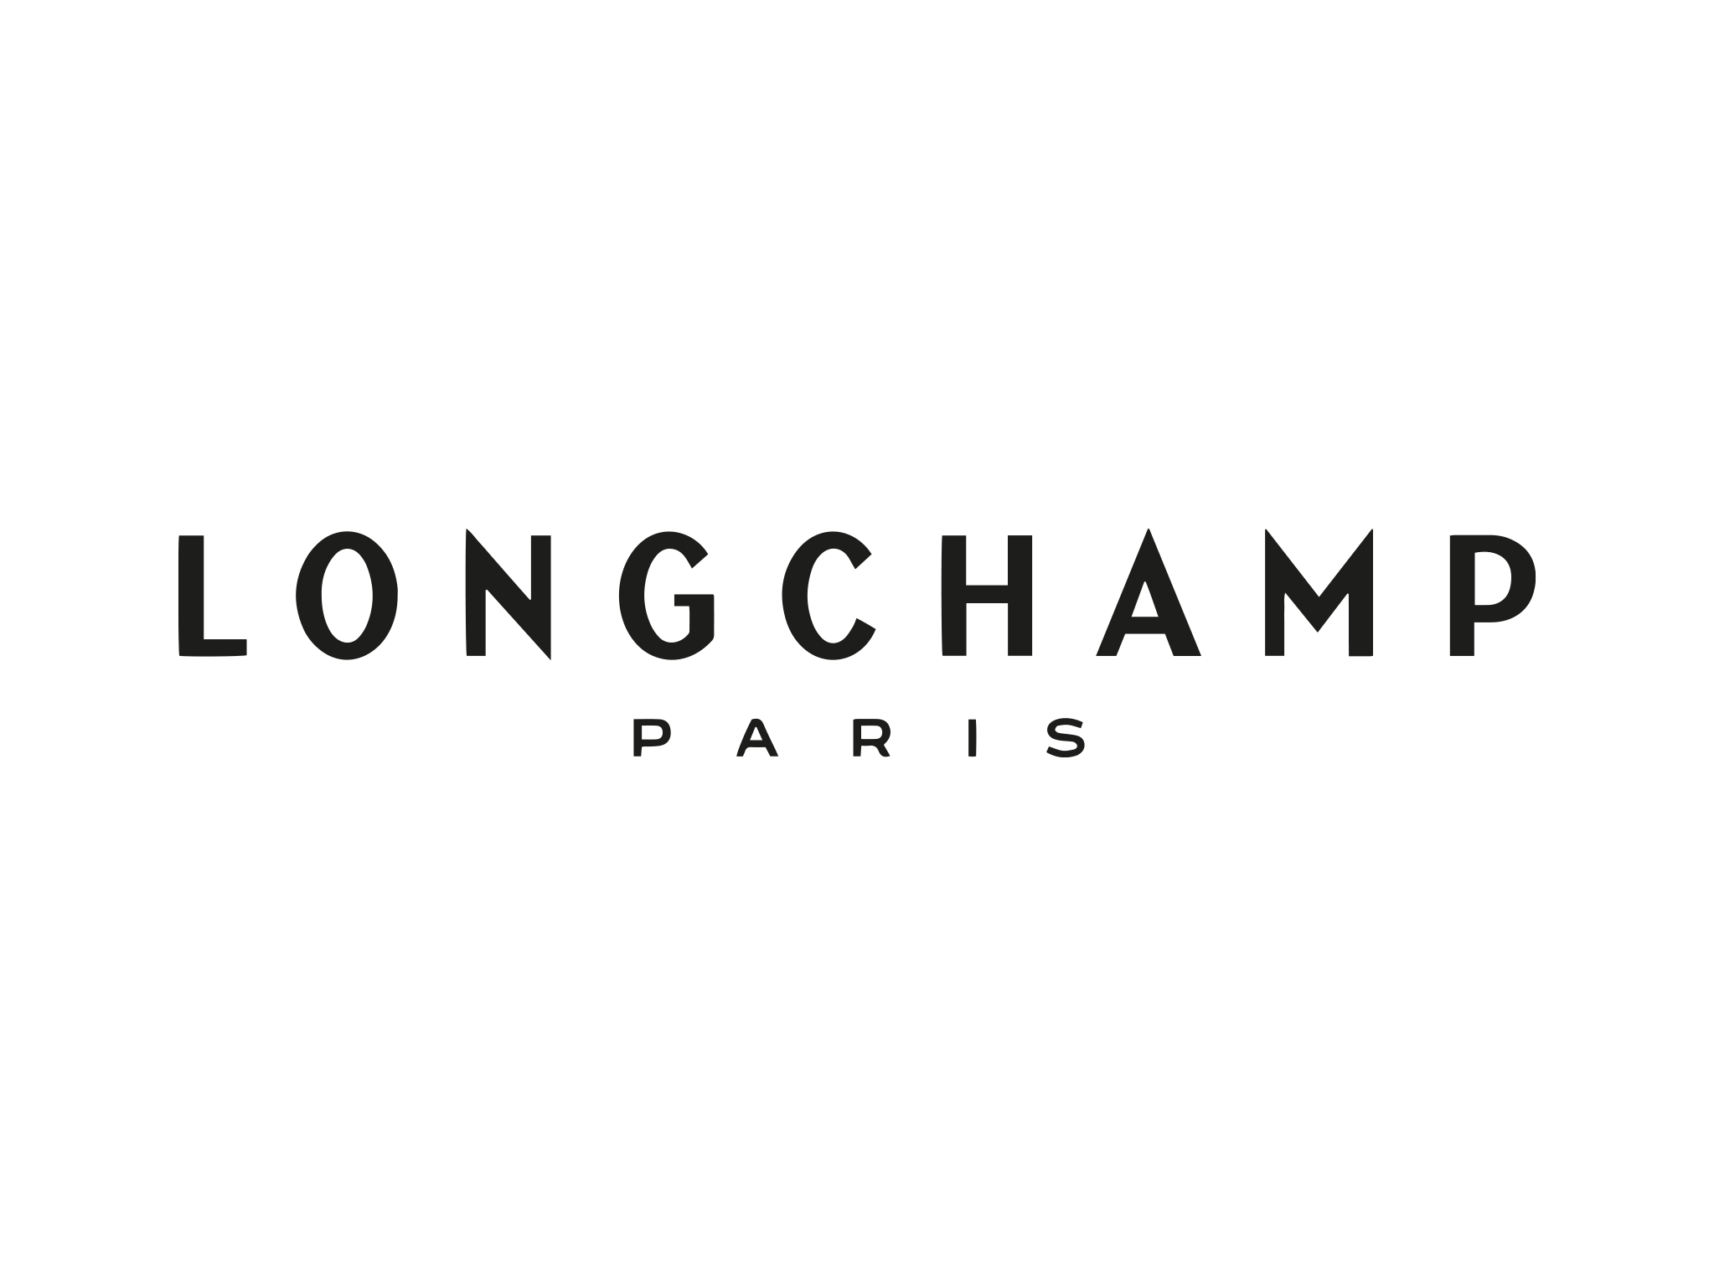
Longchamp Le Pliage: Navigating Luxury Fashion's Competitive Landscape
SHREYA PUNJ
131271207
MRK620SAA
Professor: Duncan Reith
15 April 2024

Slide 2
Longchamp is mainly involved in the premium clothing sector, who specializes on setting up, manufacturing goods, and marketing excellent in quality leather items such as handbags, luggage, accessories, and clothing that is ready to wear apparel. Longchamp is attractive to a targeted audience in the luxury and premium markets, reflecting exclusivity, modification, and refined taste. Its clients comprise of wealthy individuals seeking luxury items that radiate elegance and workmanship, reflecting their sophisticated lifestyle preferences. Longchamp's global retail network and flagship shop in Paris appeal to luxury admirers who adore French beauty and cherish the brand's renowned work of art.
Defining The Market
Longchamp, the company, operates in the fashion and luxury goods industry. It specializes in designing, manufacturing, and retailing premium leather goods, including handbags, luggage, accessories, and ready-to-wear apparel.
Handbags: Longchamp is recognized for their stylish handbags, which come in a variety of styles spanning from conventional to futuristic. Longchamp purses are a sought-after item amongst fashion-forward people since they are exquisitely made and useful.
Luggage: Longchamp's luggage portfolio blends utility and elegance, appealing to travellers who value aesthetics as well as dependability. Whether it's an overnight stay or a long-distance trip, Longchamp baggage guarantees that travelers travel in fashion, with pieces built to resist the rigours of travel while radiating ageless refinement.
Accessories: Longchamp's accessories complement its handbags and luggage, offering a range of items such as wallets, belts, scarves, and small leather goods. These accessories not only enhance the overall look but also provide functional solutions for everyday needs, reflecting Longchamp's commitment to luxury and versatility.
Ready-to-wear Apparel: Longchamp's ready-to-wear collection offers modern and stylish styles that represent the company's unique flair. From effortless daywear to sophisticated evening attire, Longchamp offers a curated collection of clothing that exudes elegance and refinement, appealing to discerning customers who seek timeless fashion pieces.
These markets cater to affluent consumers seeking premium, stylish, and high-quality products that reflect sophistication and elegance.

Slide 3
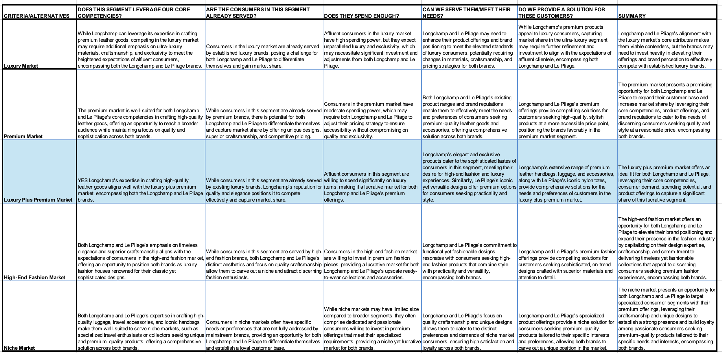
Targeting the Luxury Plus Premium Market
The final recommendation is to target The Luxury Plus Premium Market.
This recommendation aligns with Longchamp's core competencies in crafting high-quality leather goods and serves as an ideal avenue to leverage the strengths of both the Longchamp and Le Pliage brands. Consumers in the elegance Plus Premium Market are already accustomed to premium items, but they want a combination of elegance and functionality, which Longchamp and Le Pliage can supply with their famous designs and superb craftsmanship.

Slide 4
Longchamp's current status and business performance demonstrate it to be a thriving luxury fashion and lifestyle brand with a worldwide reach.
Longchamp has experienced substantial expansion, attaining a revenue of €500 million by 2015.
The widely recognized and admired Le Pliage brand makes up around 12% of the company's product range and has achieved sales of more than 30 million pieces globally.
The company's competitive strengths are rooted in its French lineage, superior artistry, and wide range of products, encompassing nylon and leather bags.
Longchamp's immediate goals involve preserving the appeal of its brand and growing its client base, while its long-term goals centre around fostering brand loyalty and enhancing its market presence.
The brand strives to be regarded as an emblem of refinement, sophistication, and enduring fashion by both customers and retailers.
Current situation and business performance for Longchamp
Heritage and Tradition: Longchamp boasts a long history of craftsmanship and tradition in leatherworking, dating back to its founding in 1948. This heritage lends authenticity and prestige to its brand image.
Quality and Craftsmanship: The firm has become recognized for its ongoing commitment to outstanding workmanship and precise craftsmanship in all of its merchandise, which ensures endurance and everlasting attractiveness.
Iconic Products: Longchamp's signature product, Le Pliage, has achieved iconic status in the fashion industry, serving as a symbol of the brand's elegance and functionality.
Brand Recognition: Longchamp has built strong brand recognition globally, with a presence in major fashion capitals and a loyal customer base attracted to its luxury offerings.
Product Diversification: Alongside to its recognized handbags, Longchamp produces an extensive selection of items such as luggage, accessories, and ready-to-wear clothes to meet the broadened requirements of its clients.
Longchamp Competitive Advantages

Slide 5
Current Positioning of Longchamp and Le Pilage and is it clear?
Longchamp's present positioning highlights its fusion of luxury, artistry, and practicality, mainly focusing on its Le Pliage brand. Although the brand has gained worldwide recognition and is highly popular, its ability to stand apart from competitors may be hindered by the prevalence of its characteristic Le Pliage bags.
The current positioning of Longchamp and Le Pliage is clear, emphasizing a combination of luxury, craftsmanship, and practicality. While Le Pliage has achieved significant popularity, its differentiation from competitors may be hindered by its widespread presence. Sustaining this positioning over the long term may require strategies to enhance exclusivity and maintain relevance amid evolving market dynamics.
SHORT TERM OBJECTIVES | LONG TERM OBJECTIVES
Maintain and enhance brand loyalty within existing consumers. | Maintain brand relevance and attract by constantly developing and adapting to changing market trends.
Boost market share in significant markets by using focused marketing and distribution methods. | Expand into new international markets while maintaining the brand's core identity and values.
Optimize retail partnerships in order to offer the best brand presence and customer satisfaction. | Cultivate a reputation for premium quality, craftsmanship, and fashion-forward design among both customers and retailers. Foster strong relationships with retailers, ensuring alignment with Longchamp's brand image and values, and providing support for brand promotion and sales efforts.
Longchamp has been successful to date because of its ongoing commitment to superior quality, creativity, and adaptation. It has effectively employed its tradition of workmanship and superior products to build a strong worldwide brand recognition. Furthermore, Longchamp's potential to accurately foresee trends in the marketplace, in addition to strategic choices, has helped it stay ahead of the competition while remaining pertinent in the ever-changing fashion sector.

Slide 6
Longchamp's Strategy in a Nutshell
The analysis indicates that Longchamp's robust brand equity and loyal client base are a firm basis for future expansion. Nevertheless, the corporation must persist in distinguishing its products, especially in light of growing competition in the high-end fashion industry. By capitalizing on its French heritage and expertise in workmanship, Longchamp may enhance its standing in the industry through the adoption of innovative strategies and diversification into new product categories. Furthermore, it will be imperative to bolster its brands' uniqueness and perceived worth, namely Le Pliage, by implementing well-planned marketing and distribution strategies. This will be crucial for to maintain its edge over competitors in the future.
Longchamp's crucial reach emphasizes client relationships as the key value discipline. This conclusion is drawn from the company's emphasis on building strong client connections through customized goods and exceptional service. Longchamp has a thorough understanding of its clients' wants and tastes, demonstrated by its ability to offer a diverse assortment of things to fit multiple tastes and interests. The company's commitment to quality workmanship and innovative layout strengthens its customer-centric strategy.
Although Longchamp primarily focuses on client intimacy, the company also exhibits operational excellence and product leadership aspects. Longchamp's streamlined production methods and adept supply chain management exemplify operational efficiency, enabling the company to provide superior products punctually. In addition, Longchamp's emphasis on innovation and product development demonstrates a dedication to becoming a leader in the market by offering distinctive and inventive designs.
However, Longchamp's value discipline extends beyond operational excellence or product leadership. Although these factors hold significance, the company's primary advantage rests in establishing enduring connections with its clients, prioritizing customer intimacy as the dominating value discipline. This strategy aligns with Longchamp's brand identity and strategic goals, highlighting the significance of comprehending and fulfilling the requirements of its discerning customers.
Value Discipline

Slide 7
Longchamp's business operations and market success are shaped by various external factors, including economic conditions, social trends, legal regulations, and environmental considerations.
Market & Context:
Longchamp operates in the premium and luxury fashion accessories market, where economic conditions play a significant role in consumer spending behavior. Fluctuations in GDP growth rates, inflation, and employment levels can impact the purchasing power of affluent consumers, influencing their propensity to buy luxury goods like handbags and accessories. Additionally, social trends such as increasing emphasis on sustainability and ethical consumption are reshaping consumer preferences in the fashion industry, affecting demand for environmentally friendly and ethically sourced products. Longchamp must adapt its strategies and offerings to capitalize on these trends and maintain its competitive edge in the market.
Consumer:
The target consumers for Longchamp's premium and luxury products are affluent individuals who value quality, craftsmanship, and brand prestige. These consumers are typically influenced by societal trends, including fashion, lifestyle, and status symbols. Longchamp's customers seek products that not only showcase their style and sophistication but also align with their values, such as sustainability and ethical production practices. Understanding these consumer preferences is crucial for Longchamp to effectively position its brand and offerings in the market.

Slide 8
Competitors:
Longchamp faces competition from both established luxury brands and emerging players in the premium and luxury fashion accessories market. Competitors such as Michael Kors, Coach, Tory Burch, and Kate Spade offer similar products targeting affluent consumers with a penchant for high-quality and stylish accessories. Longchamp must closely monitor competitors' strategies, product offerings, and marketing initiatives to identify opportunities for differentiation and maintain its market position.
Legal:
Longchamp's market access and competitive positioning are subject to legal regulations governing intellectual property rights, trade agreements, and consumer protection laws. Intellectual property laws protect Longchamp's brand identity and designs from infringement by competitors, ensuring the exclusivity and authenticity of its products. Compliance with trade agreements and consumer protection laws is essential for Longchamp to operate seamlessly in different markets and maintain consumer trust and confidence.
Environmental:
Environmental factors, including sustainability and ethical consumption trends, are increasingly influencing consumer behavior and brand preferences in the fashion industry. Longchamp must consider these factors in its product development, sourcing, and manufacturing processes to meet consumer expectations for eco-friendly and ethically produced goods. Embracing sustainable practices and offering environmentally conscious products can enhance Longchamp's brand image and appeal to environmentally conscious consumers in the premium and luxury market segment.
By understanding and adapting to these factors, Longchamp can effectively position its brand and offerings in the premium and luxury fashion accessories market, capitalize on emerging opportunities, and maintain its competitive advantage.

Slide 9
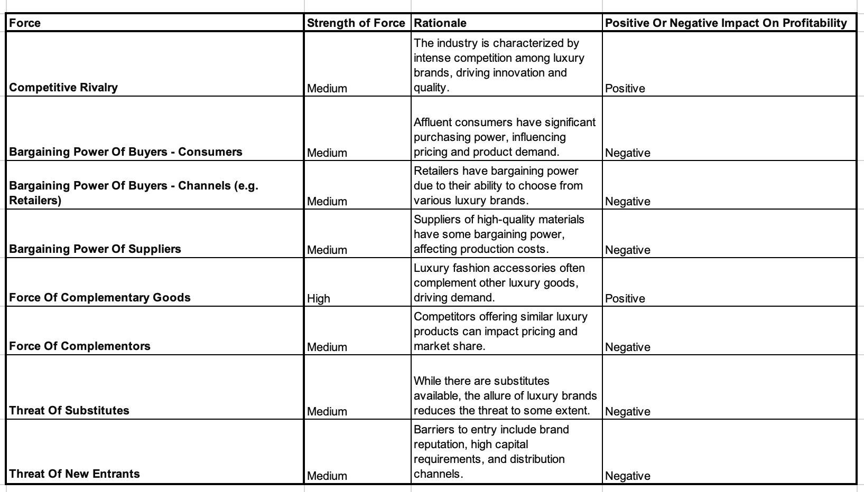
The market is favourable. Longchamp sees great prospects in the premium and luxury fashion accessories sector, thanks to its affluent client base, rising demand for high-quality and trendy items, and shifting consumer attitudes toward ecological and ethical purchasing. Despite competing demands and regulatory constraints, Longchamp's brand power, creative product offers, and positioning strategy allow it to profit on market attractiveness while maintaining its competitive advantage.
There are various key factors which have contributed to the success of Le Pliage.
First and foremost, the product's blend of functionality and style appeals to consumers seeking both useful and fashionable things. The renowned collapsible structure provides practicality for daily usage, further augmenting its widespread appeal.
Furthermore, the cost of Le Pliage, in comparison to other high-end handbag manufacturers, establishes it as a readily accessible gateway into the realm of Longchamp.
This product's design is everlasting and does not follow current trends, which has contributed to its long-term popularity among a diverse variety of consumers.

Slide 10
Le Pliage's current value proposition is based on its capacity to offer a practical, stylish, and affordable product. Consumers are provided with multifunctional items appropriate for various situations, including travel, work, and leisure activities. The brand's dedication to superior workmanship and meticulousness increases its value proposition, guaranteeing its products' durability and extended lifespan.
Le Pilage current value proposition
Do they have strong brand image ?
Role of the Longchamp brand in its success
Value does Le Pliage bring to Longchamp
Yes, the Le Pliage brand has established a strong and distinct image separate from the Longchamp brand. Its iconic foldable design, practicality, and affordability compared to other luxury handbag brands have contributed to its unique identity in the market. Despite being part of the Longchamp portfolio, Le Pliage's widespread recognition and popularity among premium and luxury consumers have solidified its independent image, catering to a specific segment of the market seeking functional yet stylish accessories.
Le Pliage has cultivated a robust and unique brand identity, separate from but closely linked to the Longchamp brand. Le Pliage's distinctive foldable design and extensive recognition have positioned it as a distinct entity in the high-end handbag industry. The popularity of the Longchamp brand extends beyond its name, attracting buyers looking for practical and stylish items.
The Le Pliage collection significantly contributes to the Longchamp brand, acting as a fundamental part of its range of products. Longchamp'sextensive popularity and robust consumer demand directly contribute to the company's sales and revenue. Moreover, Le Pliage improves Longchamp's brand awareness and market placement, draws in new clientele, and cultivates brand loyalty among current clients.
Recognizing the strong and distinct image of the Le Pliage brand implies that decisions regarding its future direction, including potential expansions, collaborations, or brand separations, must carefully consider its established identity and appeal to the premium plus luxury market segment. Any strategic moves should aim to preserve and enhance Le Pliage's unique positioning while aligning with the overarching brand strategy of Longchamp.

Slide 11
Problem Statement
The problem of maximizing Le Pliage's brand potential while preserving with Longchamp's premium plus luxury brand identity and market position which affects both Longchamp as a company and its stakeholders, including consumers, retailers, and investors. The risk of Le Pliage's success overshadowing other offerings and diluting Longchamp's luxury image poses a significant challenge. Balancing the growth of Le Pliage with the preservation of Longchamp’s brand equity is crucial to maintaining the company's competitive edge and market relevance. A successful solution would result in a clear brand identity and market positioning strategy for Le Pliage, ensuring sustainable growth while upholding Longchamp's esteemed reputation in the luxury fashion industry.
Rational
Risk of Overshadowing: Le Pliage's overwhelming success may overshadow other Longchamp offerings, risking dilution of the brand's luxury image.
Brand Equity Preservation: Balancing Le Pliage's growth with Longchamp's brand equity preservation is vital for maintaining competitiveness.
Market Relevance: Achieving a clear brand identity and market positioning for Le Pliage is essential for Longchamp's sustained relevance in the luxury fashion industry.

Slide 12
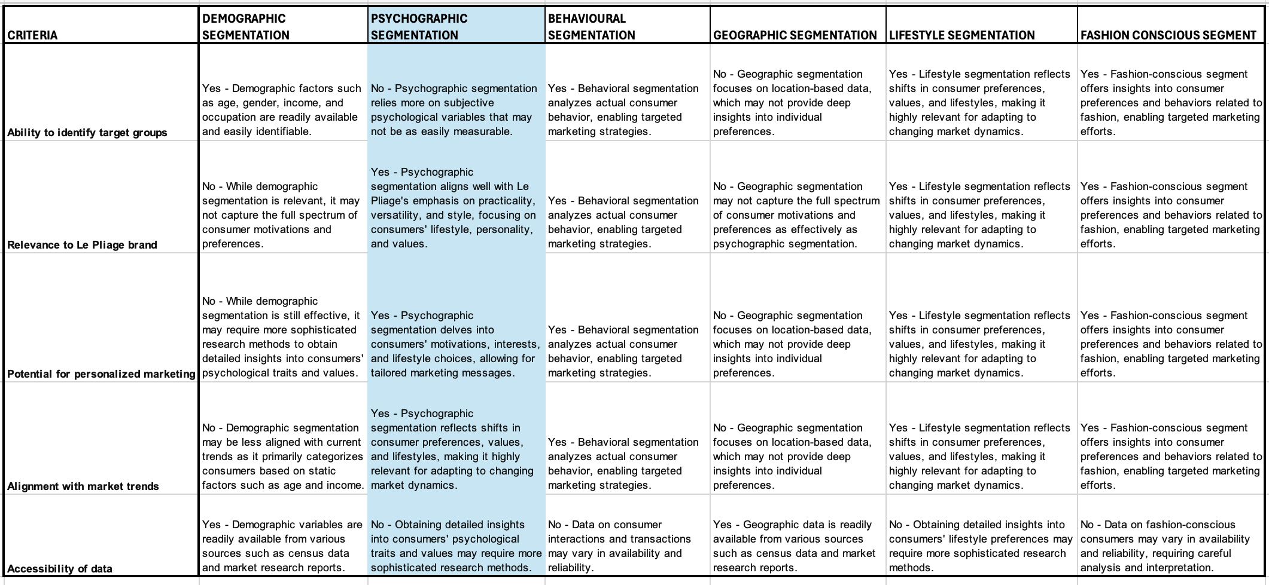
When deciding on the segmentation base for Le Pliage, we need to explore many options to achieve the best possible alignment with customer behavior and preferences. Each alternative will be assessed according to its relevance to Le Pliage's target market, measurability, accessibility, differentiation, and actionability.
After conducting a comprehensive investigation, it is recommended that psychographic segmentation be used as premium plus luxury target market for Le Pliage. The decision is derived from the criterion table, which demonstrates that psychographic segmentation provides the most thorough comprehension of the motivations behind various consumer groups' purchasing and usage behaviors. It facilitates a more thorough examination of consumer lifestyles, interests, and values, which is essential for strategically positioning Le Pliage in the market. Furthermore, psychographic segmentation is highly compatible with the brand's focus on fashion, style, and personal expression, allowing for focused marketing and product development tactics.

Slide 13
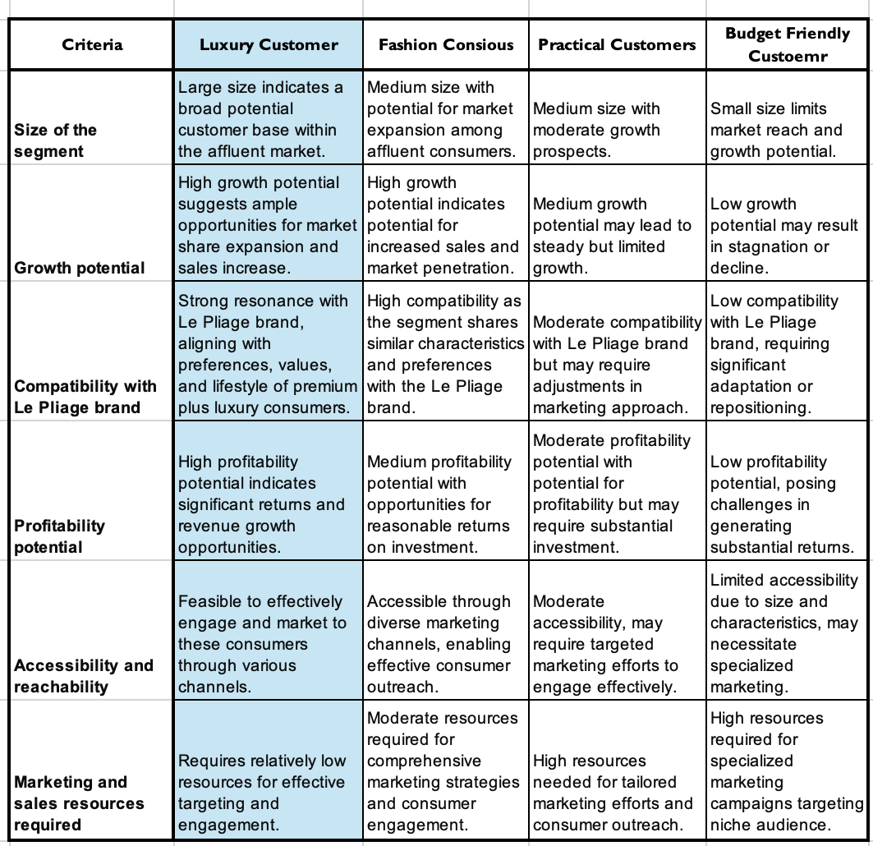
After careful evaluation of the segmentation criteria table and considering the target market of premium plus luxury consumers for Le Pliage, Segment Luxury Customer emerges as the most suitable target audience.
Segment A represents the luxury customer segment, represented by rich buyers that demonstrate quality, manufacturing, and distinction in their buying decisions. These people seek objects that represent their sophisticated preferences and will make investments in high-end companies like Le Pliage to meet their need for distinctiveness and elegance.
Segment B comprises fashion-conscious who value style, innovation, and individuality in their lifestyle choices. These consumers are drawn to Le Pliage for its contemporary designs, versatility, and ability to express their unique fashion preferences. While not as expansive as the luxury customer category, Segment B represents a significant market segment with high growth potential and strong compatibility with the Le Pliage brand.
Segment C consists of practical consumers who prioritize functionality, durability, and value in their purchasing decisions. Such individuals are looking for things that offer helpful solutions to their regular requirements, such as commutes, travel, and daily activities. While not as aligned with the luxury positioning of Le Pliage.
Segment D represents budget-conscious consumers who prioritize affordability and cost-effectiveness in their purchasing decisions. These individuals may be less concerned with brand prestige or design aesthetics and instead prioritize practicality and affordability. While not an ideal target audience for Le Pliage's premium plus luxury positioning.
Segment Luxury Customer is the ideal target audience for Le Pliage due to its large size and high growth potential within the affluent market. It aligns closely with the brand's values and lifestyle preferences of premium luxury consumers, offering high profitability potential. Moreover, Segment Luxury Customer is accessible and reachable through various channels, requiring relatively low marketing and sales resources for effective engagement.

Slide 14
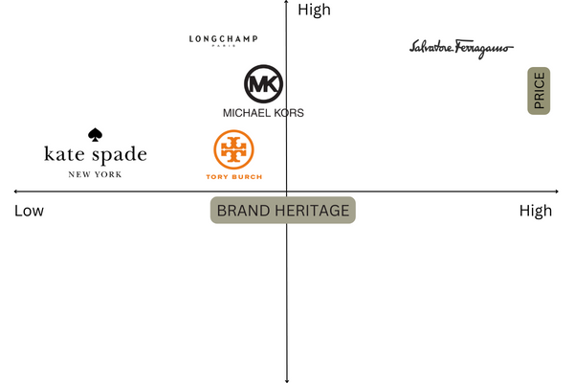
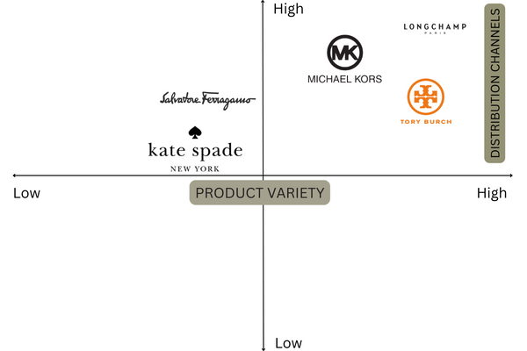
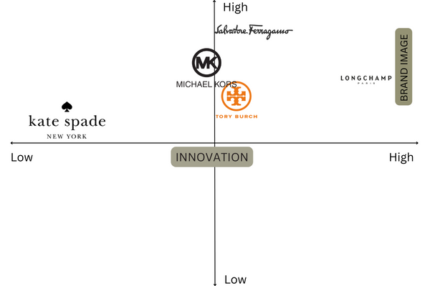
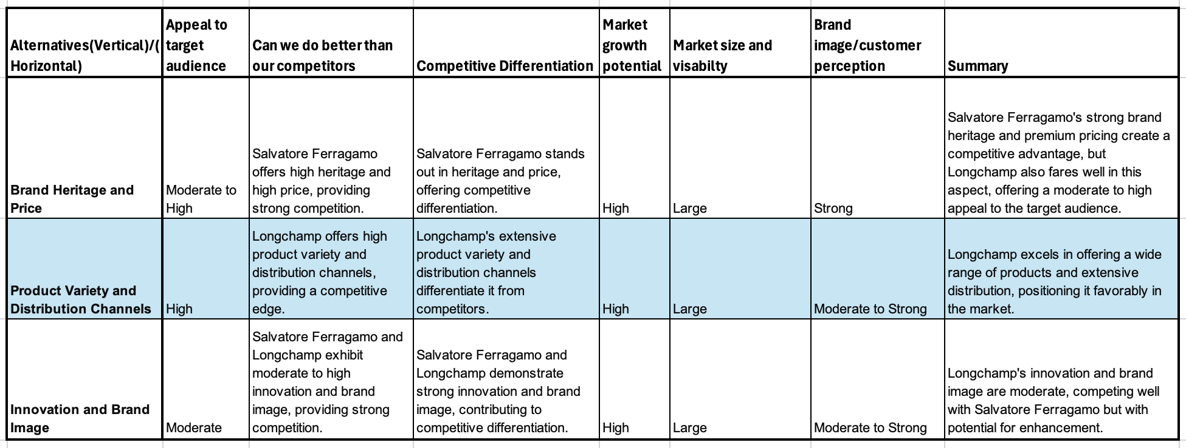
Considering the luxury plus premium market's discerning preferences and Longchamp's brand strengths, focusing on Product Variety and Distribution Channels emerges as the most strategic positioning choice for Le Pliage.
PERPECTUAL MAP 1
PERPECTUAL MAP 2
PERPECTUAL MAP 3
The decision aligns with the market's demand for choice and accessibility, allowing Longchamp to differentiate itself, maximize market reach, and capitalize on growth opportunities. By emphasizing these aspects, the brand enhances visibility and reinforces customer perception, driving sustained success in the luxury fashion industry.

Slide 15
POSITIONING STATEMENT
For discerning individuals in the luxury plus premium market who prioritize both functionality and fashion, Le Pliage is the versatile accessory solution that seamlessly integrates practicality with style. Le Pliage stands as the epitome of "Functionality and Fashion" in the realm of handbags, offering adaptable companionship for every occasion. Its enduring design, expert craftsmanship, and innovative features ensure that Le Pliage empowers individuals to navigate life's adventures effortlessly and elegantly, setting new standards for both utility and aesthetics in the luxury accessory market.
ANALYSIS FOR KEY BENIFTS
FUNCTIONAL BENEFITS:
The functional benefits of Le Pliage include its practical design and versatility, making it suitable for various occasions and purposes. Whether used for commuting, traveling, or everyday activities, Le Pliage offers consumers a reliable solution that meets their needs. The collapsible structure and lightweight materials enhance convenience and usability, further enhancing its appeal.
EMOTIONAL BENEFITS:
In addition to its functional benefits, Le Pliage delivers emotional value to consumers through its timeless design and aesthetic appeal. The brand evokes feelings of sophistication, elegance, and luxury, resonating with consumers who seek to express their personal style and taste. Owning a Le Pliage bag symbolizes status and refinement, adding a sense of prestige to the consumer's lifestyle.

Slide 16
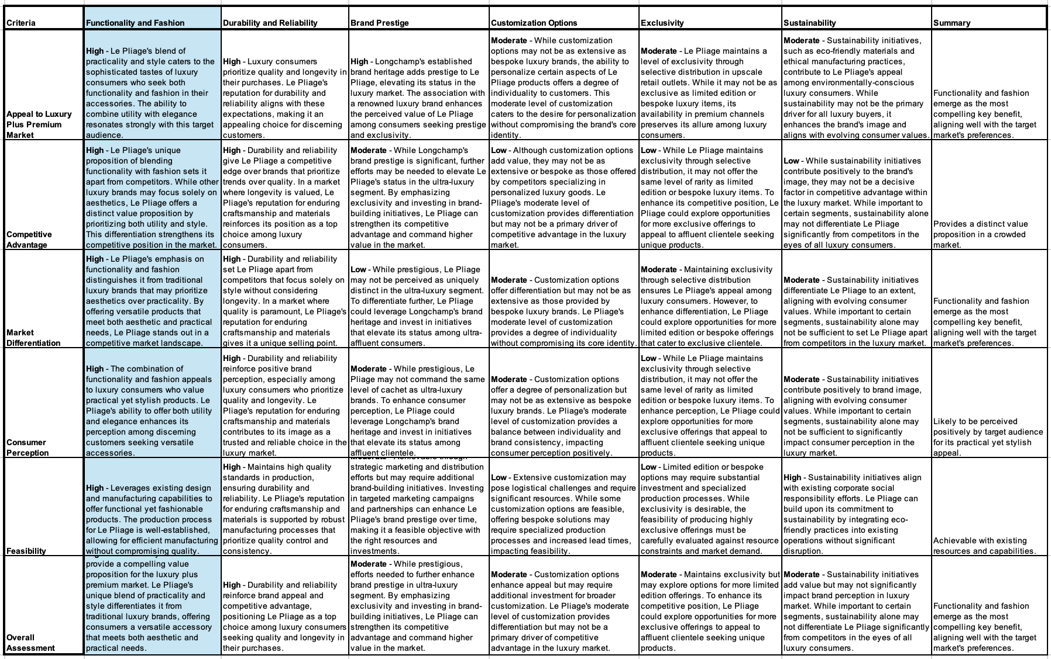
Based on the criteria table and analysis, the appropriate key benefit for the positioning statement is "Functionality and Fashion."

Slide 17
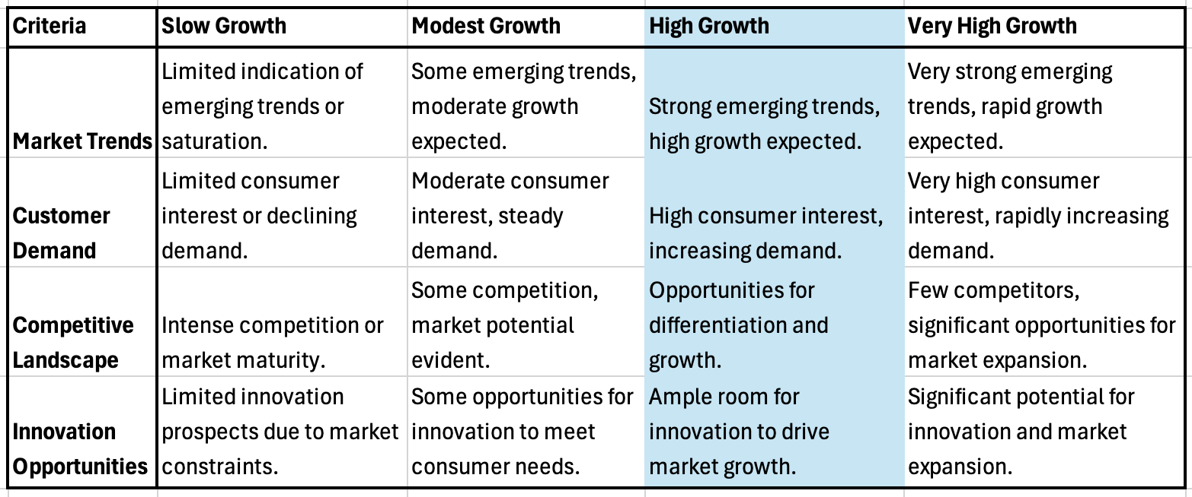
GROWTH RATE
When evaluating the rate of growth for the Le Pliage brand, it is crucial to consider various elements.
First and foremost, it is essential for Longchamp's long-term success to preserve its "mythical" reputation, indicating that a well-rounded strategy may be required.
Furthermore, although introducing Le Pliage to a broader audience could enhance its effectiveness, there is a possibility that it may diminish its uniqueness and appeal.
On the other hand, maintaining restrictions could protect its reputation but restrict the increase in revenue.
To effectively manage Le Pliage, Longchamp should find a way to maintain its attractiveness while also taking advantage of market prospects. This involves implementing a well-planned growth strategy that keeps its renowned position while deliberately extending its influence.
Longchamp can maintain the attractiveness of Le Pliage while ensuring controlled expansion by progressively increasing distribution and promotional activities. This strategy is consistent with the brand's philosophy of delivering high standards and uniqueness while adjusting to changing market conditions.
In conclusion, after a thorough analysis of the market growth potential, it's evident that Le Pliage operates within a segment characterized by high growth opportunities. The strong emerging trends, coupled with very high consumer interest and rapidly increasing demand, suggest a favorable landscape for Le Pliage to capitalize on. Furthermore, the relatively few competitors in the luxury plus premium market present significant opportunities for market expansion and differentiation. With ample room for innovation and a conducive market environment, Le Pliage is poised to achieve substantial growth and solidify its position as a leading brand in the premium plus luxury segment.

Slide 18
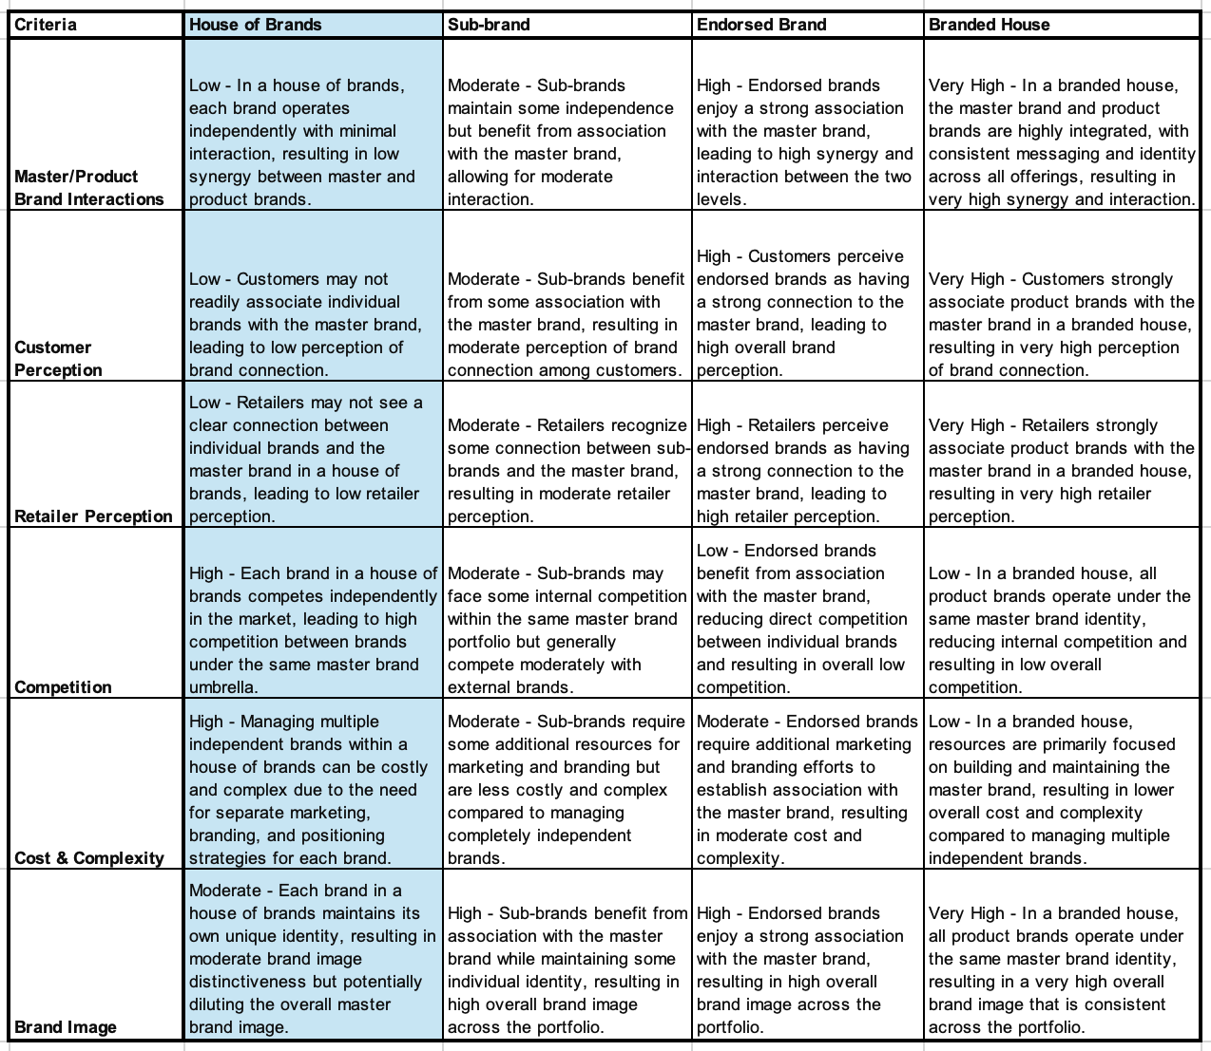
An alternative is to establish a sub-brand association whereby Le Pliage functions inside the framework of the Longchamp brand. By adopting this strategy, Le Pliage can use Longchamp's established brand value and reputation while retaining a certain level of autonomy in its marketing and product innovation. An alternative approach is to designate Le Pliage as an authorized brand, maintaining its distinct character while establishing a clear connection to Longchamp. This approach can enhance the legitimacy and backing of Le Pliage from its parent brand while also allowing for greater adaptability in marketing and distribution.
Longchamp might opt for a house of brands model, in which Le Pliage functions as its own business with its distinct brand identity and marketing efforts. This strategy provides Le Pliage with the highest level of independence. Still, it may weaken the overall consistency of the brand and make it more challenging to take advantage of the combined strengths of the entire product range.
The rationale for opting for a house of brands model for Longchamp, with Le Pliage functioning as its own independent business, lies in providing Le Pliage with maximum autonomy. This approach acknowledges the distinct brand identity and marketing efforts of Le Pliage, allowing it to tailor its strategies specifically to its target audience within the luxury plus premium market. However, it's crucial to recognize that this strategy may compromise the overall consistency of the Longchamp brand portfolio and hinder the synergies that could be achieved by leveraging the combined strengths of all products. The decision should be carefully evaluated considering factors such as maintaining brand image, customer perceptions, retailer relationships, and financial implications. Ultimately, the selected brand architecture strategy will significantly influence Le Pliage's positioning in the market and its alignment with Longchamp's broader product decisions and marketing initiatives.

Slide 19
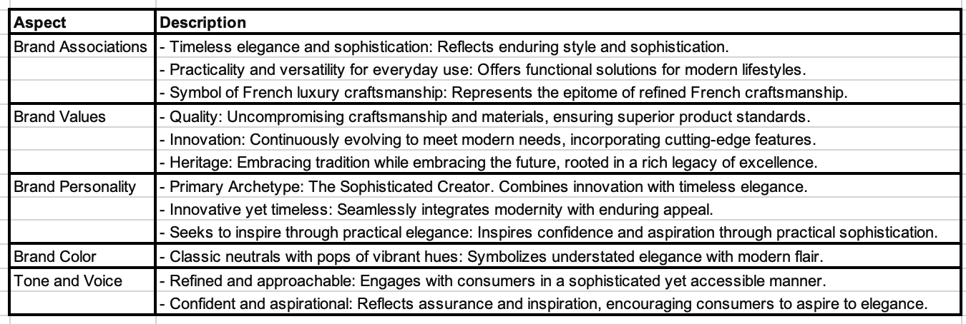
"Le Pliage embodies the essence of French luxury, seamlessly blending timeless elegance with modern practicality. From bustling city streets to chic weekend getaways, it accompanies every journey with grace and style. Crafted with precision and passion, each piece is not just a bag, but a symbol of heritage and innovation. Le Pliage: where tradition meets the future."
BRAND STORY

Slide 20
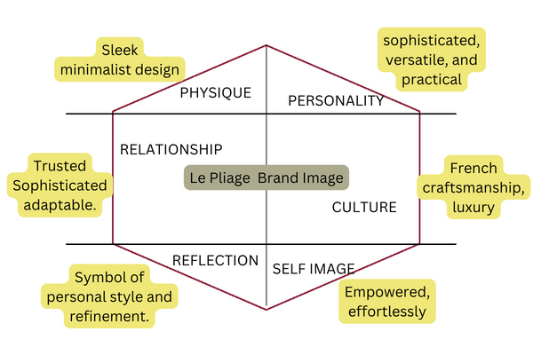
PHYSIQUE:
Sleek and minimalist design: Reflects the target audience's preference for sophistication and simplicity.
RATIONALE: Appeals to the luxury and premium market's desire for elegant, understated aesthetics.
Le Pliage Brand Image
PERSONALITY:
Trusted and adaptable: Aligns with Le Pliage's positioning as a reliable and versatile companion for modern lifestyles.
RATIONALE: Reinforces the brand's promise of quality and practicality, appealing to the discerning tastes of the luxury plus premium market.
RELATIONSHIP:
The trusted and adaptable design of Le Pliage establishes a strong relationship between the brand and its consumers. By consistently delivering on its promise of quality and functionality, Le Pliage fosters a sense of trust and loyalty among its clientele, enhancing brand perception and customer satisfaction.
CULTURE:
French craftsmanship and luxury: Reflects the brand's heritage and association with high-quality craftsmanship.
RATIONALE: Enhances the brand's prestige and exclusivity, resonating with the target audience's appreciation for luxury and tradition.
SELF-IMAGE:
Sophisticated, versatile, and practical: Represents the desired self-image of the target audience, reflecting their aspiration for refinement and functionality.
RATIONALE: Aligns with the premium plus luxury market's preference for products that embody sophistication while offering practical utility.
REFLECTION:
Le Pliage serves as a symbol of personal style and refinement, allowing consumers to express their individuality and sophistication. The brand's association with elegance and timeless design reflects the aspirations and values of the affluent market segment, resonating with their desire for luxury and exclusivity.

Slide 21
Product Assortment and Expansion: Given Le Pliage's positioning as a representation of enduring grace and usefulness, it is advised to make changes to the existing range of products to match the brand's positioning statement and business goals. The addition of new categories, such as women's ready-to-wear clothing and shoes, to the Le Pliagebrand, can capitalize on the brand's current value while also broadening its appeal to new groups of consumers.
Current Le Pliage Assortment
The company should consider investigating licensing opportunities for complementing products such as fragrances and cosmetics. This could help to enhance the brand's lifestyle appeal further and generate additional sources of revenue.
Pricing Strategy: Le Pliage needs to maintain competitive pricing that aligns with the perceived value of the product to keep its market position. The pricing should align with the brand's high-end stance while also being affordable for its intended demographic. It is important to thoroughly assess any changes to pricing to maintain alignment with the brand's perceived worth and the competitive market. Comparing prices between the Longchamp brand and other brands may not be meaningful due to the different positioning and target markets of each brand.
To effectively reach Le Pliage's target audience, it is crucial to have a varied combination of distribution venues.
Maintain presence in Longchamp stores to enhance visibility and association with luxury.
Collaborate with high-end retailers like Nordstrom, Saks, and Holt Renfrew to expand exposure to affluent consumers.
Establish independent Le Pliage boutiques in key urban areas for heightened brand engagement and specialized retail experience.
Utilize outlet stores to attract cost-conscious consumers without compromising brand reputation.
Yes they should expand direct-to-consumer e-commerce channel to meet demands of modern consumers valuing convenience.

Slide 22
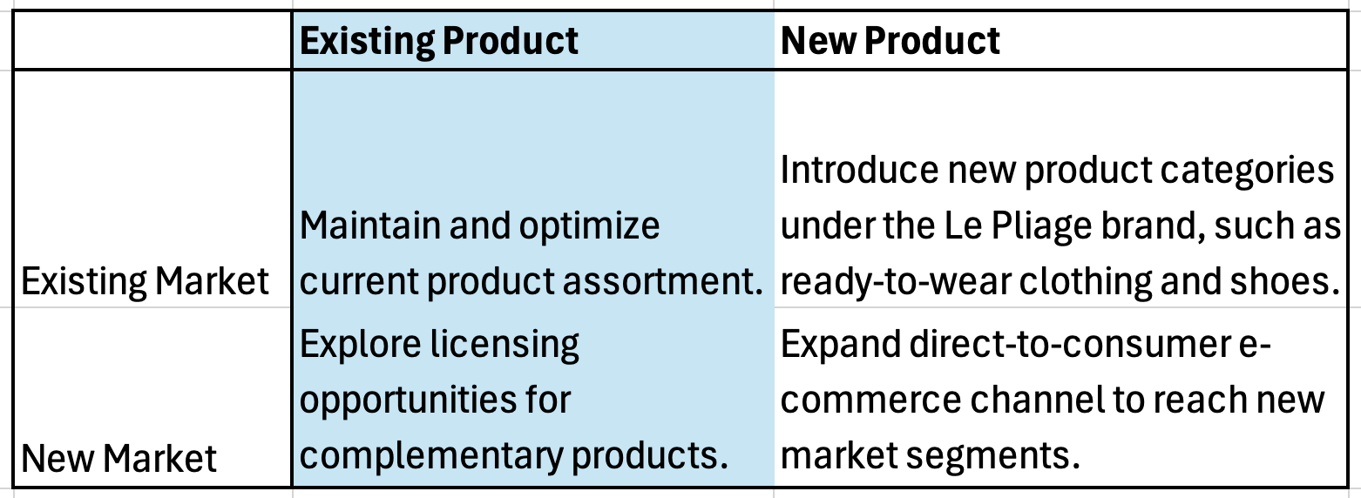
The choice to keep and maximize the present product selection in the current marketplace is supported by the brand's solid footing and reputation, which ensures loyal customers and market presence
Introducing new merchandise categories, such as ready-to-wear clothes and shoes, fits in with Le Pliage's brand identity of practical magnificence and provides prospects for increased market penetration and income. Investigating licensing options for complementary items leverages the brand's lifestyle appeal and can produce additional income streams without requiring important investment in product development. Growing the direct-to-consumer e-commerce channel to reach new market segments reacts to changing consumer preferences for online shopping convenience and allows access to previously untapped customer populations, resulting in market expansion and brand awareness.

Slide 23
In crafting an integrated marketing strategy for Le Pliage, several key decisions were made to ensure alignment with the luxury plus premium target market and the brand's positioning.
The selection of psychographic segmentation as the primary targeting approach allowed for a nuanced understanding of consumer preferences and lifestyles, ensuring Le Pliage resonates with the desired audience seeking both functionality and fashion
The chosen positioning, emphasizing the key benefit of functionality and fashion, positions Le Pliage as a versatile and stylish companion for individuals navigating various aspects of their lives with ease and elegance. This decision is supported by the brand's association with timeless elegance, practicality, and French luxury craftsmanship, enhancing its appeal to the target audience.
To further bolster brand image and market presence, Le Pliage will pursue a house of brands brand architecture strategy, providing the brand with independence and flexibility while maintaining consistency in brand values and customer perceptions.
Expanding distribution channels through collaborations with high-end retailers, establishing independent boutiques, and strengthening the e-commerce channel ensures accessibility to the target market across various touchpoints, enhancing brand visibility and engagement.
The decision to explore new product categories like ready-to-wear clothing and shoes under the Le Pliage brand extends the brand's offerings while staying true to its core values of practical elegance and quality craftsmanship.
leveraging licensing opportunities for complementary products and expanding the direct-to-consumer e-commerce channel cater to evolving consumer preferences and provide avenues for revenue growth and market expansion.
Collectively, these decisions form a cohesive and integrated marketing strategy for Le Pliage, aligning with its target market, positioning, and brand values to drive growth and strengthen brand equity in the luxury fashion landscape.

Slide 24
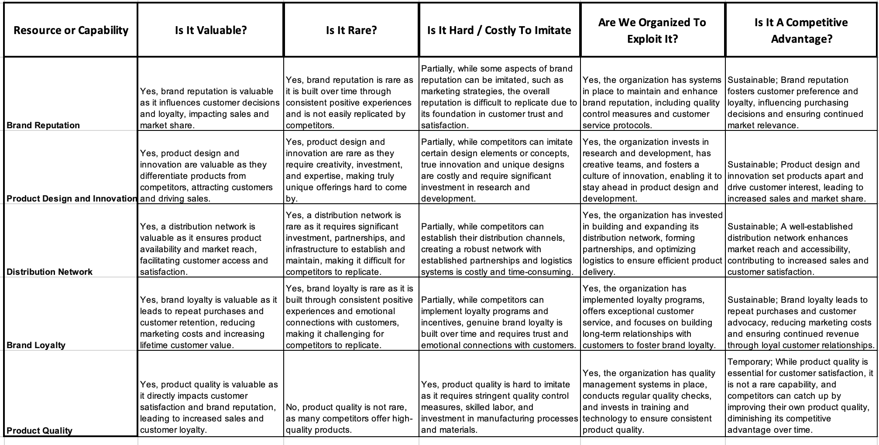
APPENDIX I: VIRO ANALYSIS
The assessment using the VRIO framework indicates that Longchamp possesses several valuable and rare resources and capabilities, providing a foundation for competitive advantage. Brand reputation, product design and innovation, distribution network, and brand loyalty are all identified as valuable and rare assets that contribute to Longchamp's market position and profitability. These resources are difficult to imitate, given the organization's investment, expertise, and established systems in place to maintain and enhance them. Longchamp is organized to exploit these resources effectively, evident in its commitment to research and development, strategic partnerships, and customer-centric practices. While product quality is valuable, it is not rare, posing a challenge to sustain a competitive advantage solely based on this criterion. Overall, Longchamp's strengths in brand reputation, innovation, distribution, and customer loyalty position it well in the market and support its continued success and growth.

Slide 25
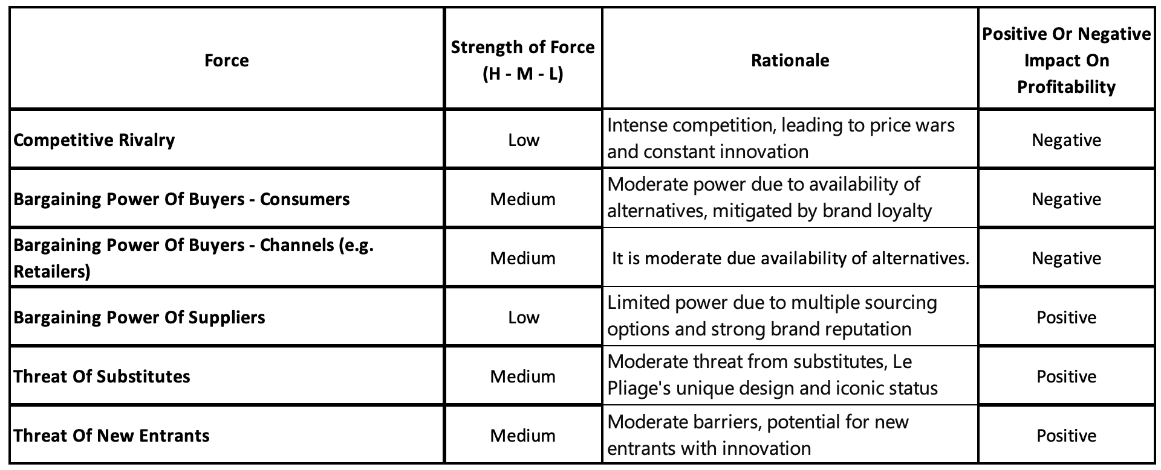
APPENDIX II: PORTER’S 6 FORCES ANALYSIS
Yes, based on the analysis provided, the market appears to be moderately attractive. While there are some challenges such as intense competitive rivalry, moderate bargaining power of buyers (both consumers and retailers), and threats from substitutes and new entrants, there are also positive factors such as low bargaining power of suppliers and Le Pliage's unique design and iconic status, which mitigate some of the negative impacts. Overall, the market's attractiveness is influenced by a balance of both positive and negative factors, making it moderately attractive.

