Slide 1
Martha Stewart Cannabis
PRESENTED BY :
Shreya Punj(131271207)

Slide 2
The Perfect Fit: Positioning Martha Stewart CBD in the Premium Market
Criteria for Market Assessment | Market 1 (Premium CBD Market) | Market 2 (Recreational Cannabis) | Market 3 (Medical Cannabis) | Market 4 (Culinary Industry)
Legal Status | Federal Legalization | Recreational Use Legalization | Medical Use Legalization | N/A (Legalization Irrelevant)
Consumer Perception | High-quality, effective, luxurious, and associated with wellness benefits. | Lifestyle Choice | Medicinal Benefits | Culinary Experience
Target Demographic | Affluent, health-conscious individuals seeking targeted solutions for various concerns (anxiety, sleep, pain). | Adult Consumers | Patients with Specific Conditions | Food Enthusiasts

Slide 3
The Perfect Fit: Positioning Martha Stewart CBD in the Premium Market
Criteria for Market Assessment | Market 1(Premium CBD Market) | Market 2 (Recreational Cannabis) | Market 3 (Medical Cannabis) | Market 4 (Culinary Industry)
Market Growth Potential | High Growth | High Growth | Moderate Growth | Moderate Growth
Competition | Increasing competition | Intense Competition | Limited Competition | Intense Competition
Regulatory Environment | Evolving Regulations | Evolving Regulations | Strict Regulations | Established Regulations
Collaborators | Premium brands | Cannabis Dispensaries | Medical Professionals | Specialty Food Suppliers
Brand Fit | Quality & Luxury | Lifestyle Appeal | Medical Expertise | Culinary Expertise

Slide 4
The Perfect Fit: Positioning Martha Stewart CBD in the Premium Market
Premium CBD Market(Market 1): :The premium CBD market is a rapidly growing segment within the larger CBD industry. It caters to discerning consumers seeking high-quality, effective, and often luxurious CBD products. The target consumers for this is affluent & health conscious individuals These consumers have disposable income and are willing to pay a premium for quality CBD products perceived as more effective and trustworthy.
Recreational Cannabis Market (Market 2): The target market comprises adult consumers seeking recreational cannabis use, presenting significant growth potential amid evolving legal landscapes. Although competition is intense, expanding legalization offers opportunities for market growth. Consumer perception views cannabis as a lifestyle choice rather than solely medicinal, driving demand in this segment.
Medical Cannabis Market (Market 3): This market targets patients seeking therapeutic benefits from cannabis products, representing a niche segment with minimal competition. The target demographic consists of individuals with specific medical conditions. Legal status is paramount, as stringent regulations govern the distribution and use of medical cannabis.
Culinary Industry (Market 4): Positioned within the culinary landscape, this market targets food enthusiasts seeking innovative culinary experiences. While not directly related to cannabis legalization, it offers moderate growth potential with intense competition from specialty food suppliers. Consumer perception emphasizes the culinary applications of cannabis, aligning with the market's target demographic of food enthusiasts.

Slide 5
The Premium CBD Market (Market 1) emerges as the most suitable target segment for Martha Stewart CBD.
Target Consumer Match
The premium CBD market caters to affluent, health-conscious individuals interested in high-quality, effective products. This perfectly describes Martha Stewart's core demographic.
Strong Brand Alignment
Martha Stewart's brand is synonymous with quality, luxury, and a focus on well-being. This aligns perfectly with the core values of the premium CBD market.
03
01
02
Product Focus
Martha Stewart CBD's focus on effective, premium CBD products directly addresses the needs of consumers in this segment.
By focusing on the premium CBD market, Martha Stewart CBD can leverage its brand strengths and target a receptive audience willing to pay a premium for quality and effectiveness.

Slide 6
Strategic Landscape: Martha Stewart & Canopy Growth
Canopy Growth Corporation (Canopy):
Canopy Growth Corporation is a leading cannabis company headquartered in Canada.
·As of the current situation in 2024, Canopy has expanded its operations globally, with a presence in both medical and recreational cannabis markets.
Despite facing challenges in the past related to regulatory changes and market volatility, Canopy has maintained its position as a key player in the cannabis industry.
Financially, Canopy has demonstrated steady revenue growth over the years, although profitability has been affected by factors such as regulatory hurdles and increased competition.
In order to drive future growth and preserve its competitive advantage in the market, the corporation keeps funding R&D, innovation, and strategic alliances.

Slide 7
Strategic Landscape: Martha Stewart & Canopy Growth
Martha Stewart Living Omnimedia:
Martha Stewart Living Omnimedia is a diversified media and merchandising company founded by lifestyle icon Martha Stewart.
The company has a strong brand presence in various sectors, including home and lifestyle, media, and consumer goods.
Martha Stewart has a loyal customer base and is known for her expertise in lifestyle and home-related products and services.
In recent years, Martha Stewart Living Omnimedia has ventured into strategic partnerships to expand its reach and offer new product lines to its customers.
The partnership with Canopy Growth Corporation represents a significant opportunity for Martha Stewart to enter the cannabis market and leverage her brand's reputation in new product categories.

Slide 8
Let's discuss Canopy short term and long term objectives
Canopy Growth
Short-Term Objectives | Long-Term Objectives
Expand market presence in key regions. Increase product innovation and portfolio diversification. Strengthen supply chain efficiency and operational capabilities. | Achieve sustainable profitability and growth. Establish a leadership position in emerging cannabis markets. Drive research and development efforts to develop novel cannabis-based products.

Slide 9
What did we understand from both objective’s ?
In the short term, Canopy prioritizes expanding its market presence in key regions, leveraging opportunities presented by the legalization and acceptance of cannabis products. By strengthening its foothold in these markets, Canopy aims to increase brand visibility, capture market share, and drive revenue growth. Concurrently, the company focuses on optimizing its supply chain and operational capabilities to enhance efficiency and meet growing demand effectively.
Looking ahead, Canopy's long-term objectives emphasize innovation and portfolio diversification to stay ahead in a competitive landscape. Through continuous research and development efforts, Canopy seeks to pioneer novel cannabis-based products, catering to evolving consumer preferences and medical needs. By diversifying its product line, the firm hopes to stay relevant, grab new market niches, and generate long-term profitability.
In conclusion, Canopy Growth Corporation blend of short-term objectives focused on market expansion and operational efficiency, coupled with long-term goals centered on innovation, leadership, and sustainability, reflects its commitment to navigating the complexities of the cannabis industry and driving value for stakeholders over the near and distant horizons.

Slide 10
Just how we understood Canopy’s objectives let's have a look for Martha Stewart as well
Martha Stewart
Short-Term Objectives | Long-Term Objectives
Successfully launch cannabis-related products in collaboration with Canopy. Build brand awareness and consumer trust in the cannabis segment. Establish distribution channels and retail partnerships for cannabis products. | Establish Martha Stewart as a trusted authority in the cannabis industry. Expand product offerings and market reach in the cannabis segment. Drive revenue growth and profitability through the sale of cannabis-related merchandise and services.
Finally, both Canopy Growth and Martha Stewart have outlined strategic objectives aimed at capitalizing on the burgeoning cannabis market. Canopy Growth short-term seeks are to increase market presence, build operational capabilities, and create leadership in new areas, while its long-term goals are to achieve sustained revenue, product innovation, and R&D. Similarly, Martha Stewart's short-term objectives emphasize the successful launch and distribution of cannabis-related products, building brand awareness, and establishing retail partnerships. Their long-term objectives aim to solidify Martha Stewart's position as a trusted authority in the cannabis industry, expand product offerings, and drive revenue growth. By aligning their objectives with the evolving needs and trends of the cannabis market, both Canopy Growth and Martha Stewart are poised to capitalize on opportunities and achieve long-term success in the dynamic cannabis industry.

Slide 11
Strategic Landscape: Martha Stewart & Canopy Growth
Objectives for the Joint Venture:
Develop a diverse portfolio of high-quality cannabis products: This objective emphasizes the importance of product development and innovation.This purpose emphasizes the significance for product development and innovation. By developing a diversified selection of cannabis goods, including as CBD-infused edibles, oils, and wellness supplements, the joint venture will be able to appeal to a wider audience with different tastes and requirements. In the highly competitive cannabis business, high-quality goods are critical for building customer reputation and trust.. High-quality products are essential to establish credibility and trust among consumers in the competitive cannabis market.
Establish Martha Stewart as a leading brand in the cannabis industry: Building Martha Stewart's brand presence and reputation in the cannabis industry is crucial for differentiation and market positioning. Leveraging Martha Stewart's established brand equity and Canopy Growth's expertise in cannabis cultivation and production, the joint venture aims to become synonymous with quality, trustworthiness, and innovation in the cannabis market.
Drive consumer adoption and acceptance of cannabis-based products: Overcoming social stigma and changing consumer perceptions are significant challenges in the cannabis industry. By educating consumers about the potential benefits of cannabis-based products and promoting responsible usage, the joint venture seeks to increase consumer adoption and acceptance. This objective aligns with broader industry efforts to normalize cannabis use and expand the market beyond traditional user demographics.
Enhance shareholder value through strategic collaborations and market expansion.: Lastly, the joint venture seeks to create value for its owners by strategically extending its presence in the marketplace and using collaborative collaborations. The joint venture aims to boost revenue growth, economic viability, and shareholder returns by leveraging synergies among Martha Stewart's brand appeal and Canopy Growth's sector experience. Strategic connections with retailers and growth into new areas are critical to attaining this goal.

Slide 12
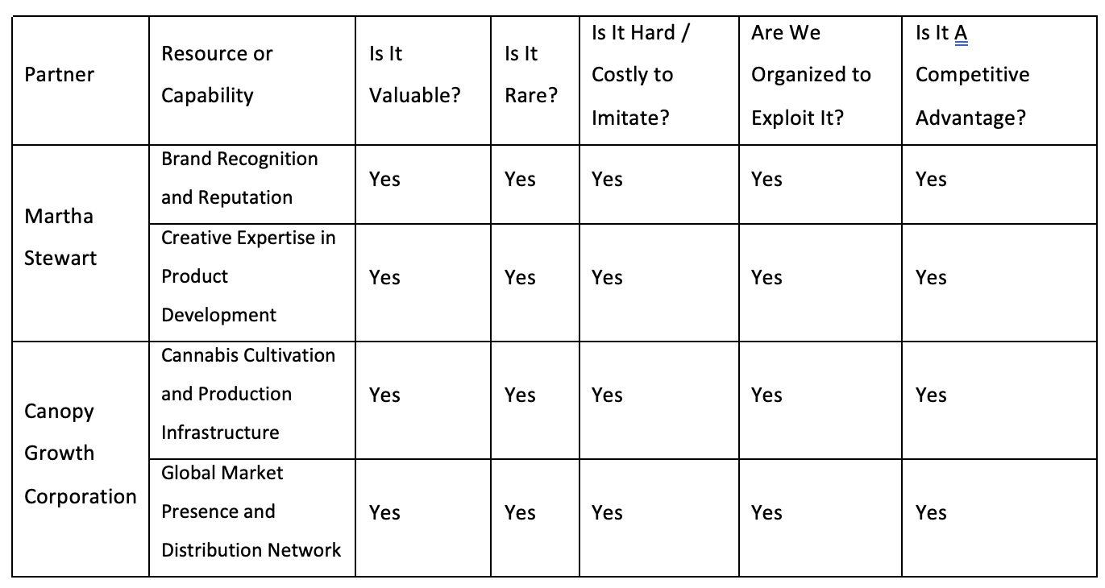
Strategic Landscape: Martha Stewart & Canopy Growth
Competitive Advantage Analysis

Slide 13
Let us examine the competitive advantage in detail.
Brand Recognition and Reputation:
This is considered Yes on all factors (Valuable, Rare, Inimitable, and Owned) Her brand recognition and reputation are valuable because they create consumer trust and loyalty. They are rare because few individuals have achieved her level of brand recognition. They are inimitable because her personal brand is unique. They are owned because Martha Stewart controls her trademarks and image rights. Overall, this makes her brand recognition a strong competitive advantage.
Creative Expertise in Product Development:
This is considered Yes on all factors (Valuable, Rare, Inimitable, and Owned) as well. Her creative expertise is valuable because it can help develop innovative and appealing cannabis products. It's rare because there are not many people with her level of experience and creativity. It's inimitable because her creativity is unique to her. And it's owned by her.
MARTHA STEWART

Slide 14
Let us examine the competitive advantage in detail.
Cannabis Cultivation and Production Infrastructure:
This is considered Yes on all factors (Valuable, Rare, Inimitable, and Owned). Their cannabis cultivation and production infrastructure is valuable because it allows them to produce cannabis products efficiently. It's rare because building such infrastructure requires significant investment and regulatory approval. It's difficult to imitate because of the regulatory hurdles and expertise needed. They own their facilities and knowledge, making it a competitive advantage.
Global Market Presence and Distribution Network:
This is considered Yes on all factors (Valuable, Rare, Inimitable, and Owned) Their global market presence and distribution network are valuable because it allows them to sell their products in a wider market. It's rare because few companies have such a broad reach. It's difficult to imitate because it takes time and resources to build a global network. And they own their facilities and distribution channels.
CANOPY GROWTH CORPORATION

Slide 15
So, what are the outcomes of the Competitive Advantage Analysis?
The competitive advantage analysis reveals that both Martha Stewart and Canopy Growth Corporation bring valuable, rare, and difficult-to-imitate resources and capabilities to the joint venture. Martha Stewart's brand recognition and reputation are significant assets, fostering consumer trust and loyalty. With decades of expertise in the lifestyle and consumer products industries, Martha Stewart's brand is associated with quality, innovation, and authenticity.. This creative expertise extends to product development, where Martha Stewart's team excels in crafting unique and appealing offerings tailored to consumer preferences.These skills not only provide worth to the joint venture, but also differentiate it from competition by providing unique and in-demand items.
On the other side, Canopy Growth Corporation's strengths include its marijuana cultivation and cultivation infrastructure, which includes modern equipment and industry-leading knowledge. Canopy Growth, one of the world's leading cannabis firms, has a strong globally market share as well as a distribution network, allowing for extensive access to its goods.. This extensive infrastructure and market reach provide a competitive edge, allowing the joint venture to penetrate markets efficiently and effectively.
Overall, the joint venture benefits from the combination of Martha Stewart's brand impact and product development expertise, as well as Canopy Growth's industry-leading infrastructure and worldwide presence. Together, these competitive advantages position the joint venture for success in the highly competitive cannabis market, allowing it to seize opportunities and sustain long-term development.

Slide 16
Beyond the Stigma: Insights for Martha Stewart's CBD Strategy
The cannabis industry has seen remarkable growth and change due to more places legalizing it, shifts in consumer attitudes, and broader medicinal and recreational use. Market segmentation now includes medical cannabis, recreational cannabis, and wellness-focused CBD products. With 38 states, three territories, and the District of Columbia allowing medical cannabis in the USA, the market is expanding rapidly. Canopy Growth produces medical-grade cannabis and aims to seize opportunities worldwide. They've set their sights on the lucrative US market, projected to hit about $50 billion USD by 2026, by partnering with Martha Stewart. However, the business faces challenges like varied consumer tastes, complex regulations, and ever-changing distribution channels, spanning dispensaries, e-commerce, and retail partnerships.
Competitor Analysis: Competitors in the cannabis industry range from established players like Aurora Cannabis and Aphria to emerging brands and craft cultivators. There is more competition when it comes to of price points, brand distinction, position in the market, and categories of products. Key rivals set themselves apart via distribution chains, brand collaborations, product innovation, and regulatory compliance.
Customer Analysis: The client environment in the cannabis market has changed dramatically, with diverse sectors such as medicinal cannabis users, recreational consumers, and CBD searchers who are looking for health benefits. Medical cannabis customers value efficacy, consistency, and safety, looking for dependable solutions that are customized to their specific requirements. Recreational customers have diverse tastes, ranging from expert aficionados to casual users, with emphasis on flavour, potency, and brand image. CBD customers that value wellness emphasize purity, potency, and transparency, looking for goods that provide health advantages like as stress alleviation or pain treatment.
Collaborative Analysis: In the cannabis sector, partnerships and collaborations are widespread supporting innovation, market expansion, and regulatory compliance. Product development, distribution methods, and access to markets are driven by strategic relationships between consumer brands, research institutes, pharmaceutical businesses, and cannabis companies. Collaborators take advantage of possibilities in the market while minimizing risks by bringing together complementary skills, resources, and expertise.

Slide 17
Talking about Pestle Analysis
Beyond the Stigma: Insights for Martha Stewart's CBD Strategy
Political: In the US market, regulatory frameworks vary across jurisdictions, impacting market entry, product legality, taxation, and licensing requirements. It will affect the overall performance of Martha Stewart Cannabis.
Economic: Economic factors influence consumer spending, market demand, investment trends, and pricing dynamics in the cannabis industry. These major factors should be kept in check while expanding the business of Martha Stewart Cannabis.
Social: Changing social norms, attitudes towards cannabis, wellness trends, and cultural acceptance shape consumer behavior and market preferences. But as a market player of medicinal cannabis supplier, It is going to be a positive side for Martha Stewart Cannabis.
Technological: The venture will always need to keep updated with the recent innovations and procedures. It will not only help to lead the market, but also save unnecessary costs.
Legal: Legal considerations encompass cannabis legislation, licensing regulations, intellectual property rights, and compliance with health and safety standards.
Environmental: Environmental factors include sustainable cultivation practices, energy efficiency, waste management, and environmental stewardship initiatives in cannabis production.
Ethical - Responsible sourcing and production practices are essential for building brand trust.
Transparency about product ingredients and potential health effects is crucial.

Slide 18
Beyond the Stigma: Insights for Martha Stewart's CBD Strategy
Unique Challenges:
Regulatory Uncertainty: Marketing and distribution are made more difficult by the uneven set of laws that exist throughout North America.
Consumer Education & Stigma: Overcoming unfavorable attitudes about cannabis and informing people about its possible advantages are continuing issues.
Restricted Marketing Routes: Innovative marketing techniques are required in light of traditional advertising limits.

Slide 19
Allow us to investigate the insights from Porter's Five Forces.
01
Threat of New Entrants
Relatively high due to the potential for federal legalization and increasing market acceptance.
02
Bargaining Power of Suppliers
Moderate, as the number of potential cannabis suppliers is growing.
03
Bargaining Power of Buyers
Moderate, as there are a growing number of CBD and cannabis product options for consumers.
04
Threat of Substitutes
High, as traditional wellness products and emerging THC-infused products can act as substitutes.
05
Competitive Rivalry
High, with established CBD brands and emerging cannabis companies vying for market share.

Slide 20
Beyond the Stigma: Insights for Martha Stewart's CBD Strategy
Insights:
The Martha Stewart CBD brand has a strong foundation due to Martha Stewart's established reputation and loyal fanbase.
The legal and regulatory environment presents significant challenges that require creative solutions for marketing and distribution.
Educating consumers about the benefits of CBD and overcoming social stigma are critical for market growth.
Partnering with established retailers like The Vitamin Shoppe provides valuable access to distribution channels.
The industry is becoming increasingly competitive, demanding a focus on brand differentiation, product innovation, and targeted marketing strategies.

Slide 21
The question is does Martha Stewart bring benefits or challenges to the joint venture and the overall cannabis industry? Let's figure out
BENEFITS
CHALLENGES
1. Established Brand Reputation: Martha Stewart brings a strong and trusted brand image to the joint venture, which can enhance credibility and consumer trust in cannabis products associated with her name.
2. Lifestyle Brand Appeal: Martha Stewart's brand is synonymous with quality, sophistication, and lifestyle, potentially attracting a more upscale segment of cannabis consumers.
3. Marketing Expertise: Martha Stewart Living Omnimedia has extensive experience in marketing lifestyle products and creating engaging content, which can be leveraged to promote cannabis products effectively.
1. Brand Dilution Risk: Associating Martha Stewart's brand with cannabis may risk diluting its wholesome and family-friendly image, potentially alienating conservative consumers.
2. Regulatory Constraints: Martha Stewart's involvement in the cannabis industry may face regulatory scrutiny and public backlash, particularly considering her mainstream appeal and influence.

Slide 22
Whether Martha Stewart should be involved in the cannabis industry ?
01
If cannabis products align with Martha Stewart's brand values of quality, innovation, and wellness, then involvement could be justified.
Alignment with Brand Values
02
If there's overlap between Martha Stewart's existing target audience and potential cannabis consumers, it may make sense to explore this market.
Target Audience Consideration:
03
The joint venture should implement robust risk mitigation strategies to address potential brand reputation risks and regulatory challenges.
Risk Mitigation Strategies:

Slide 23
Benefits and Challenges of Canopy Growth Involvement
Martha & Marijuana: A Perfect Fit?
BENEFITS
CHALLENGES
1. Industry Expertise: Canopy Growth brings deep expertise and experience in the cannabis industry, including cultivation, distribution, and product innovation.
2. Infrastructure and Resources: Canopy Growth's extensive infrastructure, including production facilities, distribution networks, and research capabilities, can support the joint venture's operations and growth.
3. Regulatory Compliance: Canopy Growth's track record of navigating complex regulatory environments can help ensure compliance and mitigate legal risks.
1. Brand Association Risks: Canopy Growth's association with recreational cannabis may raise concerns among certain consumer segments or regulatory authorities, potentially impacting partnerships with mainstream brands like Martha Stewart.
2. Market Volatility: The cannabis industry is subject to regulatory changes, market fluctuations, and competitive pressures, which can pose challenges for Canopy Growth's long-term growth and profitability.

Slide 24
A good strategic fit exists between Martha Stewart and Canopy Growth due to complementary strengths and shared objectives
Complementary Expertise:
Shared Vision:
Market Expansion Opportunities:
Martha Stewart's expertise in lifestyle branding and consumer engagement complements Canopy Growth's proficiency in cannabis cultivation, research, and distribution.
Both companies share a vision of delivering high-quality, innovative products to consumers while adhering to regulatory standards and promoting responsible cannabis use.
The partnership allows Martha Stewart to enter the burgeoning cannabis market while providing Canopy Growth access to new consumer segments and distribution channels.
Martha Stewart and Canopy Growth relationship exhibits a solid strategic match, with complementary skills, a shared goal, and potential for mutual market development. Martha Stewart's experience in lifestyle branding complements Canopy Growth's expertise in cannabis production and distribution, allowing both companies to efficiently exploit their respective strengths. With a shared commitment to producing high-quality, creative goods while complying to regulatory requirements, the cooperation paves the way for market development into new consumer categories and distribution channels. Overall, the strategic match between Martha Stewart and Canopy Growth frames the relationship for success as the cannabis market evolves.

Slide 25
The joint venture between Martha Stewart and Canopy Growth helps address some of the unique challenges of the cannabis industry
Enhancing Credibility: Martha Stewart's association adds credibility and legitimacy to cannabis products, alleviating concerns about quality and safety.
Overall, while there are potential risks and challenges, the partnership between Martha Stewart and Canopy Growth demonstrates a strategic fit that leverages each other's strengths to capitalize on the opportunities presented by the evolving cannabis industry landscape.
Educating Consumers: The cooperation may clarify myths, lessen stigma, and inform customers about the advantages of cannabis products through cooperative marketing initiatives.
Promoting Responsible Use: Martha Stewart's emphasis on wellness and lifestyle aligns with the joint venture's goal of promoting responsible and informed cannabis consumption, contributing to positive industry norms and regulations.

Slide 26
What problems did we identified?
The problem of insufficient market penetration and brand positioning in the cannabis industry affects Martha Stewart Living Omnimedia and Canopy Growth Corporation, the joint venture partners. The impacts of this issue include limited market share, suboptimal brand recognition, and missed revenue opportunities. A successful solution would result in increased market share, enhanced brand visibility, and higher profitability for the joint venture.

Slide 27
What did we examine, and can we backup our problem?
The problem identified revolves around insufficient market penetration and brand positioning within the cannabis industry, affecting both Martha Stewart Living Omnimedia and Canopy Growth Corporation, the joint venture partners. This issue is critical as it directly impacts various aspects of the joint venture's performance, including limited market share, suboptimal brand recognition, and missed revenue opportunities.
The analysis reveals that despite the joint venture's collaboration and the reputable brand association with Martha Stewart, it has not effectively penetrated the cannabis market nor positioned itself as a prominent player within the industry. This lack of market penetration and brand positioning hinders the joint venture's ability to capitalize on the growing demand for cannabis products, resulting in untapped revenue potential and underperformance compared to competitors. Therefore, addressing this problem is crucial to achieving increased market share, enhanced brand visibility, and higher profitability for the joint venture.

Slide 28
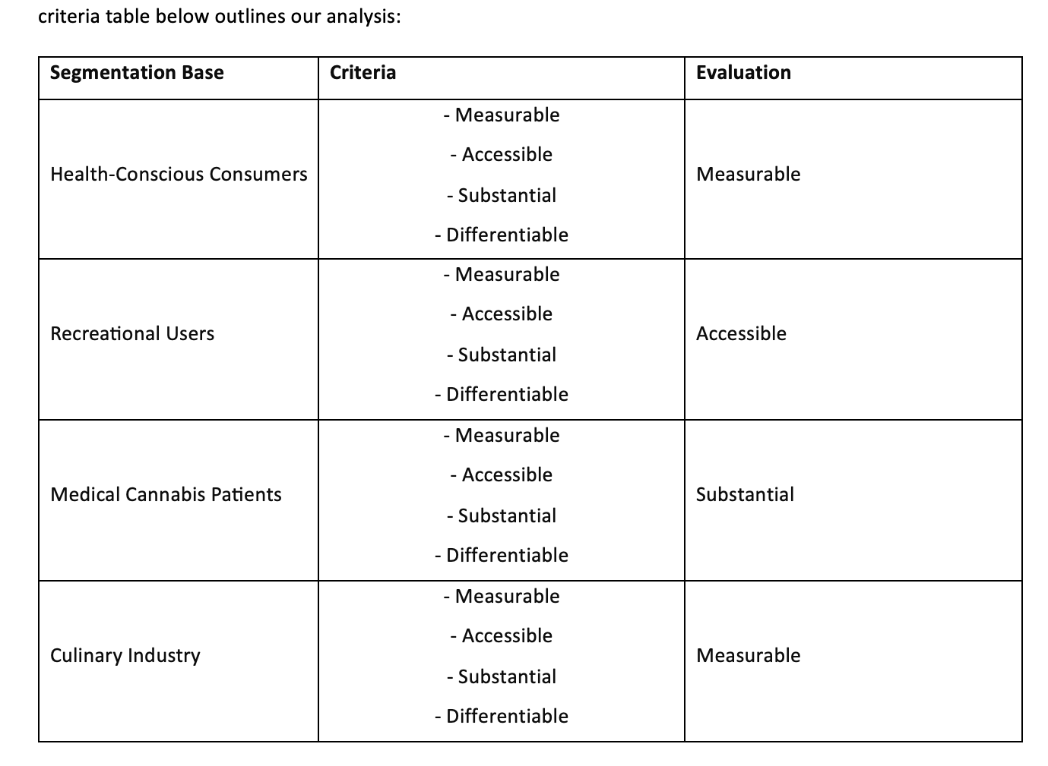
We have divided the market into four segment, and assessed them in-terms for different criteria below:
Upon careful study, Martha Stewart and Canopy Growth Corporation determined that addressing the Medical Cannabis Patients sector was the best option. This area provides significant prospects for distinction, is consistent with the firms' commitment to quality and standards, and meets the expanding need for medical cannabis goods and services.

Slide 29
Let's talk in detail
Health-Conscious Consumers:
Recreational Users:
Medical Cannabis Patients:
Culinary Industry:
While this segment is measurable and accessible, it may lack substantial differentiation in terms of cannabis product preferences compared to other health and wellness products. Additionally, targeting this segment may require additional efforts to educate consumers about the benefits of cannabis.
Although accessible, the recreational user segment may not provide substantial differentiation opportunities, as it's a broad and diverse market with numerous competitors. Moreover, the legality and regulations surrounding recreational cannabis use vary by region, posing challenges for market penetration.
This segment demonstrates substantial potential due to the growing demand for medical cannabis products and services. It offers opportunities for differentiation based on product efficacy, safety, and tailored solutions for specific medical conditions. Additionally, targeting medical patients aligns with the companies' commitment to quality and standards, enhancing brand reputation and trust.
While measurable and potentially accessible, the culinary industry segment may lack substantial differentiation within the cannabis market. Integrating cannabis into culinary practices presents unique opportunities, but it may not be the primary focus for Martha Stewart and Canopy Growth Corporation's partnership.

Slide 30
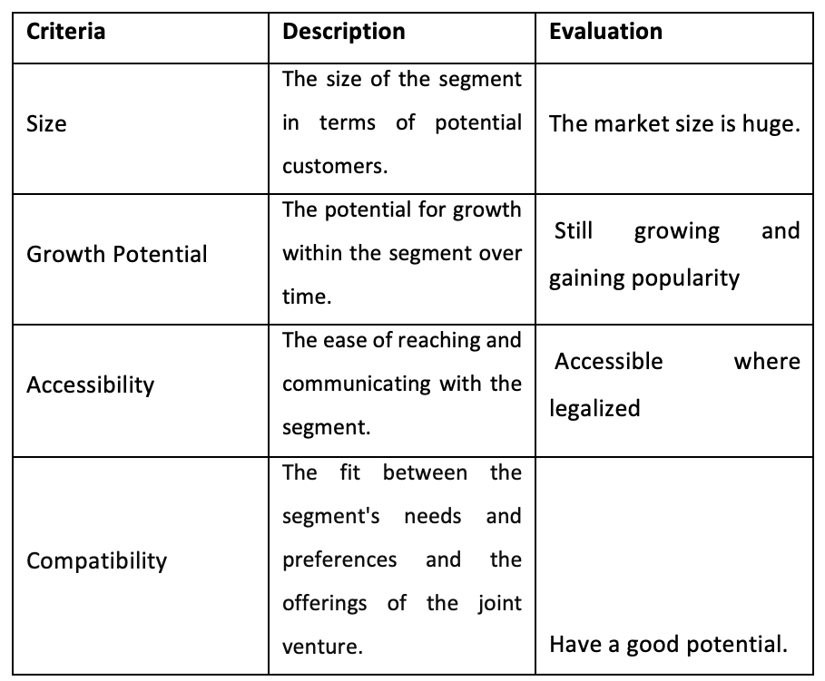
TARGET MARKET SEGMENTATION
Based on our evaluation, we recommend targeting the following segment(s) as the primary audience for Martha Stewart and Canopy Growth Corporation Medical Cannabis Patients.

Slide 31
Lets deeply Analyze the target market segment
In the ever-changing legal cannabis sector, organizations must strategically target market groups in order to capitalize on emerging possibilities and generate long-term success. Businesses may find profitable audience segments that correspond with their services and objectives by doing thorough segmentation study. In this respect, this study provides a thorough analysis of possible market segments for Martha Stewart and Canopy Growth Corporation, concentrating on factors such as size, growth potential, accessibility, and compatibility. By assessing these criteria, the research hopes to give insight into the most appropriate target demographic for the joint venture's medicinal cannabis products.
Size: The segment of medical cannabis patients is substantial, comprising individuals seeking relief from various medical conditions such as chronic pain, anxiety, insomnia, and epilepsy. As more states allow medicinal cannabis, the potential client base grows.
Growth Potential: This segment demonstrates significant growth potential as more people turn to medical cannabis as an alternative or complementary treatment option. With growing consciousness and acceptance of marijuana' medicinal benefits, the category is expected to expand significantly.
Accessibility: Patients can obtain medical cannabis in areas where it is legal. Consumers can get medicinal cannabis products via regulated dispensaries, healthcare practitioners, and internet platforms, assuring ease of access.
Compatibility: Martha Stewart and Canopy Growth Corporation's solutions are well-suited to the requirements and tastes of medicinal cannabis consumers. Its high-quality CBD products, which include oils, soft gels, and edibles, have been designed to assist patients ease medical symptoms without producing euphoria.

Slide 32
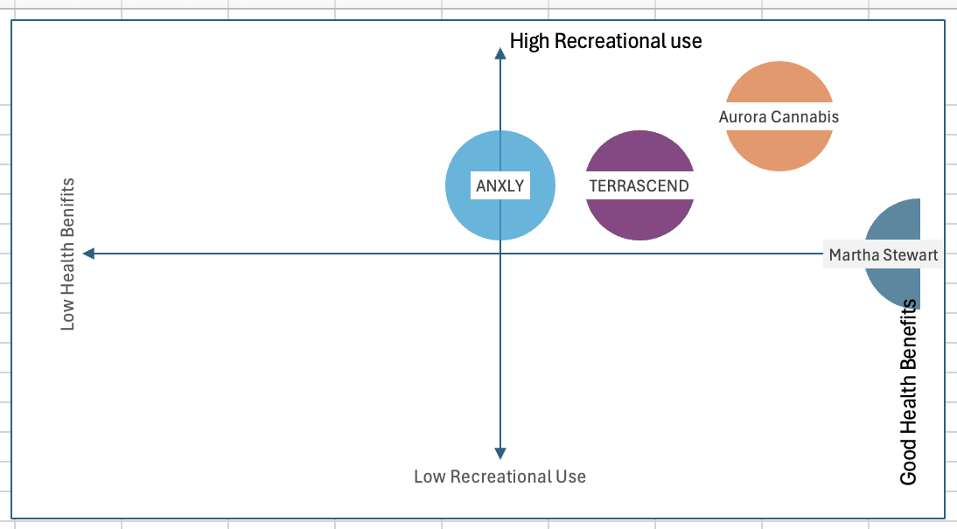
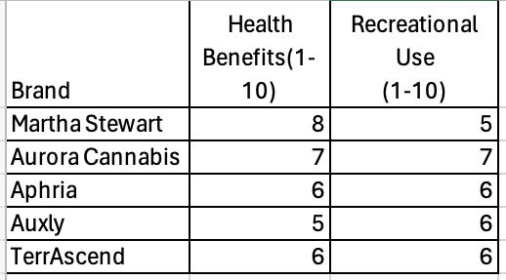
PERCEPTUAL MAPS:1
Based on the provided table, Martha Stewart emerges as a brand with a strong emphasis on health benefits, scoring an 8 out of 10, while ranking slightly lower in terms of recreational use at 5 out of 10. Aurora Cannabis, Aphria, and TerrAscend exhibit relatively balanced scores between health benefits and recreational use, with scores ranging from 6 to 7. Auxly falls slightly lower in terms of health benefits and recreational use compared to the other brands. Overall, Martha Stewart distinguishes itself with a clear focus on health benefits, positioning itself as a brand catering to consumers prioritizing wellness, while still offering recreational use options.

Slide 33
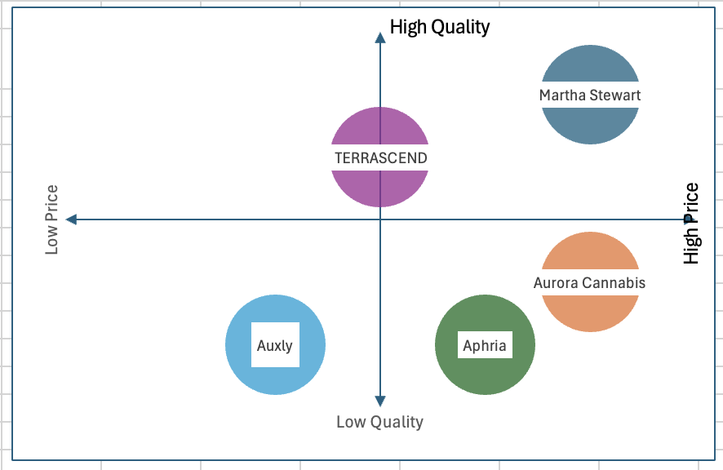
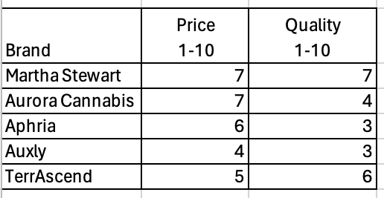
PERCEPTUAL MAPS:2
Martha Stewart appears to offer a balance between price and quality, with both attributes rated at 7 out of 10. Aurora Cannabis ranks similarly in terms of price but falls short in quality, scoring a 4 out of 10. Aphria and Auxly exhibit lower ratings in both price and quality, with scores ranging from 3 to 6. TerrAscend stands out with a slightly higher quality rating compared to its price, reflecting a focus on offering relatively higher quality products at a reasonable price point. Overall, Martha Stewart maintains a competitive edge by delivering a blend of affordability and quality, positioning itself favorably against its competitors.

Slide 34
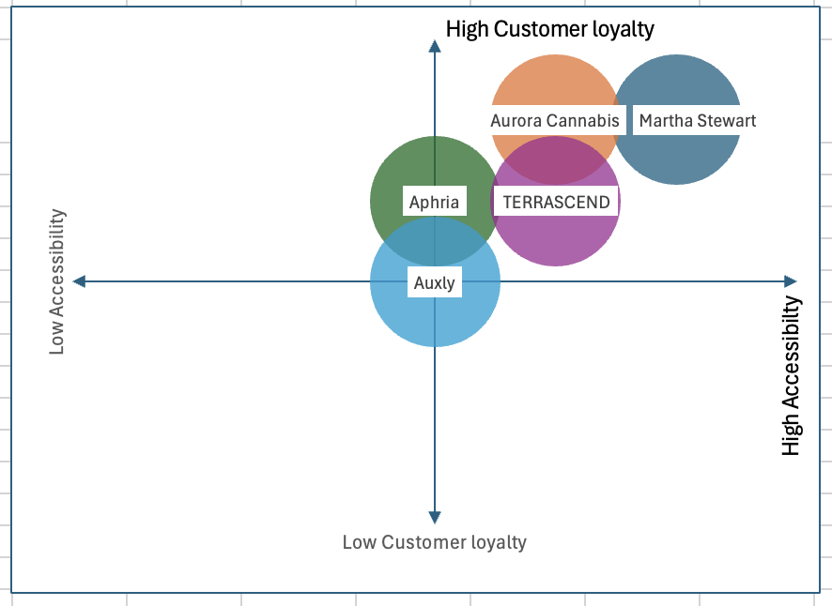
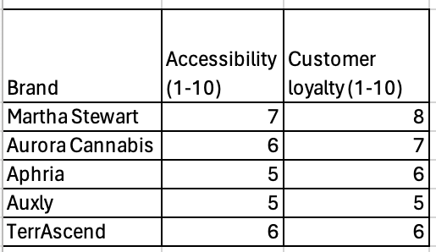
PERCEPTUAL MAPS:3
Martha Stewart demonstrates strong accessibility and customer loyalty, with scores of 7 and 8 out of 10, respectively. Aurora Cannabis follows closely behind with slightly lower scores in both categories, while Aphria, Auxly, and TerrAscend exhibit moderate ratings in terms of accessibility and customer loyalty. Overall, Martha Stewart stands out as a brand with high accessibility and strong customer loyalty, positioning it as a preferred choice among consumers and enhancing its competitive advantage in the market.

Slide 35
POSITIONING STATEMENT
For targeting the Medical Cannabis Patients segment, Martha Stewart and Canopy Growth Corporation have to maintain the quality and standard. It is the way to lead the industry and have a sustainable growth over time, that will idealize the company in this sector offering a curated selection of premium cannabis products crafted with the highest quality standards, ensuring a luxurious and trustworthy experience. Because our products are developed in collaboration with Martha Stewart, a trusted lifestyle expert renowned for her commitment to quality and excellence. Each product undergoes rigorous testing and quality control measures, guaranteeing the utmost safety and efficacy. With Martha Stewart Cannabis, consumers can indulge in premium cannabis products with confidence, knowing they are curated by a brand synonymous with sophistication and integrity.

Slide 36
After understanding the Positioning statement what are the key benefits then?
Premium Quality Assurance: The positioning emphasizes the joint venture's commitment to offering premium cannabis products crafted with the highest quality standards, ensuring a luxurious experience for medical cannabis patients.
Trusted Collaboration with Martha Stewart: The strength of the reason to believe lies in the collaboration with Martha Stewart, a renowned lifestyle expert known for her commitment to quality and excellence. Her association lends credibility and trustworthiness to the products, reinforcing the commitment to quality.
Rigorous Testing and Quality Control: Each product undergoes rigorous testing and quality control measures, guaranteeing the utmost safety and efficacy. This ensures that medical cannabis patients can rely on the products for their therapeutic needs.
Brand Synonymous with Sophistication and Integrity: Martha Stewart's association with the brand signifies sophistication and integrity, further enhancing consumer trust and confidence in the product offerings.
Sustainable Growth and Industry Leadership: By maintaining quality and standards, the joint venture aims to lead the industry and achieve sustainable growth over time. This commitment to excellence solidifies the brand's position as a leader in the medical cannabis segment.
Curated Selection of Premium Cannabis Products: The joint venture offers a curated selection of premium cannabis products, catering specifically to the needs of medical cannabis patients. This curated approach ensures that patients receive products tailored to their therapeutic requirements.
Consumer Confidence and Peace of Mind: With Martha Stewart Cannabis, consumers can indulge in premium cannabis products with confidence, knowing that they are curated by a brand synonymous with sophistication and integrity. This instills peace of mind among medical cannabis patients, fostering loyalty and repeat purchases.
Upholding Highest Standards: The brand's dedication to upholding the highest standards of quality and excellence sets it apart in the competitive landscape of the medical cannabis industry, reinforcing its position as a trusted provider of premium cannabis products for medical use.

Slide 37
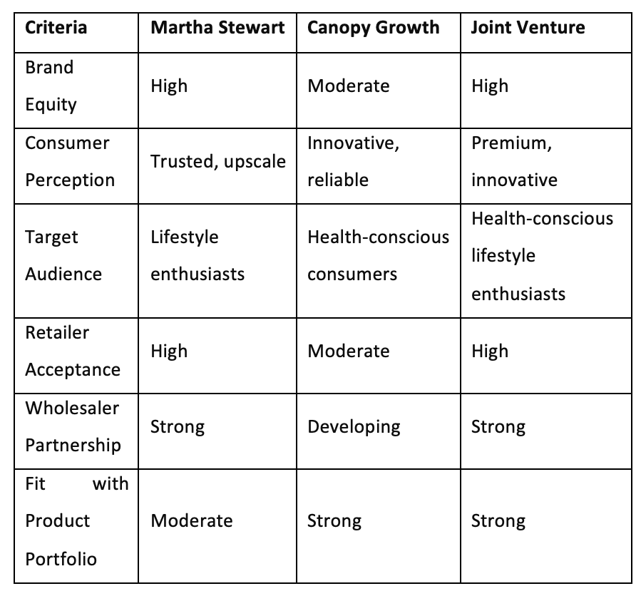
What kind of brand strategy should we adopt?
CRITERIA TABLE
The joint venture should adopt a sub-branding strategy from the brand relationship spectrum. This strategy allows leveraging the equity of both Martha Stewart and Canopy Growth while maintaining distinctiveness for the cannabis products.
The products offered by the joint venture should be branded under the name "Martha Stewart Cannabis," with each product line or category having a unique sub-brand name.
Recommendation: Based on the criteria evaluation, a sub-branding strategy leveraging the Martha Stewart and Canopy Growth brands is recommended. The products should be branded as "Martha Stewart Cannabis," reflecting the premium quality and trust associated with Martha Stewart's lifestyle expertise, while aligning with the innovative and reliable reputation of Canopy Growth in the cannabis industry.

Slide 38
After thorough analysis and evaluation, the following recommendations are proposed
1. Market Definition: Focus on the lifestyle cannabis market segment, targeting health-conscious lifestyle enthusiasts who value premium quality and trust. In these types of segments, trust is an important thing to involve the conservative buyers.
2. Situation Analysis & Insights: Highlighted the strengths and weaknesses of both Martha Stewart and Canopy Growth, emphasizing their potential for collaboration in the cannabis industry.
3. Fit Between Brands: Identified the strategic fit between Martha Stewart and Canopy Growth, leveraging their respective strengths to address unique challenges in the cannabis market.
4. Problem Identification: Identified the need to establish a clear brand positioning and product differentiation strategy in the competitive cannabis market. As soon as the problem is addressed, the growth has no limits.
5. Segmentation Base Decision: Recommended lifestyle-based segmentation to effectively target health-conscious consumers seeking premium cannabis products.

Slide 39
6. Target Market Decision: Segmented the market based on lifestyle factors and health consciousness, targeting affluent lifestyle enthusiasts with premium cannabis offerings.
7. Positioning Decision: Positioned Martha Stewart Cannabis as the premium lifestyle brand offering innovative and high-quality cannabis products, leveraging Martha Stewart's trusted reputation.
8. Key Benefit Determination & Positioning Statement: Crafted a positioning statement emphasizing Martha Stewart Cannabis as the premium brand for health-conscious lifestyle enthusiasts seeking innovative cannabis solutions.
9. Brand Strategy & Brand Name: Adopted a sub-branding strategy, branding products under "Martha Stewart Cannabis" to capitalize on both brand equities.
Summary Rationale: These recommendations aim to capitalize on the unique strengths of both Martha Stewart and Canopy Growth, positioning Martha Stewart Cannabis as the leading premium brand in the lifestyle cannabis market. By leveraging Martha Stewart's trusted reputation and Canopy Growth expertise in cannabis innovation, the joint venture can establish a strong foothold in the competitive cannabis

Slide 40
Let’s figure out how much is our industry attractive?
Introduction
This deck outlines a marketing strategy for the Martha Stewart CBD partnership with Canopy Growth Corporation, considering the current landscape of the legal cannabis industry in North America (US and Canada). We will analyze industry attractiveness using Porter's Five Forces and assess the competitive advantage of the joint venture through VRIO analysis.
Industry Attractiveness (Porter's Five Forces)
Threats of New Entrants (LOW-MEDIUM)
Barriers to Entry: Regulations, licensing requirements, and brand recognition create moderate barriers.
Capital Expenditure: Cultivation facilities and brand building require significant capital investment.
Distribution Challenges: Establishing distribution channels in a complex regulatory environment can be difficult.
Overall: The cannabis industry is still evolving, but the barriers are not insurmountable for large, well-funded companies.

Slide 41
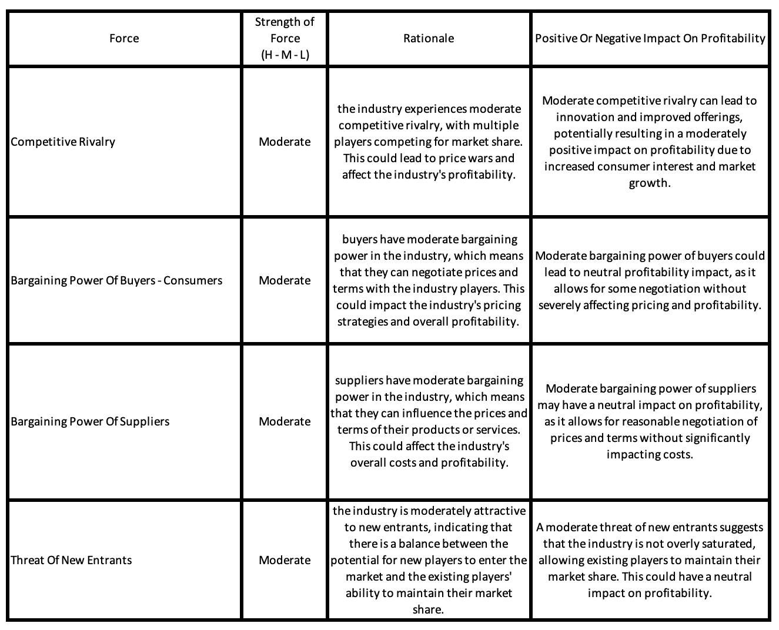
6 FORCES
So, how is the market overall ?
The overall market attractiveness for the industry appears moderately positive, characterized by moderate competitive rivalry, bargaining power from both buyers and suppliers, and a moderate threat of new entrants. While competition may lead to price pressures, it also drives innovation and market growth. Additionally, the balanced bargaining power of buyers and suppliers allows for negotiation without severely impacting profitability. The moderate threat of new entrants indicates opportunities for both existing and new players to thrive, maintaining a healthy level of market competition. Overall, these factors collectively suggest favorable conditions for profitability and growth within the industry.

Slide 42
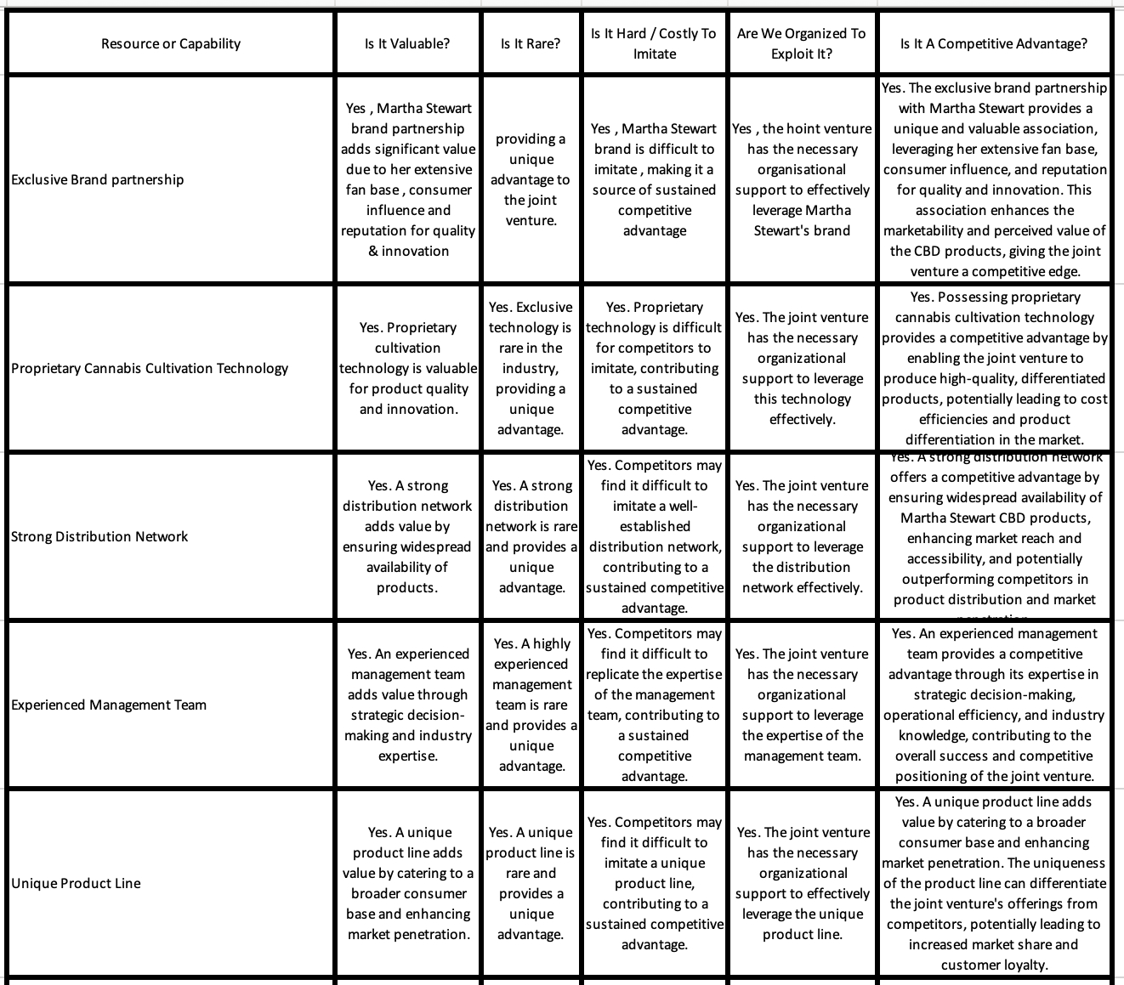
Let's Analyze the competitive advantages
The VRIO analysis reveals several key competitive advantages for Martha Stewart in the joint venture. Firstly, the exclusive brand partnership with Martha Stewart brings significant value due to her extensive fan base, consumer influence, and reputation for quality and innovation, providing a unique advantage that is difficult for competitors to imitate. Secondly, the possession of proprietary cannabis cultivation technology contributes to product quality and innovation, offering a sustained competitive advantage through its rarity and difficulty of imitation. Additionally, a strong distribution network ensures widespread availability of Martha Stewart CBD products, enhancing market reach and accessibility, and potentially outperforming competitors in product distribution and market penetration. Moreover, an experienced management team adds value through strategic decision-making and industry expertise, further contributing to the joint venture's competitive positioning and success. Finally, a unique product line caters to a broader consumer base, enhancing market penetration and differentiation from competitors, thus solidifying Martha Stewart's competitive advantage in the cannabis industry.

Slide 43
REFERENCES
1. Report State Medical Cannabis Laws (no date) National Conference of State Legislatures. Available at: https://www.ncsl.org/health/state-medical-cannabis-laws (Accessed: 26 March 2024).
2. McNarland, B. (2024) Canopy Growth’s U.S. market strategy, The Dales Report. Available at: https://thedalesreport.com/cannabis/canopy-growths-u-s-market-strategy/#:~:text=Legal%20and%20Regulatory%20Strategy%3A%20Through,in%20the%20U.S.%20cannabis%20industry. (Accessed: 26 March 2024).
3. Reiff, N. (no date) 7 biggest canadian marijuana companies, Investopedia. Available at: https://www.investopedia.com/top-canadian-cannabis-companies-by-revenue-4587803 (Accessed: 26 March 2024).
4. Corporation, C.G. (2021) Canopy Growth welcomes Martha Stewart as Official Strategic advisor, PR Newswire: press release distribution, targeting, monitoring and marketing. Available at: https://www.prnewswire.com/news-releases/canopy-growth-welcomes-martha-stewart-as-official-strategic-advisor-301295741.html (Accessed: 26 March 2024).

