Slide 1


HOW TO ACCESS MINTS DATA

Slide 2
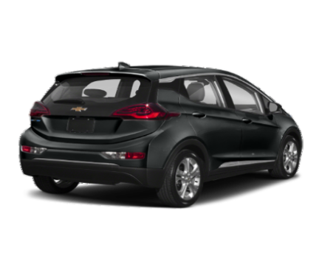
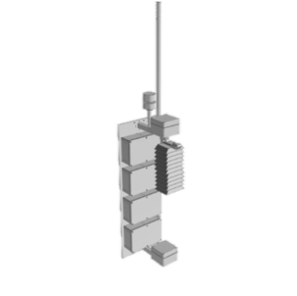
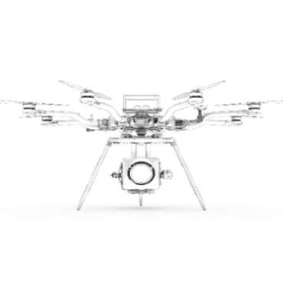
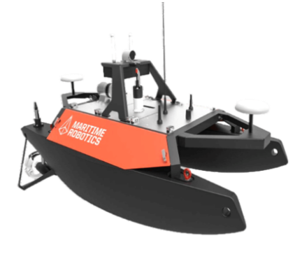
MINTS Lab
MINTS is a multidisciplinary platform developing intelligent sensing system headquartered at the University of Texas at Dallas (UTD). The platform hosts experts from the UTD department of Physics as well as other academic branches within UTD. MINTS data collected by different types of sentinels such as Ground observation monitors, Aerial survey and Robotic boat, etc.
Access MINTS data:
Public Portal:
https://www.sharedairdfw.com/
Comprehensive Grafana Dashboards:
http://mdash.circ.utdallas.edu:3000

Slide 3
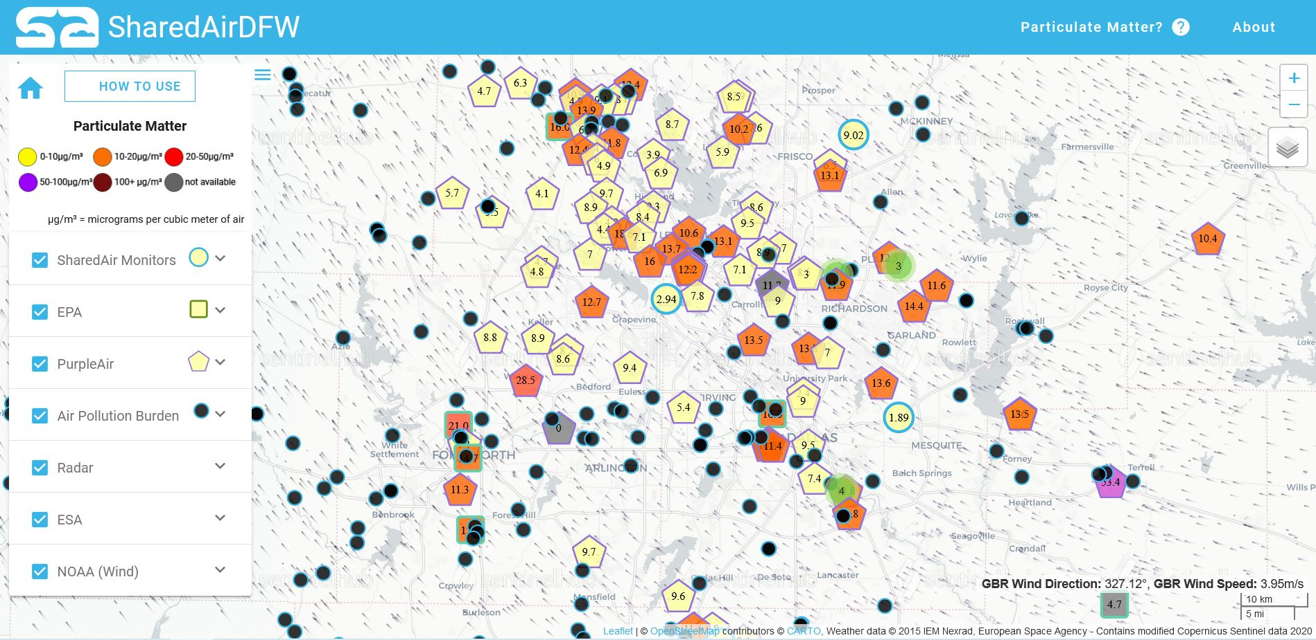
SharedAirDFW
Here is a view of a sample SharedAirDFW page. This page is essentially a map for Particulate Matter (PM_{2.5}) ground monitor locations, where only PM_{2.5} data can be obtained for easier consumption.
You can access the SharedAirDFW using https://www.sharedairdfw.com/
HOW-TO USE
SHOW/HIDE PANEL
PARTICULATE MATTER
ABOUT
HOME
ZOOM IN/OUT
MAP STYLE
SHAREDAIR MONITORS
EPA
PURPLEAIR
AIR POLLUTION BURDEN
RADAR
ESA
NOAA (WIND)

Slide 4
HOME |  | HOW-TO USE
This take you back to the default settings: It only display SharedAir monitors’ locations on the Carto Positron map style with wind vectors. |  | You can use this HOW-TO USE button to pop up brief instruction window. It provides how to see the real time data in each sensor and how to change the map style.
SHOW/HIDE PANEL |  | PARTICULATE MATTER
This button can be used to change the appearance of right-side Control panel. You can access full map hiding the Control panel by hitting on this button. |  | Once you hit this button it pops up new window with a brief description about Particulate Matter.
ABOUT |  | ZOOM IN/OUT
This provides you about this website by opening new window. It is a brief description about the SharedAir monitors and the developer of sensor and the website. |  | There are two separate buttons, “+” and “-”. These allows you to zoom in and zoom out the map area.
MAP STYLE
There are four map styles can be selected using this button. Once you get the mouse cursor on this icon it expand with map options: Carto Positron, Dark mode, Satellite and Street map.

Slide 5
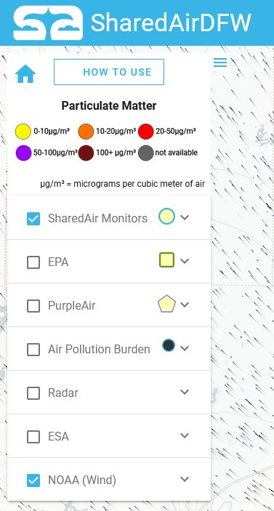
At top of the Control panel includes HOME, HOW TO USE and SHOW/HIDE PANEL buttons.
Color chart for different concentration range of Particulate Matter display right bellow the buttons
There are seven individual panels series bellow the Color chart.
Each panel has a check box and a drop-down menu.
By selecting check box make sensor location visible on the map (except NOAA (wind),).
By selecting check box of NOAA (wind) allows to display the wind vectors.
By hitting on drop-down menu of each panel shows more details and options available.

Slide 6
SHAREDAIR MONITORS |  | EPA
SharedAir monitors made in MINTS lab at UTD. Mainly PM_{2.5} concentration data available on this site. Under the drop-down menu two options are available for data averaging: hour average and 30 second average. Default is 30 second average. |  | PM_{2.5} data obtain from the EPA's Air Quality System (AQS) database collected by state, local, tribal, and federal air pollution control agencies from thousands of monitors around the nation. Only PM_{2.5} hourly averaged data available on this site.
PURPLEAIR |  | AIR POLLUTION BURDEN
PurpleAir, a community system of PM low-cost sensors that are installed, controlled and maintained by members of the community. Only PM_{2.5} data obtained from this database. |  | Yearly estimated PM_{2.5} concentration where major air pollution are permitted.
RADAR |  | ESA
Some of weather data obtained from Radar |  | Three types of data can be monitored: NO₂, CO and CH₄. Data obtained by ESA (European Space Agency)
NOAA (WIND)
Wind data obtained from NOAA (National Oceanic and Atmospheric Administration’s) database. Selecting this display wind vectors on the map. Wind direction and speed at the location where the mouse cursor displayed on the right bottom.

Slide 7
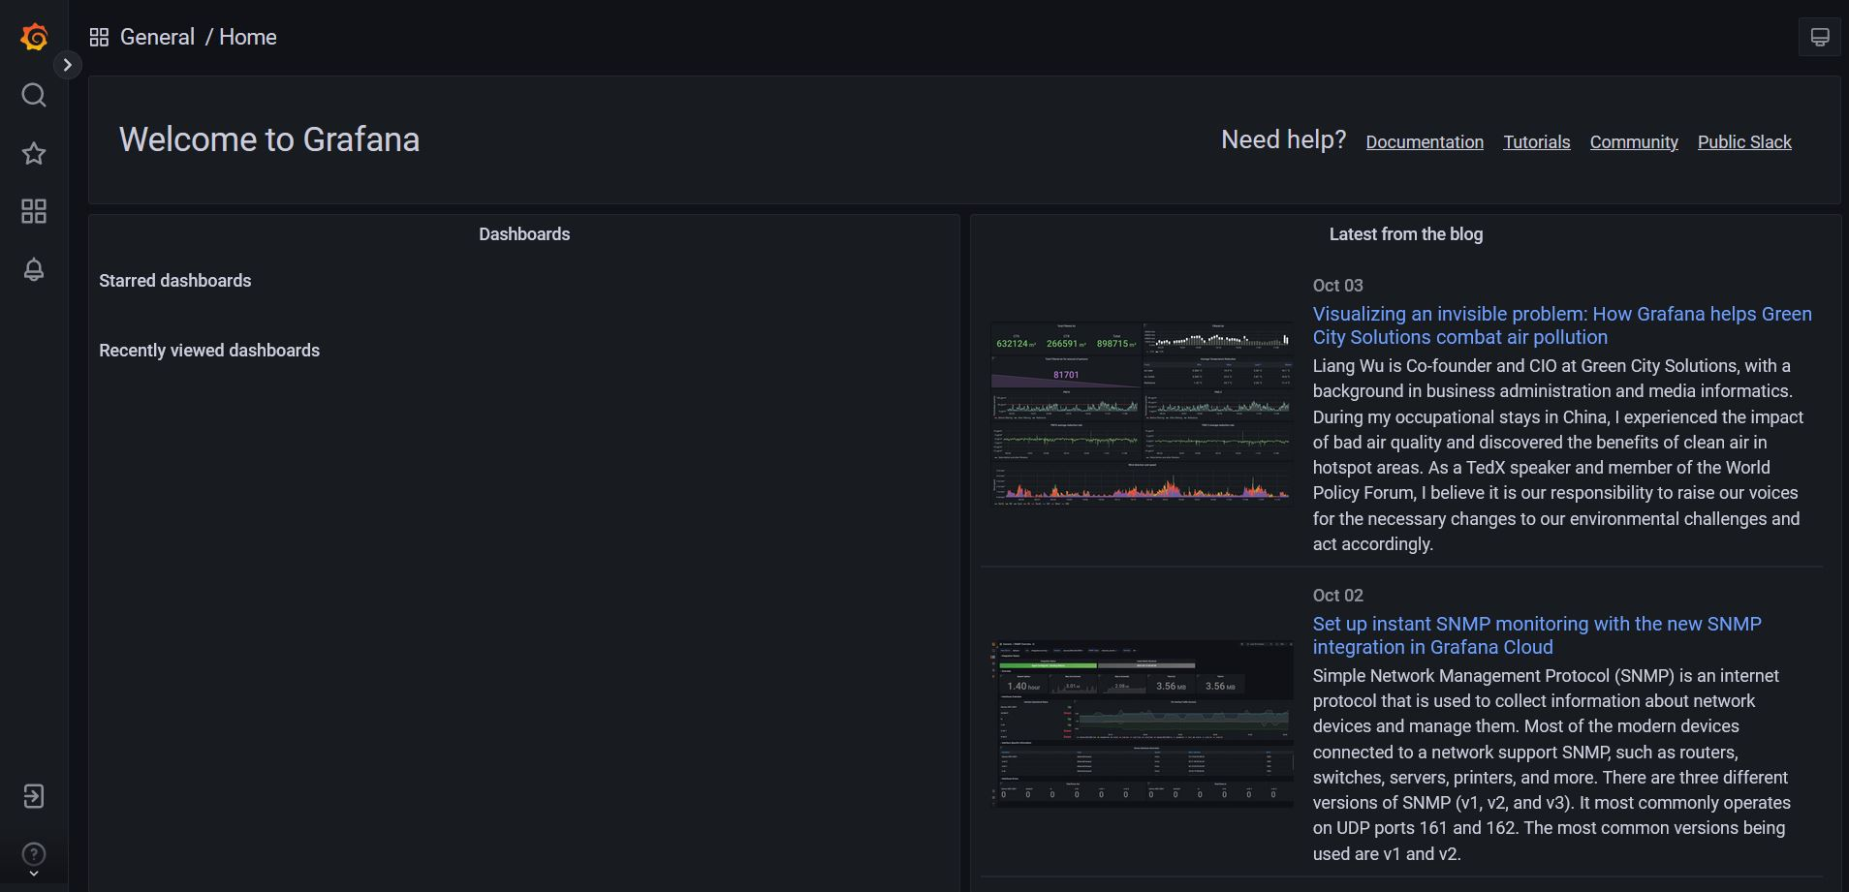
Grafana Dashboard
You can access MINTS Lab’s Grafana dashboard using http://mdash.circ.utdallas.edu:3000
Here is a view of a sample Grafana Dashboard home page:
HOME
SEARCH
STARRED
DASHBOARDS
ALERTING
SIGN IN
HELP

Slide 8
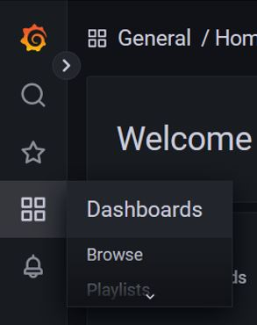
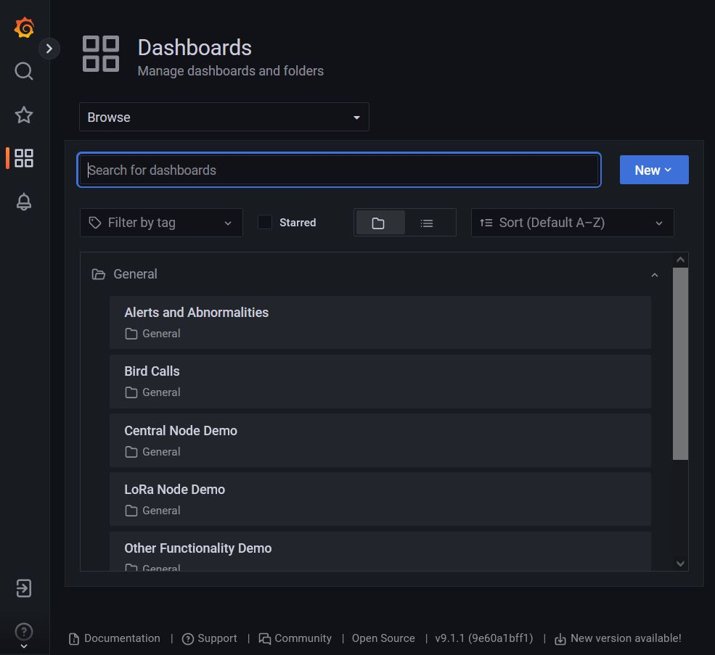
MINTS Lab Grafana Dashboard
1
2
Dashboards
icon
1
When you get your mouse cursor on Dashboards icon, it expand a drop-down menu.
Available MINTS Dashboards
2
Browse option in the Dashboards drop-down menu allows you to access all the available Dashboards of MINTS Lab
You can open any Dashboard under the General folder by selecting the relevant tile.

Slide 9
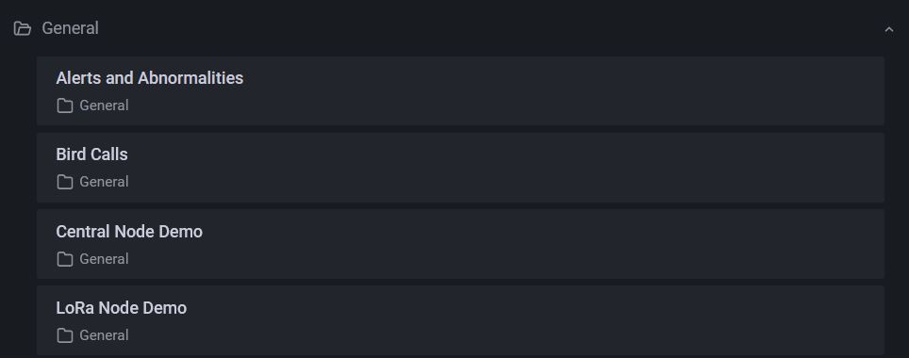
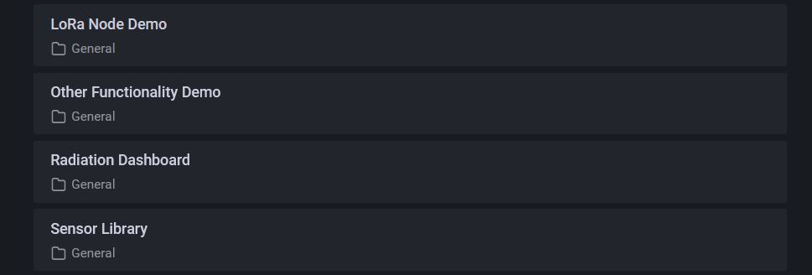
Currently available MINTS Dashboards
Bird Calls data classification
Central Nodes comprehensive data: PM data, Ozone, CO₂ and some of climate data
LoRa Nodes data: PM data and some of climate data

Slide 10
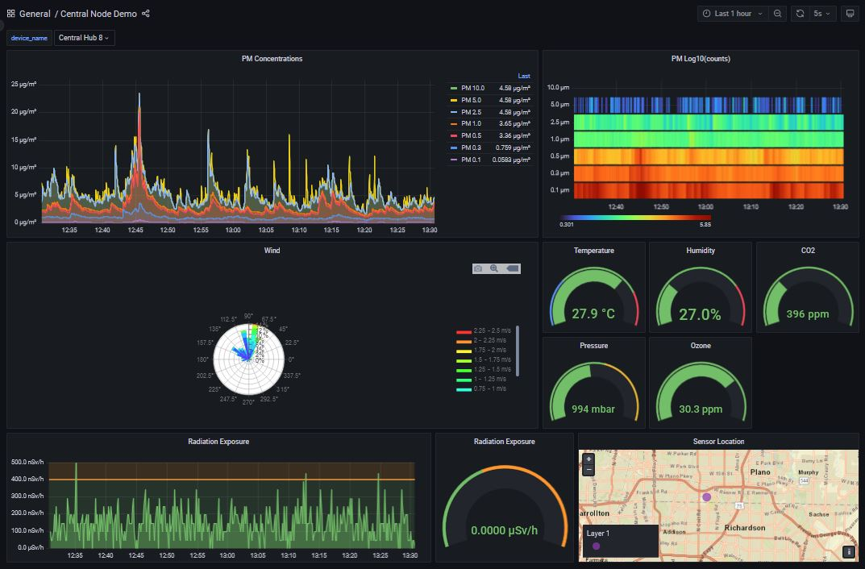
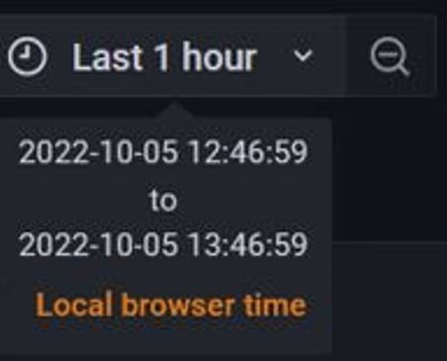

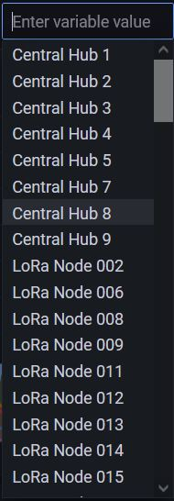
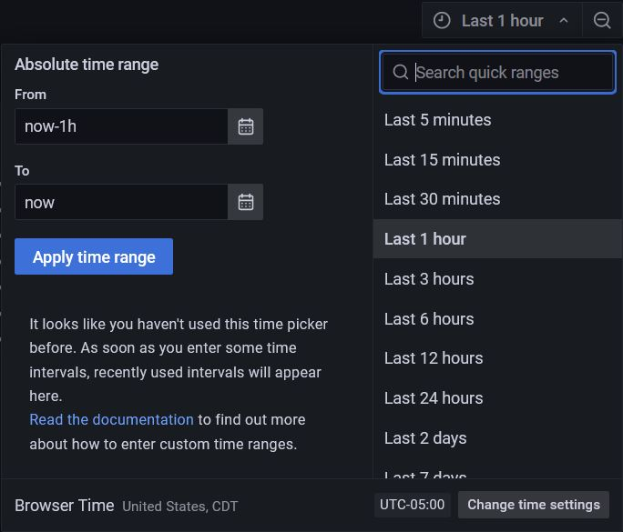

Sample Central Node Demo Dashboard page:
Tool Bar: You can change the time interval and average time interval
When you get your mouse cursor on top of Tool Bar, it shows you the time interval currently selected.
This drop-down menu allows you to select available Central and LoRa nodes. But only Central Nodes give better visualization on Central Node Demo Dashboard
Here you can select average time interval
You can change the time interval for display the data

Slide 11
Sample Dashboard display data of Central Hub 8
1
PM data for last hour. The data visible time duration depend on selected time interval from Tool Bar.
1
2
2
Spectrum of log value of PM.
3
Wind data from Airmar. Angle represent the wind direction, color code for wind speed and radial length for duration as a percentage.
4
Real time weather data, CO₂ and Ozone.
3
4
5
Radiation data for last hour. The data visible time duration depend on selected time interval from Tool Bar.
6
Real time radiation data.
7
Sensor location from GPS. You can zoom in and out.
5
6
7

Slide 12
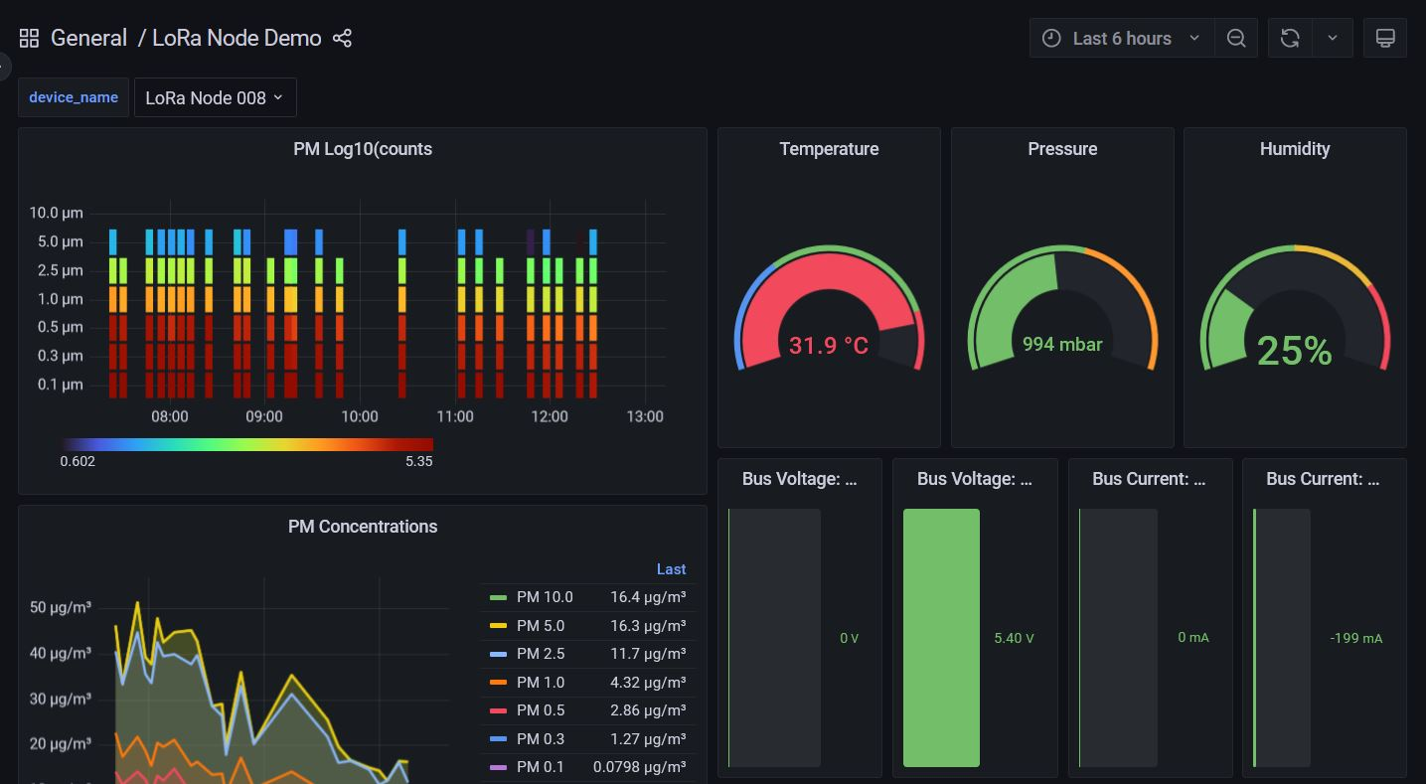
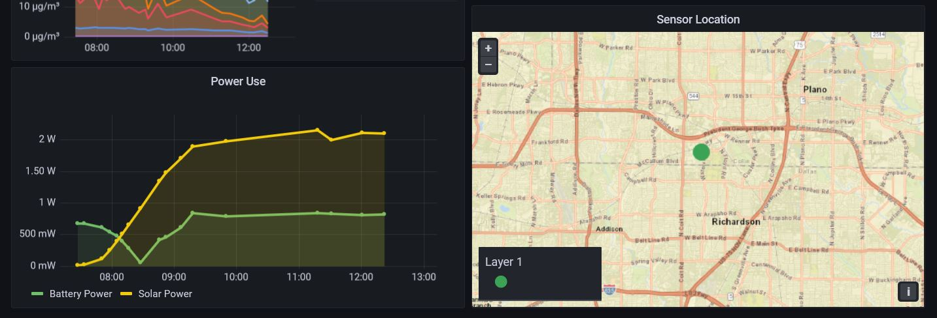
Sample Dashboard display data of LoRa Node 008
1
Spectrum of log value of PM.
1
2
2
Real time weather data.
3
PM data for last 6 hours. The data visible time duration depend on selected time interval from Tool Bar.
4
Real time current and voltage status of Battery and solar panel.
3
4
5
Power usage of sensor from battery and solar panel for last 6 hours.
6
Sensor location from GPS. You can zoom in and out.
6
5

Slide 13
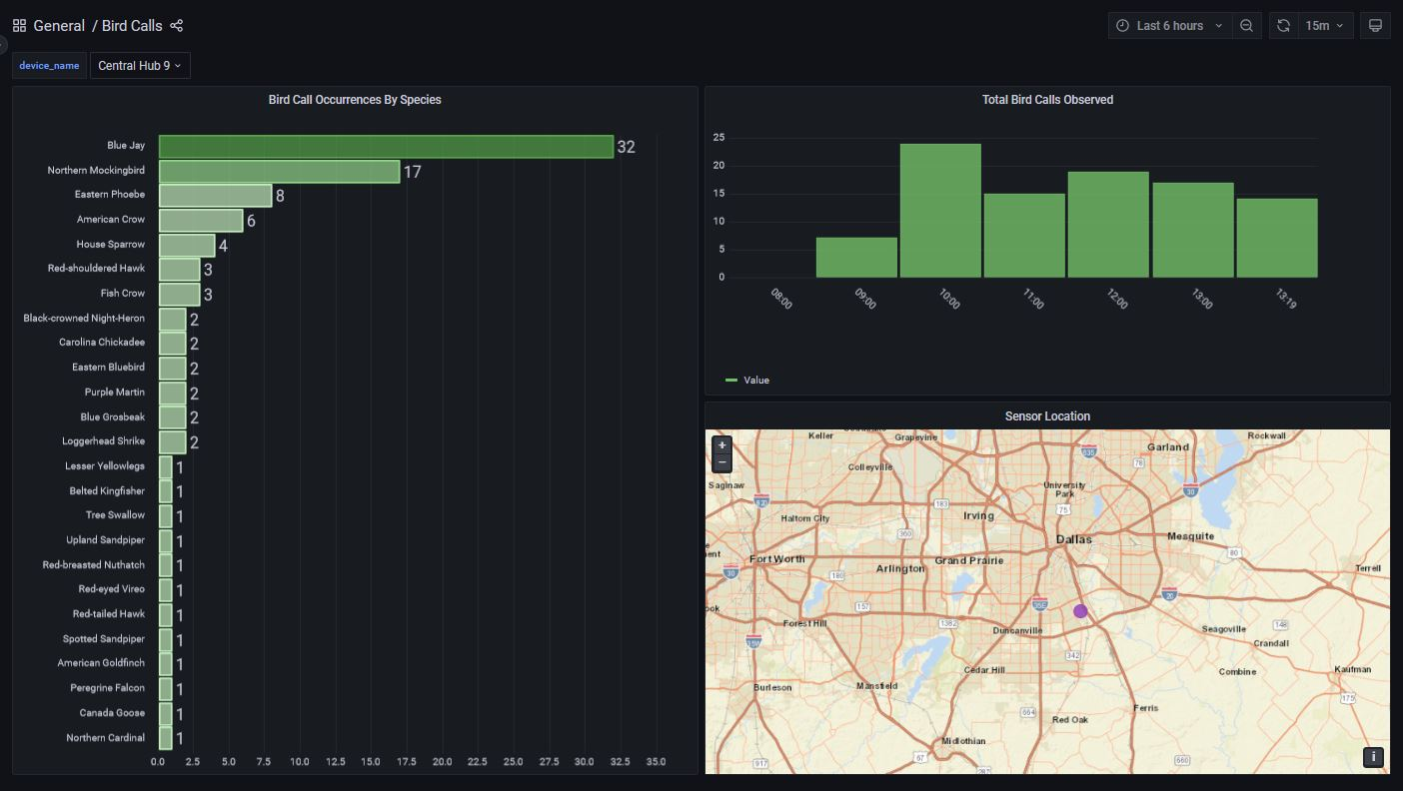
Sample Dashboard display Bird calls data
Bird calls: Central nodes includes microphone which record the bird calls and classify the species.
1
Bird calls classification: Number of bird calls for different species for last 6 hours.
2
Total number of bird calls for last 6 hours.
3
Sensor location from GPS. You can zoom in and out.

