Slide 1
Crucial Factors of Nonperforming loans Evidence from Pakistani Banking Sector
Presentation By:
Muhammad Usman
Mirza Kashif

Slide 2

Introduction
A non performing loan is any loan in which interest and principle payments are more than 90 days overdue. (IMF, 2005).
Nonperforming loans are of immense importance as they define the asset quality, credit risk of the Bank.
The main function of banks is credit creation through mobilization of deposits.
Notes:
A non performing loan is any loan in which interest and principle payments are more than 90 days overdue. (IMF, 2005).
Nonperforming loans are of immense importance as they define the asset quality, credit risk of the Bank.
The main function of banks is credit creation through mobilization of deposits.

Slide 3
Effect of NPL at a Macro Level
If Non Performing Loans increase the banks would not be able to give out loans which would ultimately hinder economic growth.
Economic growth cannot prosper without strong financial sector.
Notes:
If Non Performing Loans increase the banks would not be able to give out loans which would ultimately hinder economic growth.
Economic growth cannot prosper without strong financial sector.

Slide 4

Evidence from Past Studies
A study based on NPL published in 1991 by T. Clair which came a conclusion that rapid credit growth can cause the credit quality to deteriorate which can eventually cause banks to declare bankruptcy.
According to a research done in Pakistan in 2012 it was found that interest rate; exchange rate, unemployment, inflation, and energy crisis have positive association with NPLs while GDP growth has negative relationship with NPLs.
Notes:
A study based on NPL published in 1991 by T. Clair which came a conclusion that rapid credit growth can cause the credit quality to deteriorate which can eventually cause banks to declare bankruptcy.
According to a research done in Pakistan in 2012 it was found that interest rate; exchange rate, unemployment, inflation, and energy crisis have positive association with NPLs while GDP growth has negative relationship with NPLs.

Slide 5

NPL
NPL = f (GDP, WALR, MAT, CDR, CAR)
Gross Domestic Product is the total monetary or market value of all the finished goods and services produced within a country
Weighted Average Lending Rate is the weighted average of interest rates charged by banks on loans using share of the corresponding loan amount to total loans as weight.
Maturity time period refers to the period in which a borrower's final loan payment is due.
Credit Deposit Ratio is the ratio of how much a bank lends out of it’s deposits.
Capital Adequacy Ratio is a ratio which show the cushion to absorb a reasonable amount of losses before a bank becomes insolvent.
Notes:
GDP is the total monetary or market value of all the finished goods and services produced within a country
Weighted average interest rate is an average that is adjusted to reflect the contribution of each loan to the total debt. The weighted average multiplies each loan's interest rate by the loan balance and divides the sum by the total loan balance.
Maturity time period refers to the period in which a borrower's final loan payment is due.
CDR is the ratio of how much a bank lends out of it’s deposits
CAR is a ratio which show the cushion to absorb a reasonable amount of losses before a bank becomes insolvent.

Slide 6

Factors affecting NPLs
Gross domestic Product
A higher GDP would mean that the borrowers would be performing better and therefore would be in a better position to repay loans
Weighted average lending rate
An increase in lending rate hurts the loan repayment capacity of the borrower therefore NPLs level increase by the increase in interest rate
Maturity time period
Longer maturity period would mean that borrowers would have a longer time to repay their loans
Credit deposit ratio
A high Credit deposit ratio would mean that if the banks have lent out a higher proportion of loans compared to it’s deposits, there are higher changes of NPLs.
Capital adequacy ratio
CAR is critical to ensure that banks have enough cushion to absorb a reasonable amount of losses before they become insolvent. A higher CAR would allow banks to make more loans and hence increasing the probability of NPLs

Slide 7
GDP, CDR, MAT and CAR have a negative relation with NPLs in Pakistan
Weighted average lending rate has positive relation with NPLs

Slide 8
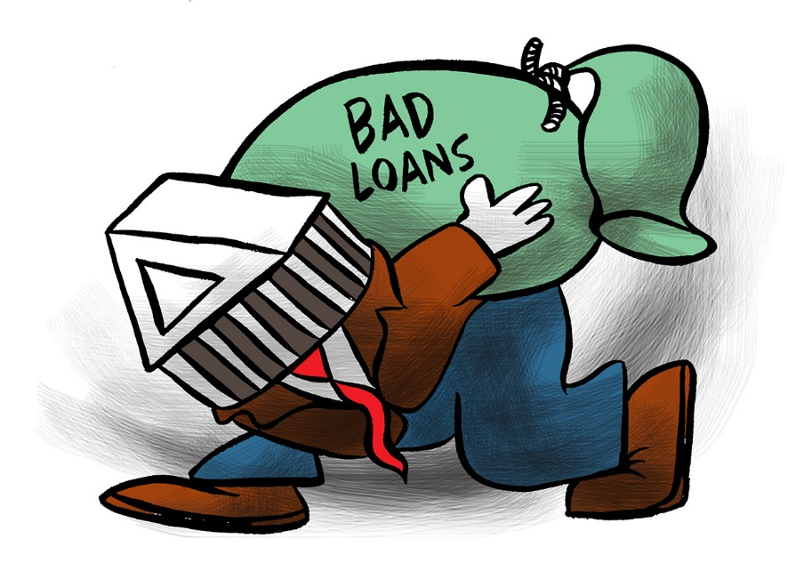
Drawbacks of NPLs
Reduction in net interest income;
Increase in impairments costs;
Additional capital requirement for high-risk weighted assets;
Lower ratings and increased cost of funding, adversely affecting equity valuations;
Reduced risk appetite for new lending; and
Additional management time and servicing costs to resolve the problem.

Slide 9

Recommendations to reduce NPLs
Detect NPL early: The banks should not just rely solely on lagging indicators
Better to have a problem loan than an NPL: It is far better if the lending department can work with the customer to resolve the problem rather than the customer goes into default and after 45 days be transferred to the loan Workout Department
Banks must focus on leading indicators of problems: increased use of overdraft, seeking new credit lines, slow payment of trade creditors, late supply of information. These tend to show potential signs of an NPL
Management analysis: A thorough analysis of borrower’s management must be conducted prior to the loan disbursement that might involves a review of the general management capabilities, crisis management capabilities, management’s integrity and turnaround management capabilities
Financial statement analysis: Financial statement analysis attempts to evaluate, from a financial perspective, the company’s performance in the light of the causes and viability of the core businesses

Slide 10
Thank You!

