Slide 1
Chapter Nine
New-Product Development and Product Life-Cycle Strategies
Copyright ©2014 by Pearson Education, Inc. All rights reserved

Slide 2
New-Product Development and Product Life-Cycle Strategies
Topic Outline
New-Product Development Strategy
New-Product Development Process
Managing New-Product Development
Product Life-Cycle Strategies
Additional Product and Service Considerations
Copyright ©2014 by Pearson Education, Inc. All rights reserved

Slide 3
New-Product Development Strategy
Two ways to obtain new products
Acquisition refers to the buying of a whole company, a patent, or a license to produce someone else’s product
New product development refers to original products, product improvements, product modifications, and new brands developed from the firm’s own research and development
Copyright ©2014 by Pearson Education, Inc. All rights reserved
Notes:
New products are important—to both customers and the marketers who serve them. For companies, new products are a key source of growth. For customers, they bring new solutions and variety to their lives. Yet, innovation can be very expensive and very risky. New products face tough odds. According to one estimate, 90 percent of all new products in America fail. Each year, companies lose an estimated $20 billion to $30 billion on failed food products alone.
A firm can obtain new products in two ways. One is through acquisition—by buying a whole company, a patent, or a license to produce someone else’s product. The other is through the firm’s own new-product development efforts. By new products we mean original products, product improvements, product modifications, and new brands that the firm develops through its own R&D efforts. In this chapter, we concentrate on new-product development.
New products are important to both customers and the marketers who serve them: They bring new solutions and variety to customers’ lives, and they are a key source of growth for companies. In today’s fast-changing environment, many companies rely on new products for the majority of their growth. For example, new products have almost completely transformed Apple in recent years. Sales of the iPhone and iPad—neither of which was available just six years ago—now bring in 72 percent of the company’s total revenues.
Yet innovation can be very expensive and very risky. New products face tough odds. By one estimate, 67 percent of all new products introduced by established companies fail. For new companies, the failure rate soars to 90 percent. Each year, U.S. companies lose an estimated $260 billion on failed new products.
Why do so many new products fail? There are several reasons. Although an idea may be good, the company may overestimate market size. The actual product may be poorly designed. Or it might be incorrectly positioned, launched at the wrong time, priced too high, or poorly advertised. A high-level executive might push a favorite idea despite poor marketing research findings. Sometimes the costs of product development are higher than expected, and sometimes competitors fight back harder than expected.
So, companies face a problem: They must develop new products, but the odds weigh heavily against success. To create successful new products, a company must understand its consumers, markets, and competitors and develop products that deliver superior value to customers.
New-product development starts with good new-product ideas—lots of them. For example, Cisco’s recent I-Prize “crowdsourcing” challenge attracted 1,200 ideas from 2,500 innovators in 104 countries. The remaining steps reduce the number of ideas and develop only the best ones into profitable products. Of the 1,200 ideas from Cisco’s I-Prize challenge, only a handful were developed.

Slide 4
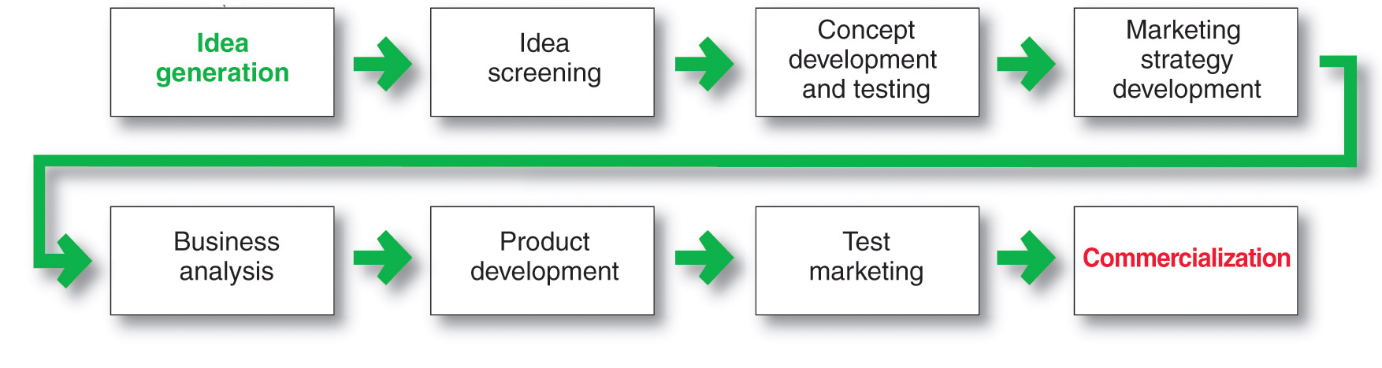
New-Product Development Process
Major Stages in New-Product Development
Copyright ©2014 by Pearson Education, Inc. All rights reserved
Notes:
A company must carry out strong new-product planning and set up a systematic, customer-driven new –product development process for finding and growing new products. Figure 9.1 shows the eight major steps in the process.

Slide 5

New-Product Development Process
Idea Generation
Idea generation is the systematic search for new-product ideas
Sources of new-product ideas
Internal
External
Copyright ©2014 by Pearson Education, Inc. All rights reserved
Notes:
Note to Instructor
Discussion Question
In groups of four come up with one idea for a new product.
It might be helpful if you assign each group a category including kitchen products, office supplies, laptop accessories, dessert products, bathroom accessories, children’s toys, baby products, etc. Students will realize this is very difficult.

Slide 6

New-Product Development Process
Idea Generation
Internal sources refer to the company’s own formal research and development, management and staff, and intrapreneurial programs
External sources refer to sources outside the company such as customers, competitors, distributors, suppliers, and outside design firms
Copyright ©2014 by Pearson Education, Inc. All rights reserved
Notes:
Idea Generation
New-product development starts with idea generation—the systematic search for new-product ideas. A company typically generates hundreds—even thousands—of ideas to find a few good ones. Major sources of new-product ideas include internal sources and external sources such as customers, competitors, distributors and suppliers, and others.
Internal Idea Sources
Using internal sources, the company can find new ideas through formal R&D. However, in a recent study, only 33 percent of companies surveyed rated traditional R&D as a leading source of innovation ideas. In contrast, 41 percent of companies identified customers as a key source, followed by heads of company business units (35 percent), employees (33 percent), and the sales force (17 percent).
Thus, beyond its internal R&D process, a company can pick the brains of its own people—from executives to salespeople to scientists, engineers, and manufacturing staff. Many companies have developed successful internal social networks and intrapreneurial programs that encourage employees to develop new-product ideas. For example, Twitter hosts an annual “Hack Week: Let’s Hack Together” event, which actively promotes internal innovation through experimentation around the company.
<ex09.02>
During Hack Week, a wide range of Twitter folks take time away from their day-to-day work to collaborate and see what crazy cool new things they can develop. Says one employee, “No meetings for a week. No releases for a week. And almost no rules. Go Hack Week!” This year, employees across the company formed nearly 100 teams to work on a variety of projects. Some developed ways to make Twitter even easier to use; others tested out cool new features or tools. Some projects were technical and strategic; some were simply fun and off the wall, giving people a chance to stretch their creative muscles. It’s still too soon to know exactly what will result from this year’s Hack Week, says Twitter, but “we can’t wait to find out. One thing we do know: We’ll have a bunch of awesome new products, features, and ideas.”
External Idea Sources
Companies can also obtain good new-product ideas from any of a number of external sources. For example, distributors and suppliers can contribute ideas. Distributors are close to the market and can pass along information about consumer problems and new-product possibilities. Suppliers can tell the company about new concepts, techniques, and materials that can be used to develop new products.
Competitors are another important source. Companies watch competitors’ ads to get clues about their new products. They buy competing new products, take them apart to see how they work, analyze their sales, and decide whether they should bring out a new product of their own. Other idea sources include trade magazines, shows, websites, and seminars; government agencies; advertising agencies; marketing research firms; university and commercial laboratories; and inventors.
Perhaps the most important sources of new-product ideas are customers themselves. The company can analyze customer questions and complaints to find new products that better solve consumer problems. Or it can invite customers to share suggestions and ideas. For example, the Danish-based LEGO Group, maker of the classic LEGO plastic bricks that have been fixtures in homes around the world for more than 60 years, systematically taps users for new-product ideas and input:
<ex09.03>
At the LEGO CUUSOO website, LEGO invites users to submit ideas for new LEGO products and to vote for other users’ ideas. Ideas supported by 10,000 votes get an internal review and a shot at production. Consumers who have their ideas chosen will earn 1 percent of the total net sales of the product. So far, the CUUSOO effort has produced dozens of major product ideas and three new products. The most recent release is LEGO Minecraft Micro World.

Slide 7
New-Product Development Process
Crowdsourcing
Inviting broad communities of people—
customers, employees, independent
scientists and researchers, and even the
public at large—into the new-product
innovation process.
Copyright ©2014 by Pearson Education, Inc. All rights reserved
Notes:
Crowdsourcing
More broadly, many companies are now developing crowdsourcing or open-innovation new-product idea programs. Crowdsourcing throws the innovation doors wide open, inviting broad communities of people—customers, employees, independent scientists and researchers, and even the public at large—into the new-product innovation process. For example, rather than relying only on its own R&D labs to produce all of the new-product innovations needed to support growth, Procter & Gamble developed its Connect + Develop crowdsourcing process. Through Connect + Develop, the company uncovers promising innovations from entrepreneurs, scientists, engineers, and other researchers—even consumers themselves—that will help it meet its goal of improving consumers’ lives (see Real marketing 9.1).
“The first rule of innovation these days is that the most powerful ideas often come from the most unexpected places—the quiet genius of employees inside your company, the hidden genius of customers,” says one expert. “Tapping into this hidden genius doesn’t require fancy technology or deep pockets—it just requires a leadership mindset that invites outside brainpower into the organization.”
Rather than creating and managing their own crowdsourcing platforms, companies can use third-party crowdsourcing networks, such as InnoCentive, TopCoder, Hypios, and jovoto. For example, organizations ranging from Facebook and PayPal to ESPN, NASA, and the Salk Institute tap into TopCoder’s network of nearly 400,000 mathematicians, engineers, software developers, and designers for ideas and solutions, offering prizes of $100 to $100,000. PayPal recently posted a challenge to the TopCoder community seeking the development of an innovative Android or iPhone app that would successfully and securely run its check-out process, awarding the winners $5,000 each. After only four weeks of competition and two weeks of review, PayPal had its solutions. The Android app came from a programmer in the United States; the iPhone app from a programmer in Colombia.
Crowdsourcing can produce a flood of innovative ideas. In fact, opening the floodgates to anyone and everyone can overwhelm the company with ideas—some good and some bad. For example, when Cisco Systems sponsored an open-innovation effort called I-Prize, soliciting ideas from external sources, it received more than 820 distinct ideas from more than 2,900 innovators from 156 countries. “The evaluation process was far more labor-intensive than we’d anticipated,” says Cisco’s chief technology officer. It required “significant investments of time, energy, patience, and imagination . . . to discern the gems hidden within rough stones.” In the end, a team of six Cisco people worked full-time for three months to carve out 32 semifinalist ideas, as well as nine teams representing 14 countries in six continents for the final phase of the competition.
Truly innovative companies don’t rely only on one source or another for new-product ideas. Instead, they develop extensive innovation networks that capture ideas and inspiration from every possible source, from employees and customers to outside innovators and multiple points beyond.

Slide 8
New-Product Development Process
Idea Screening
Identify good ideas and drop poor ideas
R-W-W Screening Framework:
  Is it real?
  Can we win?
  Is it worth doing?
Copyright ©2014 by Pearson Education, Inc. All rights reserved
Notes:
Idea Screening
The purpose of idea generation is to create a large number of ideas. The purpose of the succeeding stages is to reduce that number. The first idea-reducing stage is idea screening, which helps spot good ideas and drop poor ones as soon as possible. Product development costs rise greatly in later stages, so the company wants to go ahead only with those product ideas that will turn into profitable products.
Many companies require their executives to write up new-product ideas in a standard format that can be reviewed by a new-product committee. The write-up describes the product or the service, the proposed customer value proposition, the target market, and the competition. It makes some rough estimates of market size, product price, development time and costs, manufacturing costs, and rate of return. The committee then evaluates the idea against a set of general criteria.
One marketing expert proposes an R-W-W (“real, win, worth doing”) new-product screening framework that asks three questions. First, Is it real? Is there a real need and desire for the product and will customers buy it? Is there a clear product concept and will such a product satisfy the market? Second, Can we win? Does the product offer a sustainable competitive advantage? Does the company have the resources to make such a product a success? Finally, Is it worth doing? Does the product fit the company’s overall growth strategy? Does it offer sufficient profit potential? The company should be able to answer yes to all three R-W-W questions before developing the new-product idea further.

Slide 9
New-Product Development Process
Concept Development and Testing
Product idea is an idea for a possible product that the company can see itself offering to the market
Product concept is a detailed version of the idea stated in meaningful consumer terms
Product image is the way consumers perceive an actual or potential product
Copyright ©2014 by Pearson Education, Inc. All rights reserved
Notes:
Concept Development and Testing
An attractive idea must then be developed into a product concept. It is important to distinguish between a product idea, a product concept, and a product image. A product idea is an idea for a possible product that the company can see itself offering to the market. A product concept is a detailed version of the idea stated in meaningful consumer terms. A product image is the way consumers perceive an actual or potential product.

Slide 10
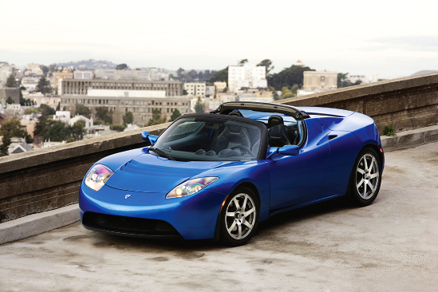
New-Product Development Process
Concept Development and Testing
Concept testing refers to testing new-product concepts with groups of target consumers
Copyright ©2014 by Pearson Education, Inc. All rights reserved
Notes:
Concept Testing
Concept testing calls for testing new-product concepts with groups of target consumers. The concepts may be presented to consumers symbolically or physically. Here, in more detail, is concept 3:
An efficient, fun-to-drive, battery-powered compact car that seats four. This 100 percent electric wonder provides practical and reliable transportation with no pollution. It goes 300 miles on a single charge and costs pennies per mile to operate. It’s a sensible, responsible alternative to today’s pollution-producing gas-guzzlers. Its fully equipped price is $25,000.
Many firms routinely test new-product concepts with consumers before attempting to turn them into actual new products. For some concept tests, a word or picture description might be sufficient. However, a more concrete and physical presentation of the concept will increase the reliability of the concept test. After being exposed to the concept, consumers then may be asked to react to it by answering questions similar to those in Table 9.1.
The answers to such questions will help the company decide which concept has the strongest appeal. For example, the last question asks about the consumer’s intention to buy. Suppose 2 percent of consumers say they “definitely” would buy, and another 5 percent say “probably.” The company could project these figures to the full population in this target group to estimate sales volume. Even then, however, the estimate is uncertain because people do not always carry out their stated intentions.

Slide 11
New-Product Development Process
Marketing Strategy Development
Marketing strategy development refers to the initial marketing strategy for introducing the product to the market
Marketing strategy statement includes:
  Description of the target market
  Value proposition
  Sales and profit goals
Copyright ©2014 by Pearson Education, Inc. All rights reserved
Notes:
Marketing Strategy Development
Suppose the carmaker finds that concept 3 for the electric car tests best. The next step is marketing strategy development, designing an initial marketing strategy for introducing this car to the market.
The marketing strategy statement consists of three parts. The first part describes the target market; the planned value proposition; and the sales, market share, and profit goals for the first few years. The second part of the marketing strategy statement outlines the product’s planned price, distribution, and marketing budget for the first year.
The third part of the marketing strategy statement describes the planned long-run sales, profit goals, and marketing mix strategy:.

Slide 12
New-Product Development Process
Marketing Strategy Development
Business analysis involves a review of the sales, costs, and profit projections to find out whether they satisfy the company’s objectives
Copyright ©2014 by Pearson Education, Inc. All rights reserved
Notes:
Business Analysis
Once management has decided on its product concept and marketing strategy, it can evaluate the business attractiveness of the proposal. Business analysis involves a review of the sales, costs, and profit projections for a new product to find out whether they satisfy the company’s objectives. If they do, the product can move to the product development stage.
To estimate sales, the company might look at the sales history of similar products and conduct market surveys. It can then estimate minimum and maximum sales to assess the range of risk. After preparing the sales forecast, management can estimate the expected costs and profits for the product, including marketing, R&D, operations, accounting, and finance costs. The company then uses the sales and costs figures to analyze the new product’s financial attractiveness.

Slide 13

New-Product Development Process
Marketing Strategy Development
Product development
Involves the creation and testing of one or more physical versions by the R&D or engineering departments
Requires an increase in investment
Shows whether the product idea can be turned into a workable product.
Copyright ©2014 by Pearson Education, Inc. All rights reserved
Notes:
Product Development
For many new-product concepts, a product may exist only as a word description, a drawing, or perhaps a crude mock-up. If the product concept passes the business test, it moves into product development. Here, R&D or engineering develops the product concept into a physical product. The product development step, however, now calls for a huge jump in investment. It will show whether the product idea can be turned into a workable product.
The R&D department will develop and test one or more physical versions of the product concept. R&D hopes to design a prototype that will satisfy and excite consumers and that can be produced quickly and at budgeted costs. Developing a successful prototype can take days, weeks, months, or even years depending on the product and prototype methods.
Often, products undergo rigorous tests to make sure that they perform safely and effectively, or that consumers will find value in them. Companies can do their own product testing or outsource testing to other firms that specialize in testing.
A new product must have the required functional features and also convey the intended psychological characteristics. The all-electric car, for example, should strike consumers as being well built, comfortable, and safe. Management must learn what makes consumers decide that a car is well built. To some consumers, this means that the car has “solid-sounding” doors. To others, it means that the car is able to withstand a heavy impact in crash tests. Consumer tests are conducted in which consumers test-drive the car and rate its attributes.

Slide 14

New-Product Development Process
Marketing Strategy Development
Test marketing is the stage at which the product and marketing program are introduced into more realistic marketing settings
Provides the marketer with experience in testing the product and entire marketing program before full introduction
Copyright ©2014 by Pearson Education, Inc. All rights reserved
Notes:
Test Marketing
If the product passes both the concept test and the product test, the next step is test marketing, the stage at which the product and its proposed marketing program are introduced into realistic market settings. Test marketing gives the marketer experience with marketing a product before going to the great expense of full introduction. It lets the company test the product and its entire marketing program—targeting and positioning strategy, advertising, distribution, pricing, branding and packaging, and budget levels.

Slide 15
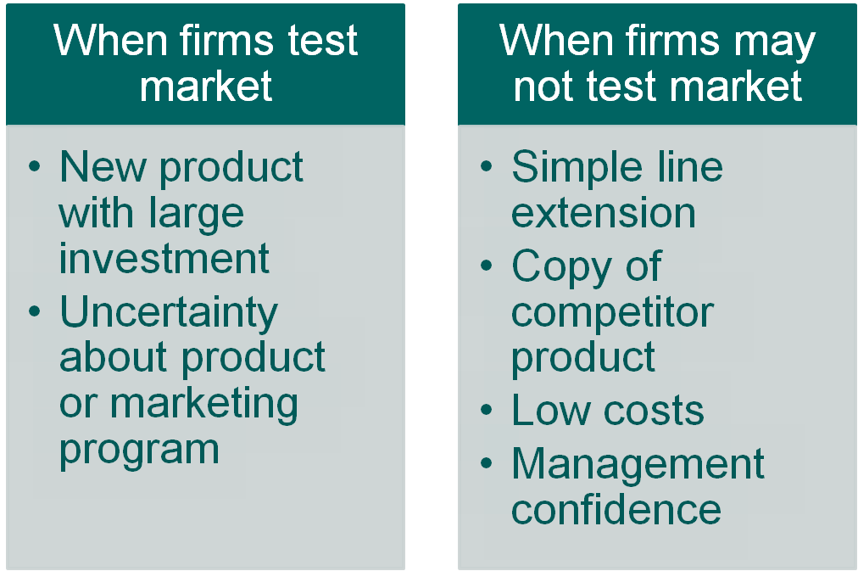
New-Product Development Process
Marketing Strategy Development
Copyright ©2014 by Pearson Education, Inc. All rights reserved
Notes:
The amount of test marketing needed varies with each new product. Test marketing costs can be high, and it takes time that may allow competitors to gain advantages. When the costs of developing and introducing the product are low, or when management is already confident about the new product, the company may do little or no test marketing. In fact, test marketing by consumer-goods firms has been declining in recent years. Companies often do not test-market simple line extensions or copies of competitors’ successful products.
However, when introducing a new product requires a big investment, when the risks are high, or when management is not sure of the product or its marketing program, a company may do a lot of test marketing. For instance, Starbucks VIA instant coffee was one of the company’s biggest, most risky product rollouts ever. The company spent 20 years developing the coffee and several months testing the product in Starbucks shops in Chicago and Seattle before releasing the product nationally. In the spring and summer of 2009, Starbucks patrons in the two test markets were offered recession-friendly $1.00 cups of coffee as well as coupons and free samples of VIA to take home with them. In addition, a Taste Challenge was created in Chicago to help drum up interest and induce trial. Performance of VIA exceeded expectations in all three cities and the promotional efforts were applied to the national rollout as well. Last year, the new brand generated more than $250 million in sales and Starbucks hopes to build it into a billion-dollar brand. Said CEO Howard Schultz, “We took a lot of time with it because we knew it could undermine the company if we didn’t do it right.”

Slide 16
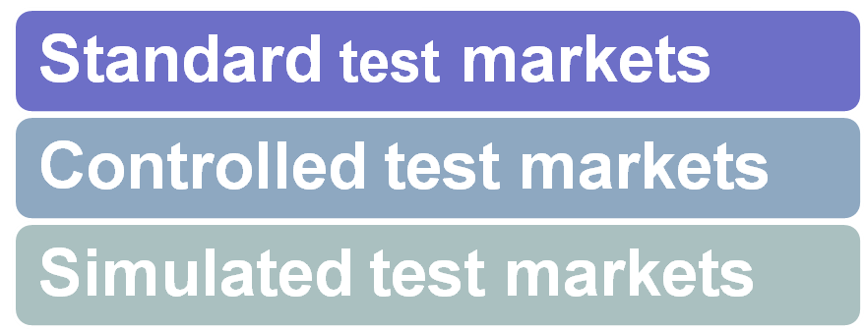
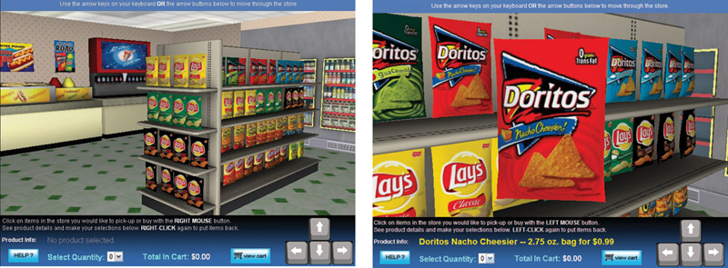
New-Product Development Process
Types of Test Markets
Copyright ©2014 by Pearson Education, Inc. All rights reserved
Notes:
Note to Instructor
Standard test markets are small representative markets where the firm conducts a full marketing campaign and uses store audits, consumer and distributor surveys, and other measures to gauge product performance. Results are used to forecast national sales and profits, discover product problems, and fine-tune the marketing program.
Controlled test markets are panels of stores that have agreed to carry new products for a fee. In general they are less expensive than standard test market, faster than standard test markets, but competitors gain access to the new product.
Simulated test markets are events where the firm will create a shopping environment and note how many consumers buy the new product and competing products. Provides measure of trial and the effectiveness of promotion. Researchers can interview consumers.

Slide 17
New-Product Development Process
Marketing Strategy Development
Advantages of simulated test markets
  Less expensive than other test methods
  Faster
  Restricts access by competitors
Disadvantages
  Not considered as reliable and accurate due to the controlled setting
Copyright ©2014 by Pearson Education, Inc. All rights reserved
Notes:
As an alternative to extensive and costly standard test markets, companies can use controlled test markets or simulated test markets. In controlled test markets, such as SymphonyIRI’s BehaviorScan, new products and tactics are tested among controlled panels of shoppers and stores. By combining information on each test consumer’s purchases with consumer demographic and TV viewing information, BehaviorScan can provide store-by-store, week-by-week reports on the sales of tested products and the impact of in-store and in-home marketing efforts. Using simulated test markets, researchers measure consumer responses to new products and marketing tactics in laboratory stores or simulated online shopping environments. Both controlled test markets and simulated test markets reduce the costs of test marketing and speed up the process.
For information on BehaviorScan Rx, http://www.iriworldwide.com/default.aspx?TabId=159&productid=75 accessed October 2013.

Slide 18

New-Product Development Process
Marketing Strategy Development
Commercialization is the introduction
of the new product
When to launch
Where to launch
Planned market
rollout
Copyright ©2014 by Pearson Education, Inc. All rights reserved
Notes:
Commercialization
Test marketing gives management the information needed to make a final decision about whether to launch the new product. If the company goes ahead with commercialization—introducing the new product into the market—it will face high costs. For example, the company may need to build or rent a manufacturing facility. And, in the case of a major new consumer product, it may spend hundreds of millions of dollars for advertising, sales promotion, and other marketing efforts in the first year. For instance, to introduce its McCafé coffee in the United States, McDonald’s spent $100 million on an advertising blitz that spanned TV, print, radio, outdoor, the Internet, events, public relations, and sampling. Similarly, Nokia spent $100 million on a campaign to launch its Ace smartphone in the highly competitive U.S. mobile market.
A company launching a new product must first decide on introduction timing. If the new product will eat into the sales of other company products, the introduction may be delayed. If the product can be improved further, or if the economy is down, the company may wait until the following year to launch it. However, if competitors are ready to introduce their own competing products, the company may push to introduce its new product sooner.
Next, the company must decide where to launch the new product—in a single location, a region, the national market, or the international market. Some companies may quickly introduce new models into the full national market. Companies with international distribution systems may introduce new products through swift global rollouts. General Motors did this with its global car, the new Malibu, which will be sold in 100 countries on six continents. The global Malibu launch was back by live, high-definition video run on Facebook and various mobile media, timed to coincide with major auto shows in both Shanghai and New York. The car’s designers and marketers were available in a live Web session to field consumer questions posted on Twitter or Chevrolet’s Facebook page.

Slide 19
Managing New-Product Development
Successful new-product development should be:
Customer centered
Team-based
Systematic
Copyright ©2014 by Pearson Education, Inc. All rights reserved
Notes:
The new-product development process shown in Figure 9.1 highlights the important activities needed to find, develop, and introduce new products. However, new-product development involves more than just going through a set of steps. Companies must take a holistic approach to managing this process. Successful new-product development requires a customer-centered, team-based, and systematic effort.

Slide 20

Managing New-Product Development
New-Product Development Strategies
Customer-centered new product development new ways to solve customer problems and create more customer satisfying experiences
Copyright ©2014 by Pearson Education, Inc. All rights reserved
Notes:
Customer-Centered New-Product Development
Above all else, new-product development must be customer centered. When looking for and developing new products, companies often rely too heavily on technical research in their R&D laboratories. But like everything else in marketing, successful new-product development begins with a thorough understanding of what consumers need and value. Customer-centered new-product development focuses on finding new ways to solve customer problems and create more customer-satisfying experiences.
One study found that the most successful new products are ones that are differentiated, solve major customer problems, and offer a compelling customer value proposition. Another study showed that companies that directly engage their customers in the new-product innovation process had twice the return on assets and triple the growth in operating income of firms that did not. Thus, customer involvement has a positive effect on the new-product development process and product success.
For example, whereas the consumer package goods industry’s new-product success rate is only about 15 to 20 percent, P&G’s success rate is over 50 percent. According to former P&G CEO A. G. Lafley, the most important factor in this success is understanding what consumers want. In the past, says Lafley, P&G tried to push new products down to consumers rather than first understanding their needs. But now, P&G employs an immersion process it calls “Living It,” in which researchers go so far as to live with shoppers for several days at a time to envision product ideas based directly on consumer needs. P&Gers also hang out in stores for similar insights, a process they call “Working It.” No other company in the world has invested more in consumer research than P&G. Each year, the company interacts with more than five million customers in 100 countries. It conducts more than 20,000 research studies every year and invests more than $400 million annually in what it calls “consumer understanding.” “We figured out how to keep the consumer at the center of all our decisions,” concludes Lafley. “As a result, we don’t go far wrong.”
Thus, today’s innovative companies get out of the research lab and connect with customers in search of fresh ways to meet customer needs. Customer-centered new-product development begins and ends with understanding customers and involving them in the process.

Slide 21
Managing New-Product Development
New-Product Development Strategies
Team-based new-product development Company departments work closely together in cross-functional teams, overlapping in the product-development process to save time and increase effectiveness
Copyright ©2014 by Pearson Education, Inc. All rights reserved
Notes:
Team-Based New-Product Development
Good new-product development also requires a total-company, cross-functional effort. Some companies organize their new-product development process into the orderly sequence of steps shown in Figure 9.1, starting with idea generation and ending with commercialization. Under this sequential product development approach, one company department works individually to complete its stage of the process before passing the new product along to the next department and stage. This orderly, step-by-step process can help bring control to complex and risky projects. But it can also be dangerously slow. In fast-changing, highly competitive markets, such slow-but-sure product development can result in product failures, lost sales and profits, and crumbling market positions.
To get their new products to market more quickly, many companies use a team-based new-product development approach. Under this approach, company departments work closely together in cross-functional teams, overlapping the steps in the product development process to save time and increase effectiveness. Instead of passing the new product from department to department, the company assembles a team of people from various departments that stays with the new product from start to finish. Such teams usually include people from the marketing, finance, design, manufacturing, and legal departments and even supplier and customer companies. In the sequential process, a bottleneck at one phase can seriously slow an entire project. In the team-based approach, however, if one area hits snags, it works to resolve them while the team moves on.
The team-based approach does have some limitations, however. For example, it sometimes creates more organizational tension and confusion than the more orderly sequential approach. However, in rapidly changing industries facing increasingly shorter product life cycles, the rewards of fast and flexible product development far exceed the risks. Companies that combine a customer-centered approach with team-based new-product development gain a big competitive edge by getting the right new products to market faster.

Slide 22
Managing New-Product Development
New-Product Development Strategies
Systematic new-product development
innovative development approach that collects, reviews, evaluates, and manages new-product ideas
Creates an innovation-oriented culture
Yields a large number of new-product ideas
Copyright ©2014 by Pearson Education, Inc. All rights reserved
Notes:
Systematic New-Product Development
Finally, the new-product development process should be holistic and systematic rather than compartmentalized and haphazard. Otherwise, few new ideas will surface, and many good ideas will sputter and die. To avoid these problems, a company can install an innovation management system to collect, review, evaluate, and manage new-product ideas.
The company can appoint a respected senior person to be its innovation manager. It can set up Web-based idea management software and encourage all company stakeholders—employees, suppliers, distributors, dealers—to become involved in finding and developing new products. It can assign a cross-functional innovation management committee to evaluate proposed new-product ideas and help bring good ideas to market. It can also create recognition programs to reward those who contribute the best ideas.
The innovation management system approach yields two favorable outcomes. First, it helps create an innovation-oriented company culture. It shows that top management supports, encourages, and rewards innovation. Second, it will yield a larger number of new-product ideas, among which will be found some especially good ones. The good new ideas will be more systematically developed, producing more new-product successes. No longer will good ideas wither for the lack of a sounding board or a senior product advocate.
Thus, new-product success requires more than simply thinking up a few good ideas, turning them into products, and finding customers for them. It requires a holistic approach for finding new ways to create valued customer experiences, from generating and screening new-product ideas to creating and rolling out want-satisfying products to customers.
More than this, successful new-product development requires a whole-company commitment. At companies known for their new-product prowess, such as Google, Apple, 3M, P&G, and GE, the entire culture encourages, supports, and rewards innovation.
When tough economic times hit, or when a company faces financial difficulties, management may be tempted to reduce spending on new-product development. However, such thinking is usually shortsighted. By cutting back on new products, the company may make itself less competitive during or after the downturn. In fact, tough times might call for even greater new-product development, as the company struggles to better align its market offerings with changing consumer needs and tastes. In difficult times, innovation more often helps than hurts in making the company more competitive and positioning it better for the future. Summarizes one analyst:
Innovation is a messy process—hard to measure and hard to manage. When revenues and earnings decline, executives often conclude that their innovation efforts just aren’t worth it. Better to focus on the tried and true than to risk money on untested ideas. The contrary view, of course, is that innovation is both a vaccine against market downturns and an elixir that rejuvenates growth. For example, imagine how much worse off Apple would be had it not—in the midst of very difficult times for the company a decade ago—created the iPod, iTunes, and iPhone.
Thus, rain or shine, good times or bad, a company must continue to innovate and develop new products if it wants to grow and prosper. Adapted from Marketing: An Introduction, Eleventh Edition Gary Armstrong, Philip Kotler

Slide 23
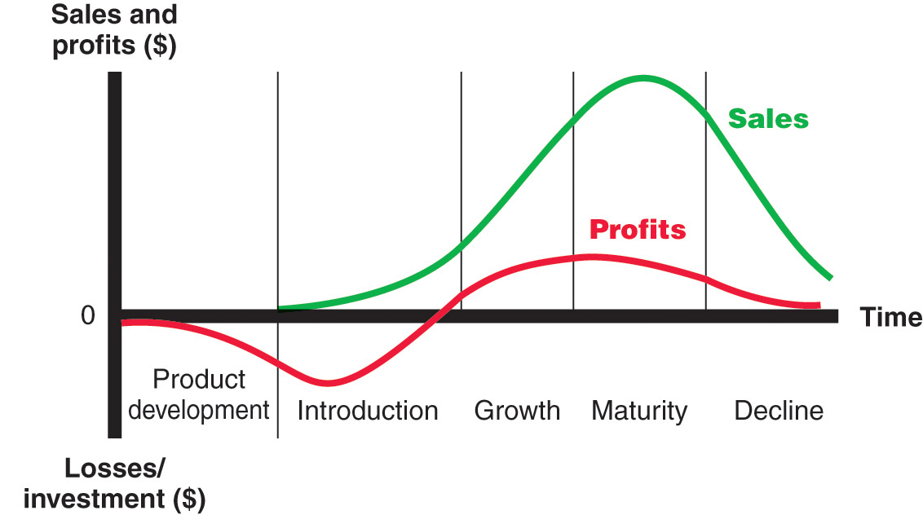
Product Life-Cycle Strategies
Product Life Cycle
Copyright ©2014 by Pearson Education, Inc. All rights reserved
Notes:
Note to Instructor
Product life cycle (PLC), Figure 9.2
The course of a product’s sales and profits over its lifetime. It involves five distinct stages: product development, introduction, growth, maturity, and decline.
Discussion Question
Name a product at each stage of the PLC.

Slide 24
Product Life-Cycle Strategies
Product development
  Sales are zero and investment costs mount
Introduction
  Slow sales growth and profits are nonexistent
Growth
  Rapid market acceptance and increasing profits
Maturity
  Slowdown in sales growth and profits level off or decline
Decline
  Sales fall off and profits drop
Copyright ©2014 by Pearson Education, Inc. All rights reserved
Notes:
Product development begins when the company finds and develops a new-product idea. During product development, sales are zero, and the company’s investment costs mount.
Introduction is a period of slow sales growth as the product is introduced in the market. Profits are nonexistent in this stage because of the heavy expenses of product introduction.
Growth is a period of rapid market acceptance and increasing profits.
Maturity is a period of slowdown in sales growth because the product has achieved acceptance by most potential buyers. Profits level off or decline because of increased marketing outlays to defend the product against competition.
Decline is the period when sales fall off and profits drop.
Not all products follow all five stages of the product life cycle. Some products are introduced and die quickly; others stay in the mature stage for a long, long time. Some enter the decline stage and are then cycled back into the growth stage through strong promotion or repositioning. It seems that a well-managed brand could live forever. Venerable brands like Coca-Cola, Gillette, Budweiser, Guinness, American Express, Wells Fargo, Kikkoman, Frye, and TABASCO sauce, for instance, are still going strong after more than 100 years. Guinness beer has been around for more than 250years, Life Savers mints recently celebrated “100 years of keeping your mouth fresh,” and TABASCO sauce brags that it’s “over 140 years old and still able to totally whup your butt!”
<ex09.09>
The PLC concept can describe a product class (gasoline-powered automobiles), a product form (SUVs), or a brand (the Ford Escape). The PLC concept applies differently in each case. Product classes have the longest life cycles; the sales of many product classes stay in the mature stage for a long time. Product forms, in contrast, tend to have the standard PLC shape. Product forms such as “dial telephones” and “VHS tapes” passed through a regular history of introduction, rapid growth, maturity, and decline.
A specific brand’s life cycle can change quickly because of changing competitive attacks and responses. For example, although laundry soaps (product class) and powdered detergents (product form) have enjoyed fairly long life cycles, the life cycles of specific brands have tended to be much shorter. Today’s leading brands of powdered laundry soap are Tide and Cheer; the leading brands almost 100 years ago were Fels-Naptha, Octagon, and Kirkman.

Slide 25
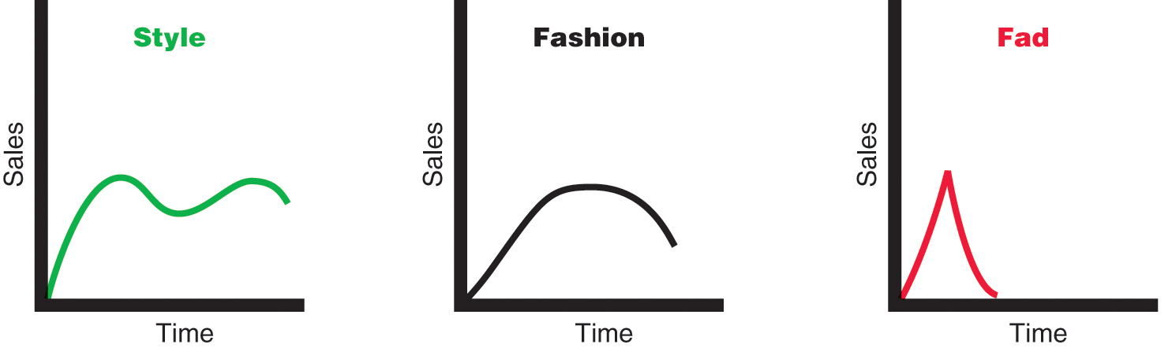
Product Life-Cycle Strategies
Copyright ©2014 by Pearson Education, Inc. All rights reserved
Notes:
Note to Instructor
Style is a basic and distinctive mode of expression.
Fashion is a currently accepted popular style in a given field.
The PLC concept also can be applied to what are known as styles, fashions, and fads. Their special life cycles are shown in Figure 9.3. A style is a basic and distinctive mode of expression. For example, styles appear in homes (colonial, ranch, transitional), clothing (formal, casual), and art (realist, surrealist, abstract). Once a style is invented, it may last for generations, passing in and out of vogue. A style has a cycle showing several periods of renewed interest.
A fashion is a currently accepted or popular style in a given field. For example, the more formal “business attire” look of corporate dress of the 1980s and 1990s gave way to the “business casual” look of the 2000s. Fashions tend to grow slowly, remain popular for a while, and then decline slowly.
Fads are temporary periods of unusually high sales driven by consumer enthusiasm and immediate product or brand popularity. A fad may be part of an otherwise normal life cycle, as in the case of recent surges in the sales of poker chips and accessories. Or the fad may comprise a brand’s or product’s entire life cycle. Pet Rocks are a classic example. Upon hearing his friends complain about how expensive it was to care for their dogs, advertising copywriter Gary Dahl joked about his pet rock. He soon wrote a spoof of a dog-training manual for it, titled “The Care and Training of Your Pet Rock.” Soon Dahl was selling some 1.5 million ordinary beach pebbles at $4 a pop. Yet the fad, which broke one October, had sunk like a stone by the next February. Dahl’s advice to those who want to succeed with a fad: “Enjoy it while it lasts.” Other examples of fads include Silly Bandz, Crocs, and Pogs.
Marketers can apply the product life-cycle concept as a useful framework for describing how products and markets work. And when used carefully, the PLC concept can help in developing good marketing strategies for its different stages. However, using the PLC concept for forecasting product performance or developing marketing strategies presents some practical problems. For example, in practice, it is difficult to forecast the sales level at each PLC stage, the length of each stage, and the shape of the PLC curve. Using the PLC concept to develop marketing strategy also can be difficult because strategy is both a cause and a result of the PLC. The product’s current PLC position suggests the best marketing strategies, and the resulting marketing strategies affect product performance in later stages.
This definition is based on one found in Bryan Lilly and Tammy R. Nelson, “Fads: Segmenting the Fad-Buyer Market,” Journal of Consumer Marketing, Vol. 20, No. 3, 2003, pp. 252–265.
See Katya Kazakina and Robert Johnson, “A Fad’s Father Seeks a Sequel,” New York Times, May 30, 2004, www.nytimes.com; John Schwartz, “The Joy of Silly,” New York Times, January 20, 2008, p. 5; and www.crazyfads.com, accessed May 2012.

Slide 26
Product Life-Cycle Strategies
Introduction Stage
Slow sales growth
Little or no profit
High distribution and promotion expense
Copyright ©2014 by Pearson Education, Inc. All rights reserved
Notes:
now look at strategies for each of the other life-cycle stages.
Introduction Stage
The introduction stage starts when a new product is first launched. Introduction takes time, and sales growth is apt to be slow. Well-known products such as frozen foods and HDTVs lingered for many years before they entered a stage of more rapid growth.
In this stage, as compared to other stages, profits are negative or low because of the low sales and high distribution and promotion expenses. Much money is needed to attract distributors and build their inventories. Promotion spending is relatively high to inform consumers of the new product and get them to try it. Because the market is not generally ready for product refinements at this stage, the company and its few competitors produce basic versions of the product. These firms focus their selling on those buyers who are the most ready to buy.
A company, especially the market pioneer, must choose a launch strategy that is consistent with the intended product positioning. It should realize that the initial strategy is just the first step in a grander marketing plan for the product’s entire life cycle. If the pioneer chooses its launch strategy to make a “killing,” it may be sacrificing long-run revenue for the sake of short-run gain. The pioneer has the best chance of building and retaining market leadership if it plays its cards correctly from the start.

Slide 27
Product Life-Cycle Strategies
Growth Stage
Sales increase
New competitors enter the market
Price stability or decline to increase volume
Consumer education
Profits increase
Promotion and manufacturing costs gain economies of scale
Copyright ©2014 by Pearson Education, Inc. All rights reserved
Notes:
Growth Stage
If the new product satisfies the market, it will enter a growth stage, in which sales will start climbing quickly. The early adopters will continue to buy, and later buyers will start following their lead, especially if they hear favorable word of mouth. Attracted by the opportunities for profit, new competitors will enter the market. They will introduce new product features, and the market will expand. The increase in competitors leads to an increase in the number of distribution outlets, and sales jump just to build reseller inventories. Prices remain where they are or decrease only slightly. Companies keep their promotion spending at the same or a slightly higher level. Educating the market remains a goal, but now the company must also meet the competition.
Profits increase during the growth stage as promotion costs are spread over a large volume and as unit manufacturing costs decrease. The firm uses several strategies to sustain rapid market growth as long as possible. It improves product quality and adds new product features and models. It enters new market segments and new distribution channels. It shifts some advertising from building product awareness to building product conviction and purchase, and it lowers prices at the right time to attract more buyers.
In the growth stage, the firm faces a trade-off between high market share and high current profit. By spending a lot of money on product improvement, promotion, and distribution, the company can capture a dominant position. In doing so, however, it gives up maximum current profit, which it hopes to make up in the next stage.

Slide 28
Product Life-Cycle Strategies
Maturity Stage
Slowdown in sales
Many suppliers
Substitute products
Overcapacity leads to competition
Increased promotion and R&D to support sales and profits
Copyright ©2014 by Pearson Education, Inc. All rights reserved
Notes:
Maturity Stage
At some point, a product’s sales growth will slow down, and it will enter the maturity stage. This maturity stage normally lasts longer than the previous stages, and it poses strong challenges to marketing management. Most products are in the maturity stage of the life cycle, and therefore most of marketing management deals with the mature product.
The slowdown in sales growth results in many producers with many products to sell. In turn, this overcapacity leads to greater competition. Competitors begin marking down prices, increasing their advertising and sales promotions, and upping their product development budgets to find better versions of the product. These steps lead to a drop in profit. Some of the weaker competitors start dropping out, and the industry eventually contains only well-established competitors.
Although many products in the mature stage appear to remain unchanged for long periods, most successful ones are actually evolving to meet changing consumer needs. Product managers should do more than simply ride along with or defend their mature products—a good offense is the best defense. They should consider modifying the market, product offering, and marketing mix.
.

Slide 29
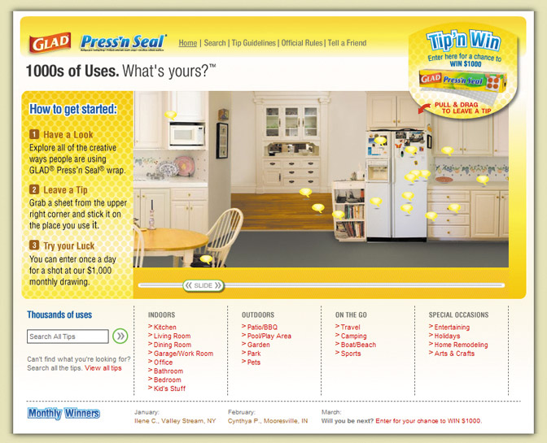

Product Life-Cycle Strategies
Maturity Stage Modifying Strategies
Market modifying
Product modifying
Marketing mix modifying
Copyright ©2014 by Pearson Education, Inc. All rights reserved
Notes:
Note to Instructor
This link is for 1000 Uses of Glad website. It is described below, and in the book, as a way to modify the product.
In modifying the market, the company tries to increase the consumption of the current product. It may look for new users and new market segments. The manager may also look for ways to increase usage among present customers. The company might also try modifying the product—changing characteristics such as quality, features, style, or packaging to attract new users and to inspire more usage. It can improve the product’s styling and attractiveness. It might improve the product’s quality and performance—its durability, reliability, speed, taste.
In modifying the market, the company tries to increase consumption by finding new users and new market segments for its brands.
modifying the product—changing characteristics such as quality, features, style, or packaging to attract new users and inspire more usage. It can improve the product’s styling and attractiveness. It might improve the product’s quality and performance—its durability, reliability, speed, and taste.
modifying the marketing mix—improving sales by changing one or more marketing mix elements. The company can offer new or improved services to buyers. It can cut prices to attract new users and competitors’ customers. It can launch a better advertising campaign or use aggressive sales promotions—trade deals, cents-off, premiums, and contests. In addition to pricing and promotion, the company can also move into new marketing channels to help serve new users.

Slide 30
Product Life-Cycle Strategies
Decline Stage
Maintain the product
Harvest the product
Drop the product
Copyright ©2014 by Pearson Education, Inc. All rights reserved
Notes:
Decline Stage
The sales of most product forms and brands eventually dip. The decline may be slow, as in the cases of stamps and oatmeal cereal, or rapid, as in the cases of VHS tapes. Sales may plunge to zero, or they may drop to a low level where they continue for many years. This is the decline stage.
Sales decline for many reasons, including technological advances, shifts in consumer tastes, and increased competition. As sales and profits decline, some firms withdraw from the market. Those remaining may prune their product offerings. In addition, they may drop smaller market segments and marginal trade channels, or they may cut the promotion budget and reduce their prices further.
Carrying a weak product can be very costly to a firm, and not just in profit terms. There are many hidden costs. A weak product may take up too much of management’s time. It often requires frequent price and inventory adjustments. It requires advertising and sales-force attention that might be better used to make “healthy” products more profitable. A product’s failing reputation can cause customer concerns about the company and its other products. The biggest cost may well lie in the future. Keeping weak products delays the search for replacements, creates a lopsided product mix, hurts current profits, and weakens the company’s foothold on the future.
For these reasons, companies must identify products in the decline stage and decide whether to maintain, harvest, or drop them. Management may decide to maintain its brand, repositioning or reinvigorating it in hopes of moving it back into the growth stage of the product life cycle. P&G has done this with several brands, including Mr. Clean and Old Spice. And Converse found fresh strategies for breathing new life into the venerable old Converse All Stars brand Management may decide to harvest the product, which means reducing various costs (plant and equipment, maintenance, R&D, advertising, sales force), hoping that sales hold up. If successful, harvesting will increase the company’s profits in the short run. Finally, management may decide to drop the product from its line. The company can sell the product to another firm or simply liquidate it at salvage value. In recent years, P&G has sold off several lesser or declining brands, such as Folgers coffee, Crisco oil, Comet cleanser, Sure deodorant, Duncan Hines cake mixes, and Jif peanut butter. If the company plans to find a buyer, it will not want to run down the product through harvesting.
Table 9.2 summarizes the key characteristics of each stage of the PLC. The table also lists the marketing objectives and strategies for each stage.

Slide 31
Additional Product and Service Considerations
Product Decisions and Social Responsibility
Public policy and regulations regarding developing and dropping products, patents, quality, and safety
Copyright ©2014 by Pearson Education, Inc. All rights reserved
Notes:
Product Decisions and Social Responsibility
Marketers should carefully consider public policy issues and regulations regarding acquiring or dropping products, patent protection, product quality and safety, and product warranties.
Regarding new products, the government may prevent companies from adding products through acquisitions if the effect threatens to lessen competition. Companies dropping products must be aware that they have legal obligations, written or implied, to their suppliers, dealers, and customers who have a stake in the dropped product. Companies must also obey U.S. patent laws when developing new products. A company cannot make its product illegally similar to another company’s established product.
Manufacturers must comply with specific laws regarding product quality and safety. The Federal Food, Drug, and Cosmetic Act protects consumers from unsafe and adulterated food, drugs, and cosmetics. Various acts provide for the inspection of sanitary conditions in the meat- and poultry-processing industries. Safety legislation has been passed to regulate fabrics, chemical substances, automobiles, toys, and drugs and poisons. The Consumer Product Safety Act of 1972 established the Consumer Product Safety Commission, which has the authority to ban or seize potentially harmful products and set severe penalties for violation of the law.
If consumers have been injured by a product with a defective design, they can sue manufacturers or dealers. A recent survey of manufacturing companies found that product liability was the second-largest litigation concern, behind only labor and employment matters. Product liability suits are now occurring in U.S. district courts at the rate of over 60,000 per year, up from 19,500 in 1990. Although manufacturers are found to be at fault in only 6 percent of all product liability cases, when they are found guilty, the median jury award is $1.5 million, and individual awards can run into the tens or even hundreds of millions of dollars. Class-action suits can run into the billions. For example, after it recalled some seven million vehicles for acceleration pedal-related issues, Toyota will face more than 100 class-action and individual lawsuits beginning in 2013 that could end up costing the company $3 billion or more.
This litigation phenomenon has resulted in huge increases in product liability insurance premiums, causing big problems in some industries. Some companies pass these higher rates along to consumers by raising prices. Others are forced to discontinue high-risk product lines. Some companies are now appointing product stewards, whose job is to protect consumers from harm and the company from liability by proactively ferreting out potential product problems.

Slide 32
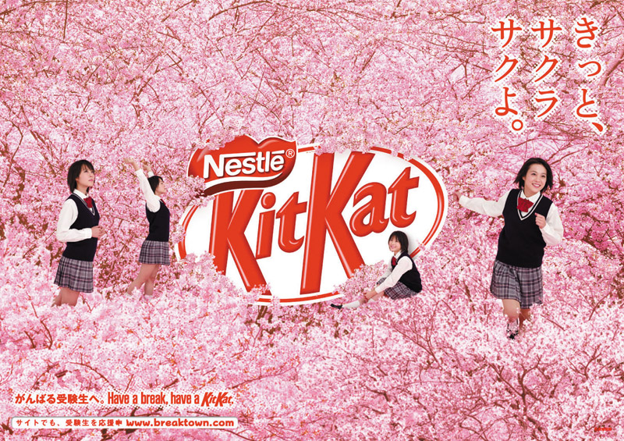
Additional Product and Service Considerations
International Product and
Service Marketing—Challenges
Determining what products and services to introduce in which countries
Standardization versus customization
Packaging and labeling
Customs, values, laws
Copyright ©2014 by Pearson Education, Inc. All rights reserved
Notes:
International Product and Services Marketing
International product and services marketers face special challenges. First they must figure out what products and services to introduce and in which countries. Then they must decide how much to standardize or adapt their products and services for world markets.
On the one hand, companies would like to standardize their offerings. Standardization helps a company develop a consistent worldwide image. It also lowers the product design, manufacturing, and marketing costs of offering a large variety of products. On the other hand, markets and consumers around the world differ widely. Companies must usually respond to these differences by adapting their product offerings. For example, by carefully adapting its menu and operations to local tastes and eating styles, YUM! Brands—parent company of quintessential fast-food restaurants KFC, Pizza Hut, and Taco Bell—has become the largest restaurant company in mainland China.
Service marketers also face special challenges when going global. Some service industries have a long history of international operations. For example, the commercial banking industry was one of the first to grow internationally. Banks had to provide global services to meet the foreign exchange and credit needs of their home country clients who wanted to sell overseas. In recent years, many banks have become truly global. Germany’s Deutsche Bank, for example, serves more than 19 million customers through 3,083 branches in 72 countries. For its clients around the world who wish to grow globally, Deutsche Bank can raise money not only in Frankfurt but also in Zurich, London, Paris, Tokyo, and Moscow.
Professional and business services industries, such as accounting, management consulting, and advertising, have also globalized. The international growth of these firms followed the globalization of the client companies they serve. For example, as more clients employ worldwide marketing and advertising strategies, advertising agencies have responded by globalizing their own operations. McCann Worldgroup, a large U.S.-based advertising and marketing services agency, operates in more than 130 countries. It serves international clients such as Coca-Cola, GM, ExxonMobil, Microsoft, MasterCard, Johnson & Johnson, and Unilever in markets ranging from the United States and Canada to Korea and Kazakhstan. Moreover, McCann Worldgroup is one company in the Interpublic Group of Companies, an immense, worldwide network of advertising and marketing services companies.
Retailers are among the latest service businesses to go global. As their home markets become saturated, American retailers such as Walmart, Office Depot, and Saks Fifth Avenue are expanding into faster-growing markets abroad. For example, since 1991, Walmart has entered 27 countries outside the United States; its international division’s sales accounts for 26 percent of total sales. Foreign retailers are making similar moves. Asian shoppers can now buy American products in French-owned Carrefour stores. Carrefour, the world’s second-largest retailer behind Walmart, now operates more than 15,500 stores in more than 35 countries. It is the leading retailer in Europe, Brazil, and Argentina and the largest foreign retailer in China.
The trend toward growth of global service companies will continue, especially in banking, airlines, telecommunications, and professional services. Today, service firms are no longer simply following their manufacturing customers. Instead, they are taking the lead in international expansion.

