Slide 1

Presentation By:
Muhammad Usman
Mirza Kashif

Slide 2
Introduction
Nishat Mills Limited (PSX: NML) is part of the Nishat group of companies
The company was set up in 1951
It is engaged in a variety of businesses; from spinning, weaving, bleaching and dyeing to dealing with yarn, cloth and other fabrics
Also generates, distributes and sells electricity.

Slide 3
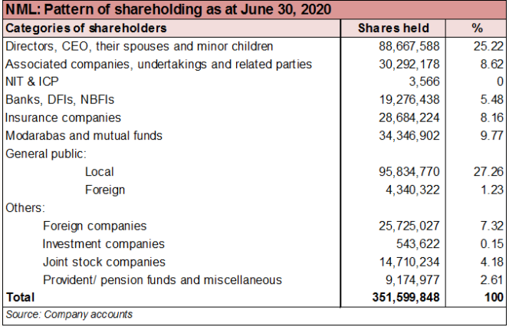
Shareholding pattern
As at June 30, 2020, over 25 percent of the shares are with the directors, CEO, their spouses and minor children
CEO, Mian Umer Mansha and the chairman, Mian Hassan Mansha hold roughly 12 percent shares, each.
The local general public owns 27 percent, followed by nearly 10 percent by modarabas and mutual funds
About 8 percent shares are held by insurance and associated companies, each.
The remaining 22 percent shares are with the rest of the shareholder categories.

Slide 4
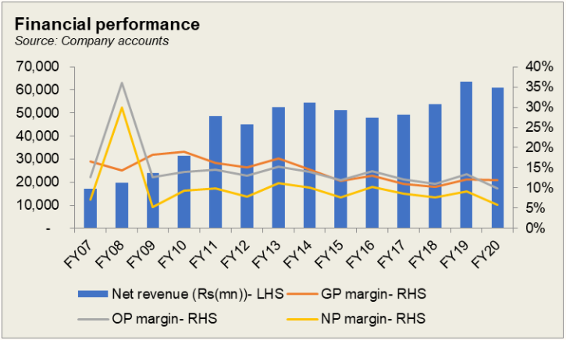
Historical operational performance
Notes:
After contracting consecutively for two years, revenue for the company grew by 2.6 percent during FY17
In FY18, revenue grew by 9 percent, despite the raw material prices and low international demand for textile products
In FY19, the company witnessed the highest growth in revenue seen since FY12, at 18 percent
Revenue was lower in FY20 by 4 percent, mostly due to the Covid-19 pandemic that brought business activity and global trade to an abrupt halt

Slide 5
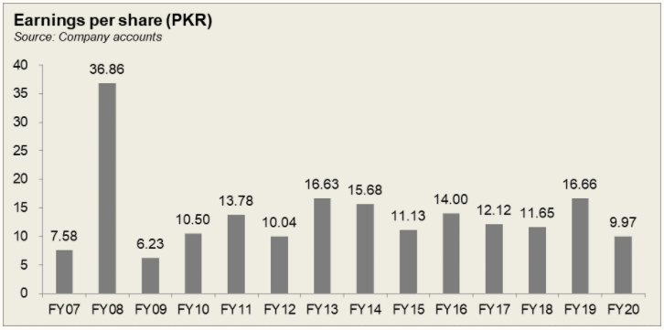

Slide 6
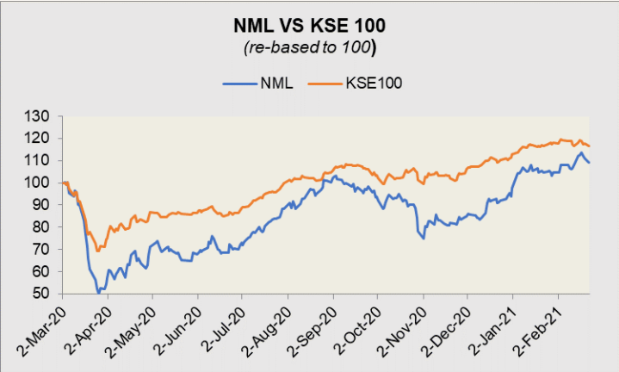
Share Price (2020-2021)
Notes:
As from the graph it can be seen that the Nishat Mills share price follows the same pattern as KSE 100 index which it follows. It has seen a major decrease in the second quarter of 2020 after which along with some fluctuations it is on the increasing
Trajectory. This could be due the Covid-19 pandemic that brought business activity and global trade to an abrupt halt. Export sales fell for the first time since FY16, by 5 percent.

Slide 7
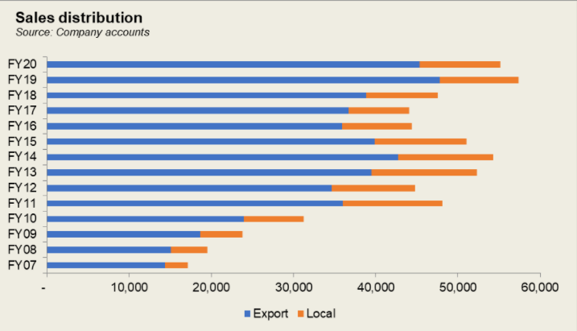
Notes:
Sales have increase over the the 13 years in context. It can be seen that Nishat Mills major share of sales come from Export. In 2019 NM took advantage of the
devaluation of the currency that boosted the export sales as seen from the graph.

Slide 8
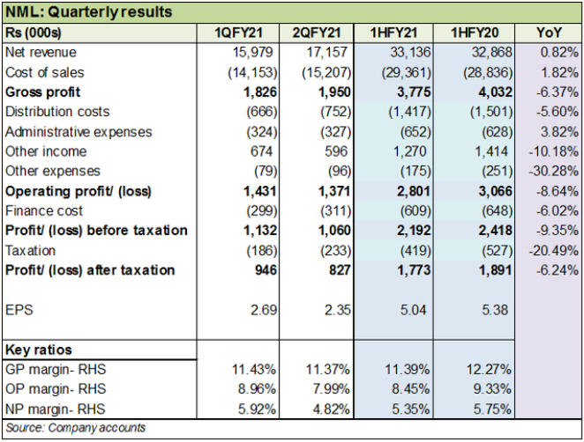
Notes:
Revenue increase was les than the icrease of CGS which decreased the GP. Overall expenses decreased but due ti decrease in GP EBIt decreased more. lesser contribution from other income, net margin was marginally lower in 1HFY21 year on year. This should also be taken in account that 2020 was the period when COVID – 19 pandemic spread and lockdowns were initiated which leaded to decrease in the Profit margins.

Slide 9
THANK YOU!

