Slide 1
Measuring and Evaluating the Performance of Banks and Their Principal Competitors
Dr Ayesha Afzal

Slide 2
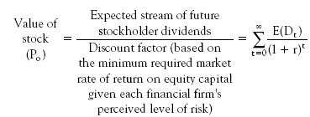
Value of the Bank’s Stock
6-2

Slide 3
Value of a Bank’s Stock Rises When:
6-3
Expected Dividends Increase
Risk of the Bank Falls
Market Interest Rates Decrease
Combination of Expected Dividend Increase and Risk Decline

Slide 4
Value of Bank’s Stock if Earnings Growth is Constant
6-4

Slide 5
Key Profitability Ratios in Banking
6-5

Slide 6
Key Profitability Ratios in Banking (cont.)
6-6
Total Interest Income __ Total Interest Expense
Earnings Spread = Total Earning Assets Total Interest Bearing Liability

Slide 7
Breaking Down ROE
6-7
x
x

Slide 8
ROE Depends On:
6-8
Equity Multiplier=Total assets/Total equity capital
  Leverage or Financing Policies: the choice of sources of funds (debt or equity)
Net Profit Margin=Net income/Total operating revenue
  Effectiveness of Expense Management (cost control)
Asset Utilization=Total operating revenue/Total assets
  Portfolio Management Policies (the mix and yield on assets)

Slide 9
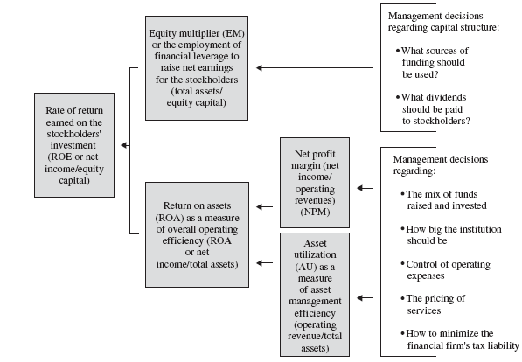
6-9
Determinants of ROE in a Financial Firm

Slide 10
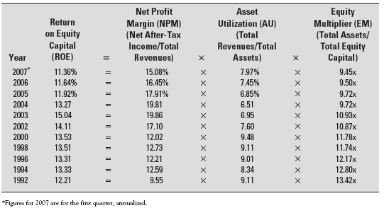
Components of ROE for All Insured U.S. Banks (1992-2007)
6-10

Slide 11
A Variation on ROE
6-11

Slide 12
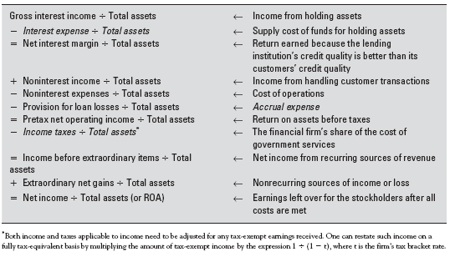
Breakdown of ROA
6-12

Slide 13
Bank Risks
6-13
Credit Risk
Liquidity Risk
Market Risk
Interest Rate Risk
Operational Risk
Legal and Compliance Risk
Reputation Risk
Strategic Risk
Capital Risk

Slide 14
Credit Risk
6-14
The Probability that Some of the Financial Firm’s Assets Will Decline in Value and Perhaps Become Worthless

Slide 15
Credit Risk Measures
6-15
Nonperforming Loans/Total Loans
Net Charge-Offs/Total Loans
Provision for Loan Losses/Total Loans
Provision for Loan Losses/Equity Capital
Allowance for Loan Losses/Total Loans
Allowance for Loan Losses/Equity Capital
Nonperforming Loans/Equity Capital

Slide 16
Liquidity Risk
6-16
Probability the Financial Firm Will Not Have Sufficient Cash and Borrowing Capacity to Meet Deposit Withdrawals and Other Cash Needs

Slide 17
Liquidity Risk Measures
6-17
Purchased Funds/Total Assets
Net Loans/Total Assets
Cash and Due from Banks/Total Assets
Cash and Government Securities/Total Assets

Slide 18
Market Risk: Comprises Price Risk and Interest Rate Risk
6-18
Probability of the Market Value of the Financial Firm’s Investment Portfolio Declining in Value Due to a Change in Interest Rates

Slide 19
Market Risk Measures
6-19
Book-Value of Assets/ Market Value of Assets
Book-Value of Equity/ Market Value of Equity
Book-Value of Bonds/Market Value of Bonds
Market Value of Preferred Stock and Common Stock

Slide 20
Interest Rate Risk
6-20
The Danger that Shifting Interest Rates May Adversely Affect a Bank’s Net Income, the Value of its Assets or Equity

Slide 21
Interest Rate Risk Measures
6-21
Interest Sensitive Assets/Interest Sensitive Liabilities
Uninsured Deposits/Total Deposits

Slide 22
Off-Balance-Sheet Risk
6-22
The Volatility in Income and Market Value of Bank Equity that May Arise from Unanticipated Losses due to OBS Activities (activities that do not have a balance sheet reporting impact until a transaction is affected)

Slide 23
Operational Risk
6-23
Uncertainty Regarding a Financial Firm’s Earnings Due to Failures in Computer Systems, Errors, Misconduct by Employees, Floods, Lightening Strikes and Similar Events or Risk of Loss Due to Unexpected Operating Expenses

Slide 24
Legal and Compliance Risk
6-24
Risk of Earnings Resulting from Actions Taken by the Legal System. This can Include Unenforceable Contracts, Lawsuits or Adverse Judgments. Compliance Risk Includes Violations of Rules and Regulations

Slide 25
Reputation Risk
6-25
This is Risk Due to Negative Publicity that can Dissuade Customers from Using the Services of the Financial Firm. It is the Risk Associated with Public Opinion.

Slide 26
Capital Risk
6-26
Probability of the Value of the Bank’s Assets Declining Below the Level of its Total Liabilities. The Probability of the Bank’s Long Run Survival

Slide 27
Capital Risk Measures
6-27
Stock Price/Earnings Per Share
Equity Capital/Total Assets
Purchased Funds/Total Liabilities
Equity Capital/Risk Assets

Slide 28
Other Goals in Banking
6-28

