Slide 2
Introduction
A non performing loan is any loan in which interest and principle payments are more than 90 days overdue. (IMF, 2005).
Nonperforming loans are of immense importance as they define the asset quality, credit risk of the Bank.
The main function of banks is credit creation through mobilization of deposits.

Slide 3
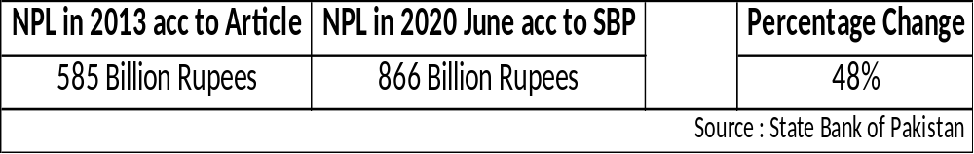
Effect of NPL at a Macro Level
If Non Performing Loans increase the banks would not be able to give out loans which would ultimately hinder economic growth.
Economic growth cannot prosper without strong financial sector.

Slide 4
Evidence from Past Studies
A study based on NPL published in 1991 by T. Clair which came a conclusion that rapid credit growth can cause the credit quality to deteriorate which can eventually cause banks to declare bankruptcy.
According to a research done in Pakistan in 2012 it was found that interest rate; exchange rate, unemployment, inflation, and energy crisis have positive association with NPLs while GDP growth has negative relationship with NPLs.

