Slide 2
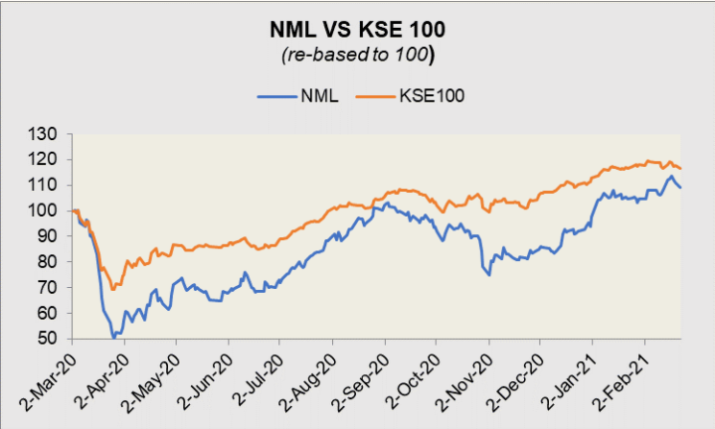
Notes:
As from the graph it can be seen that the Nishat Mills follows the same pattern as KSE 100 index which it follows. It has seen a major decrease in the second quarter of 2020 after which along with some fluctuations it is on the increasing
Trajectory. This could be due the Covid-19 pandemic that brought business activity and global trade to an abrupt halt. Export sales fell for the first time since FY16, by 5 percent.

Slide 3
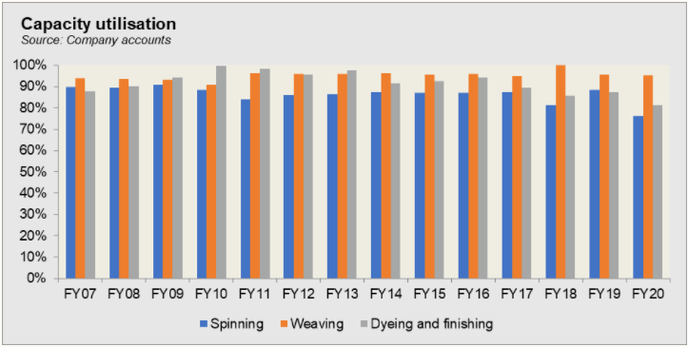
Notes:
Capacity utilization for spinning has decreased over the 13 years however weaving has increased, it reached its all time high in FY2018. as far as Dyeing and Finishing is concerned it has seen some fluctuations and continues to increase and decrease.

Slide 4
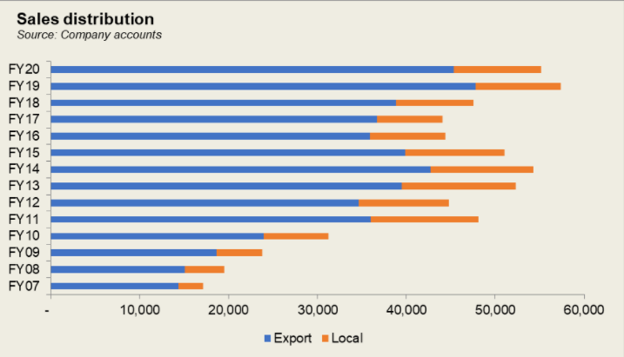
Notes:
Sales have increase over the the 13 years in context. It can be seen that Nishat Mills major share of sales come from Export. In 2019 NM took advantage of the
devaluation of the currency that boosted the export sales as seen from the graph.

Slide 5
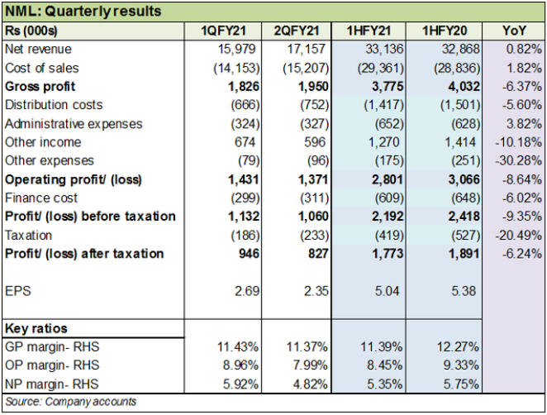
Notes:
Revenue increase was les than the icrease of CGS which decreased the GP. Overall expenses decreased but due ti decrease in GP EBIt decreased more.

