Slide 1

מסכים "חמקה"
Chimps Team
מוחמד אדריס | 314981598
אופיר סגל | 205797210
שי בן חיים | 308076553
ויאם שאהין | 311182281

Slide 2


Welcome to Hamka Checkers
Let`s Play
Games History

Slide 3


Hamka Settings
Manage Questions
Load Game

Slide 4

Update Questions
Add Questions
Question | Answers | Right Answer | Actions
SRS is IEEEs document? | Yes No | Yes
Update
Delete

Slide 5
Games History
Place | Date | Winner Nickname | Winner Score | Rival Nickname | Rival score
1 | 09/10/2020 21:00 | Mom1 | 2025 | BestChimp2 | 1033
2 | 13/11/2020 23:44 | BestChimp2 | 1505 | Adi100 | 1500
3 | 09/10/2020 09:05 | BestChimp2 | 1004 | Ori562 | 900
4 | 21/09/2020 20:31 | OS | 987 | CHIMP1 | 450
5 | 08/10/2020 15:40 | CHIMP1 | 975 | OS | 935
6 | 01/11/2020 21:52 | theKing | 970 | OS | -201
7 | 18/09/2020 14:18 | Mom | 803 | Ori | 706
8 | 02/11/2020 18:01 | ChimpTest | 704 | ChimpTest2 | -123
9 | 17/10/2020 19:20 | BestChimp2 | 561 | Dad | 499
10 | 05/11/2020 21:09 | NoName | 501 | Winning | -845

Slide 6

Let's Play!
Please enter your information
Player One
Player Two
Enter ID
Enter ID
Enter Nickname
Enter Nickname
START!
*Nicknames must be different

Slide 7
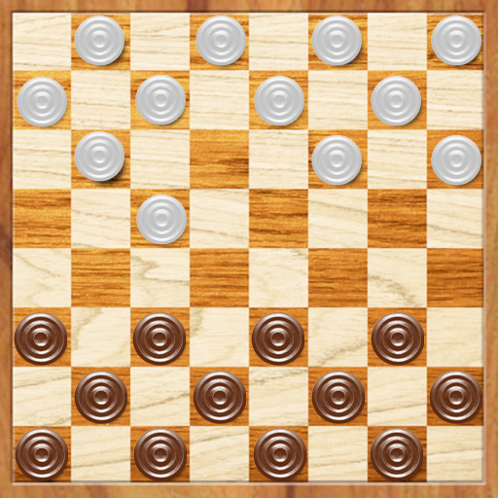
White turn
Points:
Turn time: 00:00:29
Game time: 00:00:29
White:
0
Another Turn!
Black:
0
Question for White:
SRS is IEEEs document?
Question LOD: Easy
Yes!
No.
End Game!

Slide 8
Black turn
-4 Points!
Points:
Turn time: 00:01:04
Game time: 00:01:33
White:
100
Black:
Another Turn!
+50 Points!
0
End Game!

