Slide 1
🎓 Brain Bridge: Bridge to Your Dream University

Slide 2
introduction
Presented by: shashank kanojia
Tech Stack: Python, Streamlit, Pandas, CSV, HTML/CSS
BrainBridge is a smart and user-friendly web app
that helps students discover the right university,
course, and career path based on their academic
interests and subject choices.

Slide 3
Project Overview
Problem Statement: High school students often struggle to find suitable universities, departments, and scholarships that align with their interests and academic background.
Our Solution: BrainBridge is a Streamlit-based web app that recommends universities, departments, courses, and scholarships using content-based filtering.
Key Objectives:
Provide personalized university suggestions.
Offer course and department discovery tools.
Help students find scholarships and future career options.

Slide 4
What is a Recommendation System?
Definition: A recommendation system is an AI-based engine that suggests items (e.g., universities or courses) to users based on their preferences or behavior.
Types of Recommendation Systems: 1. Content-Based Filtering: Uses user-input attributes (like subjects or interests) to suggest relevant items. 2. Collaborative Filtering: Based on preferences of users with similar profiles. 3. Hybrid Models: Combine both approaches.
BrainBridge uses: ✅ Content-Based Filtering for accurate and relevant educational suggestions.

Slide 5
Tools & Technologies Used
Python: Backend logic, filtering, and data processing.
Streamlit: Framework to quickly build interactive, user-friendly web apps.
Pandas: Library to manipulate and filter tabular data (CSV files).
CSV Files: Used as local databases for universities, courses, etc.
HTML/CSS: Basic customization for visual appeal.
Streamlit Option Menu: Sidebar navigation using icons

Slide 6
Core Features of BrainBridge
🎓 University Finder:
Recommends universities based on selected subjects & interests.
Uses multiple filters like country, course level, and fields.
🏫 Department Explorer:
View departments based on school or field.
Check what subjects are required for admission.
📚 Course Recommender:
Suggests related or similar courses based on user’s input subject.
Includes course price, popularity, and category.
💰 Scholarship Finder:
Search scholarships by level (UG/PG), field, and country.
View amount, eligibility, and direct application links.

Slide 7
🧭 Career Explorer:
Map school subjects to future careers.
Helps students understand where their strengths can lead.
📊 University Comparison (NEW):
Side-by-side comparison of up to 3 universities.
Ranking, specialization, location, and more.
❤️ Favorites Section (Upcoming):
Users can mark & save favorite universities and courses.

Slide 8
Dataset Details
universities.csv
Fields: Name, Location, Specialization, World Ranking, Website
departments.csv
Fields: School, Department, Required Subjects, University
courses.csv
Fields: Title, Subject, Level (UG/PG), Price, Category, Popularity
scholarships.csv
Fields: Name, Eligibility, Amount, Country, Field of Study
careers.csv
Fields: Subject, Career Options, Description

Slide 9
User Interface (UI) Highlights
🧭 Sidebar Menu: Easy navigation using icons and categories.
🖼️ Modern Layout: Clean backgrounds, sections, and organized filters.
🧩 Tabs & Expanders: For course lists, details, and comparisons.
🔍 Search & Filter Options: Dropdowns, multiselects, and sliders.
📸 Visual Elements: University images, icons, and flags for countries.

Slide 10
How the University Finder Works
Step 1:
User selects subjects they study in school (e.g., Math, Biology, Economics).
Step 2:
User selects areas of interest (e.g., Engineering, Medicine, Business).
Step 3:
The app filters departments where those subjects are accepted.
Step 4:
From those departments, it lists matching universities and rankings.
Output:
University name, image/logo, ranking, country, specialization, and a link.

Slide 11
Future Scope and Improvements
👤 User Accounts & Login System: Allow users to save progress, favorites, and history.
📈 Admin Dashboard: For managing data, viewing usage stats, and adding updates.
🔍 Smarter Search Engine: NLP-based input (e.g., “best UK scholarships for computer science”).
🤖 AI Chatbot Assistant: Interactive help for students to ask questions 24/7.
🌐 API Integration: Real-time data from university portals and scholarship websites.
🧠 ML Models: Predict suitable courses/careers based on academic performance.

Slide 12
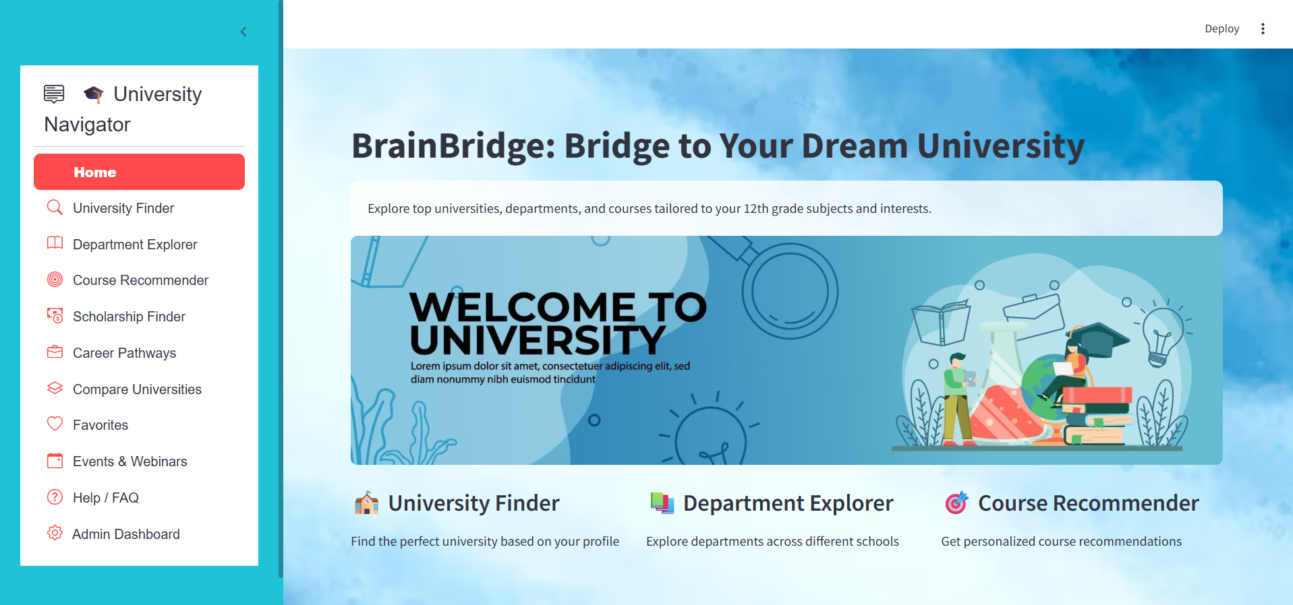
Dashboard

Slide 13
Thank You – Questions & Feedback
Thank you for your time! We hope Brain Bridge becomes a useful bridge between students and their dreams.
💬 Questions or Suggestions? Let’s discuss!
📬 Contact: kanojiashashank0gmail.com

