Slide 1
Detection of Stroke Disease using Machine Learning Algorithms

Slide 2
contents
Abstract
Introduction
Existing system
Disadvantages
Proposed system
Advantages
Conclusion
References

Slide 3
Objective of study
A stroke is a medical condition in which poor blood flow to the brain results in cell death. It is now a day a leading cause of death all over the world. Several risk factors believe to be related to the cause of stroke has been found by inspecting the affected individuals.

Slide 4
Abstract
Using these risk factors, a number of works have been carried out for predicting and classifying stroke diseases. Most of the models are based on data mining and machine learning algorithms. In this work, we have used four machine learning algorithms to detect the type of stroke that can possibly occur or occurred form a person’s physical state and medical report data.
We have collected a good number of entries from the hospitals and use them to solve our problem. The classification result shows that the result is satisfactory and can be used in real time medical report. We believe that machine learning algorithms can help better understanding of diseases and can be a good healthcare companion.

Slide 5
Introduction
A stroke occurs due to poor blood flow to the brain which results in cell death. Two main types of stroke are ischemic stroke and hemorrhagic stroke. Ischemic stroke occurs due to lack of blood flow and hemorrhagic stroke occurs due to bleeding.
There are several stroke risk factors that regulate different types of stroke. Predictive algorithms help to understand the relation between these risk factors to types of strokes. The machine learning algorithm can improve patients’ health through early detection and treatment.

Slide 6
Existing system
We have collected a entries and prepared a dataset
Cleaned and prepared the data for using in WEKA
We have trained four different models (eg. Naive Bayes, J48, k-NN, Random Forest)

Slide 7
Dis advantages
Less classification accuracy
and minimal loss using Data Mining

Slide 8
Proposed system
used Artificial Neural Networks (ANN), Support Vector Machine (SVM), Decision Tree, Logistic Regression, and ensemble methods (Bagging and Boosting) to classify the stroke disease.

Slide 9
Advantages
effectiveness and efficiency of Stoke classification strategies.

Slide 10
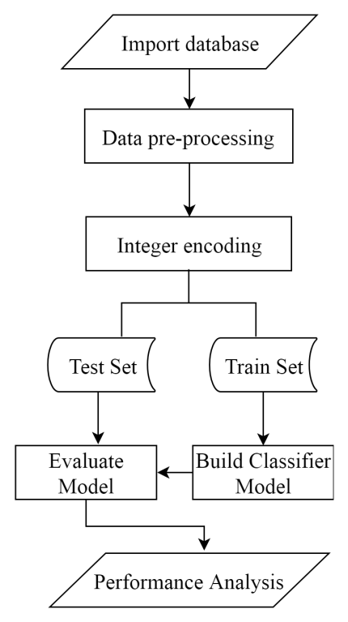
Work Flow Diagram

Slide 11
Dataset
Link
https://www.kaggle.com/fedesoriano/stroke-prediction-dataset

Slide 12
Modules
Upload Stroke Dataset:
Dataset Preprocessing & Features Selection:
Train Naive Bayes Algorithm
Train J48 Algorithm:
Train KNN Algorithm:
Train Random Forest Algorithm:
Train ANN Algorithm
Comparison Graph:

Slide 13
UML Diagrams

Slide 14
Class Diagrams

Slide 15
Sequence Diagram

Slide 16
Collaboration Diagram

Slide 17
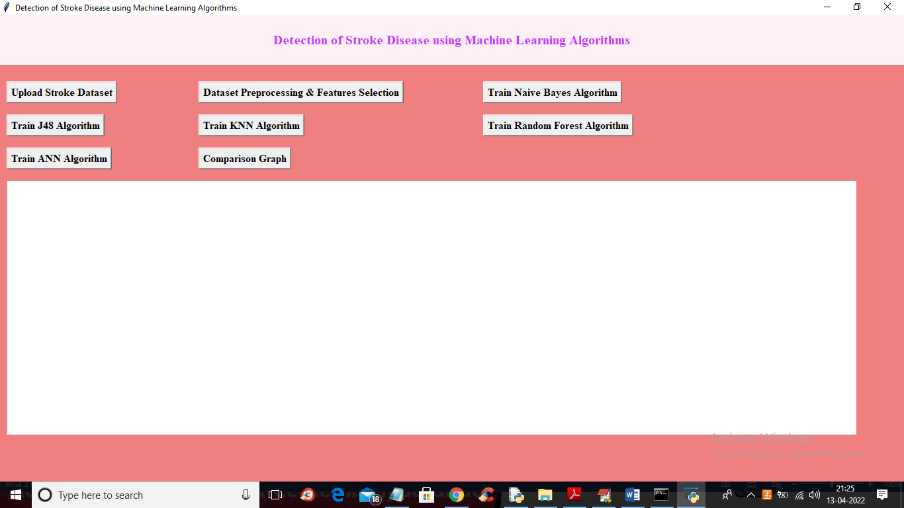
Output Screens

Slide 18
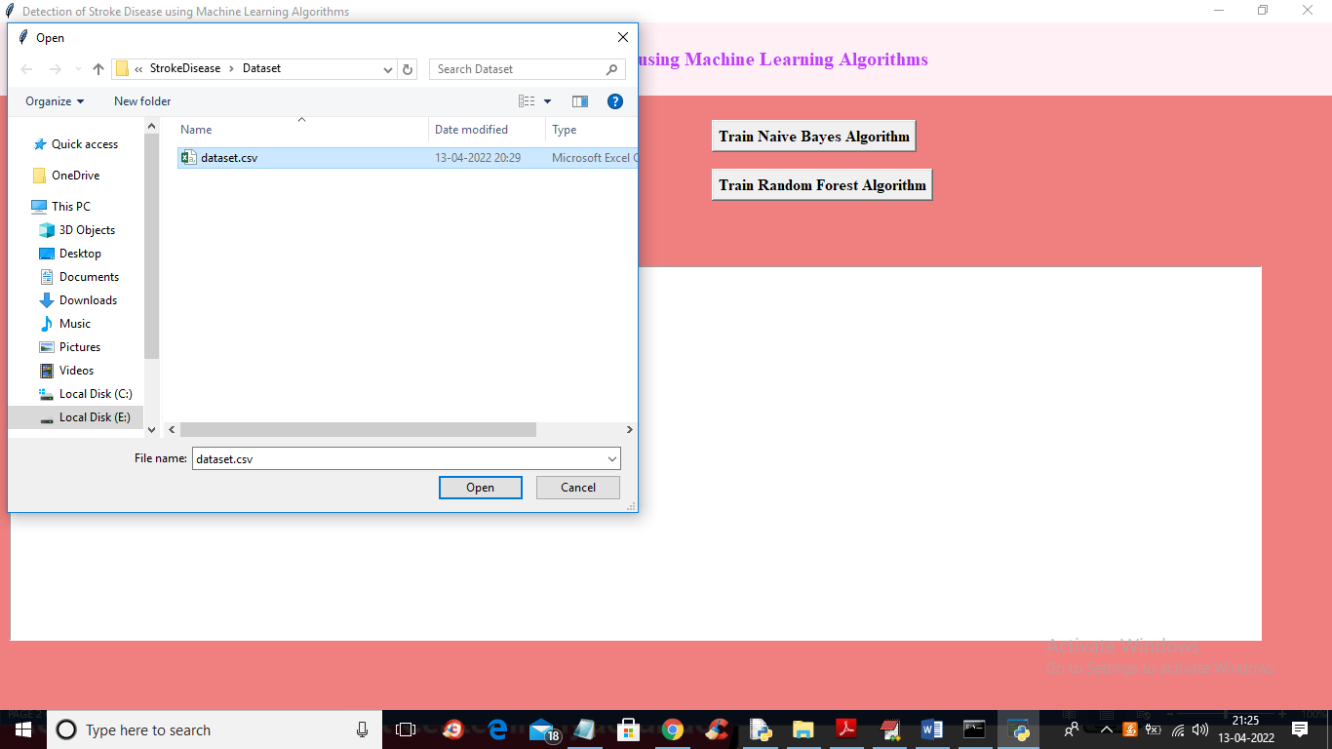
Upload Dataset

Slide 19
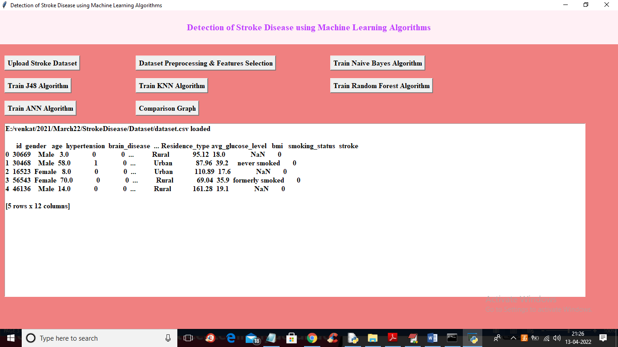

Slide 20
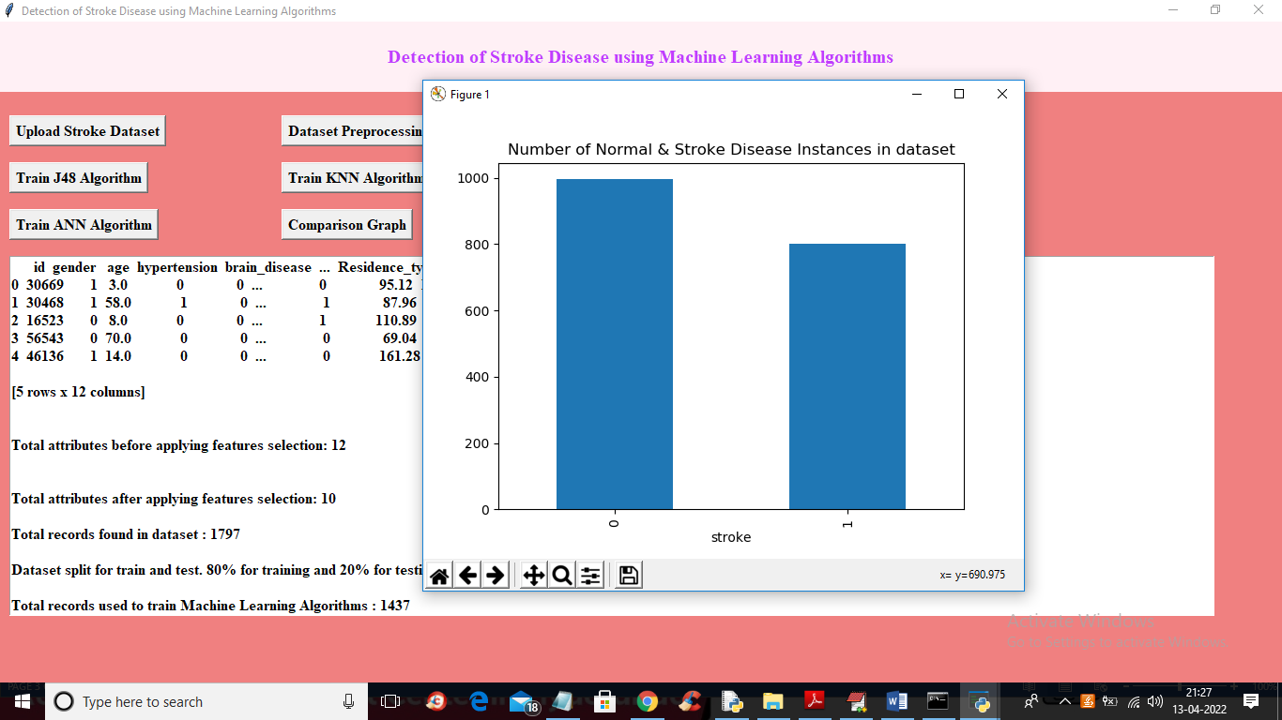

Slide 21
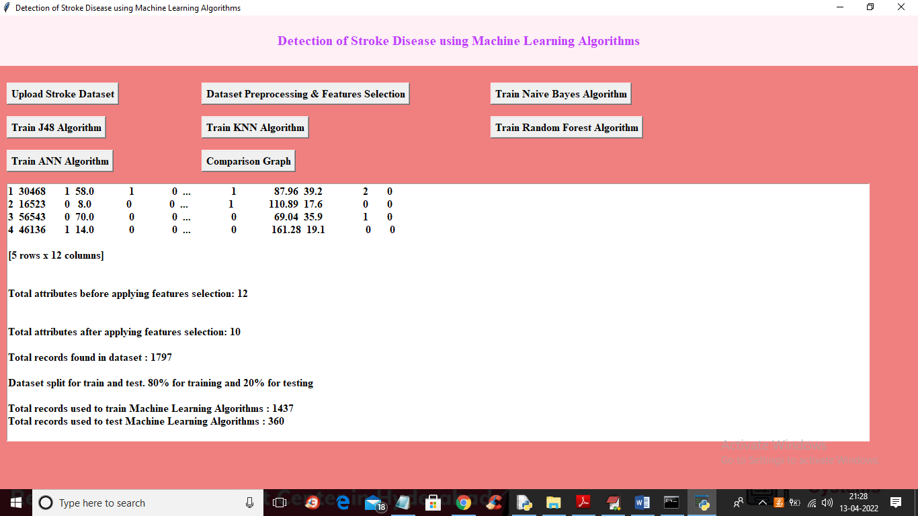
Preprocessing

Slide 22
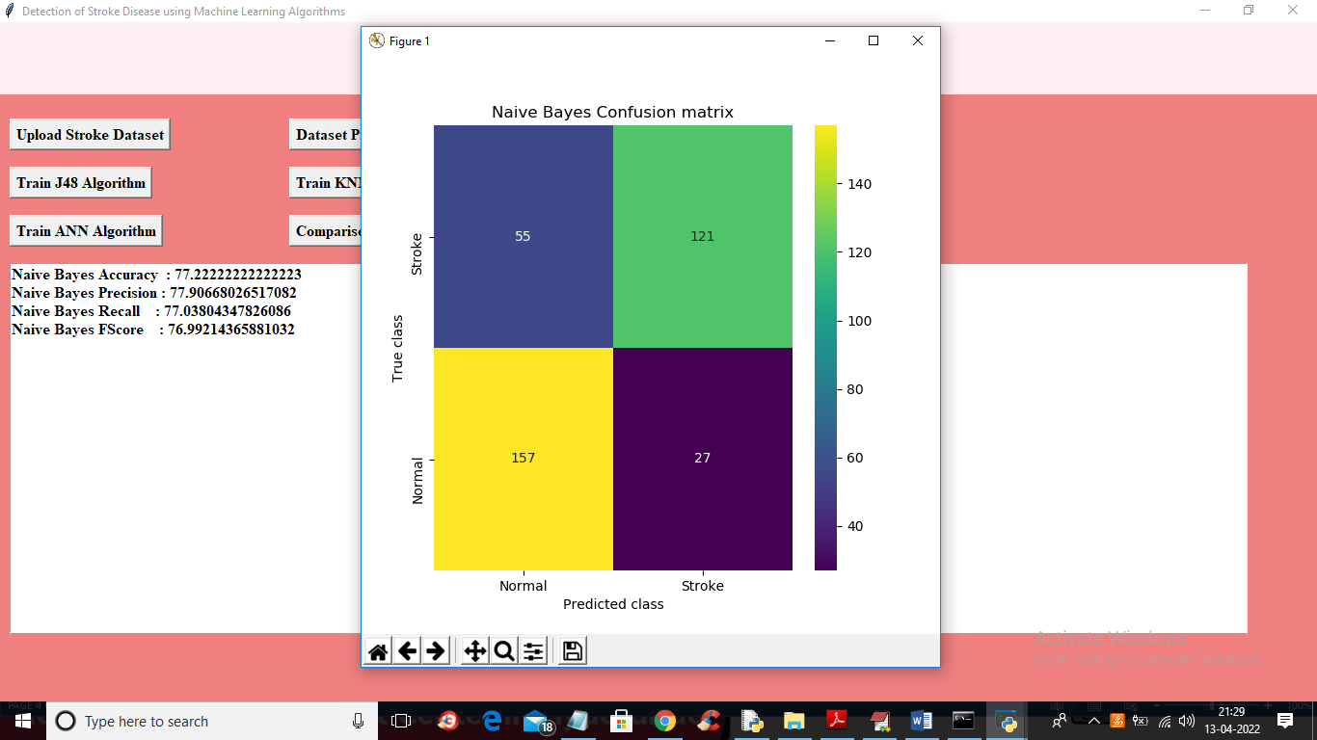
Naïve Bayes Algorithm

Slide 23
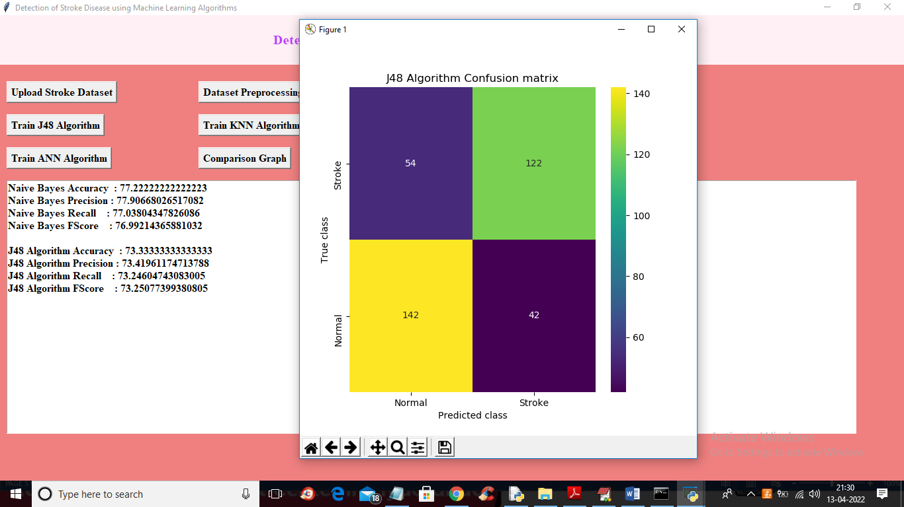
J48 Algorithm

Slide 24
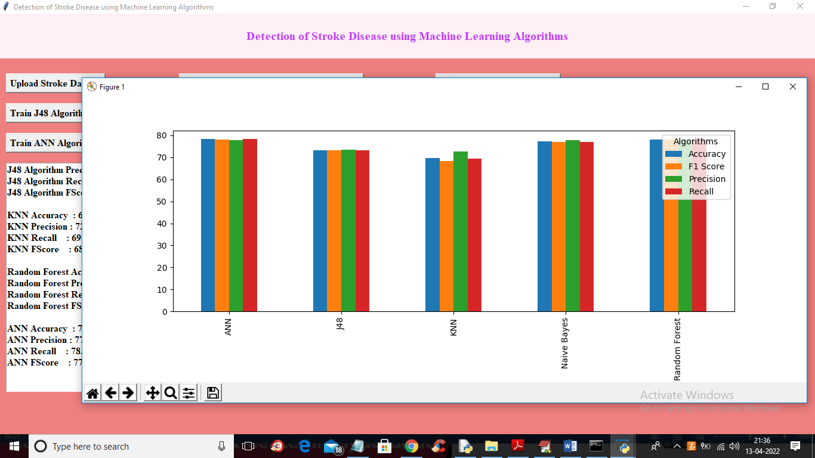
Comparison Graph

Slide 25
Conclusion
From the performance analysis we see that Naive Bayes performs better than other methods. The novelty and the main contribution of our work are collecting this dataset and preparing them to use with WEKA. The model can help people with a cautionary indication of being affected by stroke. Healthcare industries generate huge amounts of complex data about patients, hospitals resources, disease diagnosis, electronic patient records, medical devices, etc.

Slide 26
References
[1] S. H. Pahus, A. T. Hansen, and A.-M. Hvas, “Thrombophilia testing in young patients with ischemic stroke,” Thrombosis research, vol. 137, pp. 108–112, 2016.
[2] P. Govindarajan, R. K. Soundarapandian, A. H. Gandomi, R. Patan, P. Jayaraman, and R. Manikandan, “Classification of stroke disease using machine learning algorithms,” Neural Computing and Applications, pp. 1–12.
[3] L. T. Kohn, J. Corrigan, M. S. Donaldson, et al., To err is human: building a safer health system, vol. 6. National academy press Washington, DC, 2000.
[4] R. Jeena and S. Kumar, “Stroke prediction using svm,” in 2016 International Conference on Control, Instrumentation, Communication and Computational Technologies (ICCICCT), pp. 600–602, IEEE, 2016.
[5] P. A. Sandercock, M. Niewada, and A. Członkowska, “The international stroke trial database,” Trials, vol. 13, no. 1, pp. 1–1, 2012.

