Slide 1

Light Simulation & Impacts on Urban Environments
By: Conner, Kevin, Shema

Slide 2
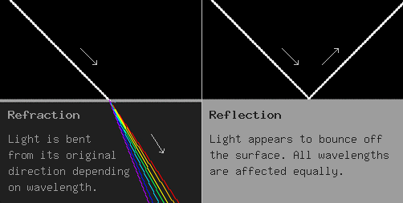
Introduction
Our Light Simulation application provides a suite of tools to calculate and interpret various light behaviors, including reflection, refraction, albedo, and intensity.

Slide 3
Problem Definition
Design a light reflection and refraction simulator that approximately reproduces light behavior on urban planning materials as a plausible means of mitigating issues such as light pollution and damage within communities

Slide 4
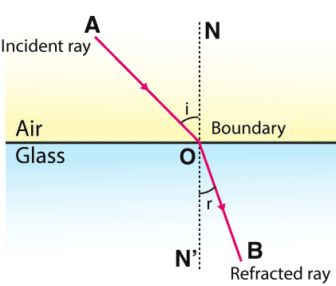
Design Requirements
Functions:
Reflection Calculation (Snell’s Law)
Albedo Calculation
Intensity Calculation
User-Friendly Interface
Result Interpretation
Objectives:
to accurately model the behavior of light with various urban materials via physics principles
Constraints:
Economic Factors
Reliability
Sustainability and Environmental Factors
Ethics
Societal Impacts

Slide 5
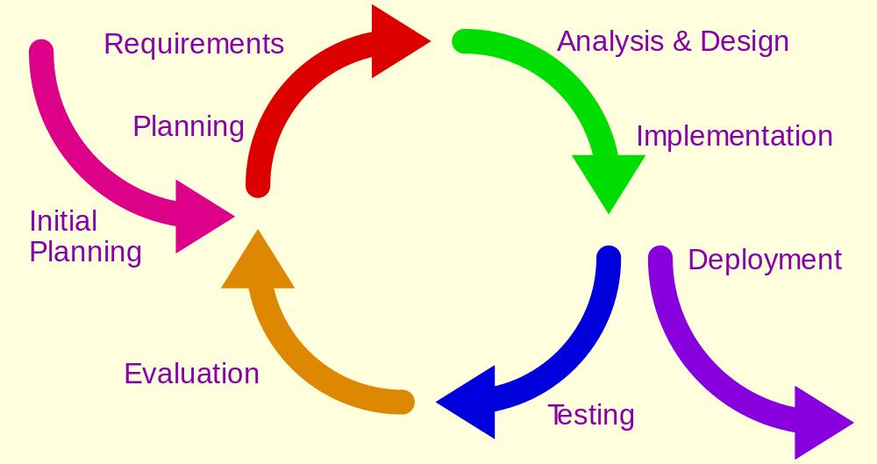
Solutions
Solution 1:
Our first iteration of the reflection and refraction simulator will focus on a single light source and material. Utilizing Snell's law for output calculations
Solution 2:
Our second solution increases the scope of consideration further for light behavior. By including the divergence and dispersion properties of light
Solution 3:
Our final solution better encompasses light behavior in a way that is most impactful on urban development and environments.

Slide 6
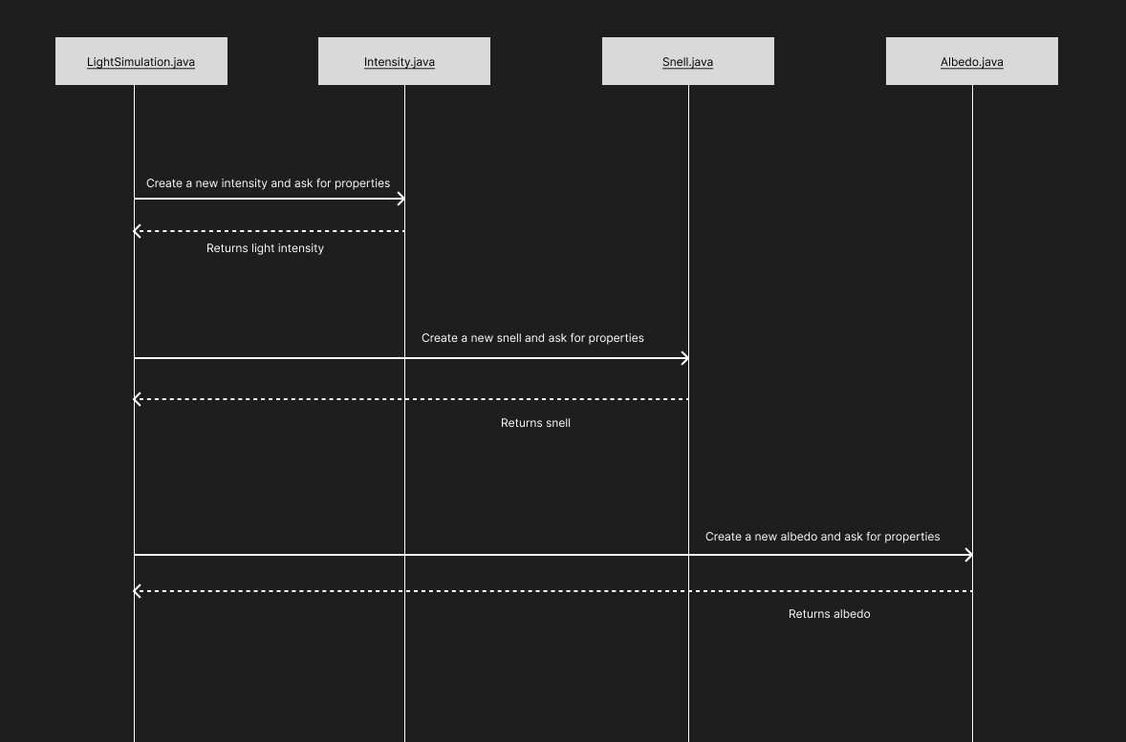
Communication Diagram

Slide 7
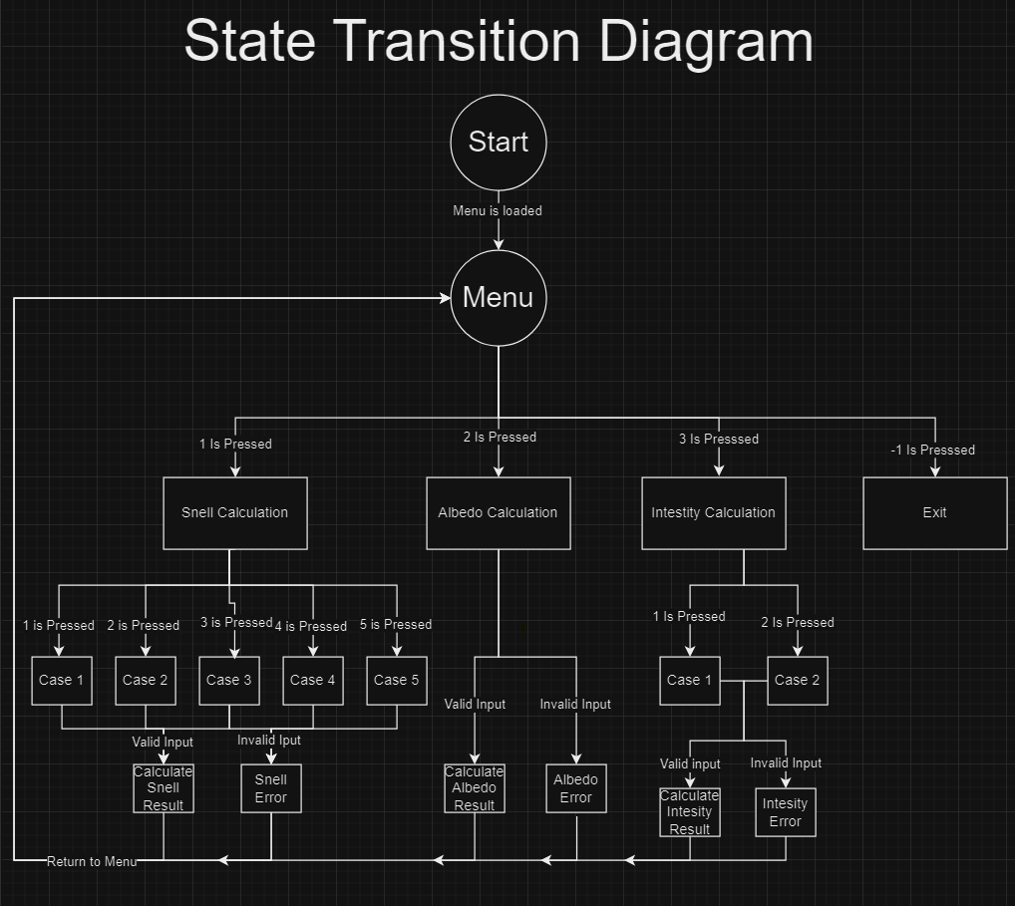

Slide 8
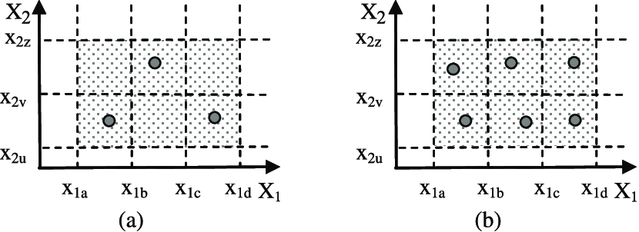
Testing
Testing Types Utilized:
Use Case
Boundary Value
Decision Table Based
Data Flow
Equivalence Class
Randomized

Slide 9
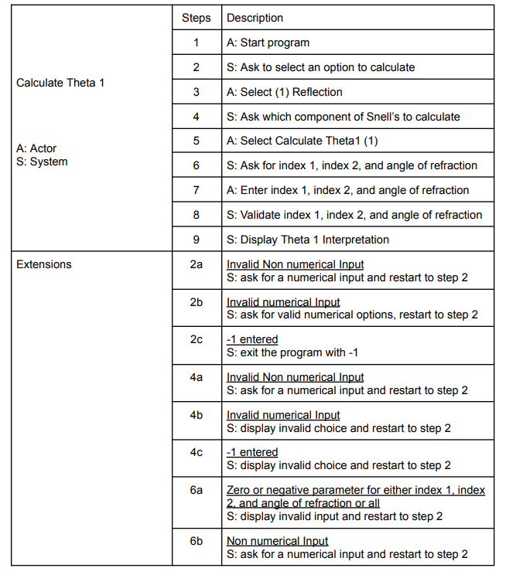
Use Case Testing

Slide 10
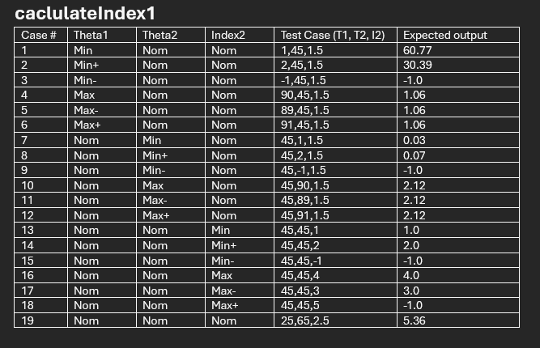
Boundary Value Testing

Slide 11
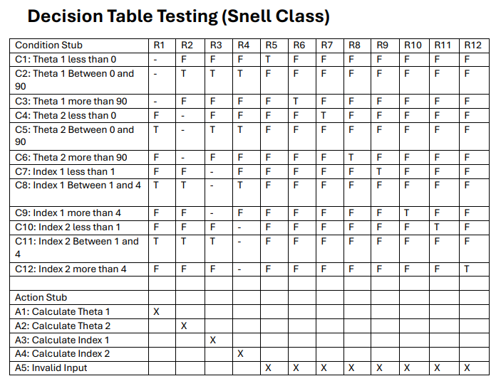
Decision Table Based Testing

Slide 12
Demonstration

Slide 13
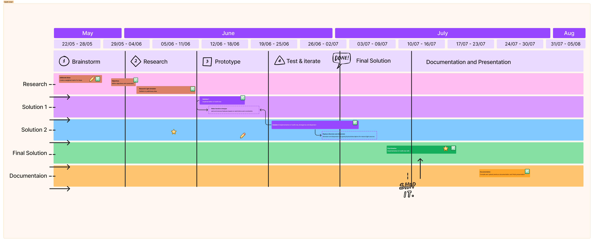
Project Management
Gantt Chart

Slide 14
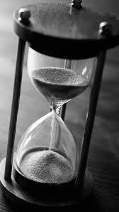
Conclusion and Future Scope
Limitations:
Time
Skill
Future:
Gui for visual displays of the simulations rather than just numerical so that users can better understand the information
Utilize form and dropdown menus for easier data entry
Error handling

Slide 15
Image References
https://scisyn.com/umuc/astro/ASTR100Notes/refract-reflect.html
https://www.toppr.com/ask/question/define-snells-law/
https://www.interaction-design.org/literature/article/design-iteration-brings-powerful-results-so-do-it-again-designer
https://www.researchgate.net/figure/Test-cases-for-a-weak-equivalence-class-testing-and-b-strong-equivalence-class_fig2_228793534
https://www.pinterest.com/pin/65583738310578206/

