Slide 1

MDM-M-1 · DIGITAL TOOLS IN DEVELOPMENT AND PRODUCTION · SS26
Advanced Robotics Assignment
Manipulator Kinematics, Trajectory
Planning & Joint-Level Control
Forward Kinematics
›
Inverse Kinematics
›
Waypoints
›
Quintic Trajectory
›
PD Control
›
Tracking
Robot: Universal Robots UR5 (6-DOF) Tool: MATLAB · Robotics System Toolbox Controller: PD on all 6 joints
Notes:
Title. Introduce the project: a full robot-motion pipeline on the UR5 in MATLAB — FK, IK, trajectory planning, PD control, tracking analysis.

Slide 2

00
GROUP INFORMATION
Team & Course
GROUP MEMBERS
Course
Members
MDM-M-1
1
Mostafa Mohamed
Digital Tools in Development and Production
2
Nadine Labib
Semester SS26 Deliverable MATLAB pipeline + reflection sheet Requirements R1 – R9 (all satisfied)
3
Dalia Hussein
4
Ali Anan
Names are placeholders — replace with the group's details before submission.

Slide 3






01
OBJECTIVE
What the project does
A complete robot-motion pipeline: from joint angles to end-effector poses, back to the joint angles needed for target points, then smooth motion between them under a feedback controller — verified at every step.
01
02
03
Model
Forward Kinematics
Inverse Kinematics
Load UR5 — 6 revolute joints, tool0 end-effector frame.
Joint angles → end-effector position & orientation. Always solvable.
Target pose → joint angles. Solved numerically, then verified.
04
05
06
Trajectory
PD Control
Analysis
Quintic path through Home→T1→T2→Home. Smooth start/stop.
Feedback controller drives a motor model to follow the plan.
Compare desired vs actual, quantify tracking error, animate.
Notes:
Six stages. FK is the easy direction (angles->pose). IK is the reverse and is hard. Everything downstream is about moving smoothly and following the plan.

Slide 4
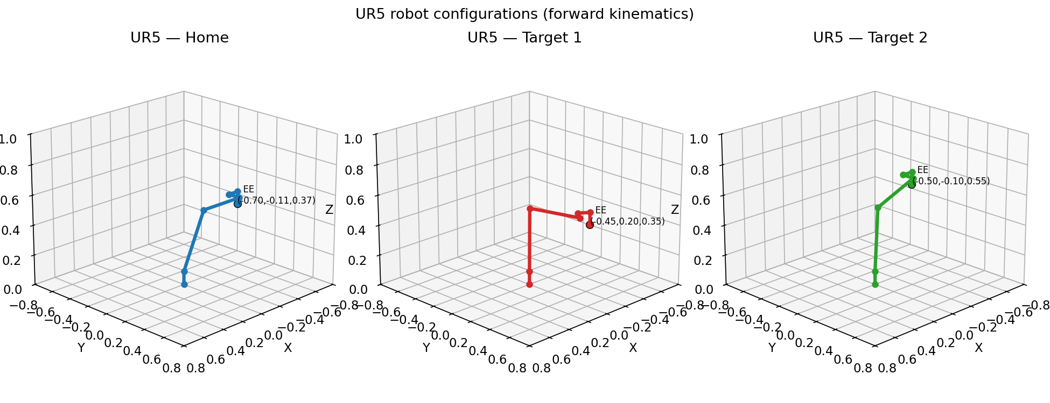

02
ROBOT MODEL & FORWARD KINEMATICS
The UR5 and its poses
6 revolute joints
FK = matrix chain
Two configs tested
UR5 loaded via loadrobot("universalUR5"); tool0 is the end-effector frame.
getTransform multiplies each joint transform → EE pose. No ambiguity.
Config A [0,0,0,0,0,0] and Config B verify the mapping produces distinct poses.

Slide 5


03
INVERSE KINEMATICS
From target point to joint angles
THE HARD DIRECTION
IK reverses the problem: given where the tool must be, find the joint angles.
Closed-loop verification
Iterative solver. inverseKinematics starts from a seed guess and nudges the joints until FK matches the target. Seeded sequentially. Target 1 seeds from Home; Target 2 seeds from Target 1 — giving a natural, continuous path. Weights [0.25 0.25 0.25 1 1 1]. Position matched ~4× more strictly than orientation.
The IK result is fed back into FK and compared to the original target.
< 10⁻⁶ m
residual position error
(both targets)
Target 1
Target 2
p₁ = (−0.45, 0.20, 0.35) m
p₂ = (−0.50, −0.10, 0.55) m
Tool pointing straight down (180° about X).
Same tool-down orientation, higher & offset.
Notes:
FK = multiply joint transforms along the chain. Two configs tested to prove distinct, sensible poses.

Slide 6
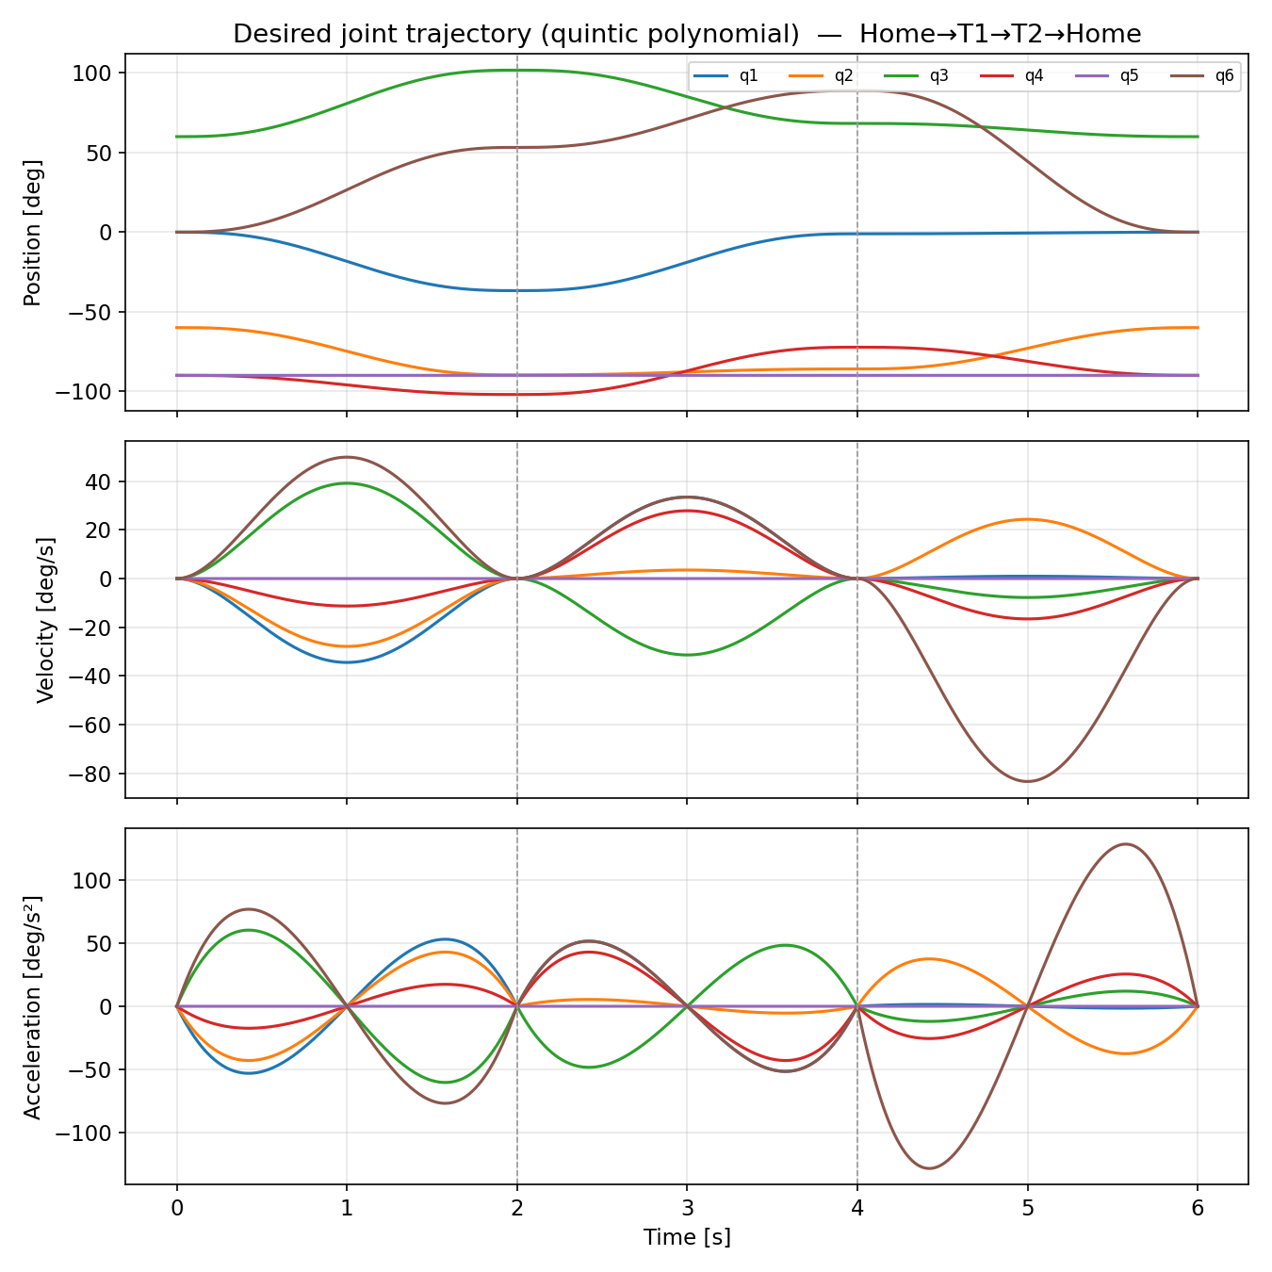

04
TRAJECTORY PLANNING
Quintic polynomial — smooth motion
HOME → T1 → T2 → HOME
Why a 5th-order polynomial?
Linear interpolation snaps velocity at each waypoint — infinite acceleration no motor can produce. A quintic fixes six boundary conditions per segment so position, velocity and acceleration are all continuous.
pos = start
pos = end
vel = 0 start
vel = 0 end
acc = 0 start
acc = 0 end
Velocity & acceleration return to zero at every waypoint (dashed lines) — the arm eases in and eases out at each stop, exactly like a real robot.
Notes:
IK: numerical solver, seeded sequentially. Key point: we verify by feeding the answer back into FK — error under 1e-6 m.

Slide 7

05
JOINT MOTOR CONTROL
Simulating a real controller
Motor model (per joint)
Proportional (Kₚ)
Kp = 120
J · q̈ + B · q̇ = u
Pushes harder the further the joint lags behind its target.
PD control law
Derivative (K_d)
u = Kₚ (q_des − q) + K_d (q̇_des − q̇)
Kd = 22
Reacts to velocity error — damps overshoot and oscillation.
Simulation
Stated limitation
Parameters: J = 1.0, B = 2.0, applied to all 6 joints. Integration: semi-implicit Euler, dt = 0.002 s (500 Hz, 3000 steps). Output: qActual — the simulated 'real' response of the arm.
Joints are treated as rigid and decoupled — no gravity, Coriolis or friction coupling between links. A deliberate pedagogical simplification, not a full UR5 dynamic model.
Notes:
Quintic = smooth ease in/out. Velocity and acceleration hit zero at each waypoint (dashed lines).

Slide 8
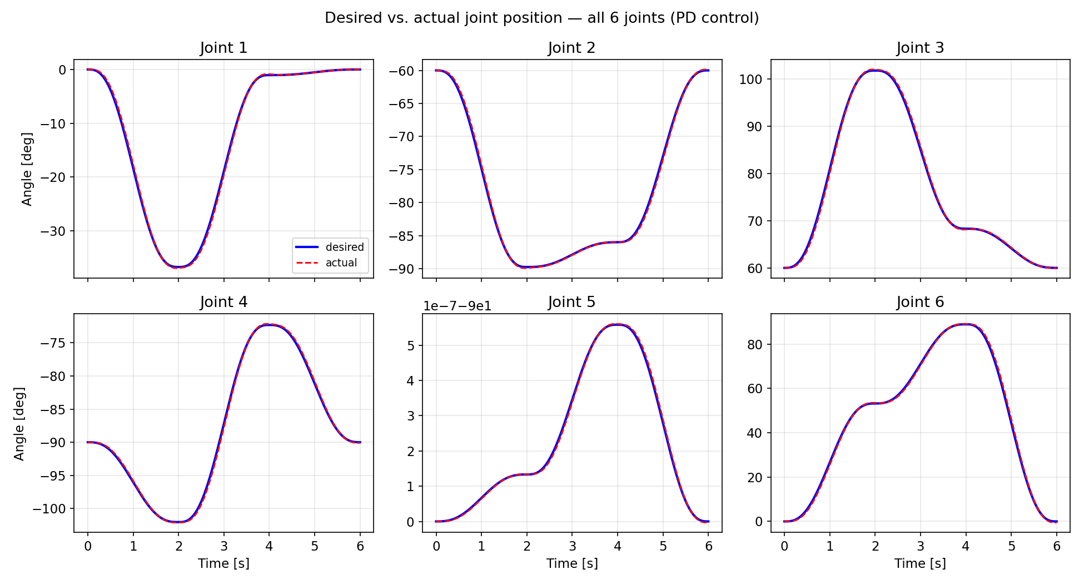
06
RESULTS — TRACKING
Desired vs. actual, all 6 joints
Blue = desired
The ideal quintic plan for each joint.
Red = actual
The PD-controlled response (qActual).
Near-perfect overlap
Controller tracks the plan closely on every joint.
Joint 5 ≈ flat
It barely moves in this path (tiny 1e-7 scale).
Notes:
PD = proportional (position error) + derivative (velocity error, damps overshoot). Say the limitation out loud: decoupled joints, no gravity/friction.

Slide 9
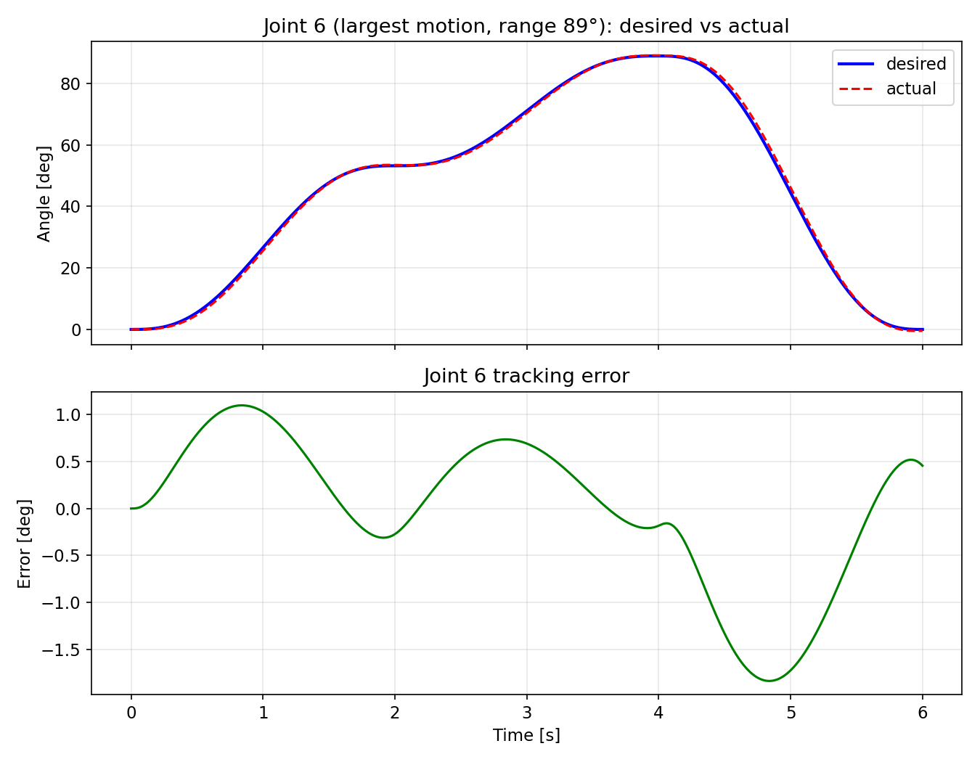
07
RESULTS — WORST CASE
Joint 6: the fastest, hardest to track
WHY ISOLATE JOINT 6
The largest-motion joint
J6 sweeps the widest range, so it moves fastest and is the hardest for the controller to follow. Showing it proves the results aren't hiding the weakest joint.
≈ 89°
≈ 1.8°
range of motion
peak tracking error
Read the lower panel: error grows during fast motion and returns to zero at each waypoint — exactly the expected PD behaviour.

Slide 10
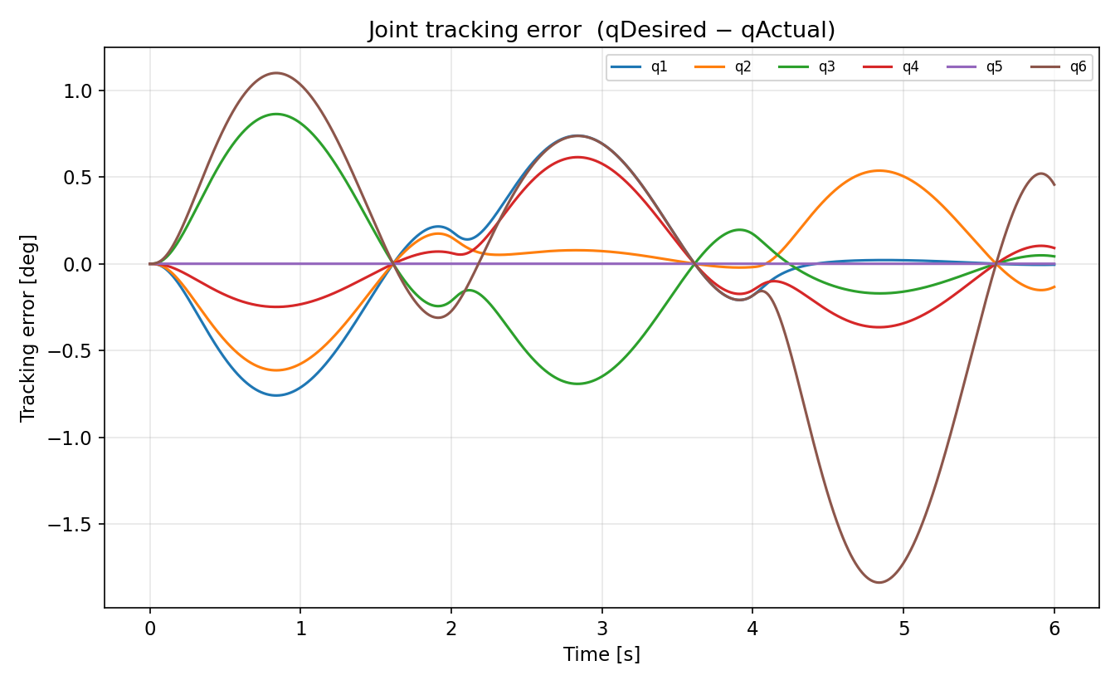

08
RESULTS — ERROR PROFILE
Tracking error, all joints
Zero at waypoints
At t = 0, 2, 4, 6 s velocity is zero, so the controller has fully caught up — error vanishes.
Peaks mid-segment
Error grows during the fastest motion — a feedback controller must lag slightly before it corrects.
J6 worst, J5 flat
Brown (J6) has the largest peak (~1.8°); purple (J5) stays at zero — it barely moves.

Slide 11
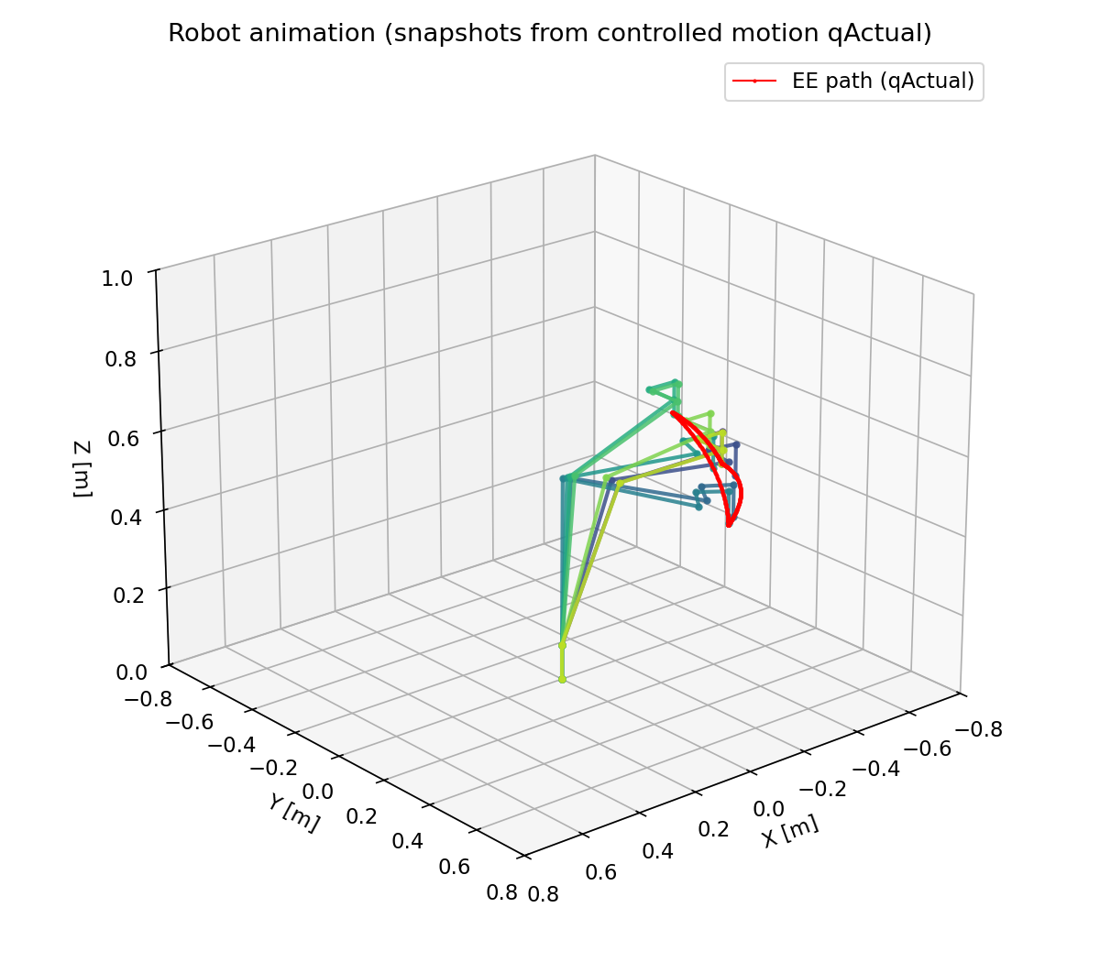
09
ANIMATION
Controlled motion with qActual
REQUIREMENT R9
The robot moves — driven by the real response
The animation replays the arm through the full Home→T1→T2→Home path using qActual — the PD-controlled response, not the idealised plan. This shows what the robot would genuinely do under this controller.
Red curve
Arm poses
End-effector path in 3D space
Snapshots sampled over time
Tip: for the live demo, screen-record the MATLAB animation window.

Slide 12
RESULTS & REFLECTION
Key numbers at a glance
< 10⁻⁶ m
< 0.8°
≈ 1.8°
6 / 6
IK residual error
RMS tracking / joint
peak error (Joint 6)
joints under PD control
FK & IK round-trip correctly
IK solutions reproduce the targets to sub-millimetre accuracy.
Motion is smooth & jerk-free
Quintic trajectory stops cleanly at every waypoint.
PD tracks with small, sensible error
Error concentrates in fast phases, vanishes at rest — physically correct.
Notes:
Key numbers slide — pause on IK <1e-6 m and RMS <0.8 deg.

Slide 13
10
CRITICAL REFLECTION
Limitations & next steps
LIMITATIONS
NEXT STEPS
What the model simplifies
How to extend it
Decoupled joints — no gravity, Coriolis or friction coupling.
Add full rigid-body dynamics (inverseDynamics) with gravity.
Fixed PD gains, tuned by hand rather than optimised.
Computed-torque or PID control for tighter tracking.
Single IK solution per target (no elbow-up / elbow-down search).
Cartesian-space (task-space) trajectory instead of joint-space.
Ideal actuators — no torque limits, backlash or sensor noise.
Collision checking and workspace-limit validation.

Slide 14
Thank you
UR5 Manipulator Kinematics, Trajectory Planning & Joint-Level Control
FK → IK
Quintic
PD × 6
verified < 10⁻⁶ m
smooth, jerk-free
RMS < 0.8°
MDM-M-1 · Digital Tools in Development and Production · SS26

