Slide 1
End-to-End ETL Pipeline
Author - Shashank Gupta
Reviewer - Oscar Luiz Silva

Slide 2
Business Problem
Design a Data warehouse store for a B2B e-commerce site utilizing ETL capabilities
Data Sources:
B2B Platform Database
Web-Log Data
Marketing Data
Required Reports:
Most Popular Device used (top 5)
Most Popular Products in the country from which most users log into
All sales of B2B platform displayed monthly for the last year

Slide 3





End-to-End ETL Pipeline (Solution)
B2B Platform
2NF Dimensional Model
Target Database
Weblogs
Marketing Spreadsheet
Data Ingestion
ETL Scripting
Source Database
Data Sources
BI & Reporting
3NF Data Model

Slide 4
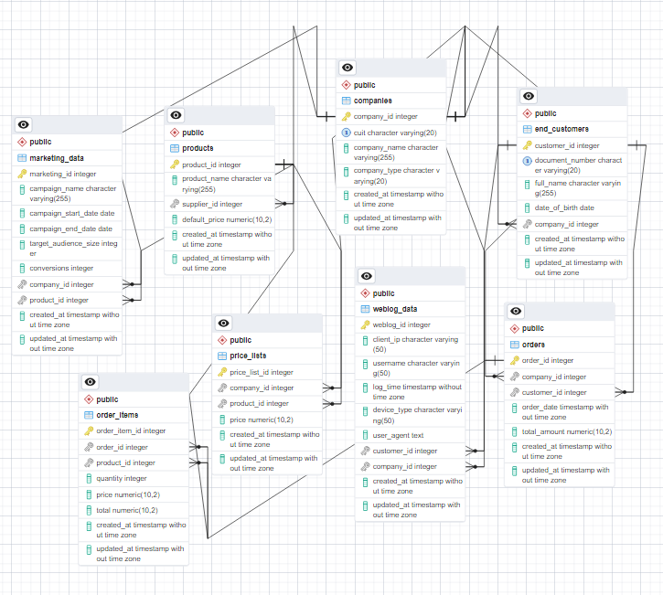
Source Database
Implemented a 3NF Data Model for the source database consisting 8 relational tables maintaining the referential integrity.
Eight Relational Tables
B2B Tables:
Product
Companies
Orders
Customer
Price List
Order Items
Weblog Tables:
Log Data
Marketing Lead Tables
Marketing Data

Slide 5
Extract Transform & Load
1.
2.
3.
Extract
Transform
Load
The Load phase truncates existing tables and loads the transformed data into the target database using SQL INSERT INTO operations. Updates Dim & Fact tables
The Transform phase involves structuring and organizing the data into the dimension tables and fact tables as part of dimensional modeling.
The Extract phase pulls raw data from the source database (companies, customers, products, orders, marketing data, and weblog data) using SQL queries

Slide 6
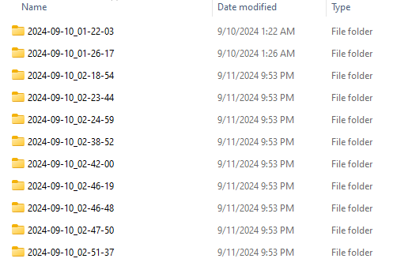
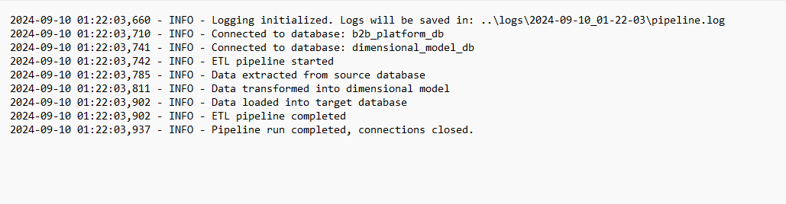
Pipeline Execution Logging Feature
This ETL pipeline has a logging feature that tracks all the runs by their timing and execution logs

Slide 7
Dimensional Model Star Schema (Target Database Modeling)
Implemented a Kimball Style Star Schema for dimensional modeling within the Target database.
Advantages:
Read Optimized Query [Fewer Joins involved]
Faster Performance [Denormalized Tables]
Easy to Scale [Add Remove Dimensions]
Improved Data Understanding
Dimensions – Contains Qualitative Context
Facts – Contains Quantitative Measures
Target Database
Dim_Company
…..
Dim_Product
Dim_Date
……
……
Six Dim Tables and 1 Fact Table
Dim Tables:
Dim_Product
Dim_Company
Dim_Date
Dim_Device
Dim_Customer
Dim_Lead
Fact Tables:
Fact_Orders
Fact_Orders
…….
Dim_Device
Dim_Customer
……..
……

Slide 8
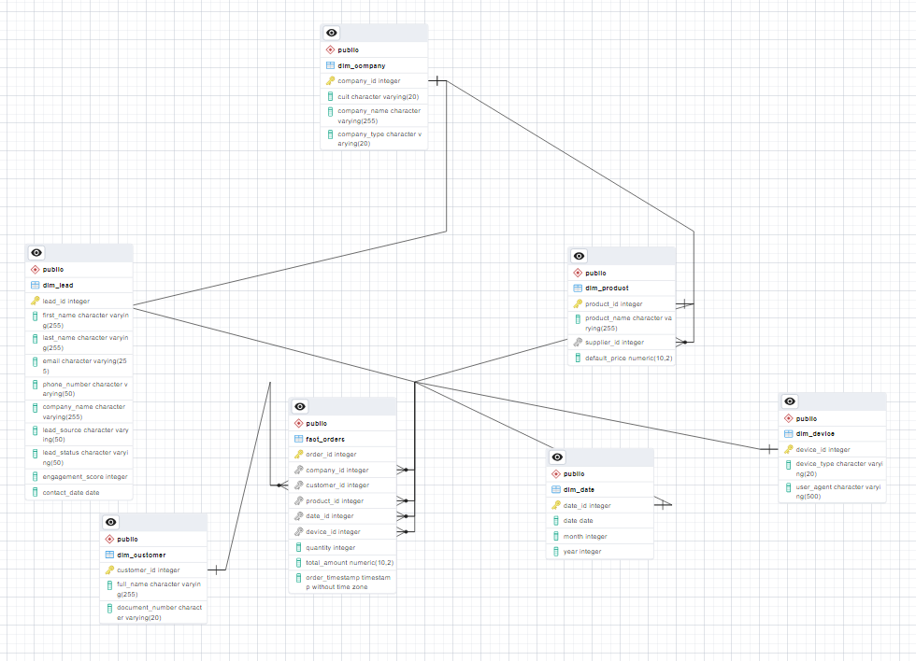
Dimensional Model Star Schema (Cont.)
Actual ERD of the Target Database designed in PostgreSQL

Slide 9
Business Impact of Key B2B Platform Reports
1. Top 5 Devices Used by B2B Clients
Target device-specific marketing
Optimize platform for high-traffic devices
2. Most Popular Products in Top Country by User Logins
Optimize inventory and supply chain.
Tailored localized marketing
3. Monthly Sales of B2B Platform for the Last Year
Better planning and forecasting
Sale performance as a KPI

Slide 10
Demo
Demo Time

Slide 11
Thank You!

