Slide 1

INSSAN Indian National Suggestion Scheme’ Association
“INSPIRE TO INNOVATE”

Slide 2
What is INSSAN?
INSSAN is the professional support network dedicated to assisting organisations to create, maintain and reinforce their Employees Suggestion Scheme.
INSSAN is managed by a team of Suggestion Scheme Practitioners with hands on experience and is the only Indian Professional Body in this field.
INSSAN works with organisations in all areas of Indian Industry both in the private and public arena in manufacturing, financial and services sector and it maintains close links with sister associations overseas.

Slide 3
What is INSSAN?
INSSAN operates a country wide consultancy services providing guidance and advice relating to the implementation and development of Employee Involvement Programmes.
Companies having Suggestion Schemes are office bearers and members, like Tata Power, M & M, Godfrey Phillips, BPCL, RCF, IPCA Lab., Siemens, Kansai Narolac, Escorts Tractors, Dalmia Cement, L & T, SAIL, BHEL, ITC, Munjal Shova, Caparo Engineering, Special Steels, Phillips India, Tata Steel, etc.

Slide 4
MORE ABOUT INSSAN
(INSSAN) is a non-profit making registered association of industrial and business organizations dedicated to the promotion of Suggestion Schemes as any process or system that elicits the contributions of Employees within an organization through suggestion/ ideas for effective Employee Involvement towards increasing organizational competitiveness and productivity.
Founded on – 04 April 1987(under the assumption of Bombay Chamber of Commerce and Industry)
INSSAN today has a membership of over 550 organisations representing a cross section of Indian Industry.
The Association has its own Memorandum of Association (MOA) and Rules and Regulations under it.
It is registered under the Societies Act. 1860 on 17th November, 1987.

Slide 5
OBJECTIVES
To encourage, promote and formulate models for Suggestion Scheme and/ or similar concepts.
To establish professional standards for administration of Suggestion Schemes or similar concepts.
To propagate benefits of Suggestion Schemes or similar concepts among industries and other organizations.
To assist members in overcoming problems faced by offering counselling services.
To provide publicity materials at concessional rate to its members.
To improve productivity and quality of products and services through promotion of Suggestion scheme and/ or similar concepts.
To pool resources and employ these gainfully for the benefits of its members

Slide 6

ASSOCIATES
INSSAN is collaborating with the following Associates :
Idea Arabia
Chairman – Hassan Omar
DIB Germany
Ideas America
President – Brenda Kelly
Ideas UK
Director – Zena Cox

Slide 7
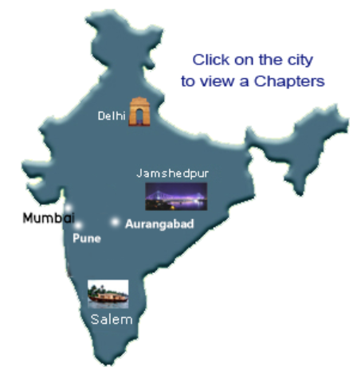
Headquarters and Chapters
NIC- North India Chapter at Delhi]
Chairman – Munjal Yogesh
EIC- East India Chapter at Jamshedpur Chairman – Pathak Sudhanshu
WIC- West India Chapter at Pune Chairman – Savangikar Shrikant
SIC- South India Chapter at Salem Chairman – Palaniappan .B
Aurangabad Chapter at Aurangabad
Chairman – Dr Sudhir Deshmukh

Slide 8
Events
PAST EVENTS
Employee Engagement : Compete and Grow (16 January 2020, Mumbai)
Tools For Employee Involvement (TEI) Seminar (20 July 2019, Pune)
SCOPE Convention Center (July 2019, New Delhi)
Innovation, Automation & Business Excellence (15 June 2019, Aurangabad)
Brochure – 29th National Convention (18 January 2019, Pune)
SILVER JUBILEE NATIONAL CONVENTION OF INSSAN (16 January 2015, Mumbai)

Slide 9
How to Contact INSSAN?
Following are the contact details of INSSAN:
Indian National Suggestion Schemes Association A/62 Satyam CHS, Dr.Rajendra Prasad Road, Near Municipal General Agarwal Hospital, Mulund(West), Mumbai 400080. Mobile : +91 9820118501 e-mail :inssan87@gmail.com, info@inssanindia.com

