Slide 1

Study of SCM in Pharmaceutical
Mechanical and system Engineering

Slide 2
Contributing Members
Guide :- Prof. Rahul Waikar
Group members:
Shaunak Deshpande (04)
Gaurav Shejwal (05)
Shrawani Shinde (09)
Shivang Singh (12)

Slide 3
What is Supply Chain Management ?
SCM is the management of the flow of goods and services
Includes all processes that transform raw material into final product
Maximises the quality of product or service
Increases profitability to the company

Slide 4

How does SCM Work?
Planning
Sourcing
Manufacturing
Delivery and Logistics
Returning
Enabling

Slide 5

Entities of Basic SCM

Slide 6
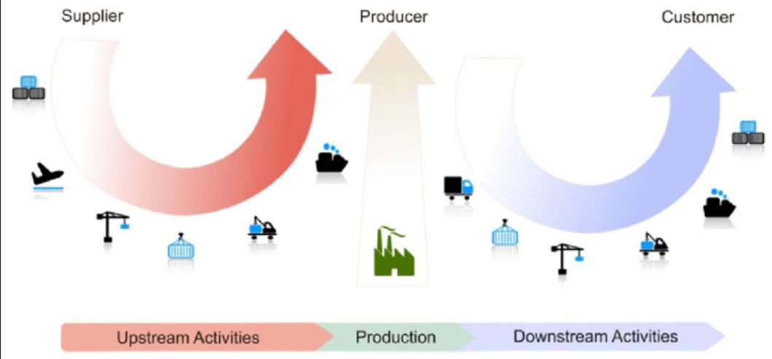
Different Activities

Slide 7
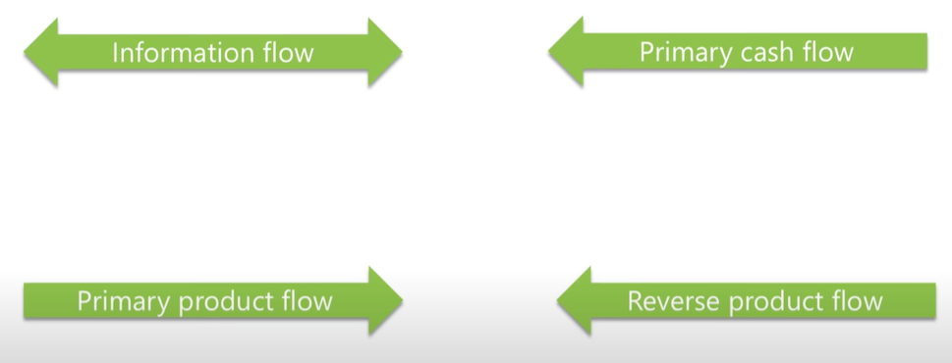
Flows in SCM

Slide 8

Strategies in SCM

Slide 9
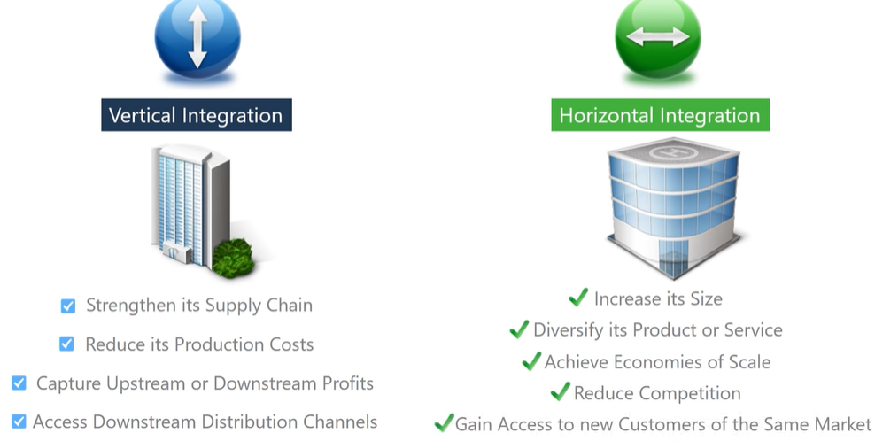
Types of SCM

Slide 10
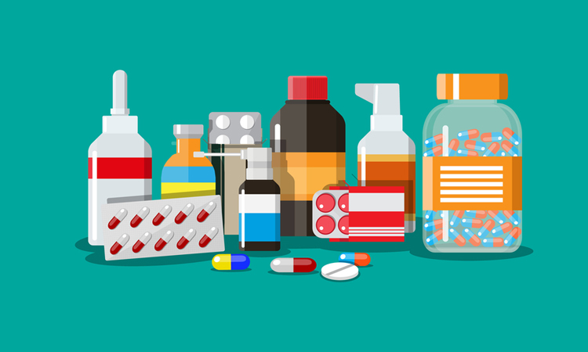
Pharmaceutical Industry
Pharmaceutical industry is responsible for the flow of products related to diagnosis, treatment or prevention of disease or abnormal physical state in humans or animals
It is a complex process involving discovery, developments and manufacturing of drugs and medications
This industry works under a very strict rules and regulations that are to be followed

Slide 11
Rules and Regulations
The manufacturer can sell only the drug which is patent
Patent must be approved by various general medical bodies
Only the substance or mixture is to be manufactured which is used in diagnosis or treatment
The drug should be stored under the suitable environment

Slide 12
Pharmaceutical SCM
The typical supply chain of any pharmaceutical company has four components:
Raw Material Sourcing
Manufacturing and Packaging
Distribution and Dispensing Logistics
Dispensing

Slide 13
Management Challenges
The challenges that occur while managing pharmaceutical products:
Managing Perishable Products
Managing Temperature Control
More focus on R&D
Shipping of expiry products
Integration of domestic and international businesses

Slide 14
Operational Challenges
Major pharmaceutical companies have ERP systems to follow the business processes. The challenges that occur are:
Demand Management
Inventory Management
Secondary Production Planning

Slide 15
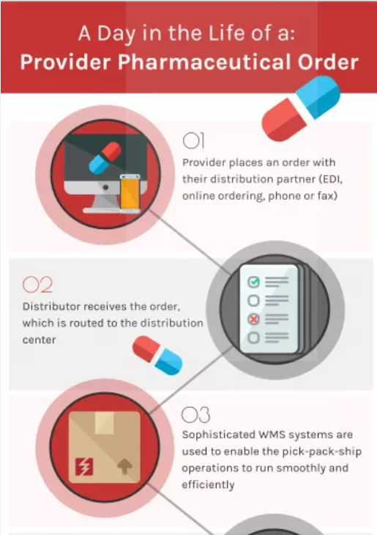

Slide 16
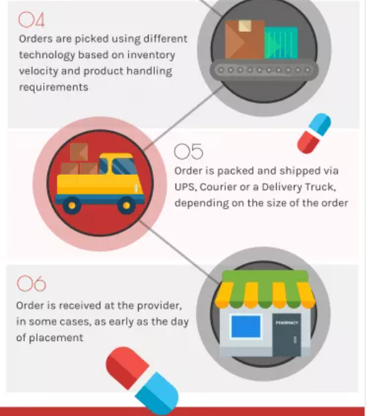

Slide 17
Benefits of SCM
Quicker customer response and fulfilment rates
Greater productivity and lower costs
Reduce inventory through the supply chain
Fewer suppliers and shorter planning cycles

Slide 18
Thank You!!

