Slide 1

Digital Signal Processing: Applications in Military
Radha Thakare, 20
Shivang Singh, 12
Shrawani Shinde, 09
Gaurav Shejwal, 05
Shaunak Deshpande, 04

Slide 2
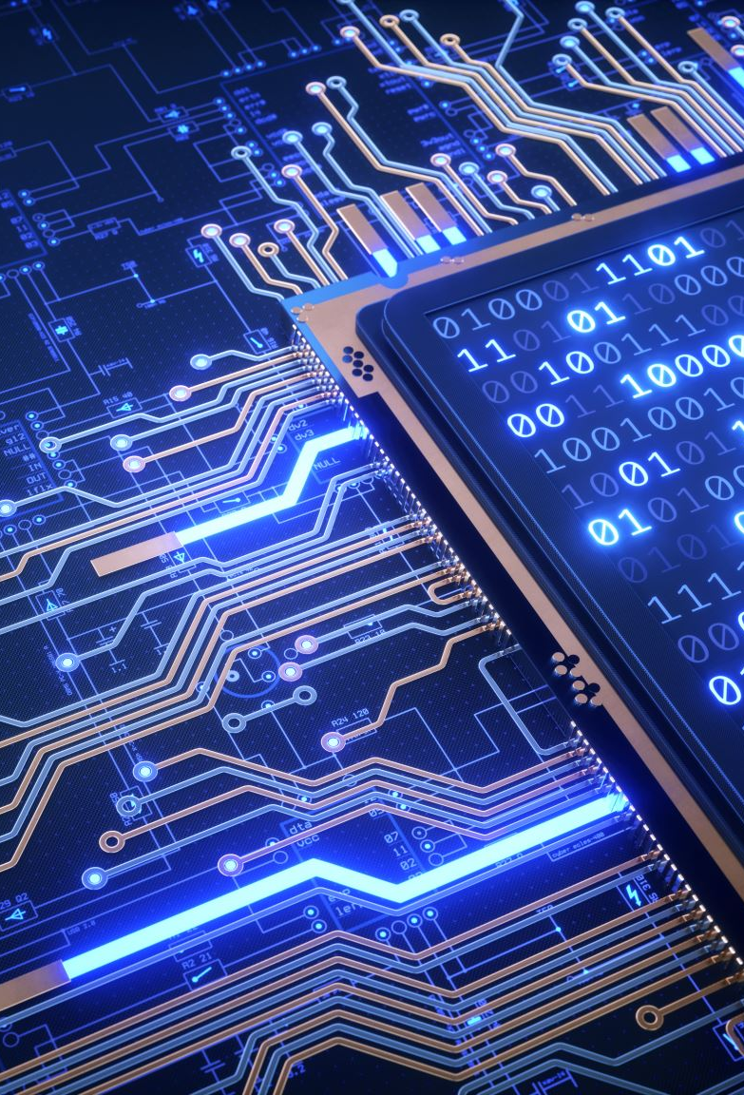
What is Digital Signal Processing?
Digital signal processing (DSP) is the use of digital processing, such as by computers or more specialized digital signal processors, to perform a wide variety of signal processing operations.
The application of digital computation to signal processing allows for many advantages over analog processing in many applications, such as error detection and correction in transmission as well as data compression.

Slide 3
Military DSP Applications
A variety of technologies heavily rely on Digital Signal Processing. A few examples are:
RADAR
electronic warfare
secure communications
electro-optics
Intelligence
Today, We will be looking at two of these applications.

Slide 4

Digital Signal Processing
RADAR

Slide 5

What is RADAR?
The word RADAR is an acronym for RAdio Detection and Ranging.
RADAR a system for detecting the presence, direction, distance, and speed of aircraft, ships, and other objects, by sending out pulses of radio waves which are reflected off the object back to the source.
RADAR transmits radio signals at distant objects and analyses the reflections.

Slide 6

Operating Principles
1. The radar is transmitting an EM pulse.
2. The radar switches to listening mode.
3. The pulse is reflected by a target.
4. The radar receives the echoes from the transmitted pulse.

Slide 7
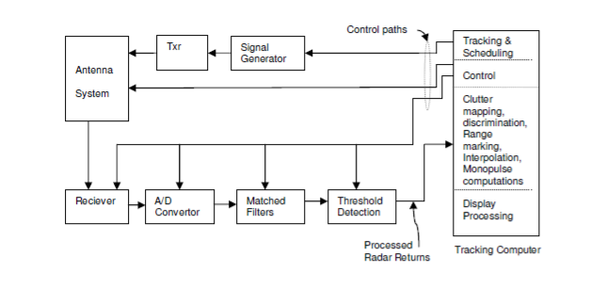
Block Diagram of a Modern Radar system

Slide 8
DSP in RADAR
In modern Radar systems digital signal processing (DSP) is used extensively.

Slide 9
??
1. How to find range of the object/Target?
2. How to find the speed of the object/Target?
3. How DSP is used to separate target from clutter?

Slide 10

Finding the Range of the object
Transmission of radio pulse
Pulse is focused in only one direction.
Propagation in every direction .
Object detection.
Receiving energy.

Slide 11
Measuring distance with a simple oscilloscope.
On the oscilloscope moves synchronously with the transmitted pulse a luminous point and leaves a trail.
The deflection starts with the transmitter pulse. The luminescent spot moves to scale on the oscilloscope with the radio wave.

Slide 12
The antenna receives the echo pulse, this pulse is also shown on the oscilloscope.
The distance between the two shown pulses on the oscilloscope is a measure of the distance target and radar.
R=c0 *t/2

Slide 13
Finding the speed of the object
“Doppler Effect”
Doppler Effect is an increase (or decrease) in the frequency of sound, light, or other waves as the source and observer move towards (or away from) each other.

Slide 14
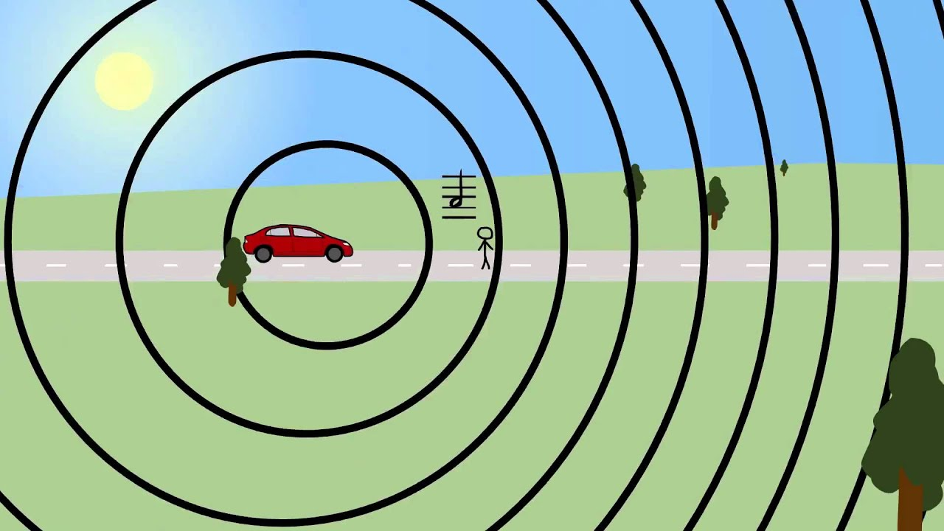
Simple image which explains doppler effect

Slide 15
Finding the speed of the object
Radial Velocity
The frequency of radar waves gets change when reflected by a moving target. While processing returned signal, the radial velocity will be estimated based on change in frequency.

Slide 16
How DSP is used to separate
target from clutter?
The signal processor is that part of the system which separates targets from clutter on the basis of Doppler content and amplitude characteristics.
The signal processor includes the following components:
The I&Q Phase Detector
The Moving Target Indication
Constant False Alarm Rate detection.

Slide 17
The plot extraction and plot processing elements are the final stage in the primary radar sensor chain. The essential process is that of generating and processing plots as distinct from processing waveforms.
The main components are:
The plot extractor
The plot processor
The plot combiner

Slide 18
Digital Signal Processing
Electronic Warfare

Slide 19

What is Electronic Warfare?

Slide 20

Electronic Warfare(EW),defined as the Department of Defense (DOD), are military activities that use electromagnetic energy to control the electromagnetic spectrum.
It represents the ability to use the electromagnetic spectrum – signals such as RADAR, Infrared or to sense, protect and communicate.
It involves the use of electromagnetic spectrum or directed energy to control the spectrum, attack an enemy or impede enemy.
Signal Processing for electronic warfare and signal intelligence applications revolves around the sequence of events that happen in transforming signals to antenna into useful information.

Slide 21
It is divided into three major subdivisions such as Electronic Attack(EA),Electronic Protection(EP) and Electronic Support(ES).
Electronic Attack is used to disrupt , deny , degrade , destroy or deceive, previously called as Electronic Counter Measures(ECM).
Electronic Protection is used in preventing a receiver from being jammed or deceived, previously called as Electronic Counter Counter Measures(ECCM). ’Jamming’ is called as the action of EM energy.
Electronic Support is used in sensing of electromagnetic spectrum, previously called as Electronic Support Measures(ESM).

Slide 22

Why are ELECTRONIC WARFARE SYSTEMS important?
These systems enables clients to detect the enemy , optimize tactical situational analysis & gather critical intelligence so that they can gain the strategic advantage in offensive and defensive operations .
Most important EWS in military :-
Surface EWS
Airborne EWS
Ground EWS

Slide 23
Electronic Capabilities Rapid signal detection and analysis Direction finding and geolocation Passive targeting support Missile warning | Electronic Attack Threat analysis & response Multispectral , RF/threat management Off board & n board self protection IR threat analysis testing
Electronic Protection Cyber Multispectral , radio frequency , countermeasures(RF, IR) | Electronic support Operational analysis Mission planning tools & data file generator Mission and Battle management Avionics Test systems & maintenance aids Sustainment & performance-based logistics

Slide 24
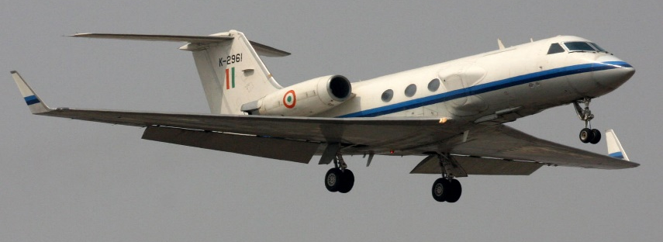
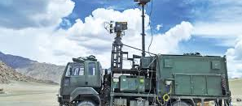
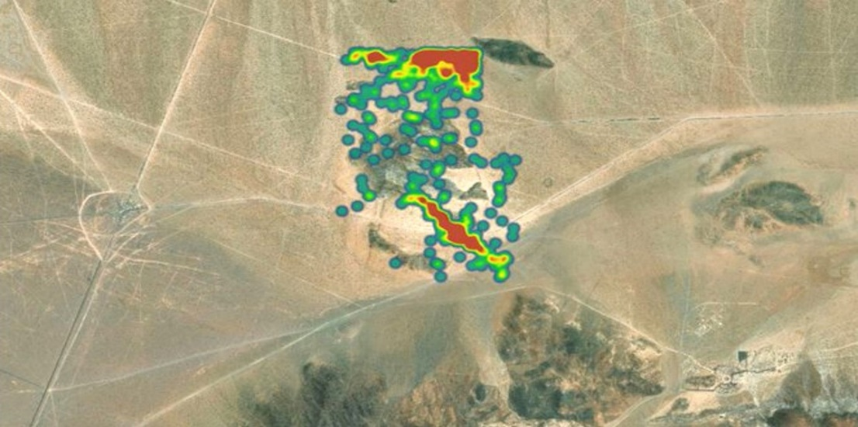
Airborne EWS
Used in following conditions:-
Tactical fight
Rotary Aircraft experience
Wildly varying conditions
e.g. Gulfstream III
Ground EWS
Used in Radio Controlled Improvised Explosive Devices and protect our warfighters
e.g. Samyukta Electronic Warfare System
Naval EWS
Used to improve anti-ship missile defense , counter targeting , counter surveillance capabilities .
Used to provide critical analysis in dynamic environment .
e.g. ALQ-248

Slide 25
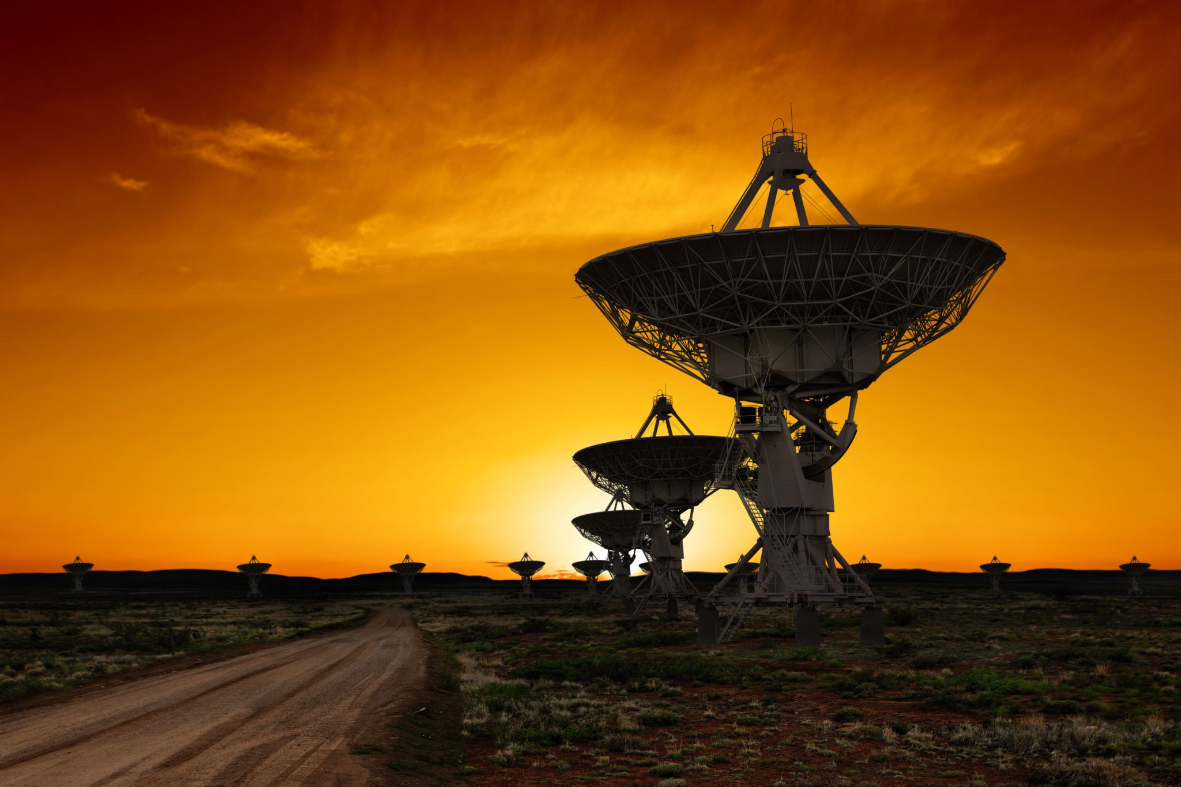
Conclusion

Slide 26
Digital Signal Processing is crucial for the advancement of Military Electronic Technologies
Radar, electronic warfare, secure communications, electro-optics, intelligence—an array of military applications can benefit from the digital signal processing (DSP) capabilities of programmable logic.
Electronic sensors at the core of these systems continue to evolve, requiring more DSP functionality and integration.

Slide 27

Thank You!
Team:
Radha Thakare, 20
Shivang Singh, 12
Shrawani Shinde, 09
Gaurav Shejwal, 05
Shaunak Deshpande, 04

