Slide 1
Presentation for Project Progress Performance Analysis of Multi-CPU Processor Simulation using Gem5
Md. Habibur Rahman, UFID: 33268516,
Himanandhan Reddy Kottur, UFID: 40931757,
Sona Maria Jose, UFID: 72280930,
Shamit Gajanan Savant, UFID: 96800755

Slide 2
Project Outline
Multi-core RISCV simulation using Gem5
While the RISC-V ecosystem includes functional-level, register-transfer-level, and FPGA simulation platforms, there is currently a lack of cycle-level simulation platforms for early design-space exploration
Gem5 is a popular cycle-level simulation platform that provides reasonably flexible, fast, and accurate simulations
This presentation presents our recent work on simulating multi-CPU RISC-V systems in gem5
We then evaluate the performance of the gem5/RISC-V simulator and discuss a design-space-exploration case study using gem5
We are using CPU type : DerivO3CPU, AtomicSimpleCPU, NonCachingSimpleCPU ,RiscvMinorCPU, O3CPU.
Performance analysis of gem5/RISCV simulator and discuss design-space exploration and case study using Gem5

Slide 3
Change from our main Proposal
In the main proposal (inspired by the Cornell University paper), on the way of doing multi-threaded simulation, they suggested modifying the source code of gem5.
We are focusing only on the application side of gem5.
We’re examining how we can explore multi-threaded applications from outside, as it correlates with our labs.
Many extra benchmarks were suggested at the end of the paper, but we mainly focused on the Ligra benchmarks.
In our original proposal, we proposed that we would perform a multi-core simulation of the existing benchmarks, but we rather focused on performance analysis of different CPU types.

Slide 4
Tools Available in RISC-V Eco-System
Functional level simulation:
Pros
High-speed simulation
Verify that applications compile and work correctly
Cons
Capture no micro-architectural details
No timing accurate
RTL Simulators: Rockets and BOOM RTL Models
Pros
Provide low-level micro-architectural details
Cycle accurate
Cons
Too slow to run many different simulations
Limited to single threaded applications and single-core system

Slide 5
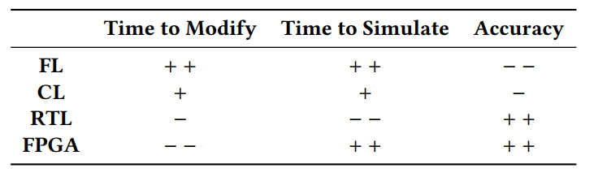
Tools Available in RISC-V Eco-System
FPGA
Pros
Fast execution
Timing accurate
Can boot a full linux image
Cons
Require physical FPGA boards
Lengthy synthesis, place and route process
Limited to existing RISC RTL models
Figures: Various RISCV tools and their characteristics

Slide 6
Gem5: Is it a solution?
Characteristics of Gem5
gem5 is an open-source, highly flexible simulator for computer system architecture research
Supports various instruction set architectures (ISAs), including RISC-V, ARM, x86
Gem5 provides detailed simulation capabilities, enabling users to analyze the performance of different hardware configurations at various levels—from individual instructions to entire system-level interactions.
Initial RISCV port in Gem5
RV64GC
Single core simulation system
System Call emulation (SE) mode
Our contribution to the RISC V port in Gem5
Multi-type-CPU system simulation in SE mode
RISC-V system infrastructure in Gem5

Slide 7
RISCV-GNU Toolchain
What is the RISC-V GNU Toolchain?
A set of development tools for compiling and debugging programs for RISC-V architecture.
It includes GNU Compiler Collection (GCC), Binutils, GDB (GNU Debugger), and Newlib (C library).
Benefits of Using RISC-V Toolchain with gem5
No Hardware Needed: Test and develop software without needing physical hardware.
Custom Processor Designs: Simulate and evaluate custom RISC-V processors.
Comprehensive Debugging: Integrate GDB with gem5 for step-by-step debugging of RISC-V code.
Realistic Performance Metrics: Evaluate performance and bottlenecks in a simulated environment before hardware implementation.
Cross-Platform Development: Build software on any host machine and run it on RISC-V targets via simulation.

Slide 8
Ligra
In the context of Gem5, "Ligra benchmark" refers to a suite of graph processing workloads used to test and evaluate the performance of different computer architectures within the Gem5 simulator, particularly when analyzing the efficiency of parallel processing on shared-memory systems.
Ligra is a popular graph processing framework that allows researchers to run various graph algorithms like PageRank or triangle counting on simulated hardware configurations within Gem5.
Functionality:
Ligra provides a set of graph algorithms designed for shared-memory systems, enabling researchers to test how different processor designs handle parallel graph computations.
Application in Gem5:
By running Ligra benchmarks on a simulated system within Gem5, researchers can analyze the performance of different cache configurations, memory systems, and processor architectures when dealing with parallel graph processing workloads.

Slide 9
The Procedure(Top Level)
Installing Gem5
ISA SimulationFramework
Integrating multi-type CPU RISCV Simulation using Gem5
Installing the RISCV GNU toolchain
Installing and applying Ligra benchmarks
Execution and Performance Evaluation
Step by step procedure

Slide 10
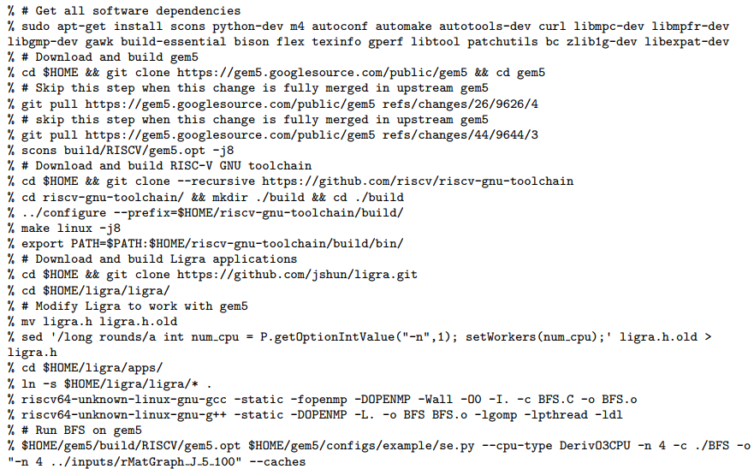
Working Code Snippet
Install all dependencies
Gem5 Installation
RISCV-Toolchain Installation
Ligra Installation
Running an application in modified Gem5
Multi core/CPU simulation step by step

Slide 11
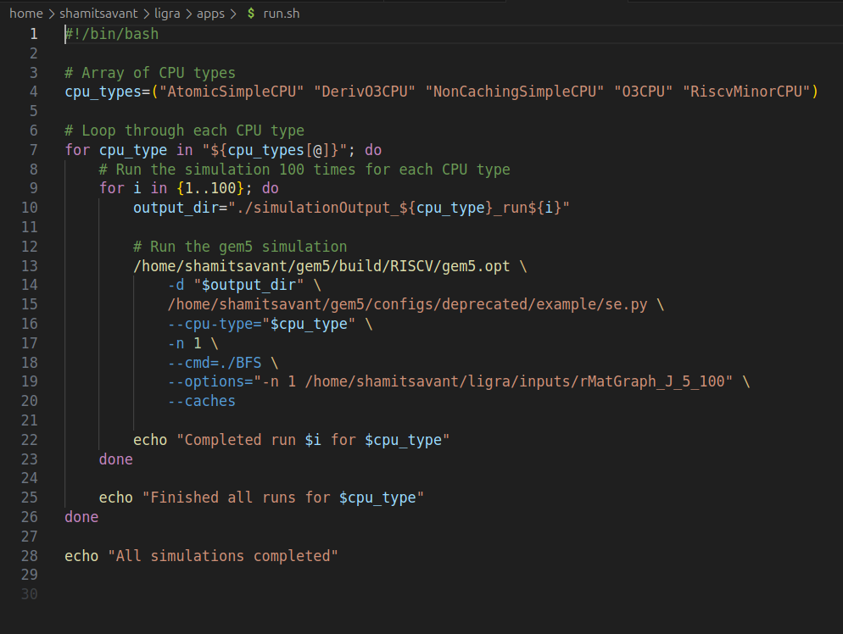
Validation models
We used the ligra benchmarks to validate a model in gem5.
We extensively ran the BFS program with data coming from an adjacency matrix on multiple CPUs
We used ligra benchmarking to discover trends in various parameters of different CPU types.
Each of the CPUs were run with this program for 100 times.
We compared the output for all these 100 stats files for the different CPU types and analyzed the results.
The results are mentioned in the following slides.

Slide 12
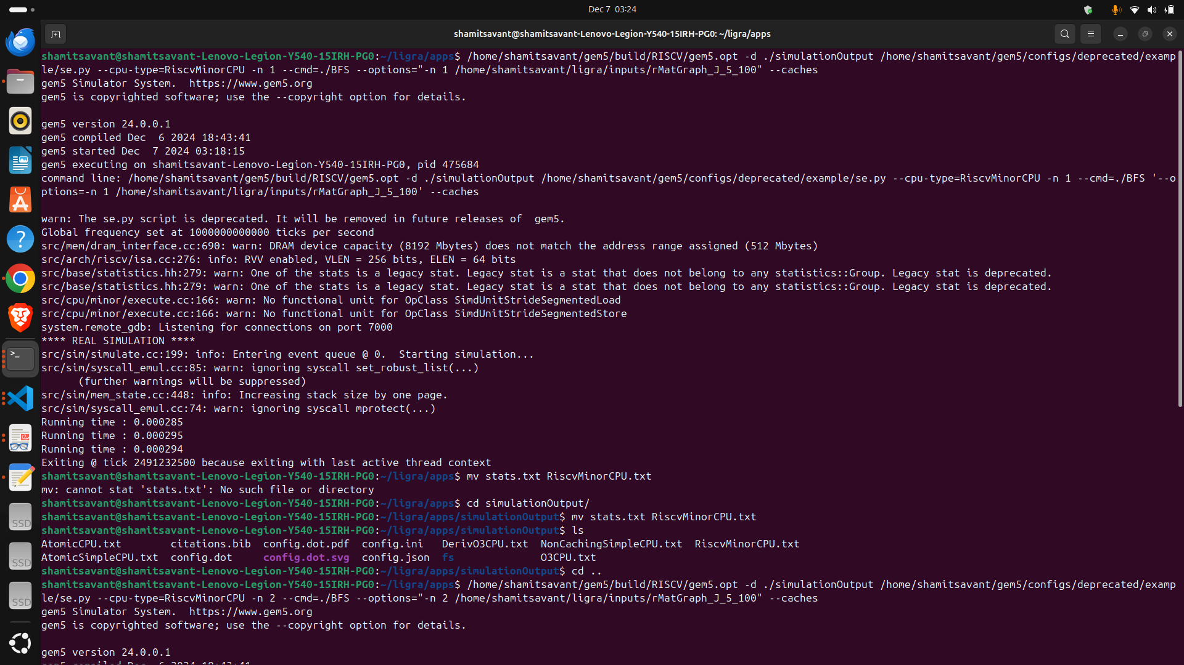
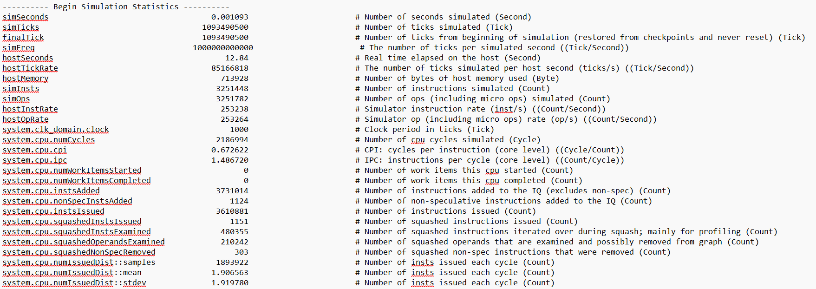
Simulation results
Figure: A sample stat file
Figure: Simulation example

Slide 13
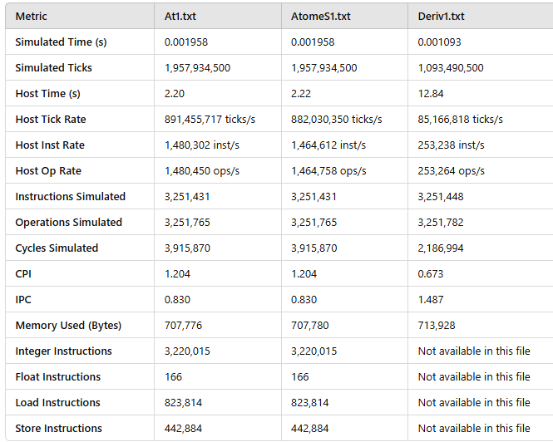
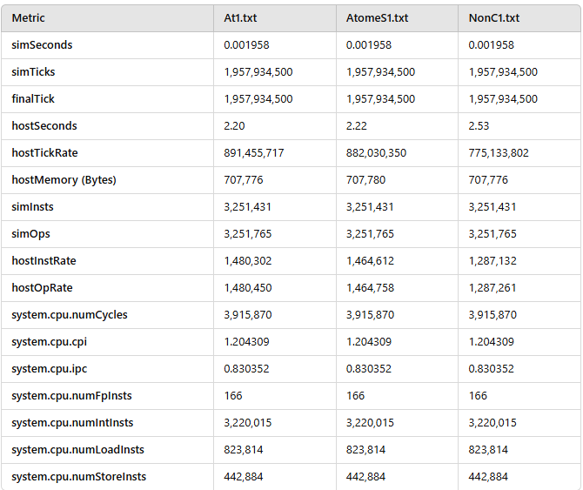
Result analysis
Alt.txt is for AtomicCPU, AtomeS1.rxt is for AtomicSimpleCPU and Deriv1.txt is for DerivO3CPU, NonC1.txt is for NonCachingSimpleCPU

Slide 14
…continued
The comparison focused on key performance metrics such as Simulated Time, Simulated Ticks, Host Time, Host Tick Rate, Host Instruction Rate, Cycles Per Instruction (CPI), Instructions Per Cycle (IPC), Number of CPU Cycles, and Number of Instructions.
A summary of the results revealed significant architectural differences. For instance, AtomS1 achieved a Host Instruction Rate of 1,464,612 instructions per second and an IPC of 0.830, while Deriv1 and O3p1 demonstrated higher efficiencies with identical IPCs of 1.487 and Host Instruction Rates of 253,238 and 265,901, respectively.
Additionally, Simulated Time was consistent at 0.001093 seconds for Deriv1 and O3p1, outperforming AtomS1’s 0.001958 seconds.
These results reflect the performance trade-offs among CPU types, with AtomS1 prioritizing simplicity over efficiency, while Deriv1 and O3p1 showcased advanced pipeline optimizations for improved execution rates.

Slide 15
Analysis
In this study, we analyzed the performance of the Breadth-First Search (BFS) algorithm from the Ligra framework on various CPU architectures under the RISCV64 platform using the gem5 simulator.
The BFS program was compiled under Ligra/apps and tested with the dataset rMatGraph_J_5, ensuring consistency across all simulations.
The CPU models evaluated were AtomicSimpleCPU (AtomS1), DerivO3CPU (Deriv1), NonCachingSimpleCPU, O3CPU (O3p1), and RiscvMinorCPU.
To ensure statistical robustness, each CPU type was simulated 100 times, and the results were averaged. The accompanying bash script automated this process, generating comprehensive performance metrics stored in stats.txt files for each configuration.

Slide 16
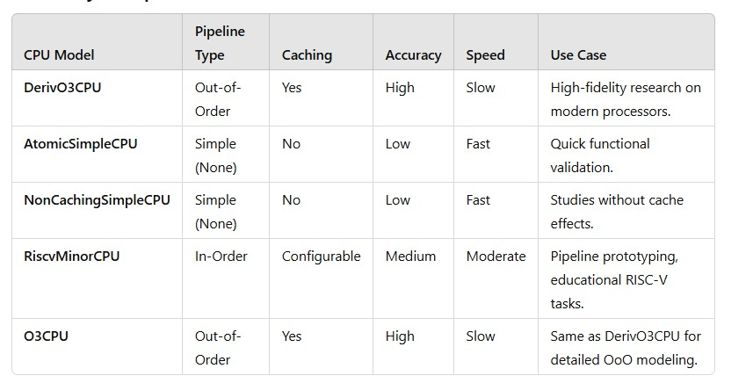
Result analysis

Slide 17
THANK YOU

