Slide 1
EEL 6935: Deep Learning in Medical Image Analysis
Final Project Presentation
Shamit G. Savant
96800755
MRI Slice Interpolation for Prostate Imaging

Slide 2
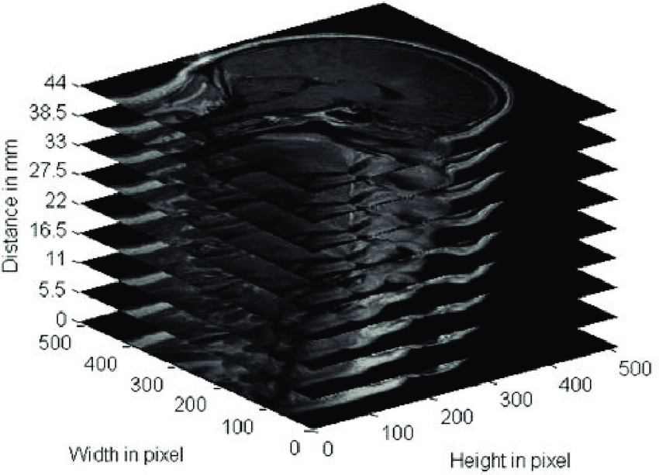
Problem Statement & Motivation
• Challenge: Anisotropic MRI resolution
  In-plane: ~0.5mm | Through-plane: ~1.5mm
• Goal: Improve through-plane resolution
  1.5mm → 0.75mm spacing using deep learning
• Clinical Impact:
  Better visualization for diagnosis & treatment planning
• Initial Approach:
  Use slices at i-2 and i+2 to predict middle slice i

Slide 3

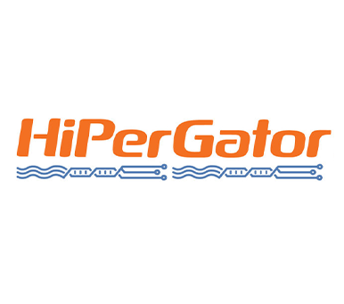
Dataset & Infrastructure Challenges
• Dataset: UCLA Prostate MRI-US Biopsy
  T2-weighted sequences, 3 Tesla Siemens scanners
  ~80 GB after preprocessing
• Infrastructure Challenge:
  Initial api upload: extremely slow (days)
  Solution: Globus transfer - efficient for large datasets
• Processing Pipeline:
  Extract T2-weighted axial sequences
  Robust normalization (1st-99th percentile)
  Resize to 256×256
• Final Dataset:
  31,952 training samples | 6,841 validation samples

Slide 4
Initial Approach: The Wall
Method | PSNR (dB) | SSIM
CNN (EDSR) | ~21.8 | ~0.56
U-Net | ~22.1 | ~0.57
GAN (Basic) | ~21.5 | ~0.54
GAN (Improved) | ~21.3 | ~0.55
Using i-2 and i+2 slices → Results plateaued regardless of architecture

Slide 5
The Pivotal Realization
• All architectures plateaued at similar performance
→ Model complexity wasn't the bottleneck
• The Real Problem:
Predicting slice i from i-2 and i+2
= Skipping 4 slices of anatomical information
= Bridging a 6mm gap
• Prostate anatomy changes significantly across 1.5mm
Task was fundamentally too difficult
• The 3-Line Code Change:
Changed from (i-2, i+2) to (i-1, i+1)
Now interpolating across 1.5mm gap with anatomical continuity

Slide 6
Results After Pivot - Quantitative Metrics
Method | PSNR (dB) | SSIM | Improvement
Linear Baseline | 27.31 | 0.838 | —
Nearest Neighbor | 22.25 | 0.686 | (worse)
CNN (EDSR) | 29.89 | 0.894 | +9.5% / +6.6%
U-Net | 30.08 | 0.898 | +10.1% / +7.1%
GAN (Basic) | 29.83 | 0.893 | +9.3% / +6.6%
GAN (Improved) | 29.67 | 0.892 | +8.7% / +6.4%

Slide 7
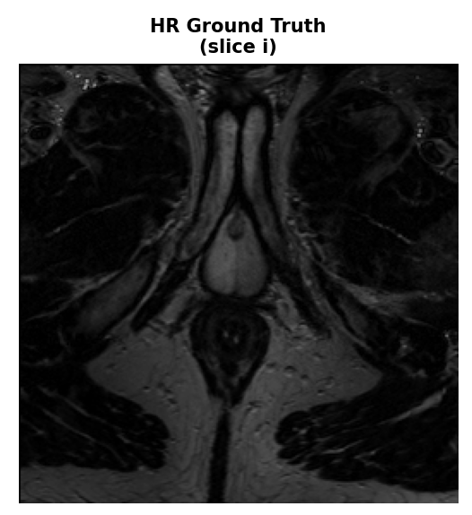
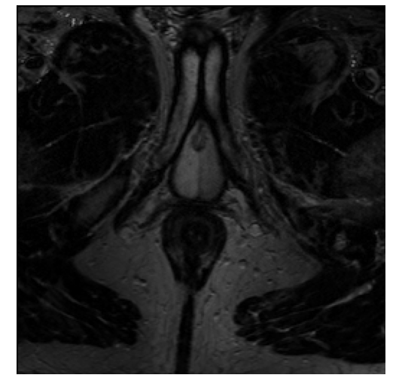
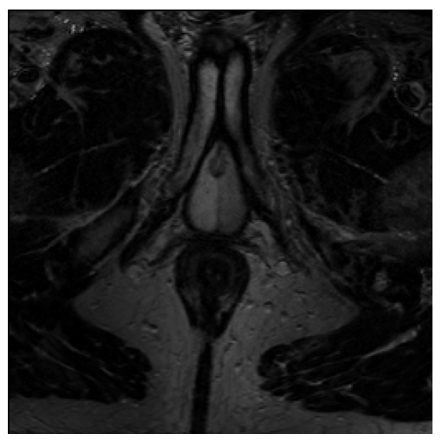
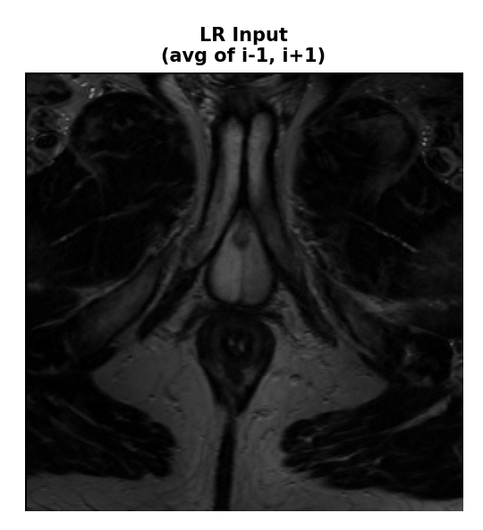
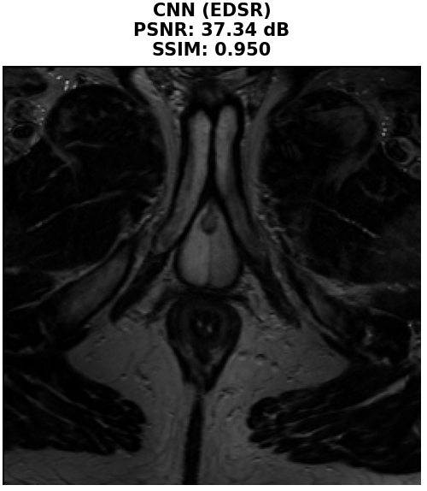
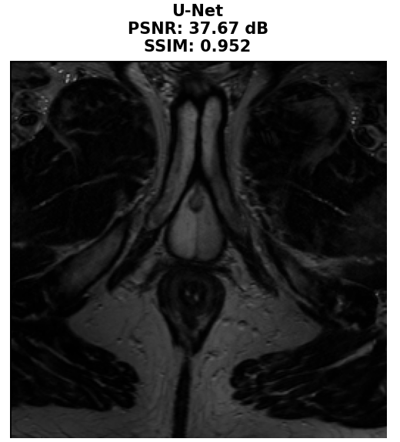
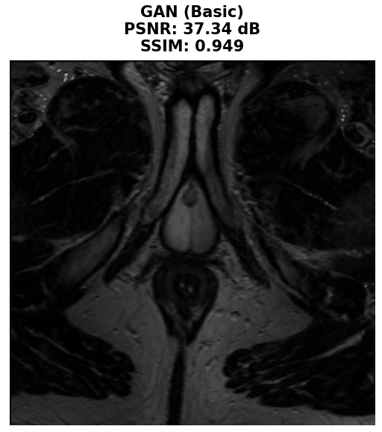
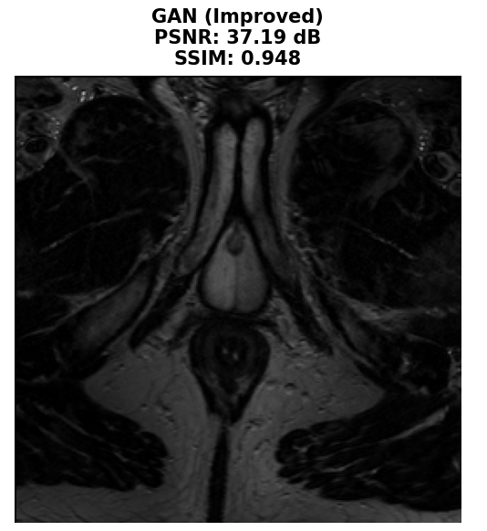
Qualitative Comparison
Visual comparison shows:
• Linear/Nearest Neighbor: Blurry or blocky artifacts
• Deep Learning Methods:
  Preserve sharp anatomical boundaries
  Maintain fine structural details
• U-Net Performance:
  Best preservation of tissue boundaries
  Smooth, realistic appearance
  Leverages skip connections effectively
Linear
Nearest

Slide 8
Key Lessons Learned
1. Problem Formulation > Model Complexity
  Well-defined problem + simple model
  beats
  Poorly-defined problem + complex model
2. Systematic Experimentation Reveals Bottlenecks
  Testing multiple architectures wasn't wasted effort
  Performance ceiling pointed to problem formulation
3. Infrastructure Matters for Research at Scale
  Right tools enable research (Globus, HiPerGator)
  Proper data management is crucial

Slide 9
Conclusion
✓ Successfully developed deep learning pipeline for MRI interpolation
✓ U-Net achieved 30.08 dB PSNR, 0.898 SSIM
  (+10% improvement over linear baseline)
✓ Confirmed U-Net as gold standard for medical imaging
Sometimes the biggest breakthrough isn't a fancier model—
it's asking the right question.

Slide 10
Thank you! Questions?

