Slide 1





Home Page
https://www.kaggle.com/competitions/sentiment-analysis-on-movie-reviews/leaderboard
Sentiment Analysis on Movie Reviews
Predictive analytics with machine learning
by Tiago Pedro

Slide 2


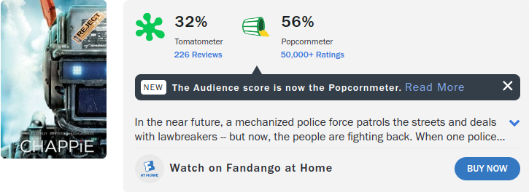


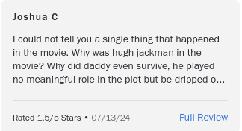
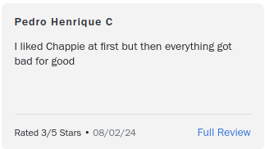
Home Page
Introduction
Playground Prediction Competition - Sentiment Analysis on Movie Reviews
Introduction
Competition Description
For this competition we are delivered a dataset from Rotten Tomatoes, with comments and the sentiment associated with the comment, we have a training data set and a test data set for the submission.
Background
Timeline
This template would help you save a lot of time and hassle. Jumpstart your design by quickly drafting a complete outline of your presentation and filling in the details here.
This template would help you save a lot of time and hassle. Jumpstart your design by quickly drafting a complete outline of your presentation and filling in the details here. Choose from over a thousand professionally-made templates to fit any objective or topic.

Slide 3
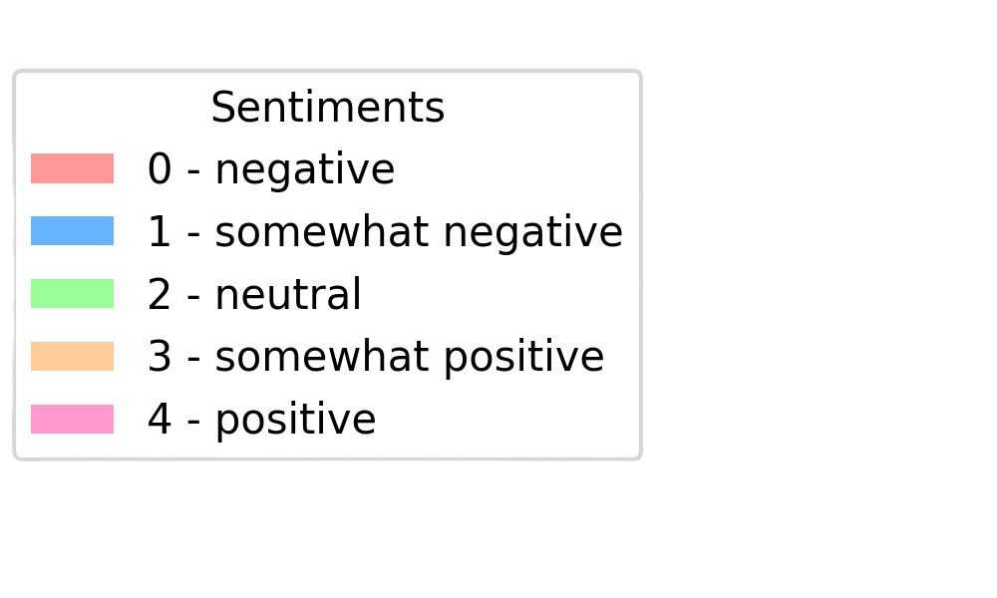
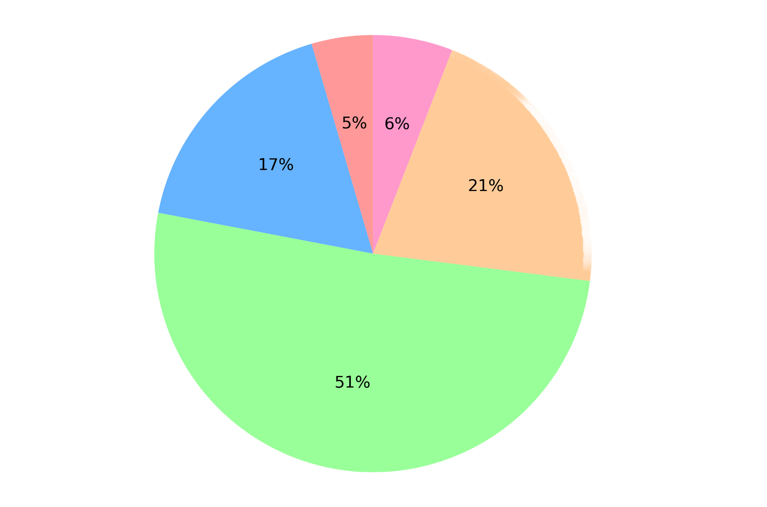
Home Page
Introduction
Project Pipeline
Playground Prediction Competition - Sentiment Analysis on Movie Reviews
EDA
The train dataset is composed of 4 columns, ‘PhraseId’, ‘SentenceId’, ‘Phrase’ and ‘Sentiment’, it has 156060 rows, with no duplicated or null values, and the sentiment is a integer that ranges from 0 to 4.

Slide 4
Home Page
Introduction
Project Pipeline
Playground Prediction Competition - Sentiment Analysis on Movie Reviews
EDA
‘PhraseId’
‘SentenceId’
‘Phrase’
An integer with the id of the phrase, a phrase then is split in multiple sentences
An integer with the number of the sentence
The string that we will use to train the model, containing the comment or parts of it

Slide 5


Home Page
Introduction
Project Pipeline
Playground Prediction Competition - Sentiment Analysis on Movie Reviews
Data Preprocessing
Null values
SMOTE
The data set had no Null values
Because of the high count of Neutral sentiments, we balanced the dataframe with SMOTE
Spacy
TF-IDF
To preprocess the text, including tokenization, lemmatization, and removal of stopwords.
Term Frequency-Inverse Document Frequency, to balance the importance of the words and convert to a array of numbers

Slide 6
Home Page
Introduction
Project Pipeline
Playground Prediction Competition - Sentiment Analysis on Movie Reviews
Model Evaluation & Metrics
Model | Accuracy | MAE | RMSE | R2 score
Logistic Regression | 0.57 | 0.49 | 0.80 | 0.66
Random Forest | N/A | 0.61 | 0.88 | 0.06
SVM | 0.65 | 0.40 | 0.72 | 0.66
KNN | 0.52 | 0.59 | 0.90 | 0.71
XGBClassifier | 0.55 | 0.53 | 0.53 | 0.63

Slide 7
Home Page
Introduction
Project Pipeline
Playground Prediction Competition - Sentiment Analysis on Movie Reviews
Hyperparameter Tuning
C (Inverse of Regularization Strength)
penalty (Regularization Type)
solver (Algorithm to Optimize the Model
max_iter (Maximum Iterations)
Logistic Regression
SVM
C (Regularization Parameter)
kernel (Kernel Function)
gamma (Kernel Coefficient for ‘rbf’, ‘poly’, and ‘sigmoid’)

Slide 8
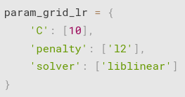
Home Page
Introduction
Project Pipeline
Playground Prediction Competition - Sentiment Analysis on Movie Reviews
Final Model
For time purposes i used the Logistic Regression, with 'C': [10], 'penalty': ['l2'], 'solver': ['liblinear'], as the SVM Hyperparameter Tuning is a long process when started it would not have time or computing power to work with it.

Slide 9
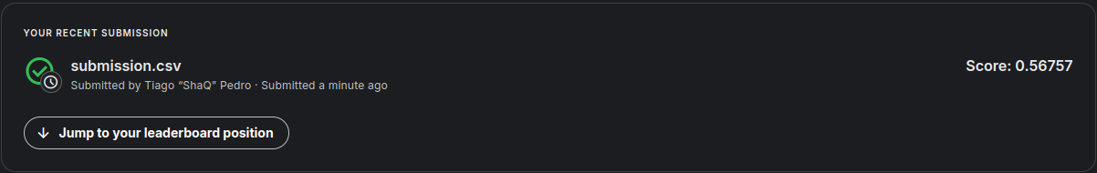
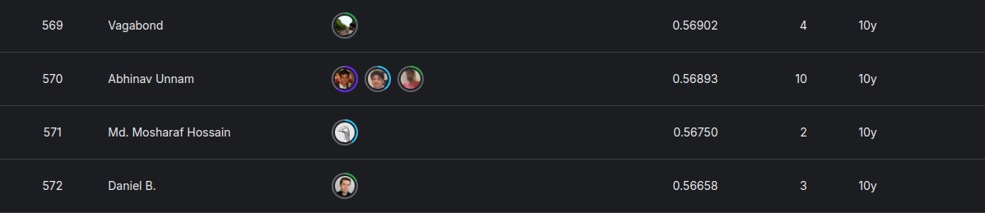
Home Page
Introduction
Project Pipeline
Playground Prediction Competition - Sentiment Analysis on Movie Reviews
Kaggle Submission

Slide 10

Home Page
Introduction
Project Pipeline
Conclusion
Playground Prediction Competition - Sentiment Analysis on Movie Reviews
Key Insights & Challenges
Machine Learning Models
Tokenization
Choosing the right ones for the project and the right way to use the parameters
The way we can compile a text to different type of values to input on the ML model
Computing power struggle
Hyperparameter Tuning
Some ML models take longer to train or are even impossible to use with the current computing power
Time consuming to try various ML, the need to test just the right from the ‘standart’ tests

Slide 11
Home Page
Introduction
Project Pipeline
Conclusion
Playground Prediction Competition - Sentiment Analysis on Movie Reviews
Possible Improvements
Use of Transformers-Based models like BERT/DistilBERT
Use of Deep Learning Models like RNNs or CNNs
More computing power to be able to use the models with the full data set
Test with different Tokenizers like KERAS
Test different word embeddings like GloVe or Word2Vec

Slide 12
Home Page
Introduction
Project Pipeline
Conclusion
Playground Prediction Competition - Sentiment Analysis on Movie Reviews
Conclusion
Machine learning is not only about the model we chose, but the way we manage the data before training the models, in this case using text to predict a data, there are various ways to treat them with different libraries for Tokenization, the lower score on the competition show the need to improve the understanding of these these libraries to optimize the data for better results.

Slide 13


Title Page
Reporters
Introduction
Conclusion
Questions
Thank you for your time
Please ask any questions you may have
Project made by Tiago Pedro

