Slide 1
STRUCTURES & UNION In C
Definition
How to create structures?
Structures Initialization.
How to access structures members?
Structures with functions
Pointers to structures

Slide 2
Definition
Structure is a user defined data type available in C that allows to combine different data types of data items.
To create a structure, struct keyword must be used.
A struct in the C programming language is a composite data type declaration that defines a physically grouped list of variables under one name in a block of memory, allowing the different variables to be accessed via a single pointer or by the struct declared name which returns the same address.
Structures are used to represent a record.

Slide 3
Define a structure
Syntax:
struct [structure tag]
{
member definition;
member definition;
...........
member definition;
} [one or more structure variables];
The structure tag is optional and each member definition is a normal valid variable definition, such as int a, float avg, char str.
At the end of the structure's definition, It is optional to specify one or more structure variables.

Slide 4
Define a structure
If we want to keep the track of books in a library, then we can declare the Book structure with the following attributes are book Id, title, author., subject.
Example:
struct Books
{
char title[50];
char author[30];
char subject[100];
int book_id;
} book1,book2;

Slide 5
Accessing Structure Members
To access any member of a structure, we use the member access operator (.) dot symbol.
The member access operator is coded as a period between the structure variable name and the structure member.
The keyword struct is used to define variables of structure type.

Slide 6
Example: Program
#include <stdio.h>
#include <string.h>
struct Books
{
char title[50]; char author[50]; char subject[100]; int book_id;
};
int main( )
{
struct Books Book1;
struct Books Book2;
strcpy( Book1.title, "C Programming");
strcpy( Book1.author, "Nuha Ali");
strcpy( Book1.subject, "C Programming Tutorial");
Book1.book_id = 6495407;
strcpy( Book2.title, "Telecom Billing");
strcpy( Book2.author, "Zara Ali");
strcpy( Book2.subject, "Telecom Billing Tutorial");
Book2.book_id = 6495700;
printf( "Book 1 title : %s\n", Book1.title);
printf( "Book 1 author : %s\n", Book1.author);
printf( "Book 1 subject : %s\n", Book1.subject);
printf( "Book 1 book_id : %d\n", Book1.book_id);
printf( "Book 2 title : %s\n", Book2.title);
printf( "Book 2 author : %s\n", Book2.author);
printf( "Book 2 subject : %s\n", Book2.subject);
printf( "Book 2 book_id : %d\n", Book2.book_id);
return 0;
}:

Slide 7
Structure: Program Output
Book 1 title : C Programming
Book 1 author : Dietel Dietel
Book 1 subject : C Programming Tutorial
Book 1 book_id : 46578900
Book 2 title : Introduction to Operating System
Book 2 author : Sylbertaz
Book 2 subject : Operating System
Book 2 book_id : 46578901

Slide 8
Structures as Function Arguments
Structure can be passed as a formal parameter to the function.
It can be used as same way of passing any other parameter or pointer.
Note:
Declare structure and function before main () function.

Slide 9
Example: Program
#include <stdio.h>
#include <string.h>
struct Books
{
char title[50]; char author[50];
char subject[100]; int book_id;
};
void printBook( struct Books book );
int main( )
{
struct Books Book1;
struct Books Book2;
strcpy( Book1.title, “ Introduction to java");
strcpy( Book1.author, “R.R. Ali");
strcpy( Book1.subject, “java Program");
Book1.book_id = 54478;
strcpy( Book2.title, “ Oracle");
strcpy( Book2.author, “ Dianeil");
strcpy( Book2.subject, “ RDBMS");
Book2.book_id = 54479;
printBook( Book1 );
printBook( Book2 );
return 0;
} ;
void printBook( struct Books book )
{
printf( "Book title : %s\n", book.title);
printf( "Book author : %s\n", book.author);
printf( "Book subject : %s\n", book.subject);
printf( "Book book_id : %d\n", book.book_id);
};

Slide 10
Program: Output
Book title : Introduction to java
Book author : R.R. Ali
Book subject : java Program
Book book_id : 54478
Book title : Oracle
Book author : Dianeil
Book subject : RDBMS
Book book_id : 54479

Slide 11
Pointers to Structures
Declare the structure variable as pointer to store the address of a structure variable.
The operator & symbol is used to get the address of the structure variable.
Syntax:
struct Books *struct_pointer;

Slide 12
Accessing members
Read Address:
struct_pointer = &Book1;
To access the members of a structure using a pointer to that structure, we use -> this operator.
Access members:
Struct_pointer->title;
Struct_pointer->author;

Slide 13
Example: Program
#include <stdio.h>
#include <string.h>
struct Books
{
char title[50]; char author[50];
char subject[100]; int book_id;
};
void printBook( struct Books *book );
int main( )
{
struct Books Book1;
struct Books Book2;
strcpy( Book1.title, “Python: WWW");
strcpy( Book1.author, “ AL Sweigart");
strcpy( Book1.subject, “Python Programming");
Book1.book_id = 64954;
strcpy( Book2.title, “ Big data Analytics");
strcpy( Book2.author, “Downey");
strcpy( Book2.subject, “Big data");
Book2.book_id = 64957;
printBook( &Book1 );
printBook( &Book2 );
return 0;
};
void printBook( struct Books *book )
{
printf( "Book title : %s\n", book->title);
printf( "Book author : %s\n", book->author);
printf( "Book subject : %s\n", book->subject);
printf( "Book book_id :%d\n",book->book_id);
};

Slide 14
Program: Output
Book title : Python: WWW
Book author : AL Sweigart
Book subject : Python Programming
Book book_id : 64954
Book title : Big data Analytics
Book author : Downey
Book subject : Big data
Book book_id : 64957

Slide 15
UNION
UNION is a special user defined data type in C, which enables to store different data types in same memory location.
It is similar as structure data type. We can define a union with many members. But, only one member can contain a value at any given time.

Slide 16
Union
Define:
To define a UNION, we use UNION keyword as follows,
SYNTAX:
Union [union tag]
{
member definition;
member definition;
……………..
member definition;
} [ one or more union variables];

Slide 17
Defining a Union
The Union tag is optional and each member definition is a normal valid variable definition, such as int a, float avg, char str.
At the end of the union's definition, It is optional to specify one or more union variables.
Example:
Union Data
{
int m;
char str1[20];
double sum[4];
} data;

Slide 18
Accessing Union members
The member access operator (.) is used to access any members of union.
This operator is coded between the union variables and union members.

Slide 19
Example : Program
#include <stdio.h>
#include <string.h> Output:
union Data data.id : 518
{ data.price : 620.5
int id; float price; char str[20]; data.str : Data Science
};
int main( )
{
union Data data;
data.id = 518;
printf( "data.id : %d\n", data.id);
data.price = 620.5;
printf( "data.price : %f\n", data.price);
strcpy( data.str, “ Data Science");
printf( "data.str : %s\n", data.str);
return 0;
};

Slide 20
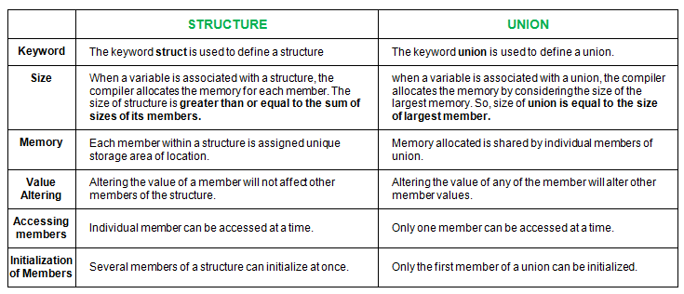
Difference between structures and unions

