Slide 1
AI Healthcare Analytics Assistant
(Agentic AI for Conversational Healthcare Data Analytics)
Snowflake • n8n • Gemini • Streamlit

Slide 2

AGENDA
Business Problem & Project Objectives
Healthcare Data & Data Model
Solution Architecture
Snowflake Data Platform & Data Preparation
Agentic AI Workflow in n8n
Healthcare Analytics & KPI Framework
Conversational AI Assistant & Visualization
Business Value & Key Insights
Live Demonstration & Project Resources
Conclusion & Key Achievements

Slide 3
BUSINESS PROBLEM
Organizations generate large volumes of business data every day, making continuous performance monitoring increasingly challenging in following areas –
Fragmented Healthcare Data - Patient, encounter, provider, payer, procedure, condition, and organization data are distributed across multiple related datasets.
High Dependency on SQL & Technical Teams - Business users need technical expertise to answer even straightforward analytical questions.
Slow Ad-Hoc Analysis - Questions such as provider performance, payer utilization, claim amounts, and encounter trends require manual query development.
Difficult Cross-Table Analysis - Meaningful healthcare insights often require combining multiple entities and calculating derived KPIs
Limited Conversational Access to Data - Traditional dashboards answer predefined questions but do not easily support natural-language follow-up analysis.

Slide 4
Business Need
A governed AI-powered analytics assistant that can:
Understand healthcare questions in natural language
Generate and execute read-only SQL against curated data
Combine information across healthcare entities
Return clear analytical answers and visual insights
Maintain conversational context for follow-up questions
Business Need: Enable faster, self-service healthcare analytics while maintaining controlled, governed access to the underlying data.

Slide 5
PROJECT OBJECTIVES
To develop an agentic AI-powered healthcare analytics assistant that enables users to query curated healthcare data using natural language and receive governed, data-driven insights through conversational analysis and visualizations.
Key Objectives
Conversational Analytics: Enable users to ask healthcare business questions using natural language instead of writing SQL.
Governed SQL Generation: Translate user questions into controlled, read-only SQL queries for analytical execution.
Integrated Healthcare Data Analysis: Analyse data across providers, patients, encounters, payers, procedures, organizations, and conditions.
AI-Powered Insights:
Return concise answers, contextual insights, and explanations from the underlying healthcare data.
Dynamic Visualization: Automatically present comparative and ranking analyses through tables and charts.
Conversational Context: Maintain context across follow-up questions using session-based AI memory.

Slide 6
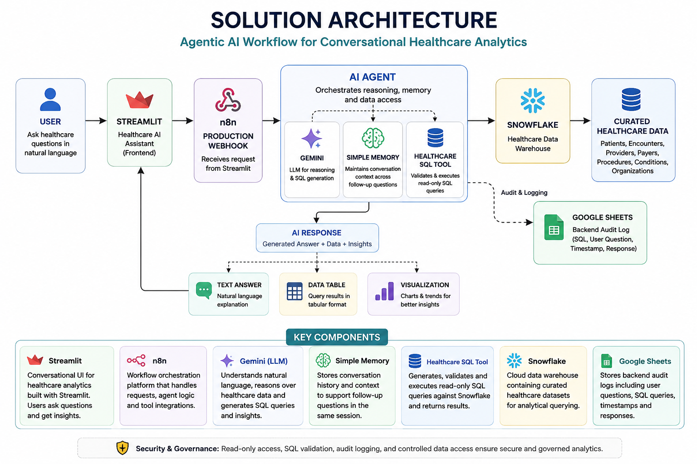

Slide 7
TECHNOLOGY STACK
❄️ Snowflake Cloud data warehouse for curated healthcare data, SQL analytics, and governed query execution.
🔗 n8n Agentic workflow orchestration, webhook/API layer, AI Agent, tool integration, and backend audit workflow.
✨ Google Gemini LLM powering natural-language understanding, reasoning, SQL generation, and analytical responses.
🖥️ Streamlit Interactive frontend for conversational healthcare analytics, tables, charts, and user interaction.
📊 Google Sheets Lightweight backend audit log for user questions, generated SQL, timestamps, status, and execution information.
🐍 Python Application development, API integration, response handling, visualization logic, and Streamlit implementation.

Slide 8
Dataset Architecture
The dataset follows a relational architecture where healthcare entities are connected through primary and foreign key relationships.
Patients Patient demographics and healthcare information Patient ID • Birth Date • Gender • Healthcare Expenses • Coverage
Encounters Central operational transaction table Encounter ID • Patient ID • Provider ID • Payer ID • Encounter Type • Claim Amount
Providers Provider and specialty information Provider ID • Provider Name • Specialty • City • State • Total Encounters
Payers Payer and coverage information Payer ID • Payer Name • Covered Encounters • Covered Amount • Revenue
Organizations Healthcare organization information Organization ID • Organization Name • City • State • Revenue • Encounters
Procedures Procedure-level healthcare activity Procedure Date • Patient ID • Encounter ID • Procedure Code • Procedure Cost
Conditions Condition / diagnosis records Start Date • End Date • Patient ID • Encounter ID • Condition Code

Slide 9
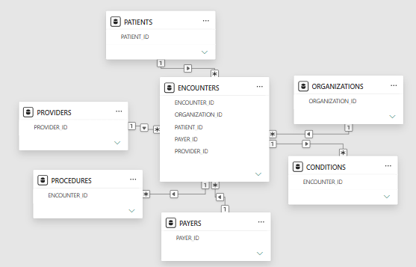
Data Model

Slide 10
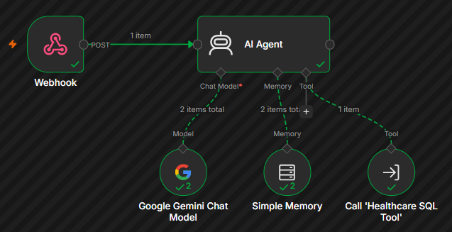
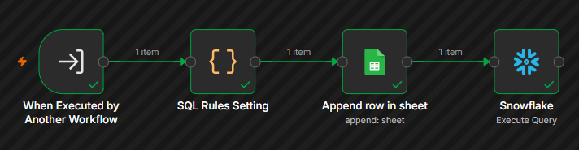
WORKFLOW IMPLEMENTATION IN n8n
Main AI Agent Workflow
Workflow Execution:
Request Intake Streamlit sends the user's healthcare question and session ID to the n8n production webhook.
AI Reasoning The AI Agent uses Gemini to interpret the question and determine the required analysis.
Context Management Simple Memory supplies recent conversation context for follow-up questions.
SQL Tool Invocation The agent invokes the Healthcare SQL Tool when database analysis is required.
Query Governance SQL Rules Setting validates that the generated query is read-only and permitted.
Audit & Execution Execution details are logged and the approved query is executed against Snowflake.
Healthcare SQL Tool workflow

Slide 11
AI-POWERED ANALYSIS & RECOMMENDATIONS
Natural-Language Understanding:
Converts healthcare business questions into analytical requests without requiring users to write SQL.
Analytical Capabilities
Healthcare Data
↓
KPI Calculation
↓
Cross-Entity Analysis
↓
Ranking & Comparison
↓
Business Insights
↓
Visual Analytics
Context-Aware Analysis:
Uses conversational memory to retain recent interaction context for follow-up questions.
Governed SQL Generation:
Generates read-only SQL and routes it through the Healthcare SQL Tool and validation layer before Snowflake execution.
Business Insight Generation:
Converts database results into concise explanations, structured tables, and visual insights.
AI Guardrails: Curated healthcare schema • Read-only SQL • Sensitive-identifier protection • Domain-specific responses
The assistant combines natural-language reasoning with governed data access to deliver business-ready healthcare insights

Slide 12
PROVIDER & HEALTHCARE PERFORMANCE
Provider Performance
Specialty Analysis:-
Provider distribution by specialty
Claim amount by specialty
Encounter volume by specialty
Average claim amount per encounter
Provider-Level Analysis:-
Encounter activity by provider
Provider performance comparisons
Provider contribution to overall claims
Payer & Encounter Performance
Payer Analytics:-
Top payers by claim amount
Encounter coverage by payer
Payer contribution to healthcare spending
Encounter Analytics:-
Encounter volume by type
Average encounter cost
Claim amount and coverage relationships
Enables stakeholders to identify high-impact specialties, compare provider activity, understand payer contribution, and uncover operational and financial patterns across the healthcare ecosystem.

Slide 13
BUSINESS VALUE & BENEFITS
Operational Benefits
Faster Ad-Hoc Analysis Users can move from a business question to an analytical answer without manually writing SQL.
Reduced Analyst Effort Automates query generation, execution, and result interpretation.
Cross-Functional Analytics Combines provider, encounter, payer, patient, procedure, and condition data.
Faster Follow-Up Analysis Conversational context allows users to continue analysis without repeatedly restating the problem.
Strategic Benefits
Self-Service Healthcare Analytics Enables non-technical stakeholders to interact with analytical data more easily.
Governed AI Adoption AI is connected to a curated schema with SQL validation and controlled execution.
Scalable Architecture The reusable AI Agent + SQL Tool pattern can be extended to other datasets and domains.
Improved Decision Support Transforms raw healthcare records into understandable business insights and visual comparisons.
Business Impact:-
Faster insight generation, lower manual analysis effort, and more accessible healthcare data-driven decision support.

Slide 14
LIVE AI WORKFLOW DEMONSTRATION From a natural-language healthcare question to a governed analytical insight ASK → UNDERSTAND → VALIDATE → QUERY → INSIGHT Streamlit → n8n AI Agent → Gemini + Memory → SQL Governance → Snowflake

Slide 15
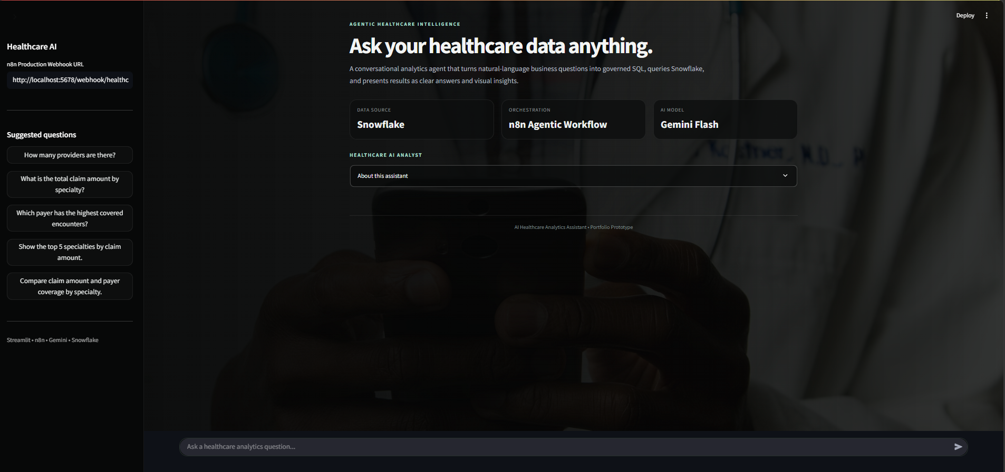
Step 1 - Ask a Question Natural-language healthcare query through the Streamlit AI Assistant.
You can either choose the questions from left panel’s suggested questions,
or you can type your question below in the typing bar for the answer

Slide 16
Step 2 - AI Analysis n8n orchestrates the AI agent, conversational memory, SQL validation, and Snowflake execution
AI Agent Orchestration:-
The n8n AI Agent interprets the healthcare question, uses Gemini for reasoning, maintains conversational context through memory, and invokes the Healthcare SQL Tool when data retrieval is required.
Governed SQL Execution:-
The SQL Tool validates the generated query, records the execution for auditability, and executes approved read-only SQL against the curated Snowflake healthcare database.
Natural Language → SQL
Gemini translates business questions into analytical queries.
Context-Aware Analysis
Simple Memory preserves conversational context for follow-up questions.
Governed Data Access
Only validated read-only queries reach Snowflake.
Agentic flow: Understand → Remember → Validate → Query → Return Insight

Slide 17
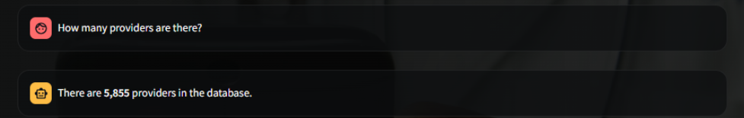
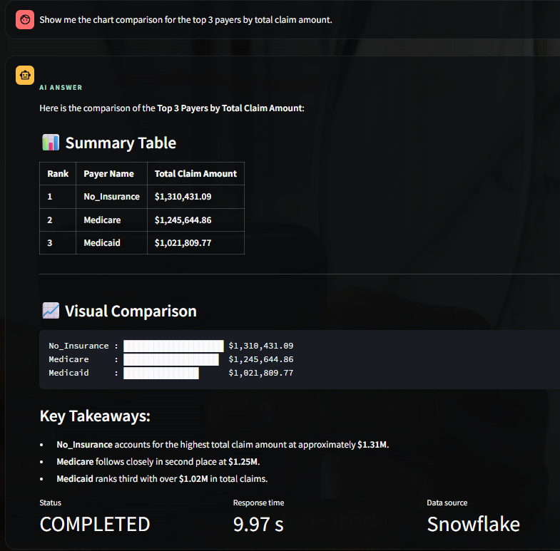
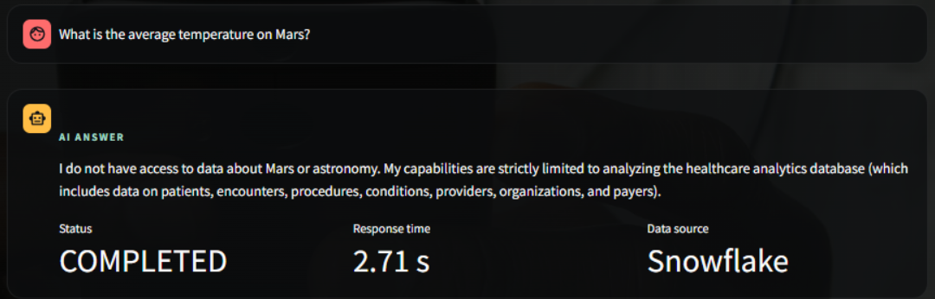
Step 3 - Insight Delivery The application converts validated healthcare query results into clear answers, tables, and visual insights.
Natural-Language Query:-
Users can ask healthcare questions in plain language and receive direct analytical answers from the assistant.
Domain Guardrails:-
The assistant is restricted to the healthcare analytics domain and gracefully handles out-of-scope questions without fabricating an answer.
Visual & Analytical Insight:-
Comparative and ranking questions return structured results that can be presented as tables and visual insights.

Slide 18
LIVE DEMONSTRATION & PROJECT RESOURCES
Project Resources :
Live AI Healthcare Analytics Assistant - AI Healthcare Analytics - Streamlit
GitHub Repository - GitHub Link
KPI Repository (Google Sheets) - Healthcare AI Query Log - Google Sheets
n8n Agentic Workflows - AI Agent + Healthcare SQL Tool
Snowflake SQL & Data Scripts - Healthcare data preparation, cleaning & analytics scripts
Explore the live application and project repository to review the complete agentic healthcare analytics solution.

Slide 19
CONCLUSION & KEY ACHIEVEMENTS
Successfully Developed
AI Healthcare Analytics Assistant
Agentic AI Workflow
Governed Healthcare Analytics Layer
Conversational Context
Dynamic Analytical Responses
End-to-End Application
Business Outcomes Delivered
Faster Access to Healthcare Insights
Reduced Manual Analytical Effort
Self-Service Data Exploration
Governed AI Adoption
Improved Decision Support
Data-Driven Decision Support
The project demonstrates how agentic AI can make governed healthcare analytics more conversational, accessible, and efficient without replacing the underlying analytical data platform.

Slide 20
THANK YOU!

