Slide 1

DEVELOPING THE BEST SMART PHONE
Presented by :
Muhammad Shaan KC

Slide 2
INTRODUCTION
In this presentation we will explore the data on mobile phone sales.
We will look at selling price, RAM of the phone , ROM, Color, Rating of the phone and see how it changes between different mobile phones.
Our aim is to develop a low budget phone with high efficient in performance and maintain users reliability.

Slide 3
COLUMN DESCRIPTION
Brand- Name of the Mobile Manufacturer
Model- Model number of the Mobile Phone
Color- Color of the model.
Memory - RAM of the model (4GB,6GB,8GB, etc.)
Storage- ROM of the model (32GB,64GB,128GB,256GB, etc.)
Rating- Rating of the model based on reviews (out of 5). Missing or Null values indicate there are no ratings present for the model.

Slide 4
Selling Price- Selling Price/Discounted Price of the model in INR when this data was scraped. Ideally price indicates the discounted price of the model
Original Price- Actual price of the model in INR. Missing values or null values would indicate that the product is being sold at the actual price available in the 'Price' column.

Slide 5
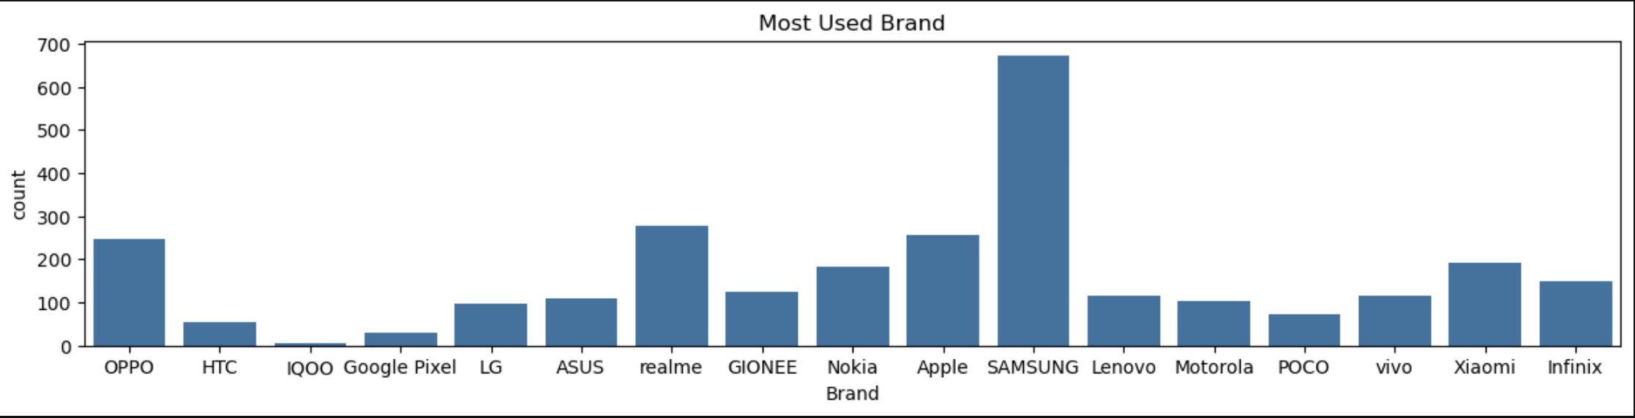
Most Used Brand
This bar chart shows the distribution of mobile brands based on their usage count. Two key points about the graph are:
Samsung is the most used brand, with the highest count, significantly outpacing other brands.
Realme , OPPO, and Apple are also popular, each having a relatively high count compared to other brands like HTC, IQOO, and Lenovo.

Slide 6
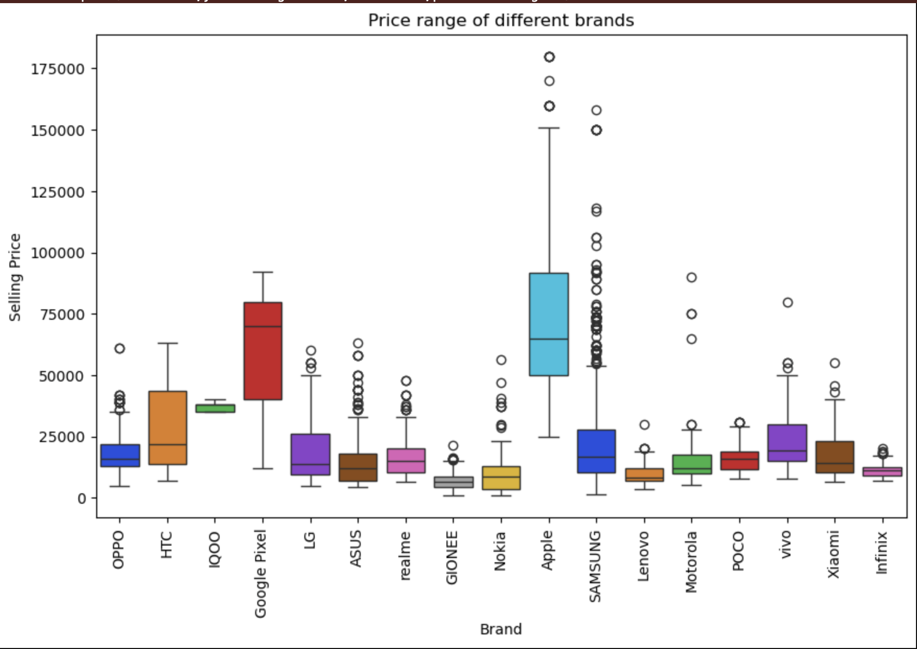
PRICE RANGE BETWEEN DIFFERENT BRANDS
This box plot shows the price ranges of different mobile brands. Key observations include:
Apple and Google Pixel have the highest median prices, with Apple having a wide price range and many outliers.
Samsung also has a significant price range, though its median price is lower than Apple's.
Brands like Realme , POCO, and Infinix have much lower median prices, with smaller price ranges.
This graph provides a clear visual of the price variation across mobile brands.

Slide 7
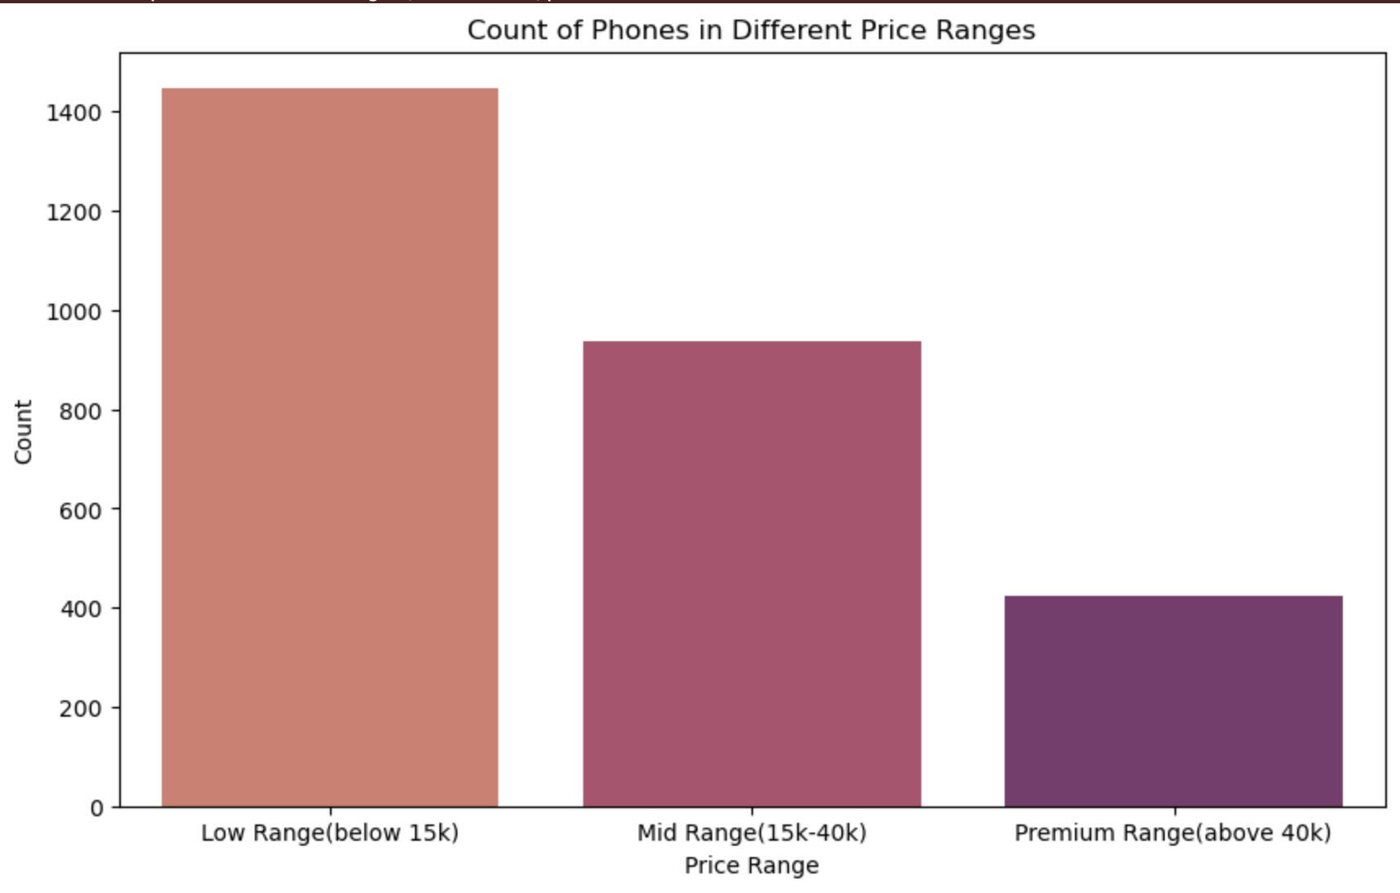
Count Of Phones In Different Price Ranges
This bar chart displays the count of phones in different price ranges. Key points:
Low Range (below 15k) has the highest number of phones, exceeding 1,400 units.
Mid Range (15k-40k) has a smaller count, around 900 phones.
Premium Range (above 40k) has the lowest count, with fewer than 500 phones.
This shows that more phones are available in the budget segment than in the premium category.

Slide 8
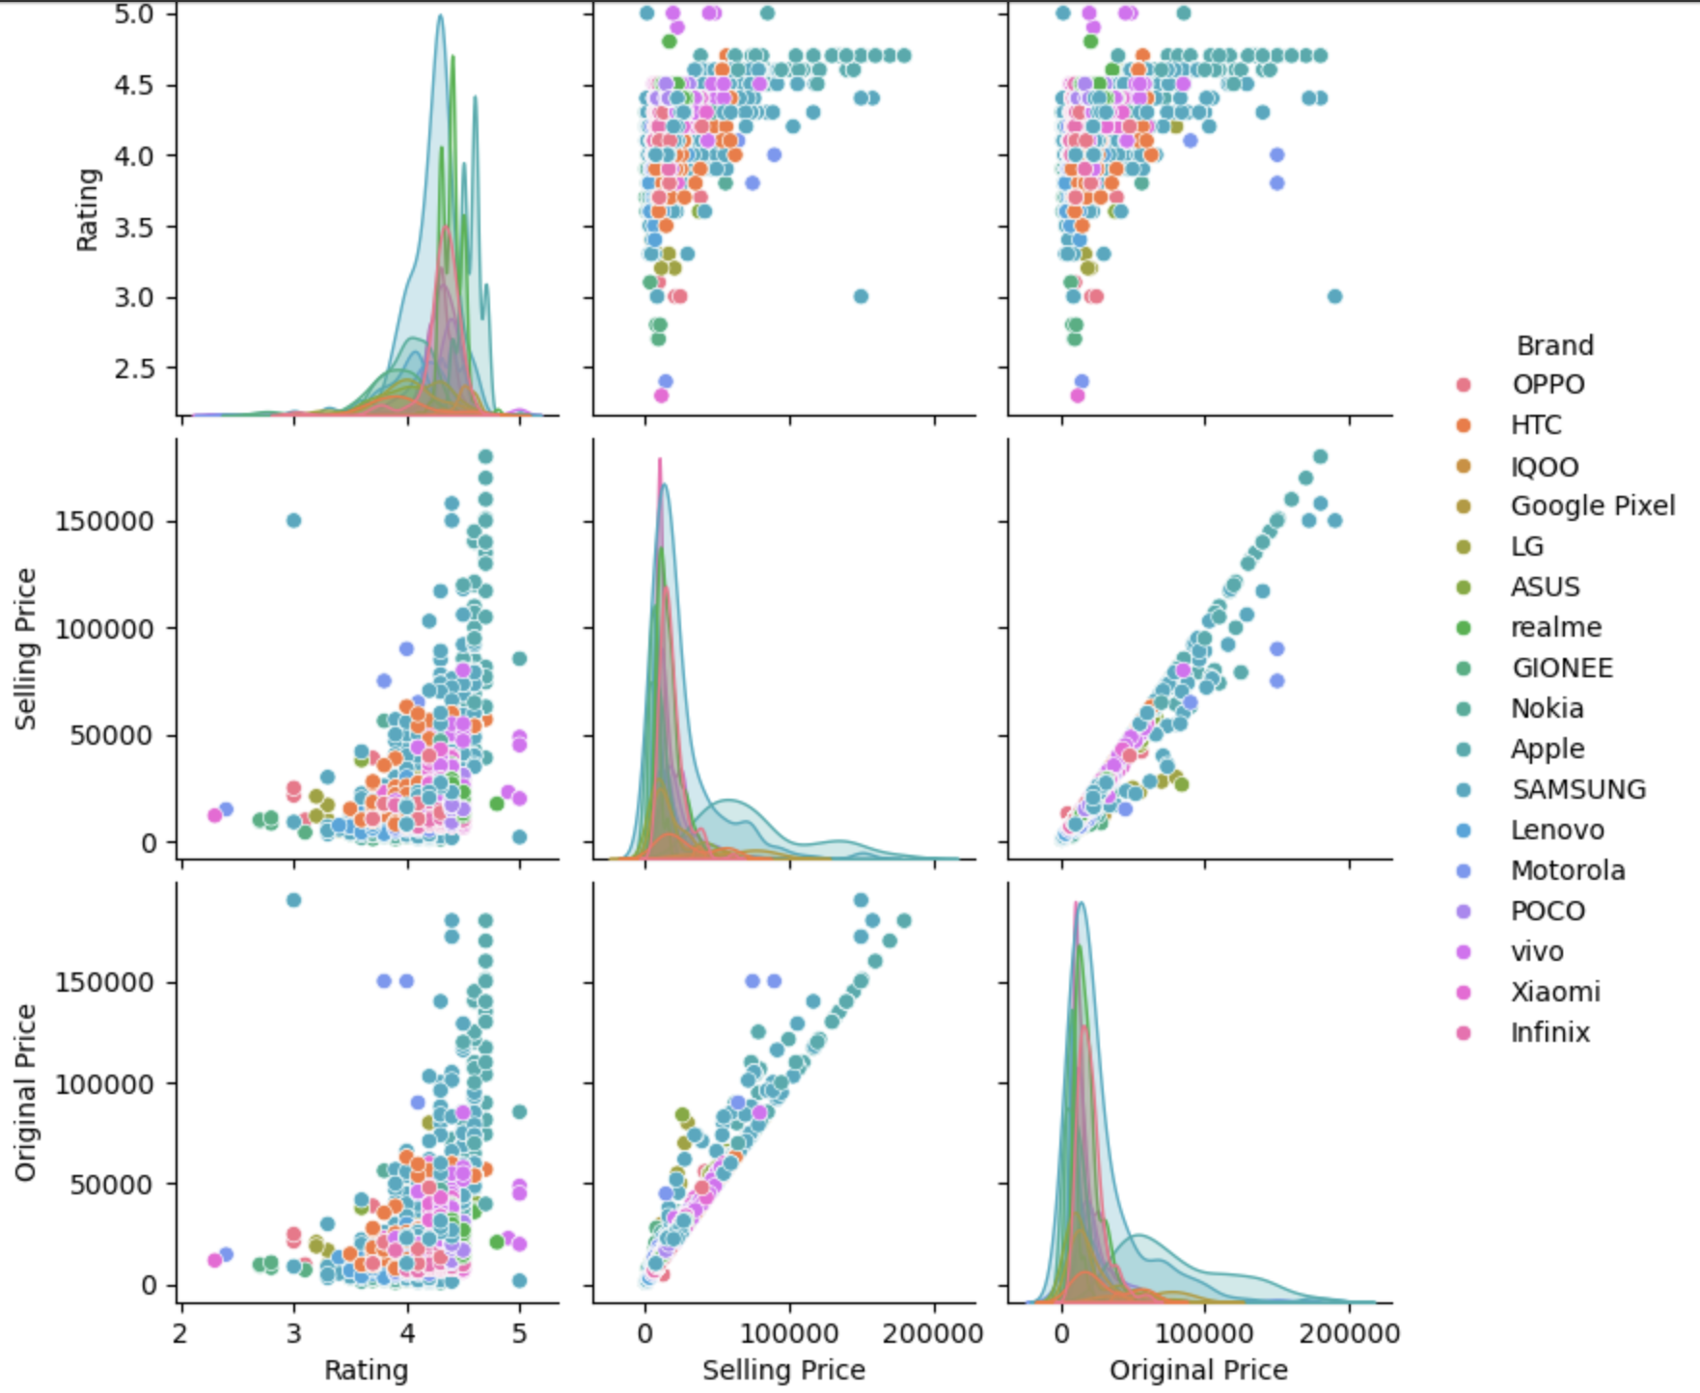
PAIRPLOT
A strong positive correlation exists between Original Price and Selling Price across all brands.
Higher-priced phones, especially from premium brands like Apple and Samsung, generally have better ratings.
Mid-range brands like Xiaomi, OPPO, and Vivo show diverse pricing and rating patterns compared to premium brands.
The data reflects clear market positioning, where premium brands command higher prices and maintain higher ratings.

Slide 9
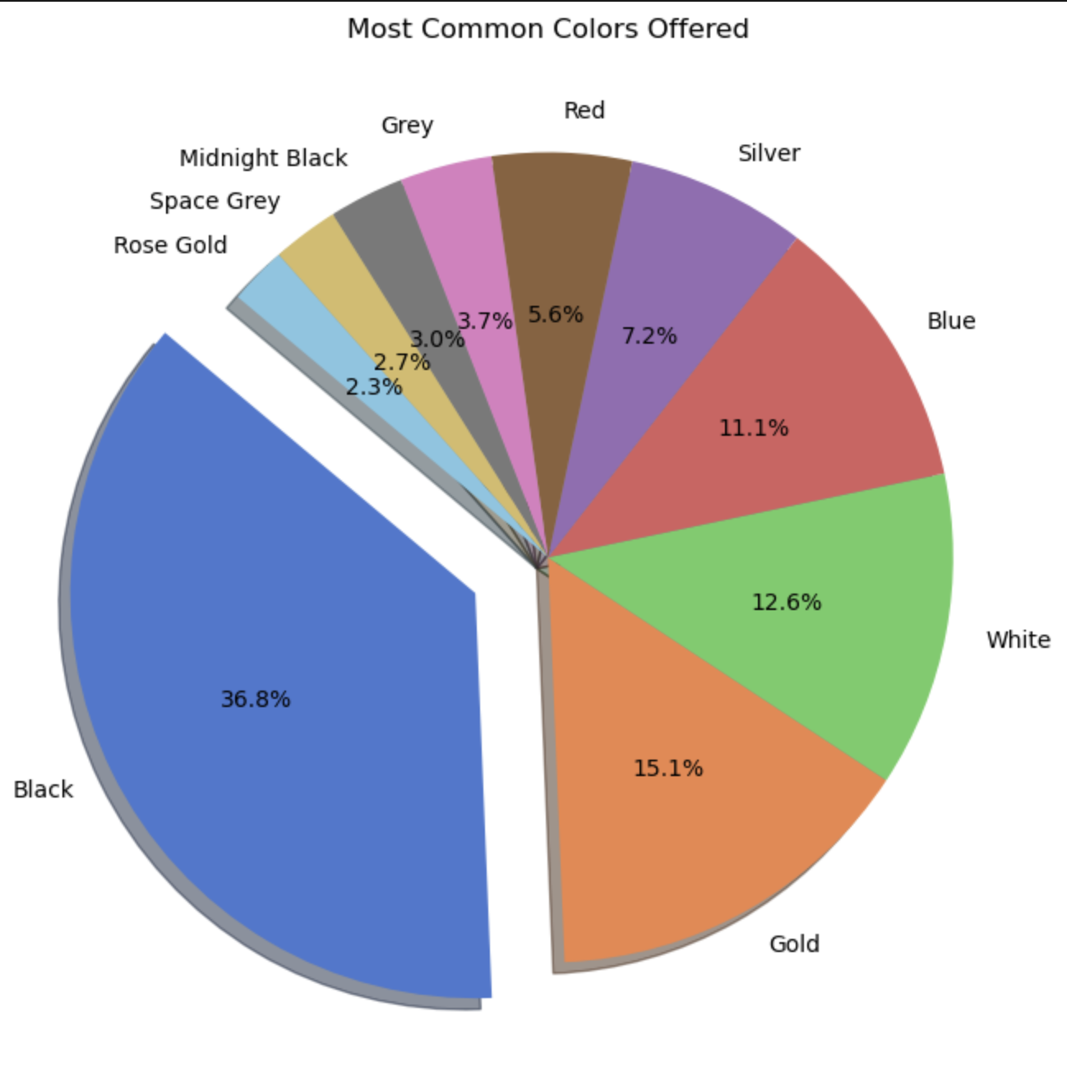
Most Offered Color
Black is the most common color offered, making up 36.8% of the total options.
While black leads, other popular colors include Gold (15.1%), White (12.6%), and Blue (11.1%), showing a broad range of choices.

Slide 10
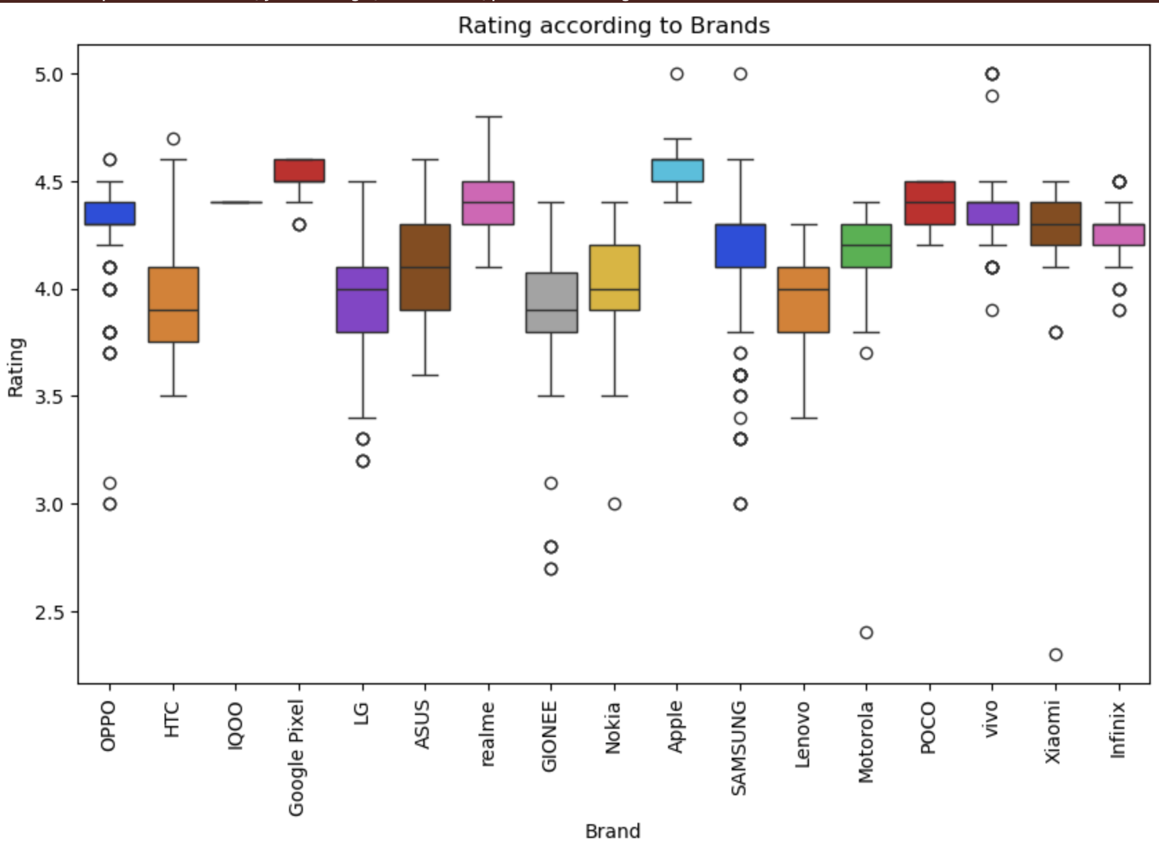
Rating According To Brands
Top-rated Brands: Google Pixel, Apple, and OPPO have consistently high ratings, with median ratings around or above 4.5.
Rating Variability: Brands like Lenovo and Samsung show a wider spread in ratings, with more outliers, indicating a broader range of customer satisfaction.

Slide 11
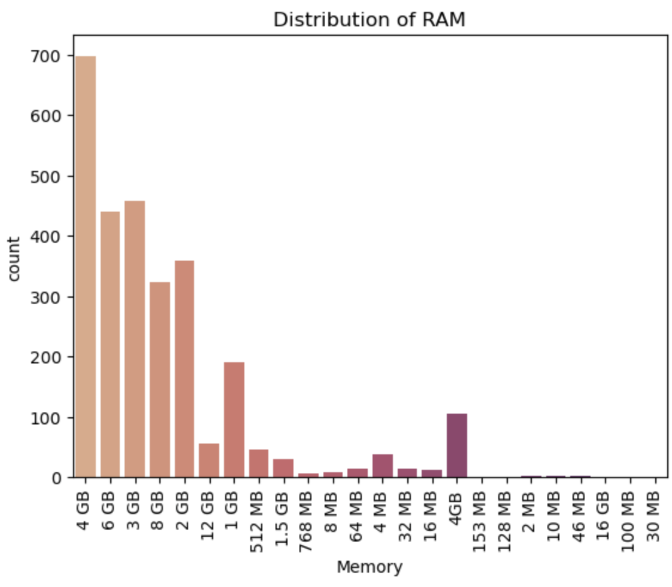
Distribution Of RAM
The plot shows the distribution of RAM, most phone has 4GB RAM compared to others , so that phone has a highest sale when looking. Towards about the Specifications.

Slide 12
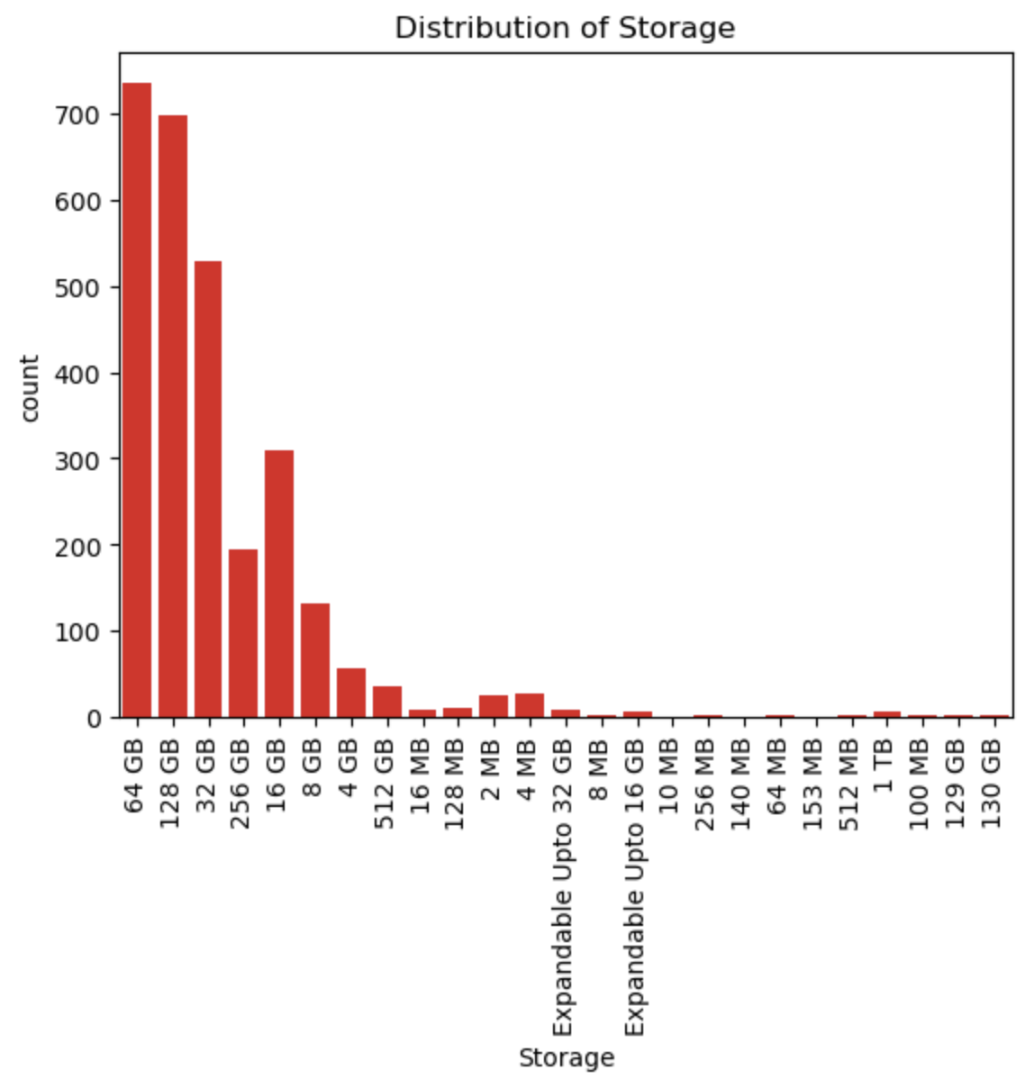
Distribution Of Storage
The plot shows the most used memory on different phones , and it has the highest sale according to the analysis.
Here the most used memory space on different phones are 64GB

Slide 13
CONCLUSION
The most demanded mobile phone is at the price range below 25k.
By developing mobile phone at this price with at least 128GB memory and 6GB ROM can take the market in hands.
When the memory space increases the demand for the phone will also increase.
This data shoes that color black has a premium look and there is an high demand for this color.
So by developing an mobile phone granting all the above requirements will become an history.

Slide 14
THANK YOU

