Slide 1
THE FLAGSHIP MIC HACKATHON OF TECHNOVIT
IDEA SUBMISSION — TEMPLATE
01
RECURSION
EDITION II
to understand recursion, first understand recursion
PROJECT TITLE
TEAM
Causeway
Marlloz
Shaan GS
ONE-LINE PITCH
Pradeesh Govindarajan
For SOC analysts: one incident, with a named cause, from a night of alerts.
Shreyas Gopalika
TRACK
Cybersecurity — PS2
full contact sheet → frame 09
FRAME 01 / 09
Notes:
Cover: fill TRACK, PROJECT TITLE, ONE-LINE PITCH and TEAM names. Phone & email for each member goes on the last slide, frame 09. Keep layout, colours & logos as-is. RECURSION is TechnoVIT's flagship hackathon.

Slide 2
RECURSION - EDITION II
02
PROBLEM DEFINITION
answer in 2–3 lines · readable outside your track
01
WHO & HOW OFTEN
02
TODAY'S WORKAROUND
SOC analysts, every shift. One attacker action fires dozens of correct alerts across endpoint, identity, email, firewall and cloud.
Analysts pivot between consoles by hand, matching timestamps and identities. Tooling dedups by merging alerts whose text looks alike.
03
WHY IT FALLS SHORT
04
EVIDENCE
Text-merging destroys evidence: two alerts that read alike can be two attack stages. Broad automation isolates hosts on weak grounds.
We measured it. On a 938-alert corpus, text dedup buried the successful login that was the root cause and recovered 4 of 9 stages.
TECHNOVIT'S FLAGSHIP HACKATHON
FRAME 02 / 09
Notes:
Answer each question in 2–3 plain lines. Someone outside your track should understand every answer.

Slide 3
RECURSION — EDITION II
03
PROPOSED SOLUTION
name it plainly · connect straight back to frame 02
PRODUCT / SYSTEM NAME
01
WHAT A USER DOES
Causeway
Open one case instead of hundreds: a causal graph, the ranked root cause, and a recommended action that shows its reasoning.
02
WHY IT BEATS THE WORKAROUND
Rebuilds the causal incident behind scattered alerts, ranks what to contain, and gates every response on the evidence for it.
938 alerts became 17 cases. All nine stages in one incident, recall 1.00, root cause correct. Nothing is deleted.
03
WHAT'S GENUINELY DIFFERENT
We rank entities, not alerts — nobody contains a row. Confidence stays separate from what the evidence may authorise.
TECHNOVIT'S FLAGSHIP HACKATHON
FRAME 03 / 09
Notes:
Name the product plainly. The three answers should connect directly back to the problems on frame 02.

Slide 4
RECURSION — EDITION II
04
SYSTEM ARCHITECTURE
walk the full flow · name real services & models
FIG. 04-A — SYSTEM FLOW
ALERTS IN
RESOLVE + DEDUP
CAUSAL EDGES
EVIDENCE GATE
CASE + ACTION
any product → canonical entities → causal DAG → evidence-gated response
01
KEY TECHNICAL DECISION
02
HARDEST PART TO BUILD
03
HOW YOU KNOW IT WORKS
No model, no network call in the decision path. Deterministic rules, ~42 ms per run, every refusal explainable in one sentence.
Stopping the benign estate collapsing into one incident. Fixed by weighting entities by rarity, so hub entities link nothing.
27 tests, four configurations. With rarity weighting off precision collapses to 0.13 — the control that proves the design works.
TECHNOVIT'S FLAGSHIP HACKATHON
FRAME 04 / 09
Notes:
Replace the placeholder flow with your real architecture diagram. Name real services and models, then answer the three questions.

Slide 5
RECURSION — EDITION II
05
FEASIBILITY & SCOPE
a working slice with a known limit beats an over-promised demo
01
SCOPE
02
RUNNING COST
In: correlation, entity resolution, reversible dedup, root cause, gated response, console
Effectively zero. Pure Python, no model calls, no external API. 938 alerts in ~42 ms, and it runs fully on-premise.
Out: we recommend actions, never execute them; no live connectors, no ML model
03
RISKS & FALLBACK
04
AFTER THE HACKATHON
Precision on real telemetry. We tested on the public AIT corpus: dedup transferred, correlation did not. Reported, not hidden.
Learn entity rarity from an environment's own baseline, then add live connectors.
TECHNOVIT'S FLAGSHIP HACKATHON
FRAME 05 / 09
Notes:
Be honest about scope. A working slice with a known limit beats an over-promised demo.

Slide 6
RECURSION — EDITION II
06
IMPACT METRICS
01
WHAT MEASURABLY IMPROVES
show how the figure was measured, an estimate is fine
98%
Analysts open 17 cases, not 938 rows, with the root cause named.
02
WHO ELSE COULD USE IT
MSSPs, cloud-security teams, and regulated environments needing an audit trail.
fewer queue items — 938 alerts became 17 cases
03
WHAT COULD GO WRONG / BE MISUSED
HOW IT WAS MEASURED
Over-trust: a confident graph could persuade an analyst to skip verification.
938-alert corpus, labelled 9-stage intrusion. Cases = 17. Recall 1.00 and zero evidence-erasing suppressions.
04
HOW YOU'D HANDLE THAT
Nothing is deleted; every suppression is reversible. Destructive actions need a human.
TECHNOVIT'S FLAGSHIP HACKATHON
FRAME 06 / 09
Notes:
Pick one primary metric. Show how it was measured — an estimate is fine if you show your working.

Slide 7
RECURSION — EDITION II
07
REFERENCES & ATTRIBUTION
one source per line · uncredited work is disqualifying
TABLE 07-A — SOURCES & LICENCES
TYPE | SOURCE (AUTHOR, TITLE, YEAR) | WHAT IT GAVE YOU | BORROWED / YOURS | LICENCE
Paper | Landauer et al., “A New Alert Data Set for Multi-Step Attack Analysis”, CSET ’24 | Alert-level corpus design; multi-step framing | borrowed — cited | ACM, cited
Repository | Ventriloquist — our own EDGE NOVA’26 provenance gateway | Lineage closure, blast radius, audit chain, policy engine | yours | own work
Documentation | FastAPI · Starlette · Uvicorn · PyYAML | HTTP surface and YAML policy loading | borrowed | MIT / BSD-3
Dataset | AIT Alert Data Set — doi 10.5281/zenodo.8263181 | 45,544 real labelled alerts, 3 detectors | borrowed | CC-BY-4.0
Model weights | None — no ML model or pretrained weights | Correlation is deterministic; no inference step | n/a | n/a
TECHNOVIT'S FLAGSHIP HACKATHON
FRAME 07 / 09
Notes:
One source per line — papers, repos, docs, datasets, model weights. Uncredited work is disqualifying.

Slide 8
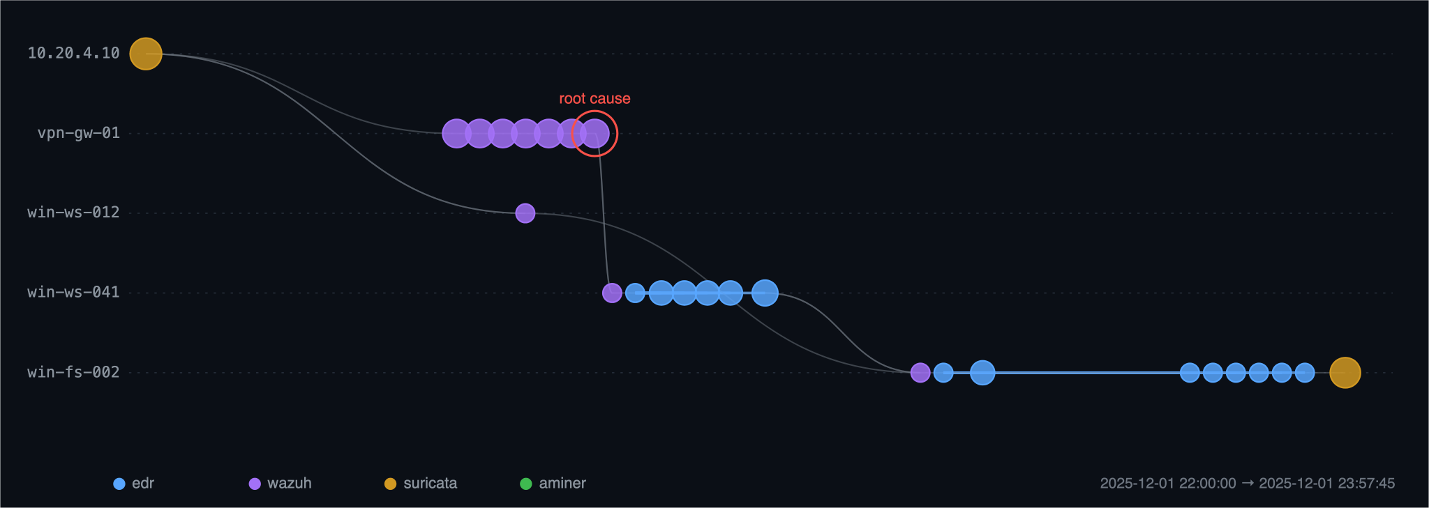
RECURSION — EDITION II
08
THE CONSOLE
One reconstructed incident: 938 alerts in, ranked root cause, gated response.
TECHNOVIT'S FLAGSHIP HACKATHON
FRAME 08 / 09
Notes:
Optional space: demo links, screenshots, GitHub, QR codes, anything extra that strengthens the submission. Delete the checklist sticker and the hint line once you're done.

Slide 9
RECURSION — EDITION II
09
TEAM & CONTACT
one line per member · so organisers can reach you after submission
Marlloz
TABLE 09-A — TEAM CONTACT SHEET
NAME | PHONE | EMAIL
Shaan GS | — | shaangurushankar@gmail.com
Pradeesh Govindarajan | — | pradeeshgovi@gmail.com
Shreyas Gopalika | — | sg8268@srmist.edu.in
TECHNOVIT'S FLAGSHIP HACKATHON
FRAME 09 / 09
Notes:
List every member's phone and email so organisers and judges can follow up after the round. This slide is for the submission file — remove it if presenting live on stage.

