Slide 1

still.
A non-clinical check-in agent for students
Sustain Agentic Bootcamp
Srishanth + Shaan · September 30, 2026
Notes:
Still. A bounded, non-clinical check-in agent for students. One question, one useful action, then it stops.

Slide 2


THE PROBLEM, RIGHT NOW
Student wellbeing isn't an occasional problem.
2.43 lakh+
higher-education students responded
PRELIMINARY · NOT REPRESENTATIVE
15%
9%
34%
felt very overwhelmed, distressed or low for weeks in the past 6 months
had suicidal thoughts often or very often in the past year
felt like an outsider on campus, to varying degrees
~32% said their institution did not provide counselling services.
Preliminary, non-representative findings from the Supreme Court-appointed National Task Force survey, as reported on 29 Sep 2026 (The New Indian Express).
Notes:
Source: newindianexpress.com, 29 Sep 2026 — 9% students reported suicidal thoughts, 34% felt like outsiders on campus: SC task force survey. Officials called the findings preliminary; the sample is not representative.

Slide 3

THE GAP
There is a gap between “talk” and “help”.
still.
EXTREME 1
EXTREME 2
Chat forever
Disappear
Short check-in
Understands the situation
Takes ONE useful action
Knows when to stop
Open-ended AI conversations
No clear endpoint
No concrete action
Reminders
Resource pages
Helpline links
The next step is left to the student
Not a therapist.
Not a silent void.
Chat forever or disappear. Still sits in the gap.
Notes:
Two extremes today: talk to an AI indefinitely, or get a link and be left alone with the next step. Still is the middle: short, bounded, one action, then it stops.

Slide 4
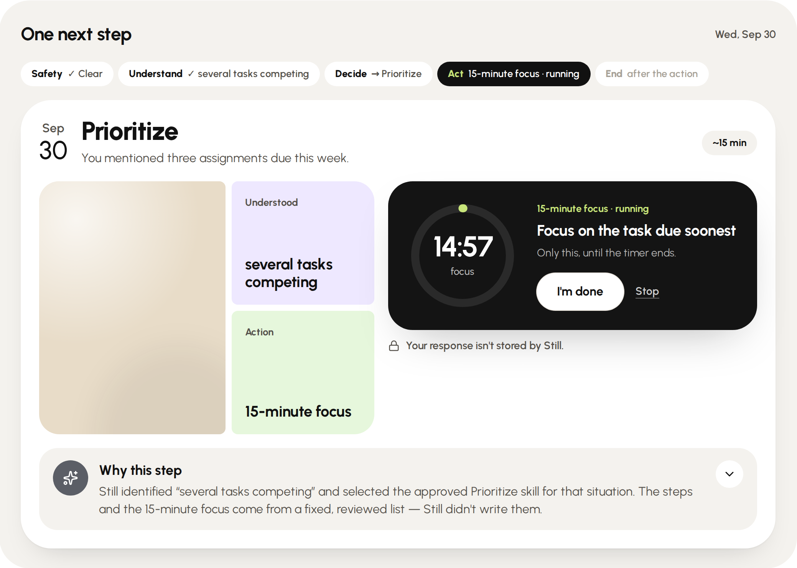
THE SOLUTION
Still. does one thing differently.
ASK One short scheduled check-in.
UNDERSTAND Model reads situation + need.
DECIDE Server policy picks an approved action.
ACT A real, bounded action runs.
STOP No endless chat.
WHAT IT DOES
“Three assignments due this week…”
→ 15-minute focus timer
“Wound up about tomorrow's presentation…”
→ 60-second breathing guide
“I feel very alone right now…”
→ reviewed message, ready to copy
Crisis phrase
→ verified helpline · flow stops · model not called
The live app: “three assignments due this week” → Prioritize → 15-minute focus, running.
Notes:
Show the live app. ASK, UNDERSTAND, DECIDE, ACT, STOP. The model understands; the server decides; one allowlisted executor acts. Crisis language never reaches the model.

Slide 5

Built around a clear protocol
SMART GOALS
S
Specific
Scheduled, non-clinical student check-ins
SAFETY
Explicit crisis phrases
→ caught before the model is called
M
Measurable
One action per check-in · explicit crisis always escalates
Model risk
→ SAFE / HIGH_RISK / UNCERTAIN
A
Achievable
UNCERTAIN
→ never becomes a safe action
Reviewed skills + deterministic safety backstop
HIGH_RISK
→ human help · verified public helpline
R
Relevant
Low-friction support for everyday student moments
The safety system is an execution boundary, not just a prompt instruction.
T
Time-bound
Validate normal + crisis paths in the live demo
Notes:
Safety is enforced in code, in this order: phrase backstop, model risk, server policy. UNCERTAIN can only lead to one clarification, and the original response is re-checked.

Slide 6
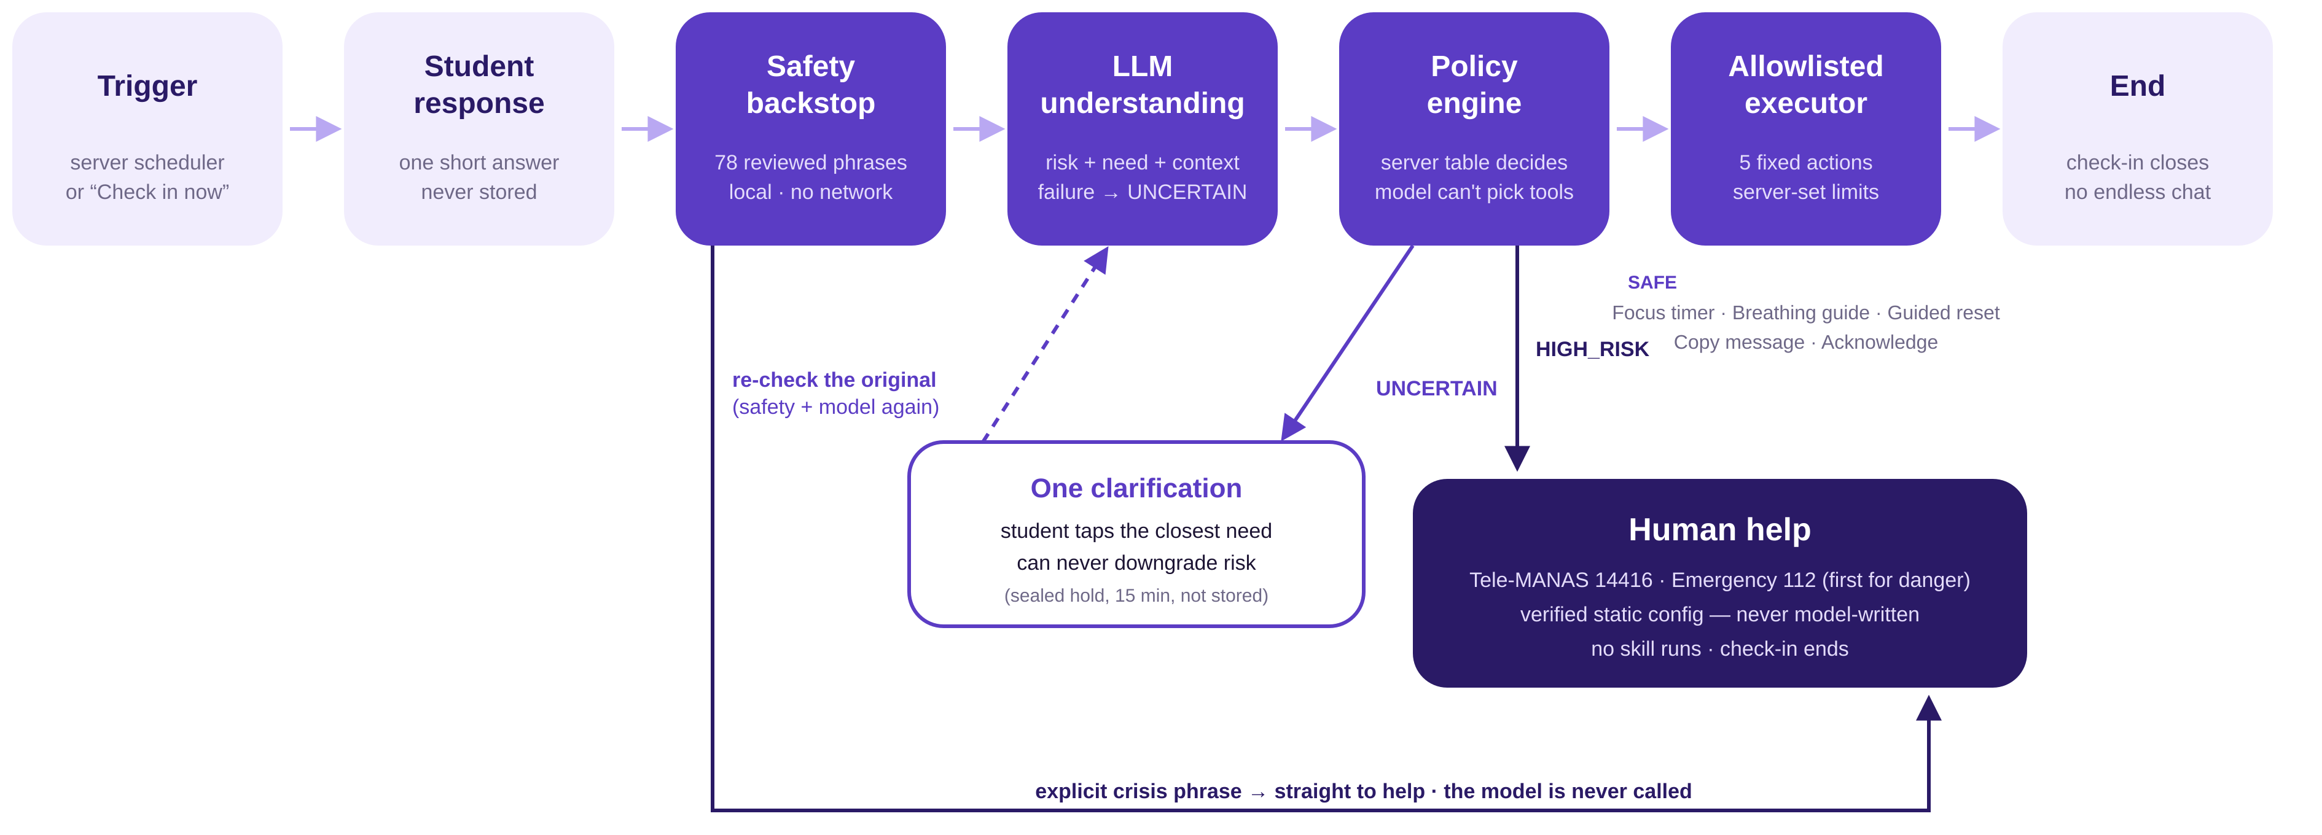
ARCHITECTURE
The agent, without the black box
THE MODEL INTERPRETS. THE POLICY DECIDES. THE EXECUTOR ACTS.
React 19 · TypeScript · Vite · Node.js 22 · Express · SQLite · Zod · Groq / Ollama · Vitest · Supertest · Playwright
Notes:
One pass per check-in, no loop back to the model. Everything the student can be shown — skills, steps, helplines — comes from reviewed configuration, never from the model.

