Slide 1

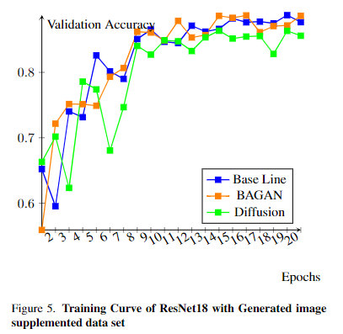
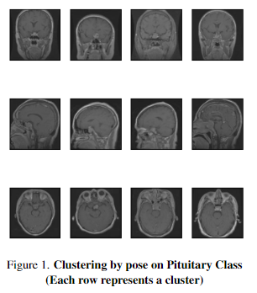
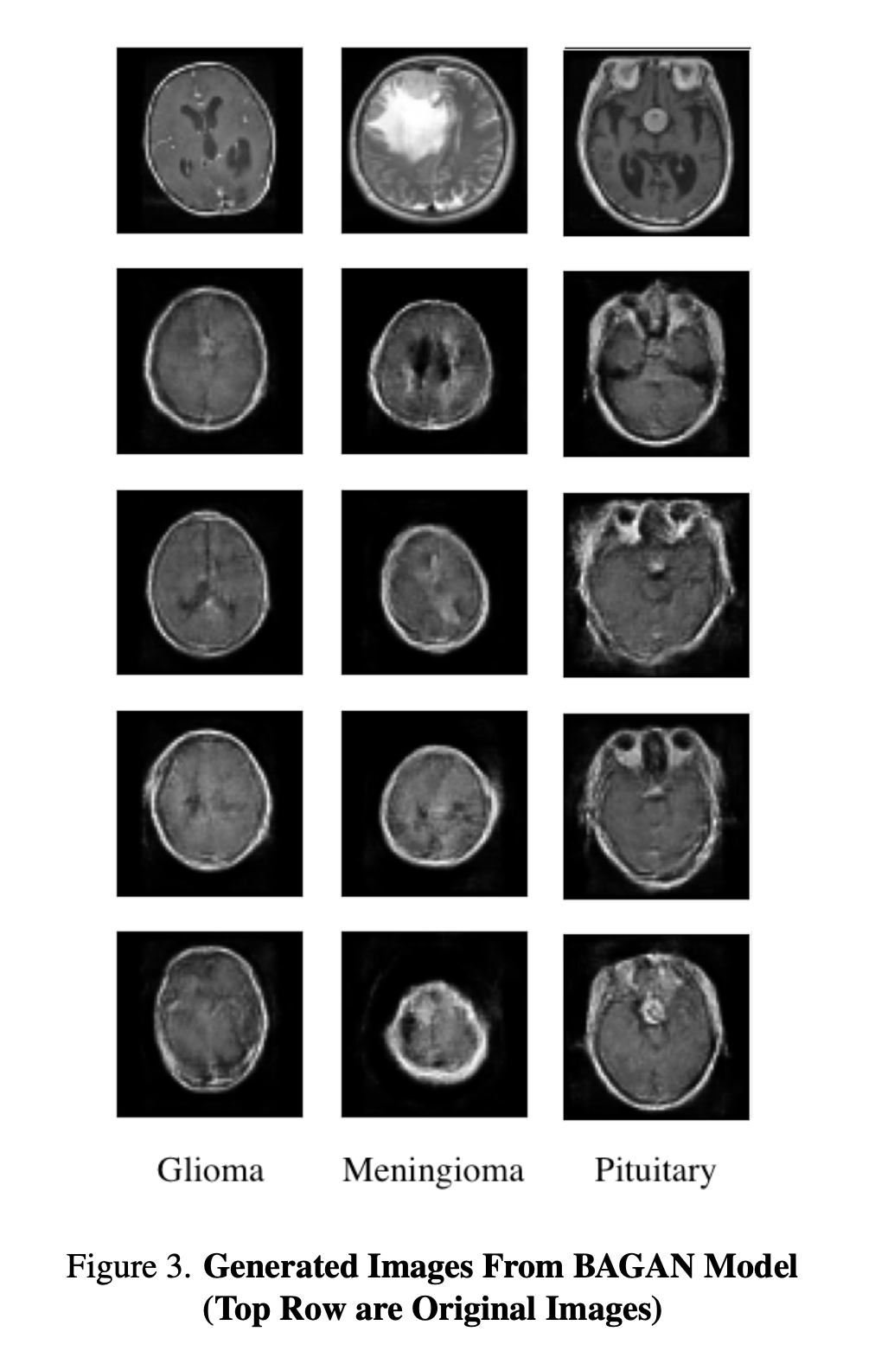
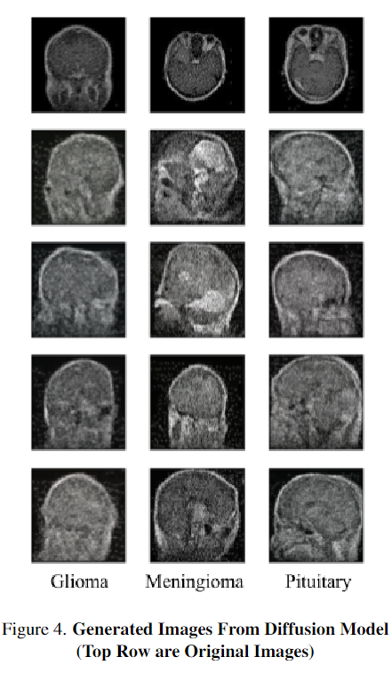
On the Use of Denoising Diffusion Models for Dataset Rebalancing
S. Gill, M. Harbola, E. Mendes, C. Snider
Georgia Institute of Technology
ABSTRACT
RESULTS
CONCLUSION
In recent years, the development of diffusion models has led to their adoption in many areas of computer vision. These models have often supplanted older generative adversarial network (GAN) architectures, which have shown to be consistently outperformed by diffusion models. In this work, we investigate whether this adoption of diffusion models is appropriate to the problem of skewed dataset rebalancing multi-class classification settings, which involves increasing the number of images in minority-classes in skewed datasets from limited resource domains. Specifically, we compare the classification accuracy on a skewed cancer tumor dataset after it has been rebalanced using the current state-of-the-art GAN architecture and denoising diffusion probabilistic models (DDPM's). Through our experiments, we find little difference in performance between these approaches and the baseline and conclude that the vanilla DDPM architecture is not sufficient to improve performance on this rebalancing task.
As mentioned, we train three separate diffusion models for each of the three minority classes (Glioma, Meningioma, Pituitary). During training, we used an Adam optimizer with a learning rate of 0.001, 500 warmup steps with a cosine scheduler, a batch size of 16, over 50 epochs. Due to the nature of training three computationally expensive models, it was infeasible to perform comprehensive hyperparameter tuning on each of these models, However, we did use some manual tuning of the learning rate. We then used this model to generate 1000 images for each of the minority classes. Figure 4 shows examples of these generated images using the diffusion model that was used to augment the training dataset.
Using the fixed brain scan pose images, we trained our BAGAN across all four image classes. To accommodate Huang and Jafari’s model architecture, we downsampled the 128x128 grayscale brain images to 64x64 and normalized the pixel values onto the [-1, 1] interval. We trained our autoencoder over 60 epochs and used an Adam optimizer with a learning rate of 0.0020, 𝛽₁ = 0.5, 𝛽₂ = 0.9, and a mean absolute error loss function. Our discriminator and generator were trained over 50 learning steps with 2 epochs using an identical Adam optimizer with a learning rate of 0.0002, 𝛽₁ = 0.5, 𝛽₂ = 0.9. We tuned the model with the goal of minimizing validation autoencoder loss, discriminator loss, and generator loss, in that order. In the end, we generated 1000 images per minority class, as seen in Figure 3, in order to augment the training dataset.
When training ResNet18 with the baseline skewed data set, we reached a validation accuracy of 88.875%. Once we introduced bagan and diffusion generated images we reached a 88.7097% and 86.3710% validation accuracy respectively. While there are slight differences in the peak accuracy of the models depending on the source of generated images or the lack thereof, the change only varies by 2.504%. This change is small compared to the changes the models can make between epochs, and considering the overall trend trend of the models we can see the performance overall remain rather similar. All three models trained start with quick growth into epoch 8 then proceed with considerably slower growth to reach their final maximums.
Overall, our experiments have shown that introducing generated images into a data set have poor impact on the performance in training a classification system. In every instance of training with generated data little change occurs and change has always been negative on the performance of the model. Introducing the generated data to supplement the underrepresented data led to slightly inferior results. This may be due to the fact that a given image only contains a certain amount of information, or entropy, that can be applied to the classification problem. The diffusion or bagan models cannot create new information or patterns since they are in themselves trained on the same training data set as the classification system is. Thus in terms of information, the benefit that they may provide is that they can evoke patterns already present, but concealed in the data that the classification model may struggle to learn from the data directly. However, it seems our results imply that the ResNet model on its own is able to extract the information and patterns as well as the generative models or at least well enough where any noise from that the generative models create in their images offsets the gains from the processed data.
If one model is chosen, our results suggest the BAGAN models produce slightly higher accuracy rates compared to the diffusion model. This may because the Bagan model exaggerates difference between classes. By training the bagan model on only a single perspective, the bagan may have more easily exaggerated the patterns unique to the given tumor since all else was kept as equal as possible.
However, as a result of the our testing we do not recommend using generative models to supplement a skewed data set when training a classification system, or at least not one as sophisticated as ResNet. Generating the images greatly expands the computational costs and time of training a classification model while introducing little and negative changes in final performance.
OBJECTIVES
To experiment with improving the performance of a classification system that is trained on a skewed data set by introducing generated images. These images were generated using a BAGAN and Denoising Diffusion model. Our aim is to see if these generated images can improve the performance of the classification model by providing data to balance out the dataset across the various cancer classes.
MATERIALS & METHODS
Dataset Preparation The dataset we are using was developed with the purpose of detecting brain tumors through MRI scans. The motivation behind the dataset was to use CNN based models to classify and detect brain tumors through MRI scan early so that it can used help treat patients earlier. In the training set there are 1321 glioma images, 1339 meningioma images, 1595 no tumor images, and 1457 pituitary images. And in the testing set there are 300 glioma images, 306 meningioma images, 405 no tumor images, and 300 pituitary images. Each file in this dataset is an image however not all images are the same size or the same number of color channels (some are greyscale others are RGB).
BAGAN + Fixed Pose Scans We used Huang and Jafari’s original implementation of the BAGAN-GP architecture for training on our dataset. It is important to note BAGAN neural architecture is designed with the intention to ”let the GAN distinguish between different classes explicitly” and learn ”useful features from majority classes and use these to generate images for minority classes” [1]. Therefore, an approach we undertook with BAGAN to improve baseline ResNet classification scores was to select brain scans across classes with the same head orientation. By keeping the scan pose in the dataset across classes consistent, our intention was to make it easier for the BAGAN to learn the differences between the tumor classes and further minimize generator/discriminator loss during training. As a result, our expectation was for the BAGAN to generate more realistic images for minority classes as it no longer has to account for different scan poses. Since the poses are not labeled in the dataset we will need to use unsupervised learning to properly separate all of the poses. We decided to use K-means clustering in order to accomplish this. K-means will group all of the pictures into k clusters, where each cluster represents a group pictures closest to each other in a vector space. To vectorize our images we ran them through a pretrained VGG-16 model and removed the final 2 layers to extract features for each of the images. After that we decided to use PCA to reduce the dimensionality of these vectors as the output of the previous step produces a 4,096 size vector per image. Finally we put the output of PCA through K-means and use the elbow method to find the ideal number of clusters. Since we are clustering the 4 tumors we need to run this for all tumors to find the ideal number across all 4 tumors. This method was taken from the the following article [2].
Denoising Diffusion Probabilistic Models: As this is the first work that investigates the use of DDPM's for this task, we use a relatively simple U-Net architecture similar to the one proposed by Ho et al. [3] for our models. Specifically, we use a U-Net implementation from the HuggingFace diffusers library with five regular ResNet blocks along with a single spatial self-attention block each for downsampling and upsampling. We also use an unmodified noise scheduler to the one specified by Ho et al. Unlike with the BAGAN architecture, minority classes are considered independent during the training and generation process. For this reason, it is necessary to train separate DDPM's for each of the minority-classes in the same way that Dhariwal et al. [4] train separate models for each class in their experiments.
ResNet We used ResNet as our measurement of success. We imported an untrained ResNet18 model via Pytorch and trained the model using our skewed and generated data. We then monitored the validation accuracy across data sets that were generated to monitor a generative model's viability to train a classification system.
REFERENCES
[1] Giovanni Mariani, Florian Scheidegger, Roxana Istrate, Costas Bekas, and Cristiano Malossi. Bagan: Data augmentation with balancing gan, 2018
[2] Gabe Flomo. How to cluster images based on visual similarity, 2020
[3] Jonathan Ho, Ajay Jain, and Pieter Abbeel. Denoising diffusion probabilistic models. In H. Larochelle, M. Ranzato, R. Hadsell, M.F. Balcan, and H. Lin, editors, Advances in Neural Information Processing Systems, volume 33, pages 6840–6851. Curran Associates, Inc., 2020.
[4] Prafulla Dhariwal and Alex Nichol. Diffusion models beat
gans on image synthesis, 2021
ACKNOWLEDGMENTS
Many thanks to Dr. Danfei Xu as well as the Deep Learning TA team for their support and advice towards developing the diffusion and gan models.

