Slide 1
TOPIC: TEXT MINING
SHANIA KHAN

Slide 2
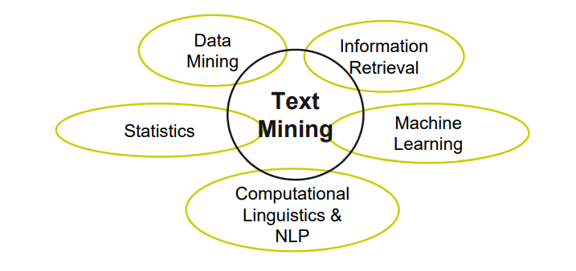
Introduction: Text Mining
The extraction of implicit, previously unknown and potentially useful information from large amounts of textual resources

Slide 3
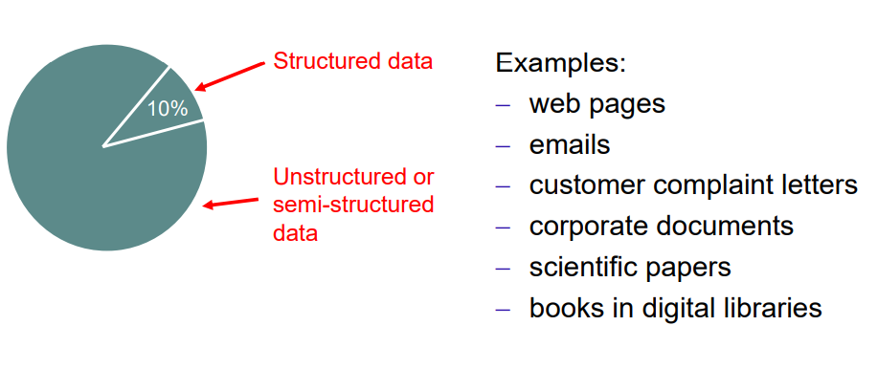
Motivation for Text Mining
Approximately 90% of the world’s data is held in unstructured formats.

Slide 4
Text Mining Applications Example
Classification of news stories or web pages
Email and news filtering / SPAM detection
Sentiment analysis
Clustering documents or web pages
Search term auto-completion
Information extraction

Slide 5
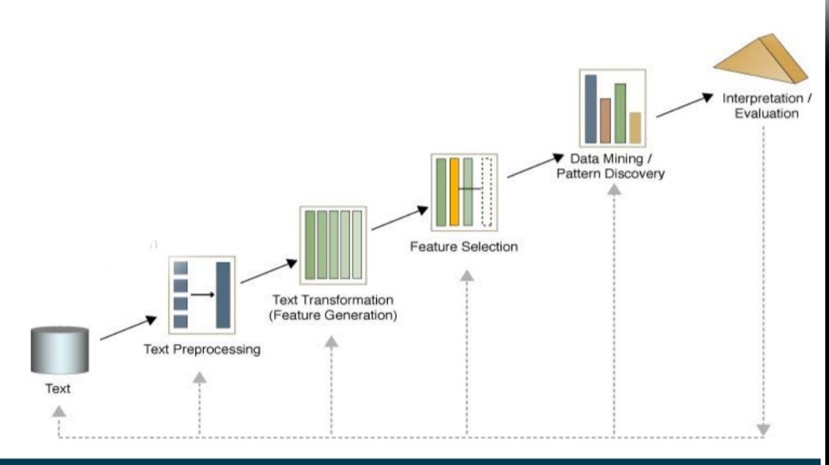
Text Mining Process
1. Text Preprocessing
• Syntactic and/or semantic analysis
2. Feature Generation
• Bag of words, word embeddings
3. Feature Selection
• Reduce large number
4. Data Mining
• Clustering
• Classification
• Association analysis
5. Pattern Discovery

Slide 6
Text preprocessing steps
Tokenization
Stop word Removal
Stemming
POS Tagging

Slide 7
Syntactic and Linguistic Text Preprocessing
Simple Syntactic Processing have two parts
1. Cleanup (remove punctuation and HTML tags)
2. Tokenization (break text into single words or N-grams)

Slide 8
Syntactic and Linguistic Text Preprocessing (Cont)
Advanced Linguistic Processing have two parts
Word Sense Disambiguation
1.1. Determine which sense a word is having.
1.2. Normalize synonyms (United States, USA, US)
1.3. Normalize pronouns (he, she, it)
2. Part Of Speech (POS) Tagging
2.1. Parse sentences according to grammar
2.2. Determine function of each term., example John (noun) gave (verb) the (det) ball (noun).

Slide 9
Stopword Removal
Many of the most frequently used words in English are likely to be useless for text mining.
These words are called Stopwords.
Examples:
the, of, and, to, an, is, that, …
• Typically, text contains about 400 to 500 such words

Slide 10
Why should we remove Stopwords?
Reduce data set size: Stopwords account for 20-30% of total word count
Improve effectivity of text mining methods : Stopwords may confuse the mining algorithm

Slide 11
Stemming
Example:
Words: User, users, used, using -> Stem: use
Words: Engineering, engineered -> Stem: engineer
Usefulness for Text Mining
• improve effectivity of text mining methods
• matching of similar words
• reduce term vector size
• combing words with same stem may reduce the term vector as much as 40-50%.

Slide 12
Stemming Rules
Remove endings
-> if a word ends with a consonant other than s, followed by an s, then delete s.
-> if a word ends in es, drop the s.
-> if a word ends in ing, delete the ing unless the remaining word consists only of one letter or of th
-> If a word ends with ed, preceded by a consonant, delete the ed unless this leaves only a single letter.
And so, on

Slide 13
Stemming Rules
Transform words
-> if a word ends with “ies” but not “eies” or “aies” then “ies -> y.”

Slide 14
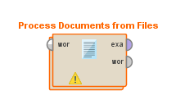
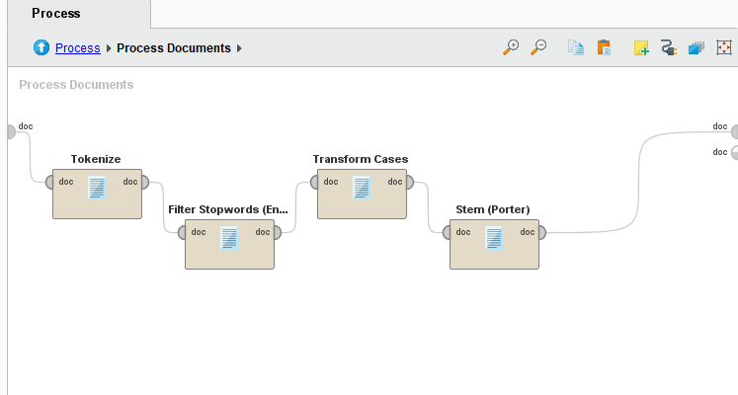
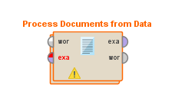
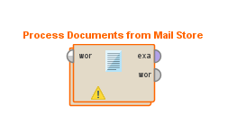
Preprocessing Operators in RapidMiner
To use the operators, you need to install the Text Processing Extension first.

Slide 15
2. Feature Generation
1. Bag-of-Words
2. Word Embeddings

Slide 16
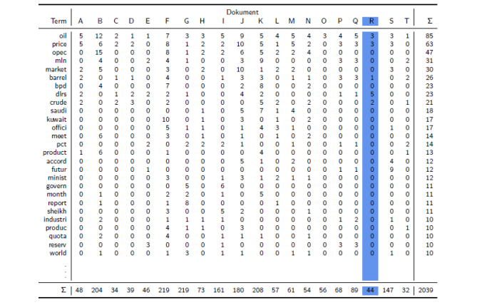
Bag-of-Words: The Term-Document Matrix

Slide 17
Bag-of-Words: Feature Generation
Document is treated as a bag of words (or terms)
Each word/term becomes a feature
Order of words/terms is ignored
Each document is represented by a vector

Slide 18
Techniques for vector creation
1. Binary Term Occurrence: Boolean attributes describe whether a term appears in the document
2. Term Occurrence: Number of occurrences of a term in the document (problematic if documents have different length)
3. Terms Frequency: Attributes represent the frequency in which a term appears in the document (number of occurrences / number of words in document)
4. TF-IDF

Slide 19
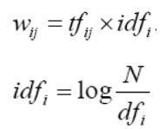
The TF-IDF Term Weighting Scheme
The TF-IDF weight (term frequency–inverse document frequency) is used to evaluate how important a word is to a corpus of documents.
TF: Term Frequency
IDF: Inverse Document Frequency
N: total number of docs in corpus
dfi: the number of docs in which ti appears
It gives more weight to rare words.
It give less weight to common words (domain-specific stopwords).

Slide 20
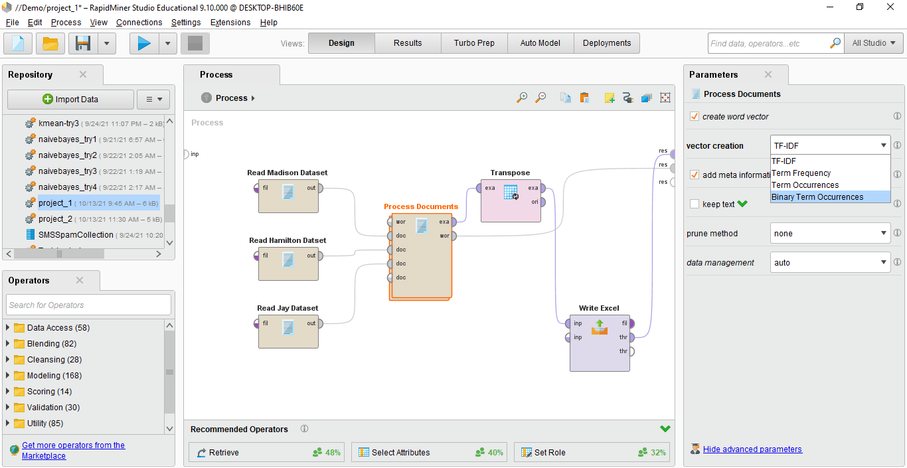
Feature Generation in RapidMiner

Slide 21
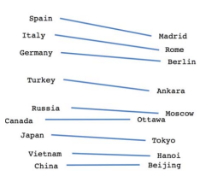
Word Embeddings
Embeddings represent words not as a single number in a word vector but represent each word as a vector of real numbers (distributed representation)
Embeddings are chosen in a way that semantically related words end up at similar locations in the vector space

Slide 22
Pruning Document Vectors in RapidMiner
Prune methods: specify if and how too frequent or too infrequent words should be ignored.
1. Percentual : ignore words that appear in less / more than this percentage of all documents.
2. Absolute: ignore words that appear in less / more than that many documents.
3. By Rank: specifies how many percent of the most frequent / infrequent words are ignored.

Slide 23
Filter Tokens by POS Tags
POS tagging may be helpful for feature selection
Sometimes you want to focus on certain classes of words:
– Adjectives (JJ.) for sentiment analysis : good, bad, great
– Nouns (N.) for text clustering

Slide 24
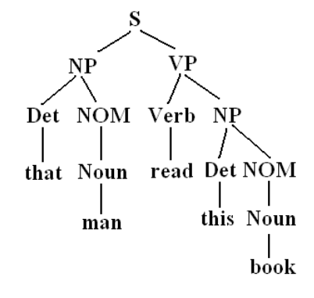
Filter Tokens by POS Tags (RapidMiner supports)
PENN tag system for English
STTS tag system for German
Filtering conditions are expressed as regular expressions

Slide 25
5. Pattern Discovery
Methods:
1. Cluster Analysis
2. Classification
3. Association Analysis

Slide 26
5.1 Document Clustering
Goal:
Given a set of documents and a similarity measure among documents find clusters such that:
documents in one cluster are more similar to one another
documents in separate clusters are less similar to one another

Slide 27
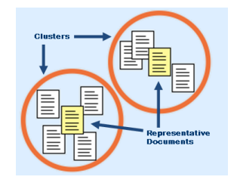
5.1 Document Clustering Applications
Topical clustering of news stories
Email message thread identification

Slide 28
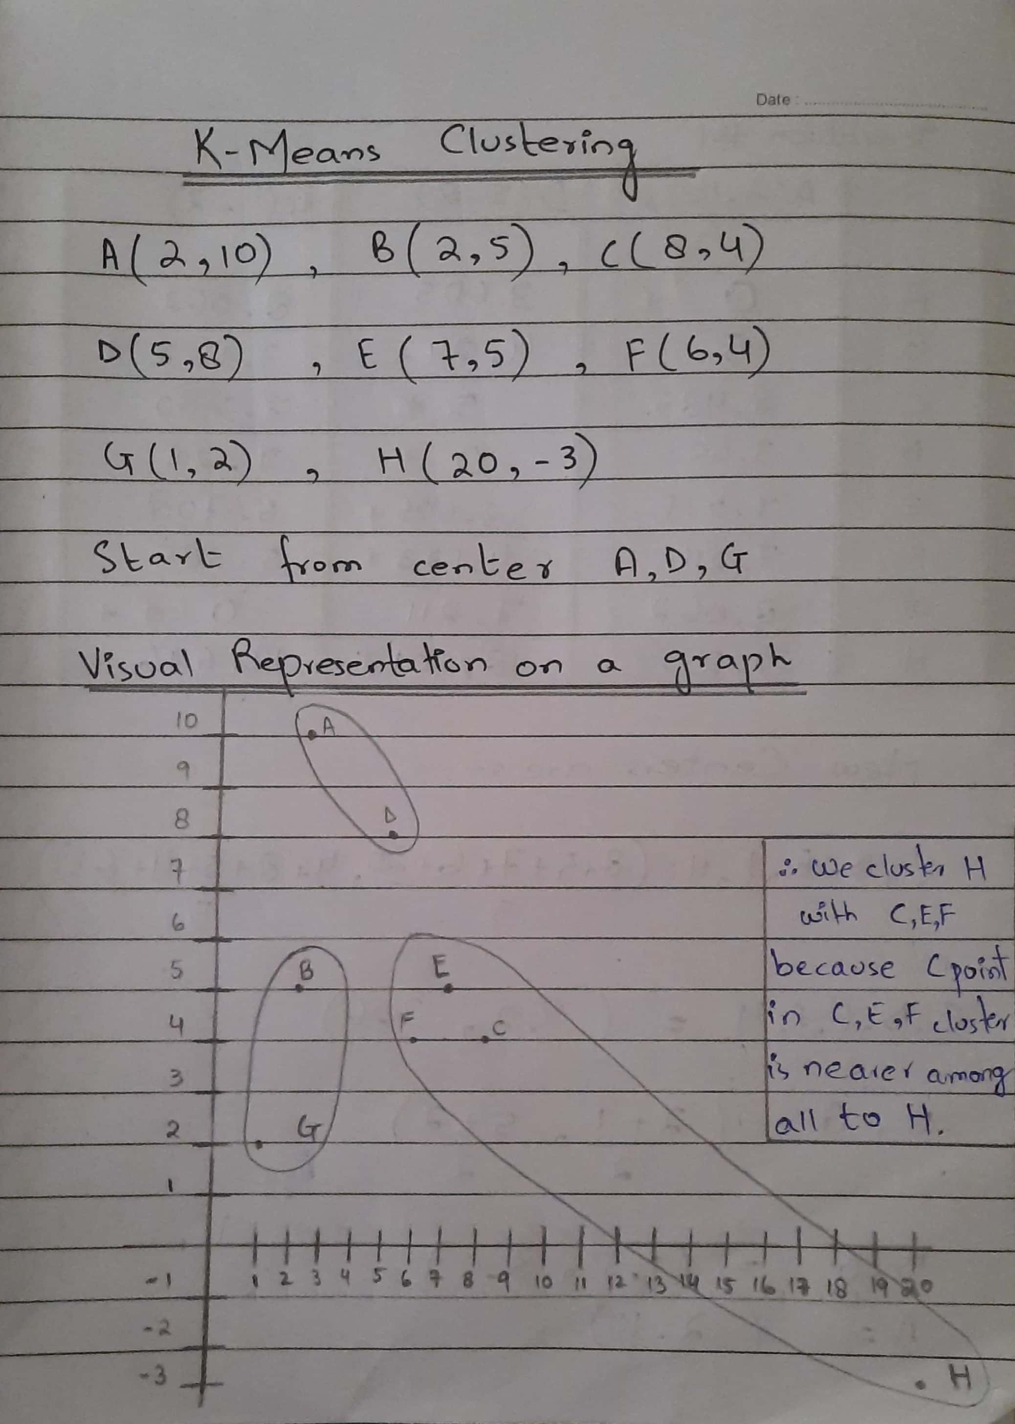
5.1 Document Clustering Example

Slide 29
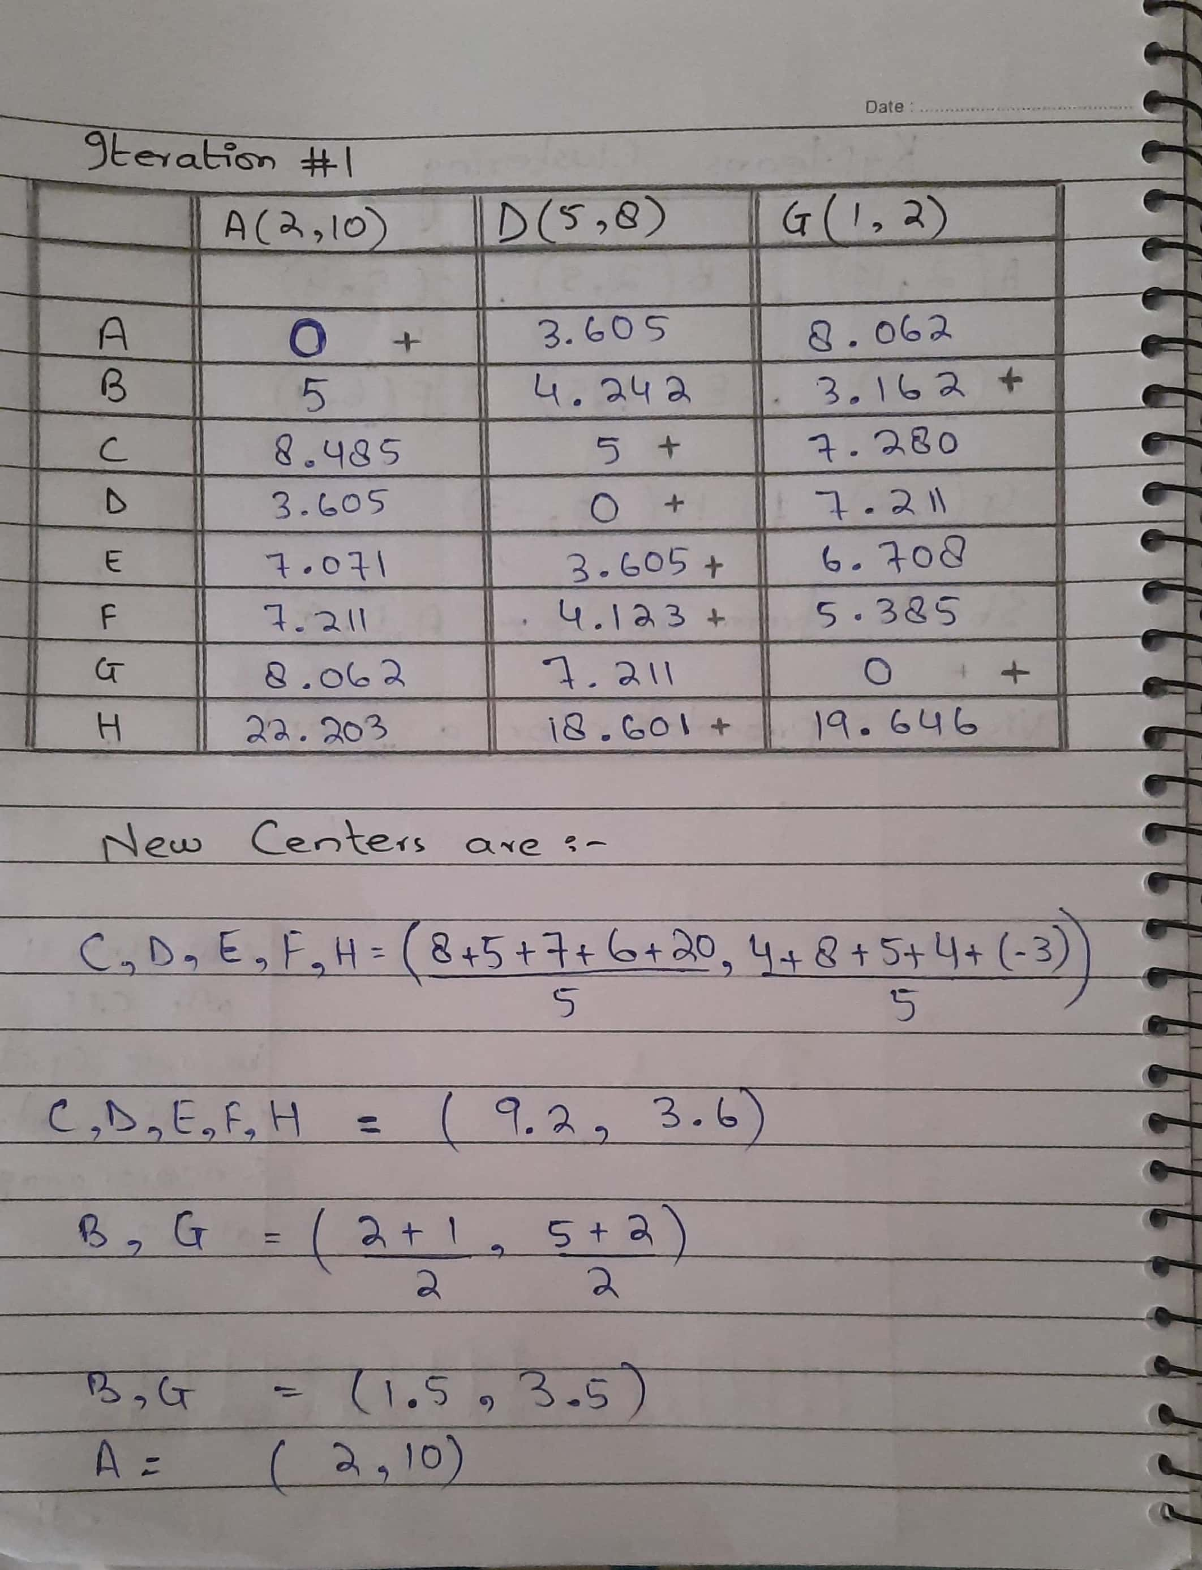
5.1 Document Clustering Example

Slide 30
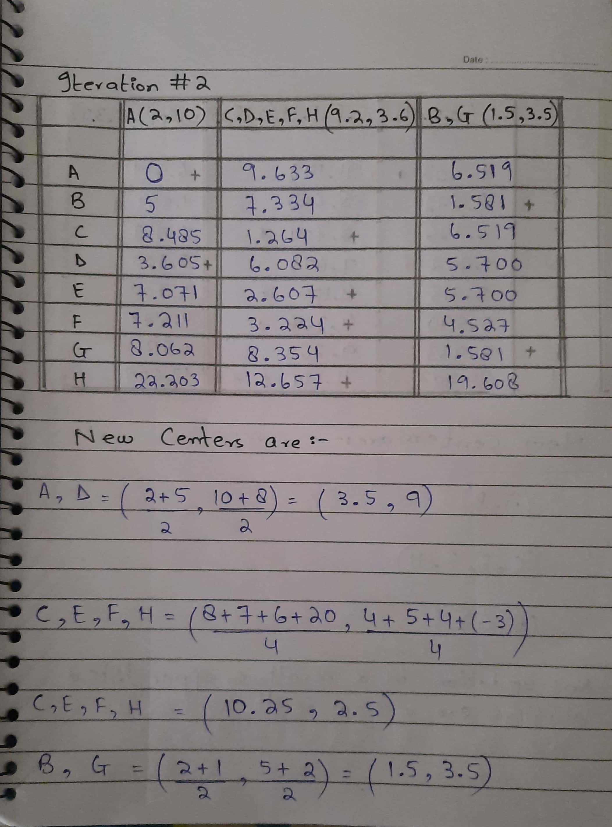
5.1 Document Clustering Example

Slide 31
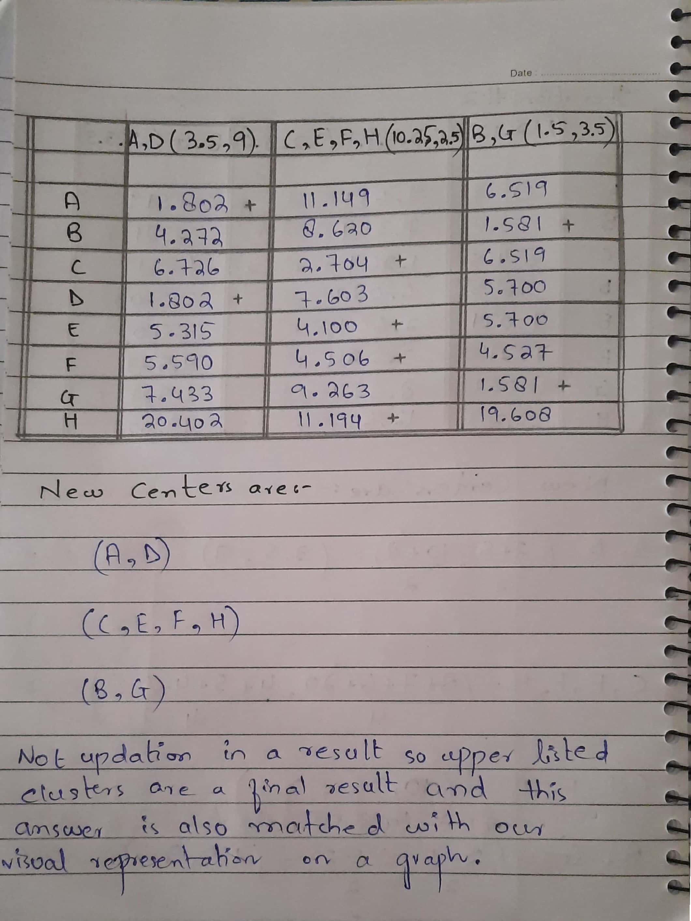
5.1 Document Clustering Example

Slide 32
5.2 Document Classification
Given: A collection of labeled documents (training set).
Find: A model for the class as a function of the values of the features.
Goal: Previously unseen documents should be assigned a class as accurately as possible.

Slide 33
5.2 Document Classification (Applications)
Topical classification of news stories or web pages
SPAM detection
Sentiment analysis

Slide 34
5.2 Document Classification methods commonly used for Text
1. Naive Bayes
2. Support Vector Machines
3. Recurrent Neural Networks, Long Short-term Memory
4. KNN or random forests may also work

Slide 35
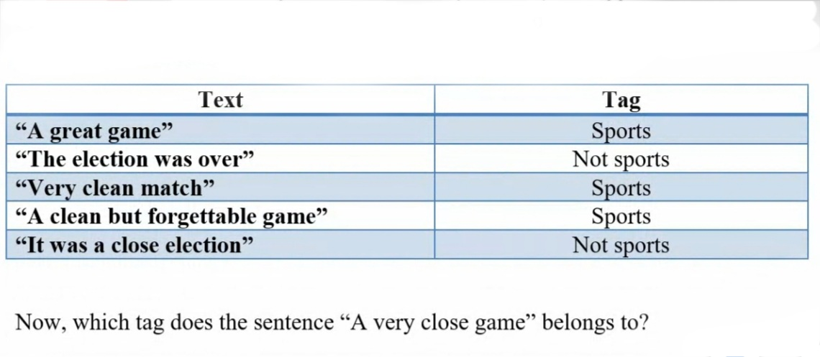
5.2 Document Classification Example

Slide 36
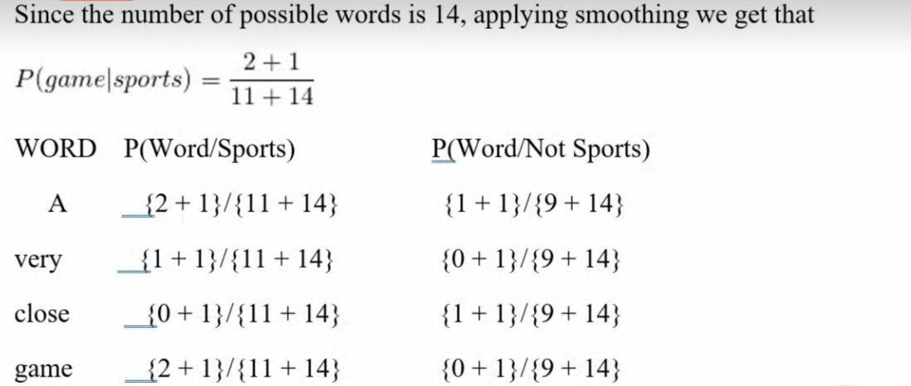
5.2 Document Classification Example

Slide 37
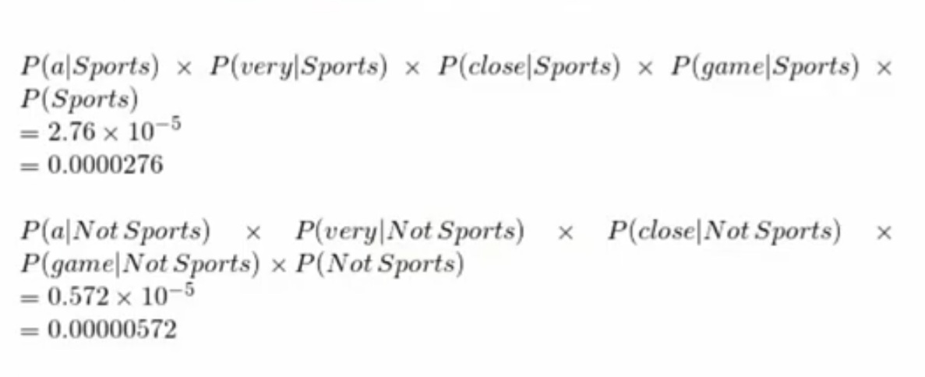
5.2 Document Classification Example

Slide 38
Text Mining on Rapid Miner (Example)
Imagine if you have multiple documents and you want to see how many times this particular word appears in this multiple documents you can do this by text analysis.

Slide 39
Text Mining on Rapid Miner Example (Datasets)

Slide 40
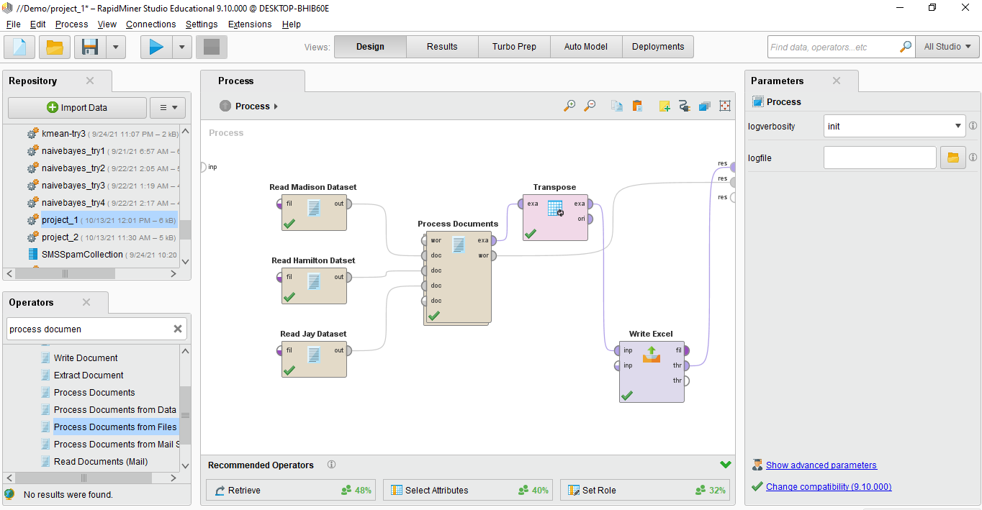
Text Mining on Rapid Miner Example

Slide 41
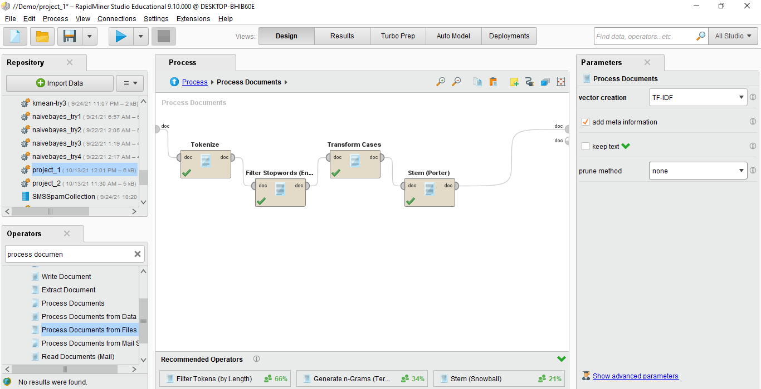
Text Mining on Rapid Miner Example

Slide 42
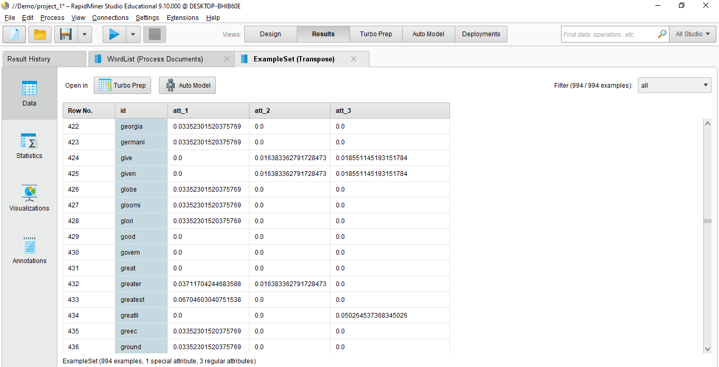
Text Mining on Rapid Miner Example

Slide 43
Summary
1. Main challenge in text mining: Preprocessing of text
- In order to be able to apply well known Data Mining algorithms.
There are lots of alternative preprocessing techniques
- Thus, you need to experiment in order to find out which work well for your use case.

