Slide 1

GAME THEORY IN NETWORKING
PRESENTED BY :
SHIVANI GARG
VANDNA
NIT KURUKSHETRA

Slide 2

OUTLINE
Introduction
Classification of games
Solving and analyzing a game
Game theory in networking
Layered perspective
Conclusion
NIT KURUKSHETRA

Slide 3
GAME THEORY
Game theory is a mathematical method for predicting human behaviour in strategic, multi-player situations.
Game theory assumes that each player forms rational beliefs about what other players (associates) in the game will do and then chooses a response to those strategies that maximizes its own payoffs.
NIT KURUKSHETRA

Slide 4
CLASSIFICATION OF GAMES
Non-Cooperative (Competitive) Games: (individualized play, no bindings among players)
Cooperative Games: (play as a group, possible bindings)
NIT KURUKSHETRA

Slide 5



COMPONENTS OF GAME
A Game consists of:
  at least two players
  a set of strategies for each player
  a preference relation over possible outcomes
Player is general entity:
  individual, company, nation, protocol, animal, etc
NIT KURUKSHETRA

Slide 6

Cont...
Strategies:
  actions which a player chooses to follow
Outcome:
  determined by mutual choice of strategies
Preference relation:
  modeled as utility (payoff) over set of outcomes
NIT KURUKSHETRA

Slide 7

GAME OF CARS
Analysis of situations when two cars are approaching to each other.
2
2
NIT KURUKSHETRA

Slide 8
Cont… Possible results are…:
GREEN | RED | RESULT
Go straight | Go straight | They Crash
Go straight | Swerves | Green is happy he wins, Red is sad he loses
Swerves(Turn) | Go straight | Green is sad he loses, Red is happy he wins
Swerves | Swerves | They stare at each other shocked at what they've done
NIT KURUKSHETRA

Slide 9
GAME MATRIX
RED
Swerves Go straight
GREEN
Swerves
Go straight
0,0 | (Nash Equilibria) -1,5 (Probability distribution)
(Nash Equilibria) 5,-1 (Best response, probability distribution) | -10,-10 (Best response)
NIT KURUKSHETRA

Slide 10
ANALYSING THE GAME
Dominance rule(strict dominance)
Saddle point(weak dominance)
Best response(non-cooperative)
Checking for Nash equilibrium
Probability distribution(assuming probability of each strategy is 1/2)
NIT KURUKSHETRA

Slide 11
GAME THEORY IN NETWORKING
Many games are played over networks, in the sense that players interact with others linked to them through a network-like structure.
Alternatively, in several important games, the actions of players correspond to a path in a given network.
The most important examples are choosing a route in a traffic problem or in a data routing problem.
Finally, the formation of networks is typically a game-theoretic (strategic) problem.
NIT KURUKSHETRA

Slide 12
ANALOGY
Game Component | Entities in network
Players | Network nodes, service providers or customers
Resources | spectrum, power, bandwidth , income etc.
Strategies | A decision regarding a certain action of the player, depending on the application field (forward packet, set power level, accept new request, etc.)
Payoffs | Estimated by utility functions, based on QoS merits (delay, throughput, SNR, etc.)
NIT KURUKSHETRA

Slide 13
LAYERED PERSPECTIVE
PRODUCER AND CONSUMER
FORWARDER’S DILEMMA
JOINT PACKET FORWARDING
MULTIPLE ACCESS GAME
JAMMING GAME
UPPER LAYERS
TRANSPORT LAYER
NETWORKING LAYER
DATA LINK LAYER
PHYSICAL LAYER
NIT KURUKSHETRA

Slide 14
PHYSICAL LAYER
From a physical layer perspective, performance is generally a function of the estimated signal-to-interference and-noise ratio (SINR) that players/nodes receive, a physical layer interactive decision making process occurs.
In this frame, game theory can be applied to allocation problems concerning resources such as power or spectrum.
NIT KURUKSHETRA

Slide 15
Cont…
Here we formulate a non-cooperative frequency control FDMA system.
Simplified version of this model is jamming game. It’s a zero sum game with mix strategy Nash equilibrium.
NIT KURUKSHETRA

Slide 16
JAMMING GAME
NIT KURUKSHETRA

Slide 17

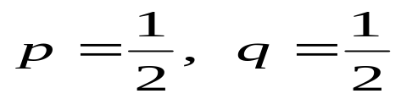
transmitter
transmitter:
reward for successful
transmission: 1
loss for jammed transmission: -1
jammer:
reward for successful
jamming: 1
loss for missed jamming: -1
two channels:
C₁ and C₂
jammer
Green
Blue
C_{1 (q)}
C_{2(1-q)}
C_{1(p)}
(-1, 1) | (1, -1) NE
(1, -1) NE | (-1, 1)
C_{2(1-p)}
p: prob. of transmit on C₁ for Blue
There is no pure-strategy Nash equilibrium
q: prob. of transmit on C₁ for Green
is a Nash equilibrium
NIT KURUKSHETRA
<number>/37

Slide 18
DATA LINK LAYER
Game theory applications regarding the data link layer involve the medium access control problem.
In these games, selfish users seek to maximize their utility by obtaining an unfair share of access to the channel.
NIT KURUKSHETRA

Slide 19
MULTIPLE ACCESS GAME
Time-division channel
Green
Reward for successful
transmission: 1
Cost of transmission: c
(0 < c << 1)
Blue
Quit
Transmit
Quit
(0, 0) | (0, 1-c)
(1-c, 0) | (-c, -c)
Transmit
No strict dominance and two Nash equilibrium
NIT KURUKSHETRA
Here comes your footer  Page <number>
B.2 Static games
<number>/37

Slide 20
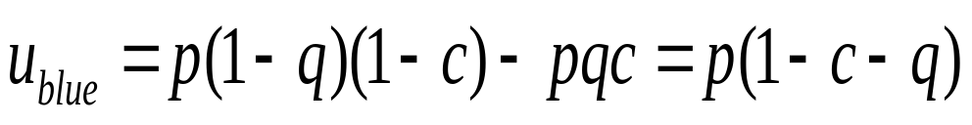
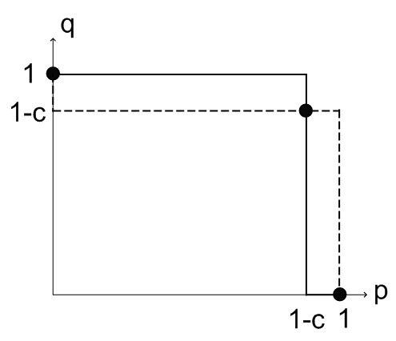
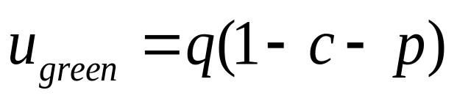
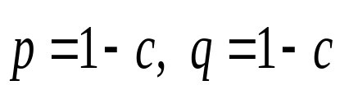
Mixed strategy Nash equilibrium
p: probability of transmit for Blue
q: probability of transmit for Green
is a Nash equilibrium
NIT KURUKSHETRA
<number>/37

Slide 21
NETWORKING LAYER
It does establishment of routes and the forwarding of packets along those routes.
Game theory may be applied to aid a node in determining which the optimal route is or deciding whether it should forward a received packet or not.
NIT KURUKSHETRA

Slide 22
The Forwarder’s Dilemma
Blue
Green
The Forwarder’s Dilemma is a symmetric nonzero-sum game, because the players can mutually increase their payoffs by cooperating.
<number>/37
NIT KURUKSHETRA

Slide 23
JOINT PACKET FORWARDING GAME
Blue
Green
It is based on selecting optimal among multiple equilibrium points.
NIT KURUKSHETRA
<number>/37

Slide 24
Cont…
Green
No solution possible!!
Blue
Forward
Drop
E1: The Forwarder’s Dilemma
(1-c,1-c) | (-c, 1)
(1, -c) | (0, 0) NE
Forward
Drop
Green
Optimal solution
Blue
Forward
Drop
E2: The Joint Packet Forwarding game
Forward
(1-c,1-c) | (-c, 0)
(0, -c) | (0, 0)
Drop
NIT KURUKSHETRA

Slide 25
TRANSPORT LAYER
At the transport layer, game-theoretic models have been mainly developed to analyze the effectiveness of congestion control .
Congestion avoidance control refers to controlling the load of the network by restricting the admission of new user’s sessions and resolving the unwanted overload situations.
NIT KURUKSHETRA

Slide 26
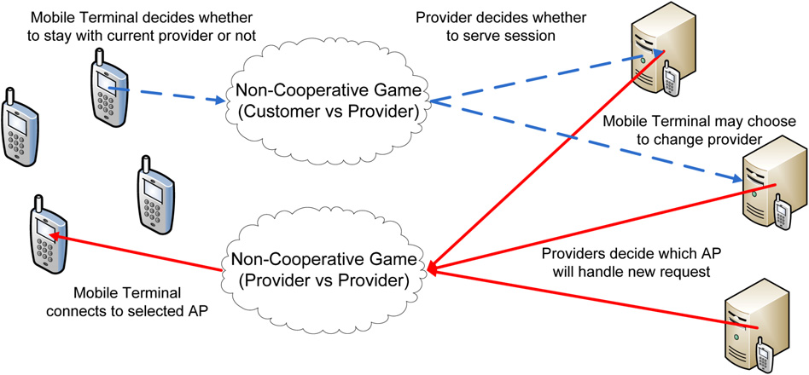
ADMISSION CONTROL
NIT KURUKSHETRA

Slide 27
LIMITATIONS
Assumption of rationality
Assumption of willingness to cooperate
Not guaranteed existence of equilibrium
NIT KURUKSHETRA

Slide 28
CONCLUSION
Game theory is a concept and a fascinating tool which we can integrate to our own study of real life situation.
It helps in optimal decision making considering individual and collective interests.Thus game theory has a strong role to play in the development and analysis of protocols.
NIT KURUKSHETRA

Slide 29
Thank You!!
NIT KURUKSHETRA

