Slide 1

CRYPTOGRAPHY
SUBMITTED BY :
SHIVANI GARG(110137-co3)
BHAVIKA MIGLANI(110223-co3)

Slide 2
BASICS
Meaning : “secret writing”
Definition :
Cryptography is the art or science encompassing the principles and methods of transforming message an intelligible into one that is unintelligible, and then retransforming that message back to its original form.

Slide 3
OBJECTIVES
Confidentiality: only sender, intended receiver should “understand” message contents
Authentication: sender, receiver want to confirm identity of each other
Message integrity: sender, receiver want to ensure message not altered (in transit, or afterwards) without detection
Access and availability: services must be accessible and available to users within required time.

Slide 4
BASIC TERMINOLOGY
Plaintext
The original intelligible message
Ciphertext
The transformed message
Cipher
An algorithm for transforming an intelligible message into one that is unintelligible by transposition and/or substitution methods
Key
Some critical information used by the cipher, known only to the sender & receiver

Slide 5



THE LANGUAGE OF CRYTOGRAPHY
Alice’s
encryption
key
Bob’s
decryption
key
K
K
A
B
plaintext
encryption
algorithm
ciphertext
decryption
algorithm
plaintext
m plaintext message
K_{A}(m) ciphertext, encrypted with key K_{A}
m = K_{B}(K_{A}(m))

Slide 6
CONTINUED
KERCHOFF’s PRINCIPLE :
All algorithms must be public; only the keys are secret.

Slide 7
PRINCIPLES OF CRYPTOGRAPHY
Redundancy: Messages must contain some redundancy.
Freshness : Some method is needed to foil replay attacks.

Slide 8
TYPES OF CRYPTOGRAPHY
SYMMETRIC
(sharing
secrecy)
ASYMMETRIC
(personal
secrecy)

Slide 9
ONE-TIME PADS
One of the goals of cryptography is perfect secrecy. A study by Shannon has shown that perfect secrecy can be achieved if each plaintext symbol is encrypted with a key randomly chosen from a key domain. This idea is used in a cipher called one-time pad, invented by Vernam.

Slide 10
QUANTUM CRYPTOGRAPHY
In 1984, Bennett and Brassard describe how the quantum money idea with its basis {0,1} can be used in quantum key distribution protocol.

Slide 11
BB84 PROTOCOL
Alice and Bob are connected by a quantum communication channel which allows quantum states to be transmitted.
In addition they communicate via a public classical channel.
This protocol encodes the information in pair of non-orthogonal states.
The usual polarization state pairs used are either the rectilinear basis of vertical (0°) and horizontal (90°), the diagonal basis of 45° and 135°(-45).

Slide 12
BB84 PROTOCOL CONTINUED
Alice creates a random bit (0 or 1) and then randomly selects one of her two basis to transmit it in.
She then prepares a photon polarization state depending both on the bit value and basis.
Alice then transmits a single photon in the state specified to Bob, using the quantum channel.
This process is then repeated.
Bob does not know the basis the photons were encoded in, so select a basis at random to measure in.
After receiving all photons Bob communicate Alice on public channel.
Alice broadcasts the basis each photon was sent in, and Bob the basis each was measured in.

Slide 13

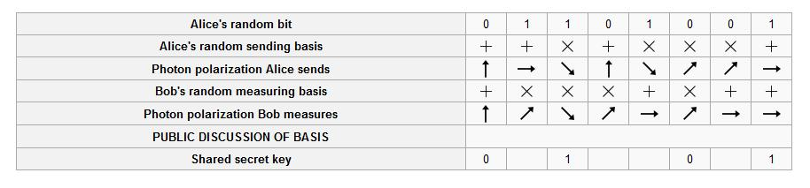
BB84 PROTOCOL CONTINUED

Slide 14
CONTINUED
To check for the presence of eavesdropping Alice and Bob now compare a certain subset of their remaining bit strings.
If a third party (Eve) has gained any information about the photons' polarization, this will have introduced errors in Bobs' measurements.
If more than p bits differ they abort the key and try again.

Slide 15
PUBLIC KEY CRYPTOGRAPHY
sender, receiver do not share secret key
public encryption key known to all
private decryption key known only to receiver
Encryption and decryption algorithms are same.
E(k_private, E(k_public, M)) =
E(k_public, E(k_private, M)) = M

Slide 16
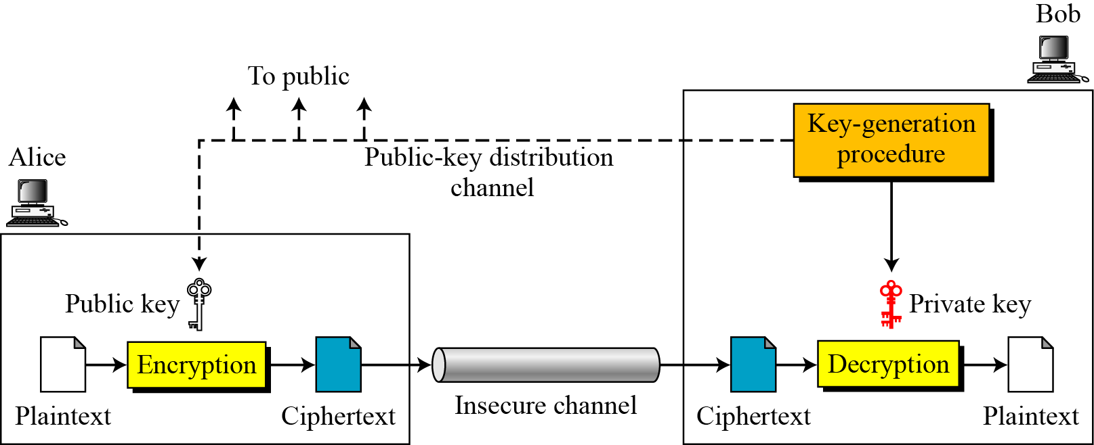
CONTINUED

Slide 17
DIGITAL SIGNATURE
A Digital Signature is a data item that vouches the origin and the integrity of a Message over the network.
DIGI_SIG = f(Signer, message)
Digital Signature is a digest of the message encrypted with the signer’s private key.
Receiver now gets original message + Digital Signature.
Original
Message
Hash
Function
Digital
Signature
Hash result encrypted with K_private

Slide 18
DIGITAL CERTIFICATE
It is like an identity document of a sender.
for example- passport, birth certificate etc.
A Digital Certificate is a binding between an entity’s public key and one or more attributes relating its identity.

Slide 19
CONTINUED

Slide 20
PUBLIC KEY INFRASTRUCTURE
A Public Key Infrastructure is an Infrastructure
to support and manage Public Key-based
Digital Certificates.

Slide 21
X509 PKI – Technical View
Basic Components:
Certificate Authority (CA)
Registration Authority (RA)
Certificate Distribution System
PKI enabled applications
“Provider”
Side
“Consumer”
Side

Slide 22
8509 PKI – SIMPLE MODEL
Certification
Entity
CA
Cert. Request
RA
Signed Certificate
Internet
Certs,
CRLs
Local
Person
Remote
Person

Slide 23
THANK YOU

