Slide 1
BALL FOLLOWING BOT

Slide 2
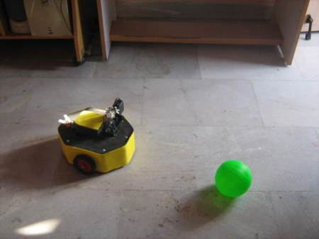

Slide 3
WHAT ARE WE DOING??
A ROBOT WHICH TRACKS THE POSITION OF THE BALL AND ORIENTS ITSELF ACCORDINGLY.

Slide 4
Why ARE WE DOING??
LEARN IMAGE PROCESSING
SPEND THE SUMMER HOLIDAYS FRUITFULLY

Slide 5
HOW ARE WE DOING ???
WEBCAM PLACED AERIALLY TO RECORD THE MOTION OF THE BALL AND THE ROBOT .
SEND THE RECORDED VIDEO TO A COMPUTER.
MATLAB- USING THE IMAGE ACQUISITION TOOLS AVAILABLE IN-BUILT AND PROCESS THE OBTAINED VIDEO
USE A USB TO SERIAL AND COMMUNICATE WITH THE BOT WITH THE HELP OF A MICRO CONTROLLER.

Slide 6
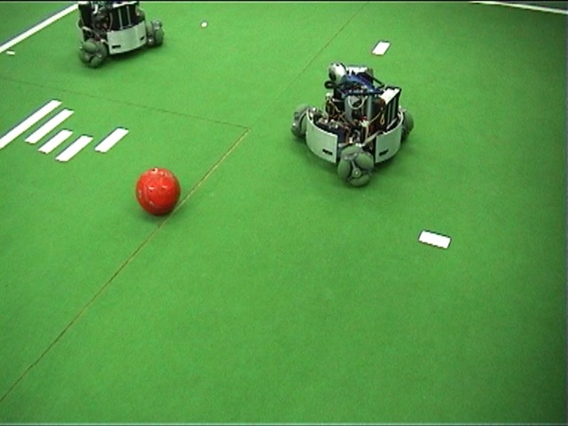

Slide 7
THE SPECIFICS

Slide 8
COMPONENTS REQUIRED
WEBCAM
ATMEGA 16 MICRO CONTROLLER
USB TO SERIAL CONVERTER
WIRES
BREAD BOARD
MOTORS
CASTORS

Slide 9
TIME LINE OF WORK
LEVEL 1:
- MAJOR AIM – TO GET THOROUGH WITH THE CONCEPTS OF MAT LAB AND ITS IMAGE ACQUISITION TOOLS
TIME ALLOTED FOR COMPLETION : 1 WEEK

Slide 10
LEVEL 2:
MAJOR AIM – TO COMPLETE THE MECHANICAL STRUCTUE OF THE ROBOT.
TIME ALLOTED FOR COMPLETION- 1-2 DAYS.

Slide 11
LEVEL 3:
MAJOR AIM: BASIC IMAGE PROCESING TESTS BY DETECTING OBJECTS.
DETAILS : TRY TO DETECT A PARTICULAR OBJECT BY PROCESSING THE DIFFERENT FRAMES OBTAINED.
TIME ALLOTED FOR COMPLETION : 2-3 DAYS

Slide 12
LEVEL 4:
-MAJOR AIM : COMMUNICATION OF THE WEBCAM WITH THE COMPUTER.
-DETAILS: GIVING GUI OUTPUTS ON COMPUTER SCREENS BASED ON MOVEMENT OF THE IDENTIFIED OBJECT.
- TIME ALLOTED FOR COMPLETION : 2-3 DAYS

Slide 13
LEVEL 5:
MAJOR AIM : ESTABLISH CONNECTION BETWEEN THE COMPUTER AND MICRO CONTROLLER.
DETAILS : TO TRANSFER DATA USING THE USB TO SERIAL CONVERTER.
TIME ALLOTED FOR COMPLETION: 1 WEEK

Slide 14
LEVEL 6: THE STEP FOR PUTTING BITS AND PIECES TOGETHER
-MAJOR AIM : TO PUT TOGETHER THE ABOVE THINGS
- TIME ALLOTED FOR COMPLETION 2 DAYS

Slide 15
Work distribution
MAIN PART OF PROJECT – CODING FOR THE IMAGE PROCESSING
WORK DISTRIBUTION IS IN TERMS OF CODE DISTRIBUTION.
PARTS OF CODE WILL BE WRITTEN BY EACH PERSON.

Slide 16
BUDGET REQUIREMENTS
ITEMS | QUANTITY | ESTIMATED COST
WEBCAM | 1 | Rs.2,000.00
USB TO SERIAL CONVERTER | 1 | Rs.200.00
MICROCONTROLLER | 2 | Rs.500.00
BREAD BOARD | 1 | Rs.200.00
MOTORS | 2 | Rs.250.00
CASTORS | 1 | Rs.25.00
MISCELLANEOUS | NA | Rs.325.00
TOTAL COST | NA | Rs.3,500.00

Slide 17
Project members
-
- SAKETH BSV EE10B071 NARMADA
KARTHIK ABINAV CS10B057 ALAKANANDA
ARMAAN BRAR BT10B006 GANGA
VIVEK KUMAR BAGARIA EE10B047 GANGA

