Slide 1
Superstore Dashboard Overview
Created in Power BI as part of Data Analytics Internship Task 3

Slide 2
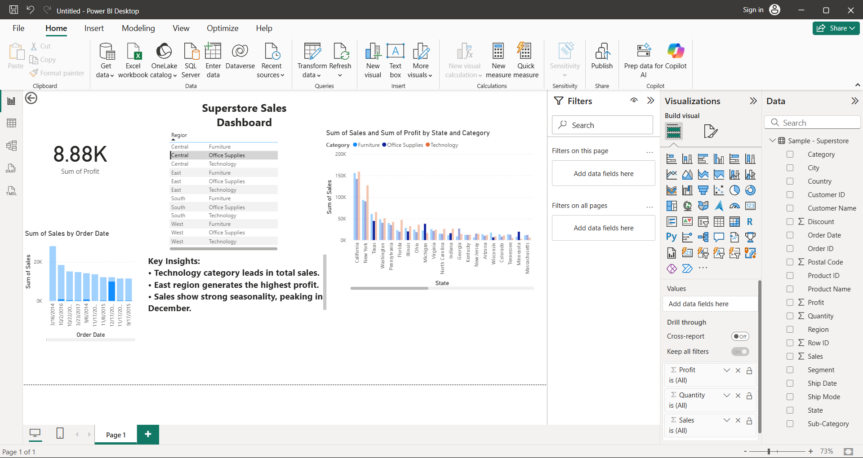

Slide 3
• Technology category generates the highest sales.
• East region contributes the most profit.
• Sales peak in December, showing seasonal patterns.
• Dashboard includes KPIs, charts, and clear storytelling visuals.

