Slide 1
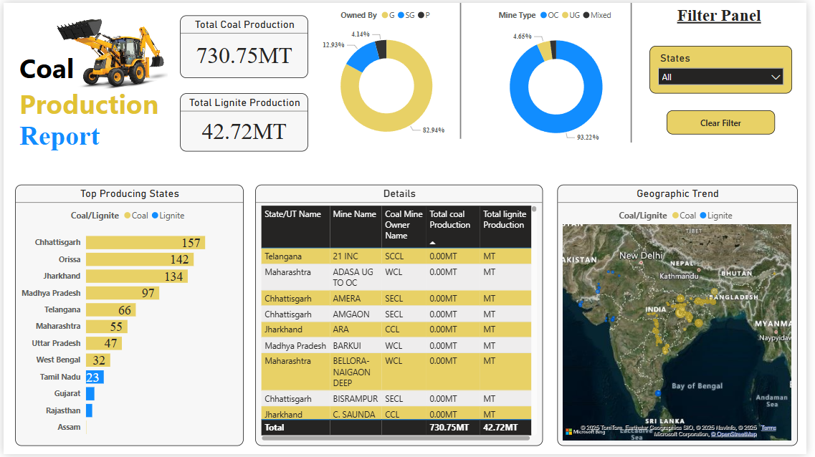
Coal Production in India – Dashboard Report

Slide 2
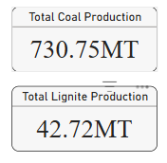
Key Production Metrics
• Total Coal Production: 730.75 MT
• Total Lignite Production: 42.72 MT
Insight:
Coal accounts for ~94.5% of the total mined material,
indicating dominance in Indian thermal resource extraction.

Slide 3
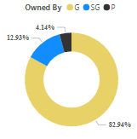
Ownership Distribution
Insight:
Government ownership dominates with 83% of mines,
showing strong public sector control.

Slide 4
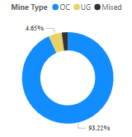
Mine Type Breakdown
Insight:
Open Cast (OC) mining accounts for over 93% of all production,
suggesting surface mining is the most efficient and widely used.

Slide 5
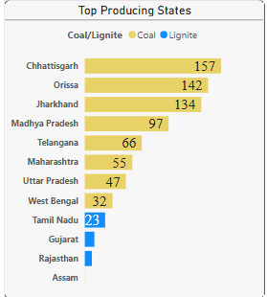
Top Producing States
Insight:
Chhattisgarh, Odisha, and Jharkhand are the top 3 contributors,
producing over 430 MT combined.
Tamil Nadu and Gujarat are primarily lignite producers.

Slide 6
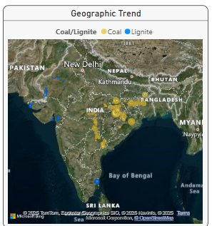
Geographic Trends
Insight:
Coal mining is concentrated in central and eastern India,
while Lignite is found mainly in Tamil Nadu and Gujarat.

Slide 7
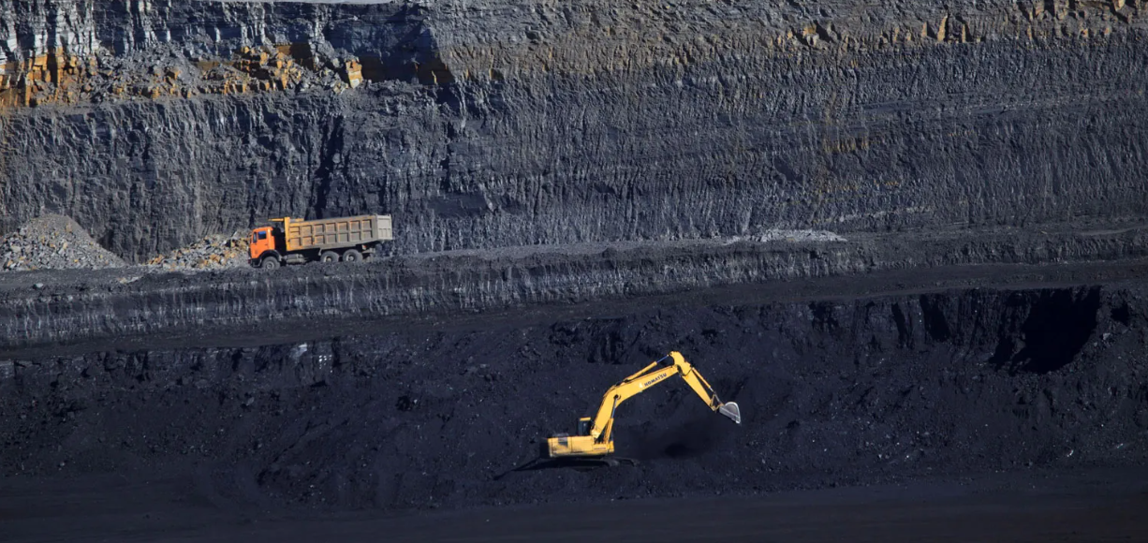
Conclusion & Recommendations
Key Takeaways:
• Government dominates coal production (83%).
• Surface mining (OC) is most common (~93%).
• Coal-rich states: Chhattisgarh, Odisha, Jharkhand.
• Lignite-rich states: Tamil Nadu, Gujarat.
Recommendations:
• Explore production potential in underutilized mines.
• Evaluate private sector engagement.
• Consider investing in UG mining modernization.

