Slide 1
Presentation
Karim, Bryan, Bryant

Slide 2
Project Scope
-The admin portal is part of a larger system in which internal employees are able to perform actions on behalf of company clients.
-The portal is the first step, essentially, in making changes because it provides a custom set of links based on which sort of administrator a user is. Employees with specific administrator roles will get an even larger set of
links from the normal “Global admin” role.
-The constraints for this application are that it is only accessible through the company network and employees must have the admin role to view available links. This portal allows employees to see available links and be redirected to those specific applications. The only function of the portal application is to allow users to login and then display the links.

Slide 3
Stuff Added In
Some stuff we added in: -Authentication tokens (using jsonwebtoken)
-jest for testing
-google material UI on our frontend
-hashing and salting passwords in the database using bcrypt
-typescript for rapid development
-reactjs
-mongodb
-atlas as a cloud provider for our database
-GroupMe
-skype

Slide 4
Software Development Model Adopted
Scrum
-The software can be continuously tested and get direct feedback from the customer
-Allowed project flexibility
-Scrum used to have the following:
--a self-organized team
--continuous testing
--continuous documentation
--have a backlog of existing needs
--ship and demo code at the end of every sprint
--we can take advantage of short daily meetings.
-Additionally, we can develop in small increments and get direct feedback from the customer
-App can be broken up (more efficient than agile)

Slide 5
Technologies, Frameworks, and Tools Used
FRAMEWORK:
-The application uses the MVC framework for several business and performance reasons.
TECH:
-MERN stack, which is simply MongoDB
-a noSQL database for easy and efficient storage
-Express Server
-web server framework for Node.js
-React.js, which is a component library for building frontends
-Node.js which is the base for Express and React. The Express server will then be the controller, while React is the presentation, and MongoDB the model.
-TOOLS:
--Node
--Node Package Manager
--a cloud host like Atlas to host the database
--Github
--GroupMe
--Skype

Slide 6





Solution Architecture
-The first page will be the login page. The data in this page will be the user input for username and password as well as the returned data on employee roles.
-Login page validates user inputs to the textboxes
-controller makes external request to an API for getting a particular user's role which will then be stored in the database.
-For the interface, the page will contain 2 textboxes with one for the username and one for the password, and a submit button that either successfully redirects to the next page or displays an error message.
-The second component will be the links page. This page will simply display the possible links to other applications that a user with a particular role can take. The data will be the links themselves and the role of the employee from the database.
-The logic of this component will be displaying certain links for certain roles concatenated with the global links and that clicking on a link will cause an http redirect to the specified web application.
-Another important part will be that clicking back on a browser should still display that component given that the role is still in the database storage. The interface will only be an unordered list of links under a title displaying the role of the user.

Slide 7
Testing Methodology (Show Word Doc)
-Testing will be done on each level, and then will be branched further out through the software as each piece is determined to have proper quality.
-What we mean by this is we test each small aspect before moving to the larger portions.
-This testing strategy is similar to smoke testing, each small portion of the project being tested can be thought of as an individual build, where each piece tested is the integrated together further.
-Lastly, our testing strategy was used to ensure the product is being built correctly and will be conducted alongside product guidelines.

Slide 8
Quality Measurement
-Targeted questions to ensure the project scope is being met.
-Ensure product conforms to set standards in order to be successful. If the product is developed with poor quality in mind, it can develop bugs even if they were not discovered upon initial testing.
-Fixing the issues that can pop up so the cost of time does not go up
-Effective project management and engineering practices

Slide 9
Maintenance Plan
-The software will be well documented so that further inspection is easier; this aided in any testing that required us to go back and fix an issue that came about.
-software made to show effective modularity and be well documented so that changes are quick, can be done by all members, and changes won’t break other aspects of the application.
-The application will be regularly maintained with bug fixes as they are reported and new features that are developed.
-Post-implementation and In-process reviews

Slide 10
Resource Plan/Roles
-This project used a three person team from UH, with one team member overseeing the frontend (bryan), one on the backend (Karim), and Maintenance (Bryant)
-The development environment only required using free versions of vendors like Atlas, for databases. -Other software tools include Github, VS Code, Postman, Skype, and Groupme.
-All individual components were designed from scratch besides the boilerplate and help of libraries like Express for Node, Mongoose for MongoDB, and create-react-app for React. Designing for abstraction allowed us to reuse these components when expanding the scope.

Slide 11

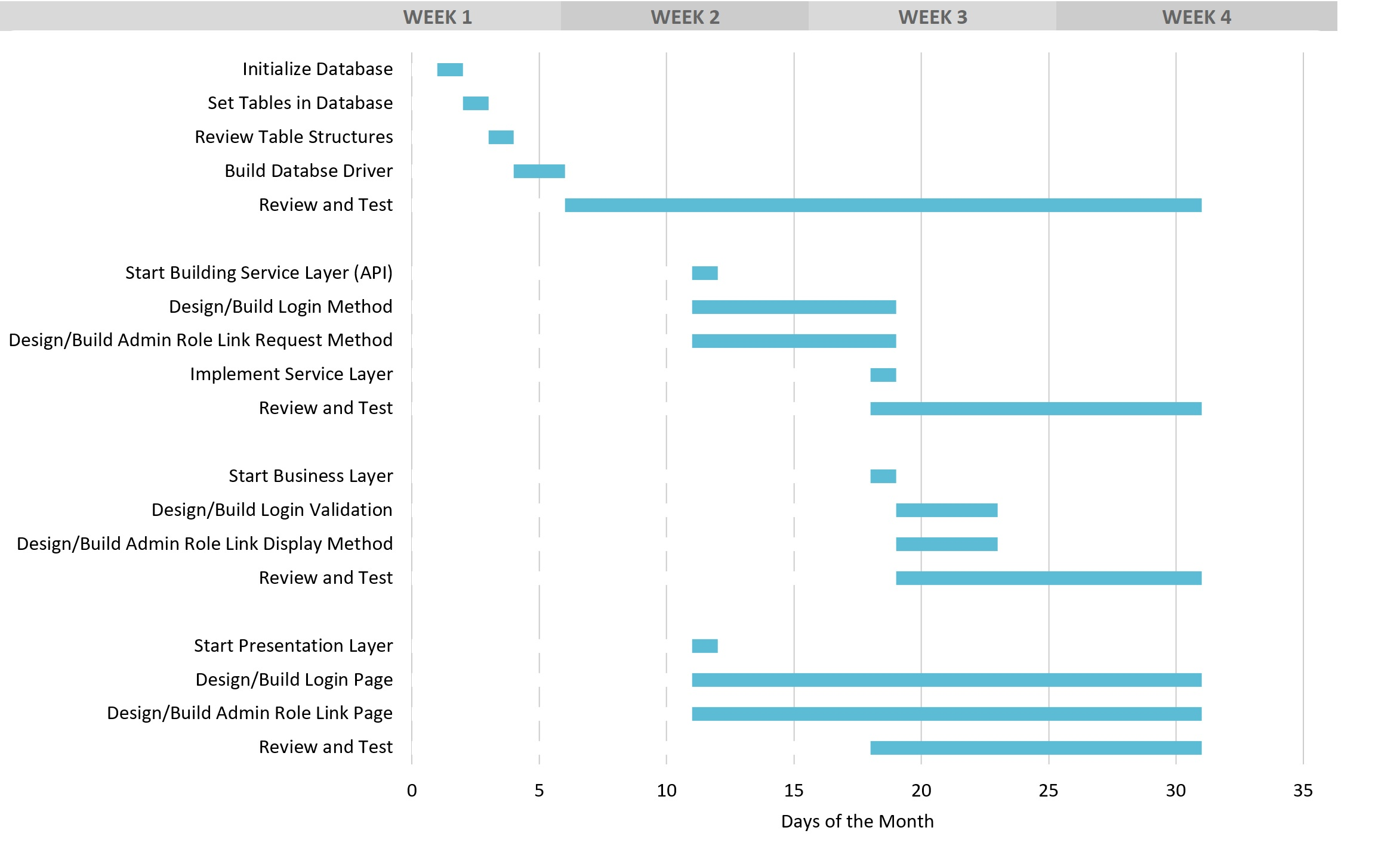
Project Schedule

Slide 12
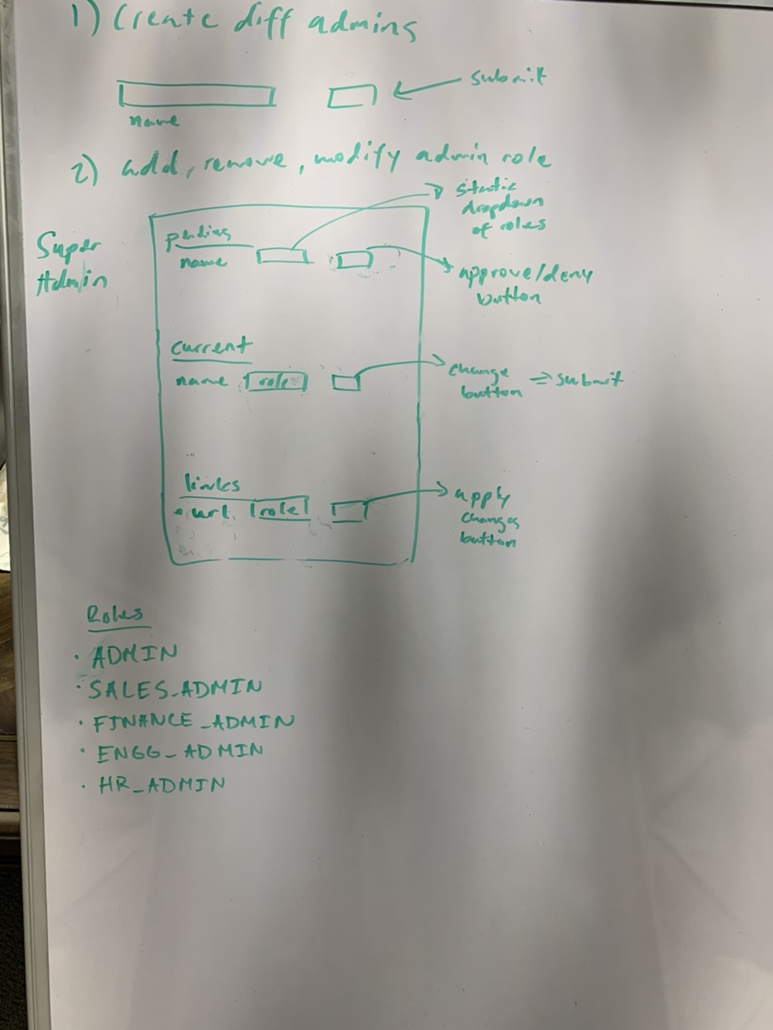
Front End Planning

