Slide 1


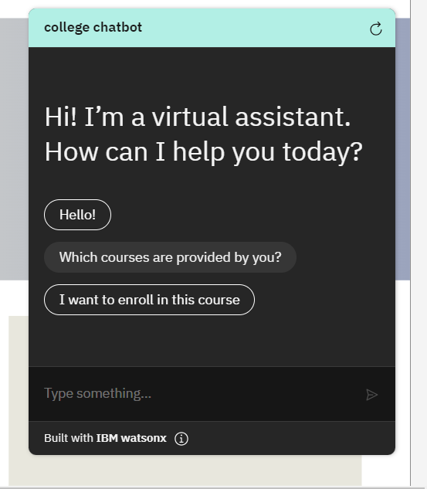
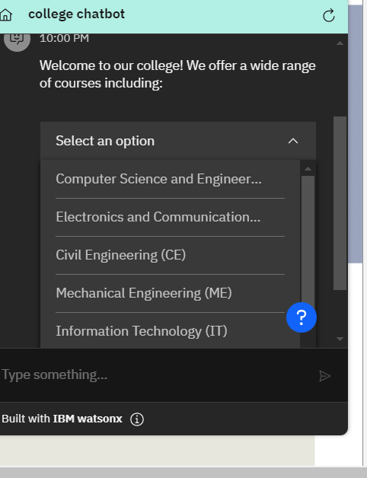
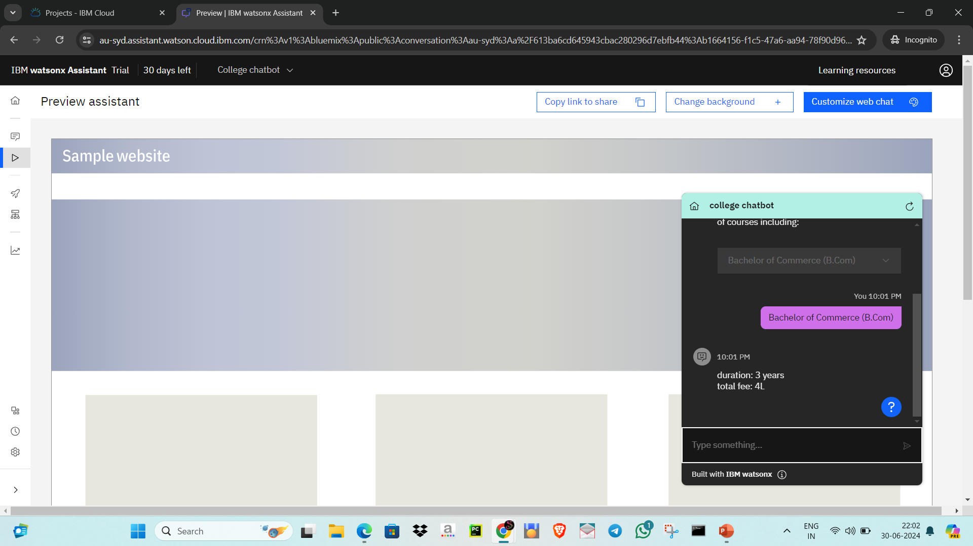
College chatbot
Add Your Professional Profile Photo Here
Program Feedback
Project Short Summary
In this program I’ve learnt lot of new things and gained knowledge
This project helps the students to access the college’s information system easily and efficiently
Syeed Shabana
syedshabana2003@gmail.com
Final Project Outcome Screenshot
Malla Reddy College of Engineering for Women
#skillsbuild

