Slide 1
Employee Data Analysis using Excel
STUDENT NAME: SHABANA PARVEEN.S
REGISTER NO: 122203100
DEPARTMENT: B.com (corporate secretaryship)
COLLEGE : Mahalashmi women's college of arts and science

Slide 2
PROJECT TITLE
Employee Performance Analysis using Excel

Slide 3


AGENDA
Problem Statement
Project Overview
End Users
Our Solution and Proposition
Dataset Description
Modelling Approach
Results and Discussion
Conclusion
3/21/2024 Annual Review

Slide 4

PROBLEM STATEMENT
Here is a problem statement in 50 words:
"Design a user-friendly and accessible online platform for students to share knowledge, resources, and ideas, fostering a collaborative learning environment and addressing the challenges of information overload, disorganization, and limited access to quality educational materials, ultimately enhancing academic performance and student success."

Slide 5

PROJECT OVERVIEW
Here is a project overview in 50 words:
"Develop an innovative online platform, 'EduShare', connecting students globally to share resources, ideas, and knowledge. Features include personalized learning dashboards, collaborative tools, and AI-driven content recommendations. Enhancing academic performance, accessibility, and student engagement, EduShare revolutionizes the education landscape, making quality learning materials accessible to all."
.

Slide 6

WHO ARE THE END USERS?
1. HRM
2.MARKETING FIELD
3. BANKS
4.INDUSTRIES
5.IT COMPANY

Slide 7

OUR SOLUTION AND ITS VALUE PROPOSITION
1.Conditional formatting
2.Filtering
3.Employee data
4.Formula used to identify performance level
5.pivot table for summarising
6.Bar gragh / pie chart

Slide 8
Dataset Description
Description:
This dataset helps organizations assess employee productivity, identify strengths and areas for improvement, and make data-driven decisions regarding promotions, raises, and training.
Features:
Position/Role: The job title or role of the employee.
Attendance Records: Data on employee attendance, including absences and tardiness.

Slide 9
MODELLING
1. SUMMERISING: Pivot table is created to summerise 2. Filter - Gender code 3. Column- performance level 4. Rows - Business unit 5.values- count of first name 6. Visualisation: Bar graph Pie chart
9

Slide 10

THE "WOW" IN OUR SOLUTION
=IFS(K2>=5,"very high",I8>=4,"high",K2>=3,"medium",true,"low")
3/21/2024 Annual Review
10

Slide 11
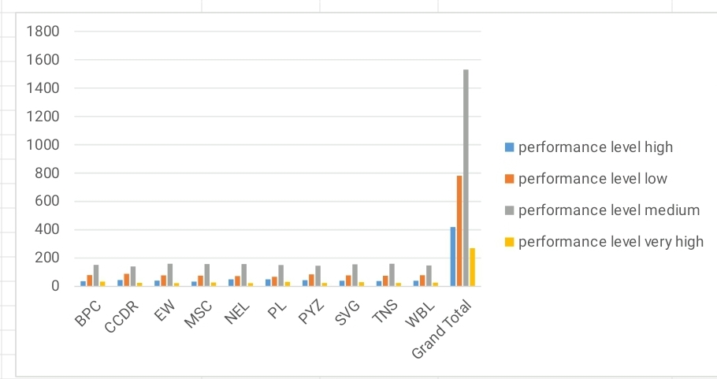
RESULTS
11

Slide 12
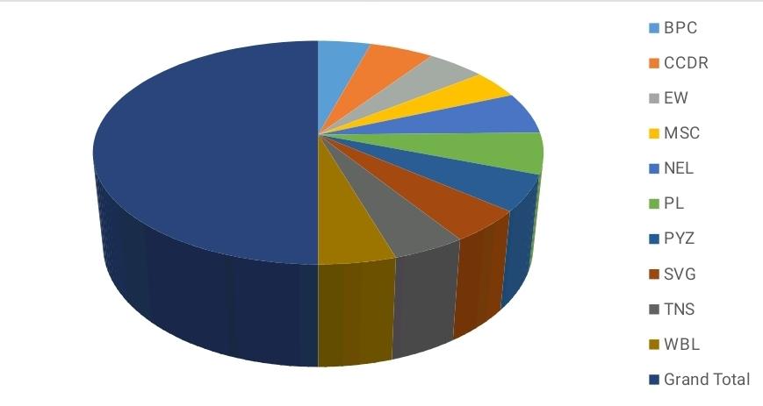
RESULTS

Slide 13
conclusion
Therefore the SVG business unit employees performs higher comparing to other units and whereas PL business unit performs lower comparing to other units. Hence the SVG business unit employees works more efficiently and effectively comparing to other units according to the employee data given.

