Slide 1
Quantum Masters
Alex - Ashkan - Elena - Esther -Eva - Lucy

Slide 2
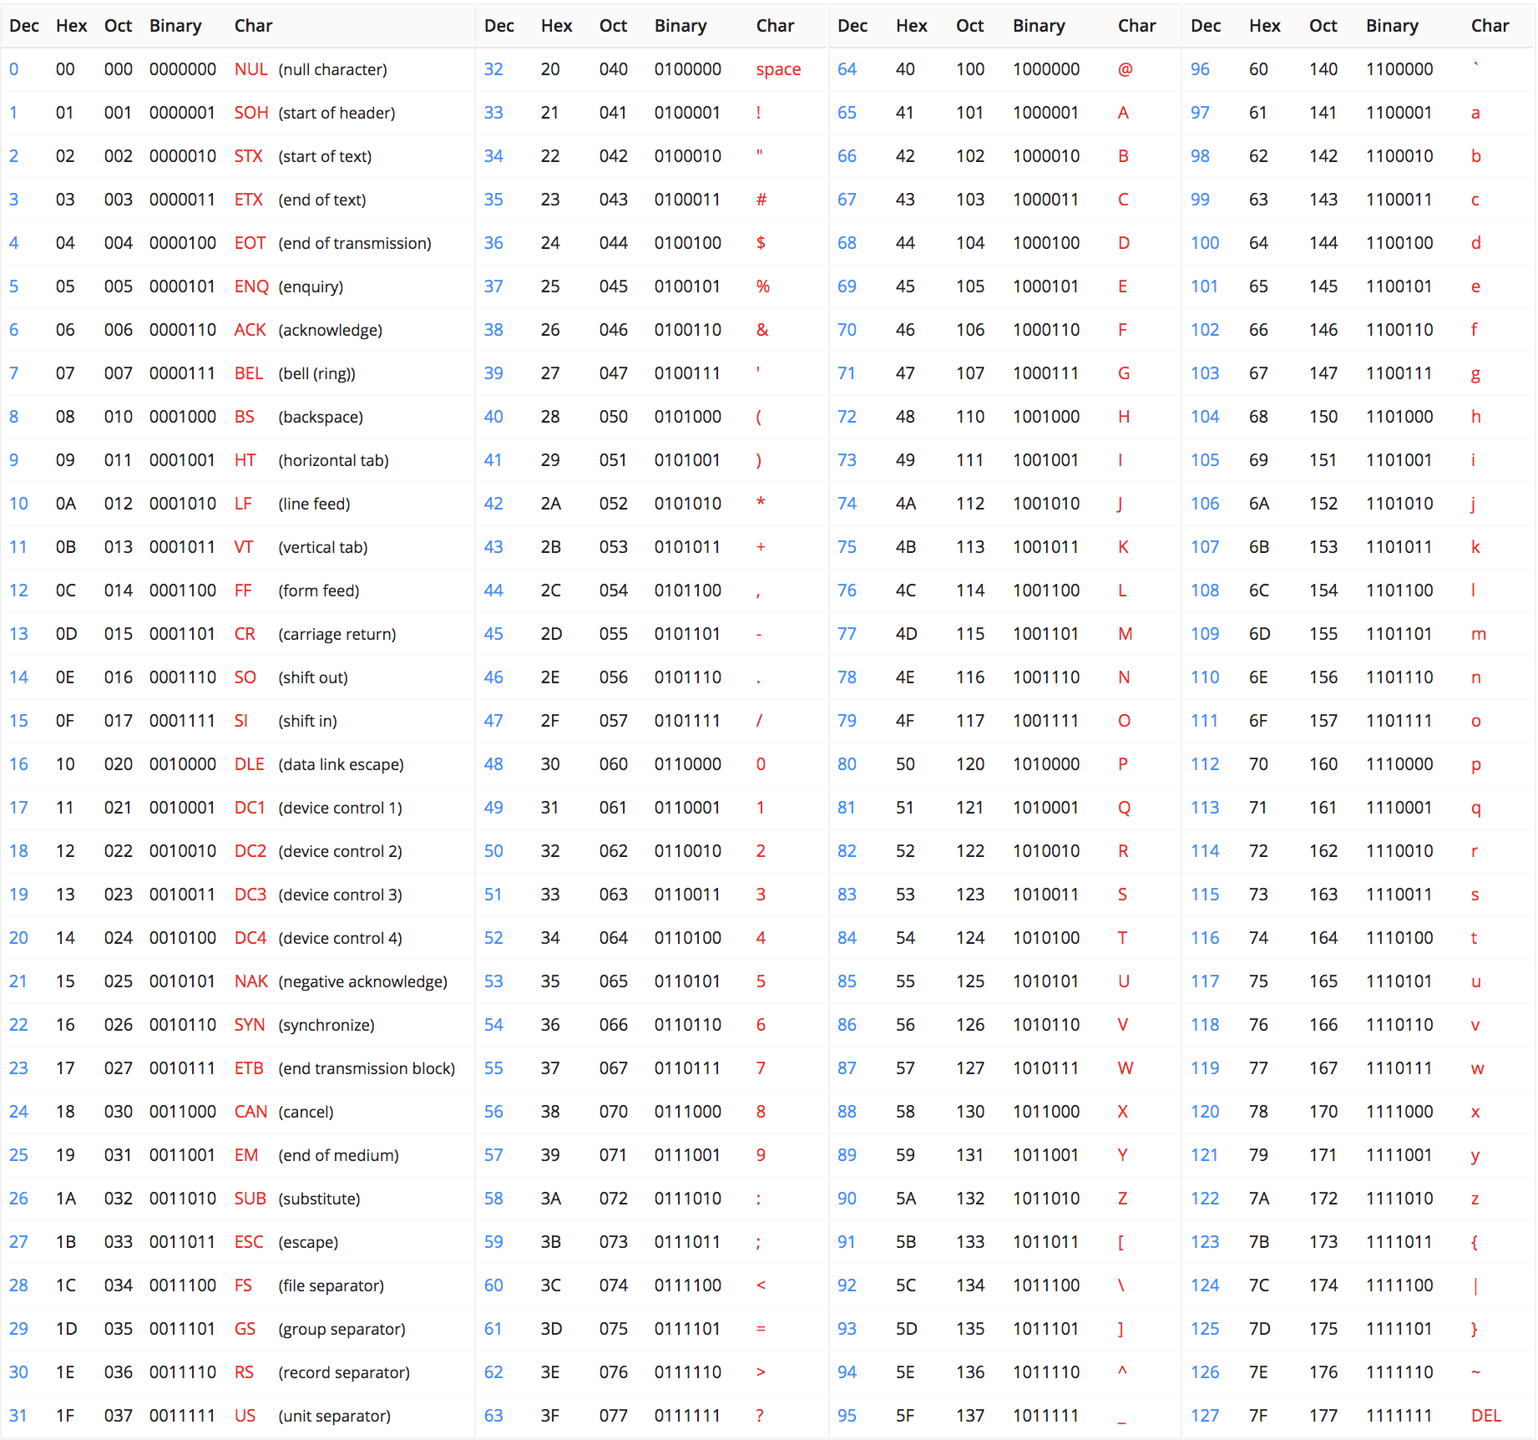
Bits
Bit: smallest unit of information
Information stored/processed as series of 0s and 1s
Binary strings: strings of bits
Can represent any information using string with at most eight bits
How all information is represented in computers
Elena

Slide 3
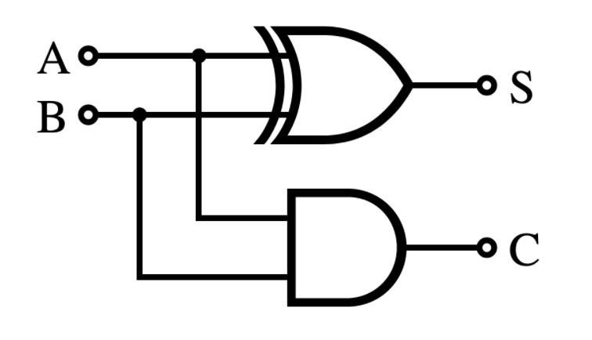
Bits
Qubits: extension of the bit, used in quantum mechanics
Circuit diagram: inputs on left, outputs on right, operations (“gates”) in middle
Elena

Slide 4
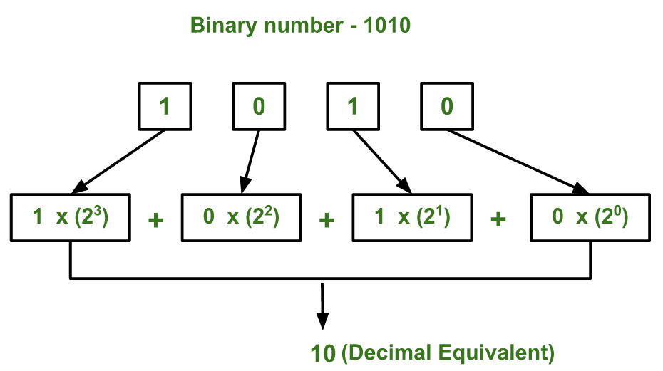
Binary System
A binary number is a number expressed in the base-2 numeral system or binary numeral system, which uses only two symbols: “0” and “1”.
In this system, the numbers are expressed as multiples of 2, 4, 8, 16 , etc. Instead of 10, 100, 1000, etc.
Can be used to represent more than just numbers.
Each digit is referred to as a bit.
Ashkan

Slide 5
Quantum notation
Classical bits:
We can only assign one of the values 0 or 1.
E.g. C=0
Qubits:
We can have something more complex
The state that gives the value 0 is called |0> and the state that gives the value 1 is called |1>.
Two orthogonal vectors should be used. Orthogonal vectors have the property that: 1 ) <0|0> 0 2) <0|1> = 0
Unlike Classical bits that could be only assigned to a value of 0 or 1, qubits’ state is a possibility of 0 and 1. In other words not entirely in state |0> and not entirely in state |1>, which is called Superposition.
Ashkan

Slide 6
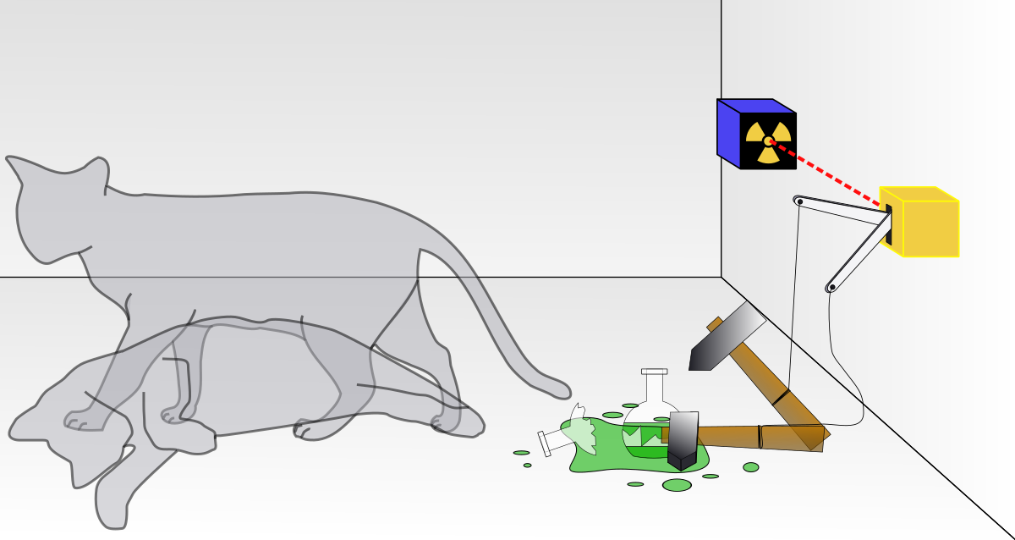
Schrödinger’s Cat
Theoretical experiment proposed by Erwin Schrödinger in 1935
Cat in steel box with Geiger counter, a poison vial, hammer, and radioactive substance
Hammer released when Geiger detects radioactive substance decay (random time)
Until box is opened, cat’s state is unknown -- considered both alive and dead until certain
Can’t be sure about a position without observing it
Have to acknowledge all positions, even if there’s a small probability
Elena

Slide 7
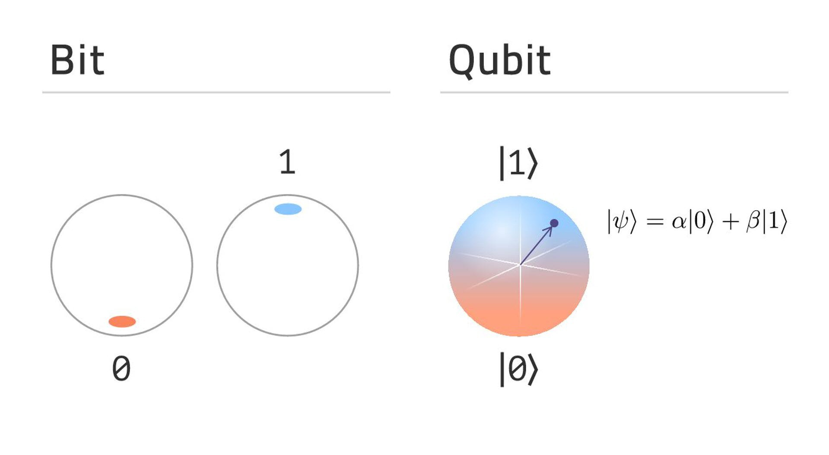
Superposition
Quantum states can be added together, or “superposed”
Qubits can be in a superposition of the basis states ❘0> and ❘1>

Slide 8
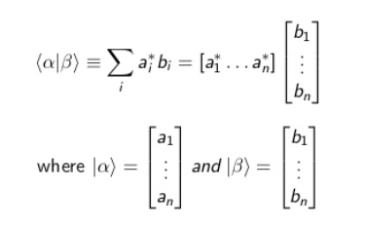
Bra-Ket Notation
❘ψ> is a ket, used to represent a quantum state
<φ❘ψ> denotes the inner product of the vectors ❘ψ> and ❘φ>, which is a generalization of the dot product

Slide 9
Probability
The wave function can be interpreted as a probability distribution
Find the probability of a state by taking the square of the inner product
𝑝(|𝑥⟩)=|⟨𝜓|𝑥⟩|²
Notes:
Lucy

Slide 10
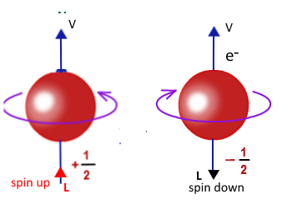
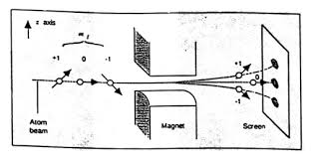
Spin
Two level system: up and down
Spin is affected by magnetic field
Stern-gerlach experiment - measuring spin up or down -> collapsing superposition state
Notes:
lucy

Slide 11
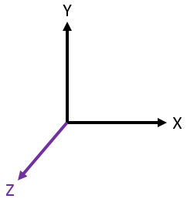
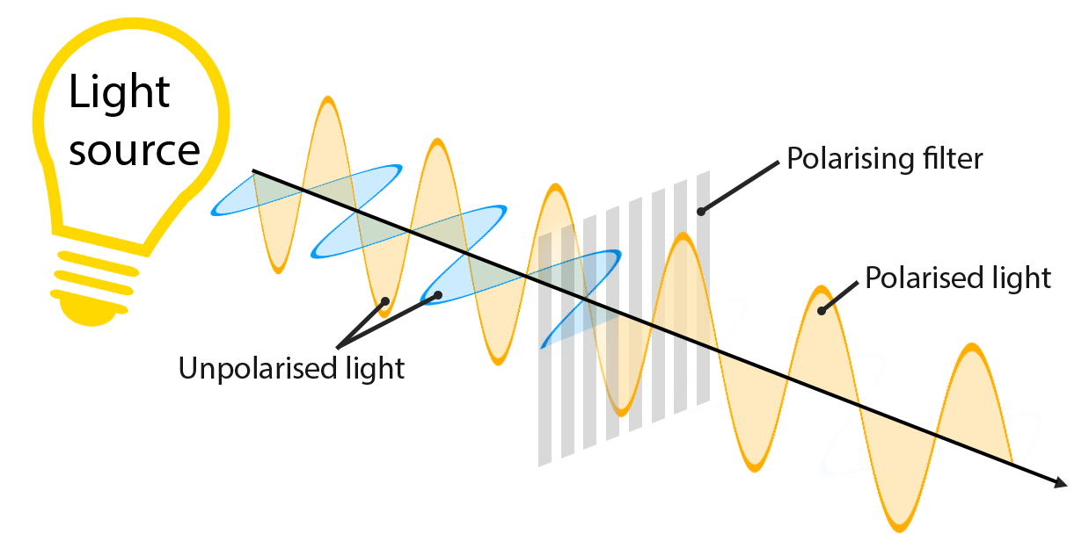
Photon Polarization
Light and matter consist of particles with wavelike properties. Light is made up of particles called photons.
Polarizer-a filter that lets certain light waves pass through while waves with other polarizations cannot pass through.
Photons go through the polarizer and measure state probability.
Esther

Slide 12
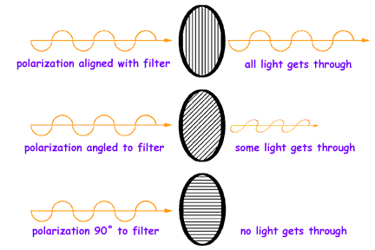
Horizontal vs. Vertical Polarization
V.S
| v > = vertically polarized
0 degrees
| H> = horizontally polarized
90 degrees
Esther

Slide 13
More on Polarization
The amplitude (wave measured from equilibrium) of the outgoing wave represents the probability of finding the wave in that state. 0 degrees polarizer measures if the wave is vertically polarized.
Esther

Slide 14
Python & Qiskit installation
We have installed Python and Qiskit on Anaconda-navigator, and on Thursday we are expected to have our first class on python.
Ashkan

Slide 15
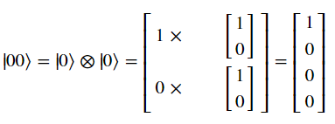
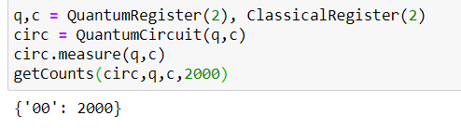
Product States
If we have two qubits, we can take a tensor product to obtain a product state:
Qubits are prepared independently and thus are not uncorrelated.
Lucy and Eva

Slide 16
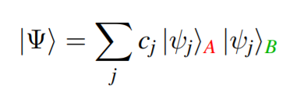
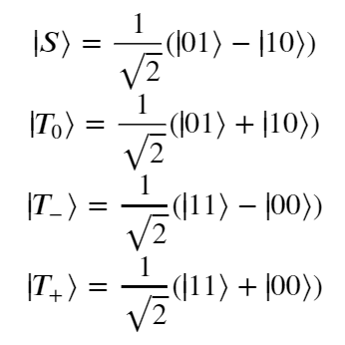
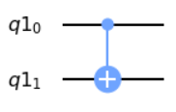
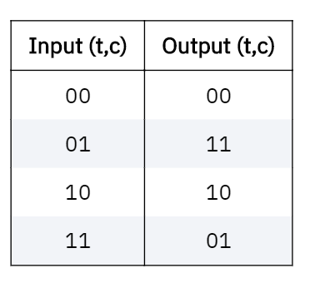
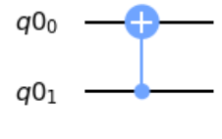
Entangled States
Bell States:
Prepared by putting the control qubit in an equal superposition and applying CNOT
Correlation between qubits is nonzero but levels of entanglement can vary.
For pure two-qubit states:
If all c_j are equal, then the state is maximally entangled.
In Qiskit, the CNOT gate is used to generate entanglement.
1st qubit is control
2nd one is target
2nd qubit is control
1st one is target
Notes:
This gate is a conditional gate that performs an X-gate on the second qubit (target), if the state of the first qubit (control) is |1>.

Slide 17
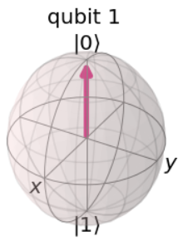
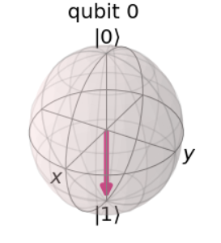
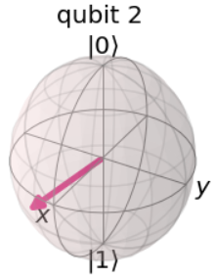
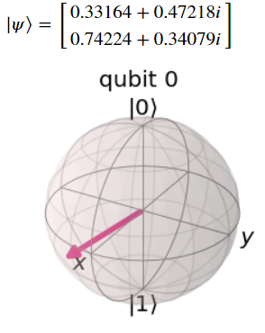
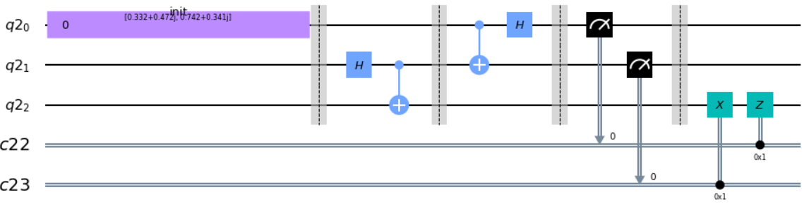
Quantum Teleportation
Goal: Send quantum information from one place to another.
Problem: Cannot simply copy qubits like you can copy bits (No-Cloning Theorem)
Approach: Use entanglement via a “third-party” and measurement (strategically)

